Slide 1
Summer Olympics Medal Analysis (1976–2008)
Data Analysis and Machine Learning Project with Python
-By Shubhangi Rajaram Garje

Slide 2
Project Overview
• Dataset: Summer Olympic medals from 1976 to 2008
• Objective: Analyze trends and predict medal type
• Tools: Python, Pandas, Seaborn, Scikit-learn

Slide 3
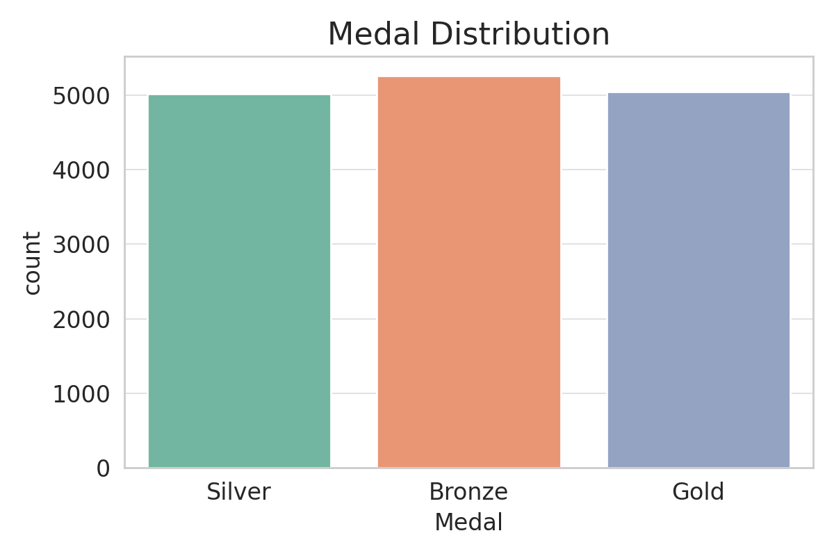
Medal Distribution

Slide 4
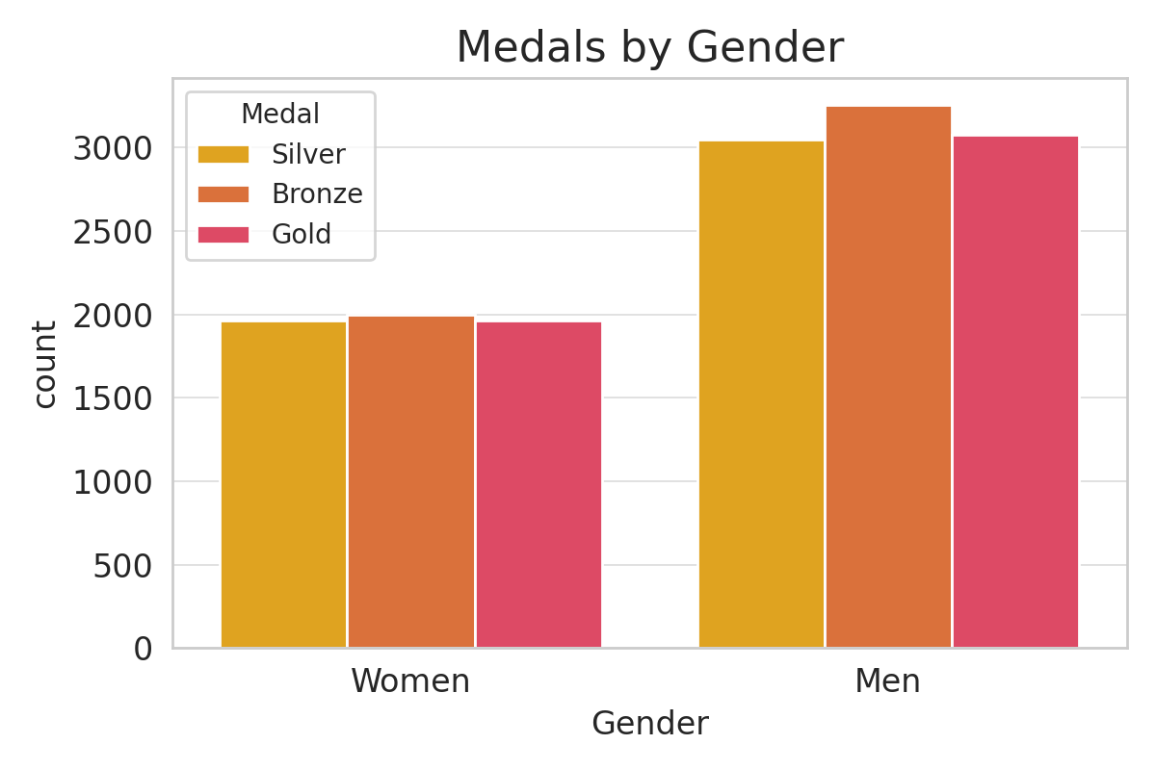
Medals by Gender

Slide 5
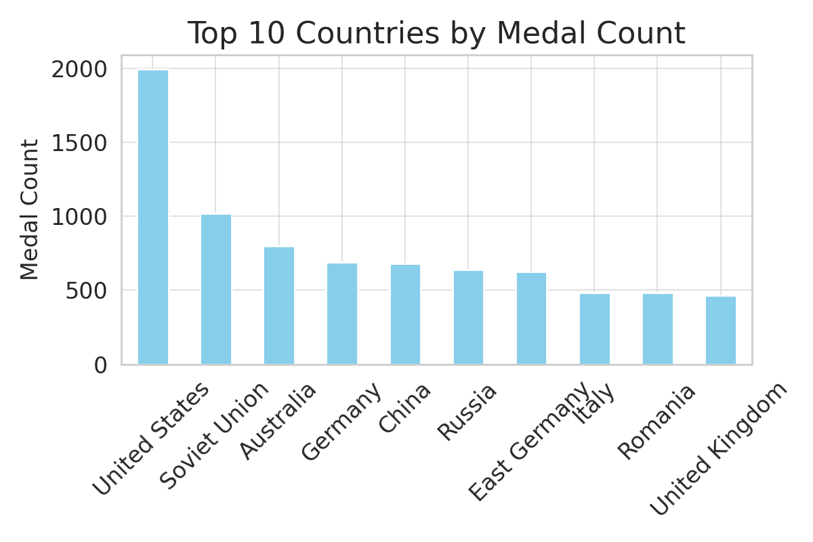
Top 10 Countries by Medal Count

Slide 6
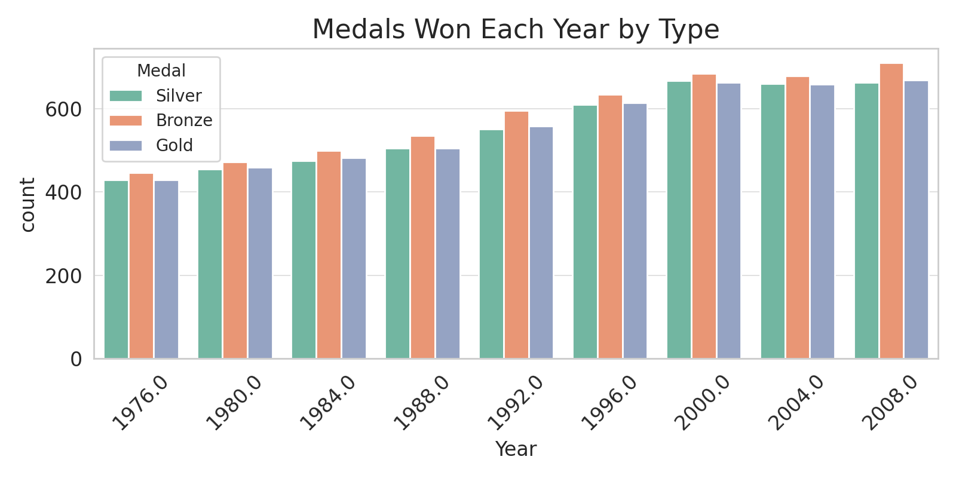
Medals by Year

Slide 7
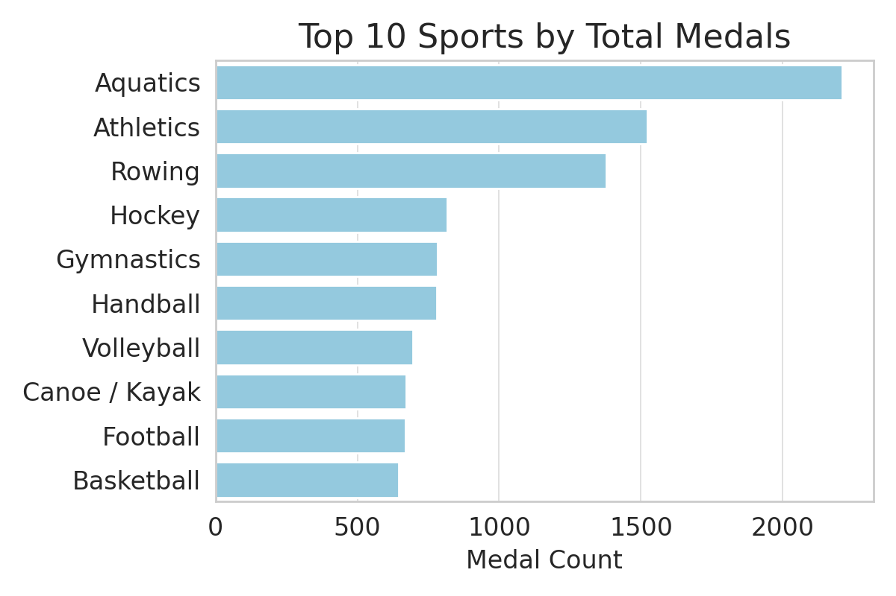
Top Sports by Total Medals

Slide 8
Conclusion
• USA, USSR, and Germany dominate medal counts
• Men dominate participation but women increasing over time
• Random Forest classifier can predict medal types with high accuracy

Slide 9
Thank You

