Slide 1
Electric Vehicle Data Analysis
A Data-Driven Insight into EV Adoption Trends
By: Shubhangi Rajaram Garje

Slide 2
Introduction
This project explores Electric Vehicle (EV) adoption trends in India.
Using Tableau, we analyze state-wise sales, vehicle types, and time-based trends to uncover insights that support policy and market strategies.

Slide 3
Objectives
- Analyze EV sales trends over the years
- Identify top-performing states in EV adoption
- Examine EV vehicle types and categories
- Derive insights for policymakers and stakeholders

Slide 4
Dataset Description
- Source: EV Sales Data by Indian States
- Time Period: 2014 onwards
- Key Fields: Year, Month, State, Vehicle Type, EV Sales Quantity
- Total Records: 96845 rows

Slide 5
Data Cleaning & Preparation
- Removed null and zero sales records
- Standardized state and date formats
- Grouped data by Year, State, and Vehicle Type for analysis
- Focused on sales quantity for insights

Slide 6
KPI Dashboard
- Total EVs Sold
- Top Vehicle Type
- Highest Sale

Slide 7
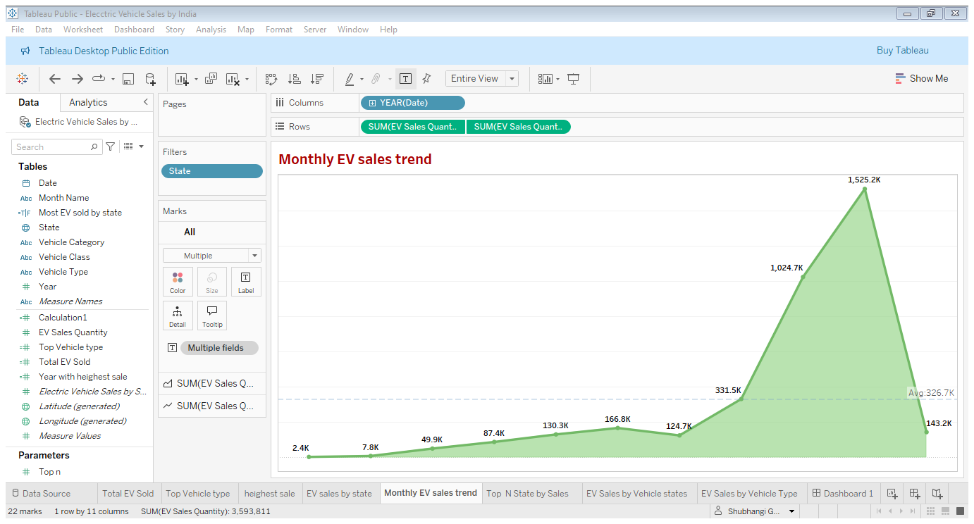
Monthly EV sales trend
The area chart shows a steady rise in EV sales over the months, with noticeable spikes in recent years. This indicates growing consumer interest and seasonal buying patterns in the EV market.
Key Insight: Identify rapid adoption years.

Slide 8
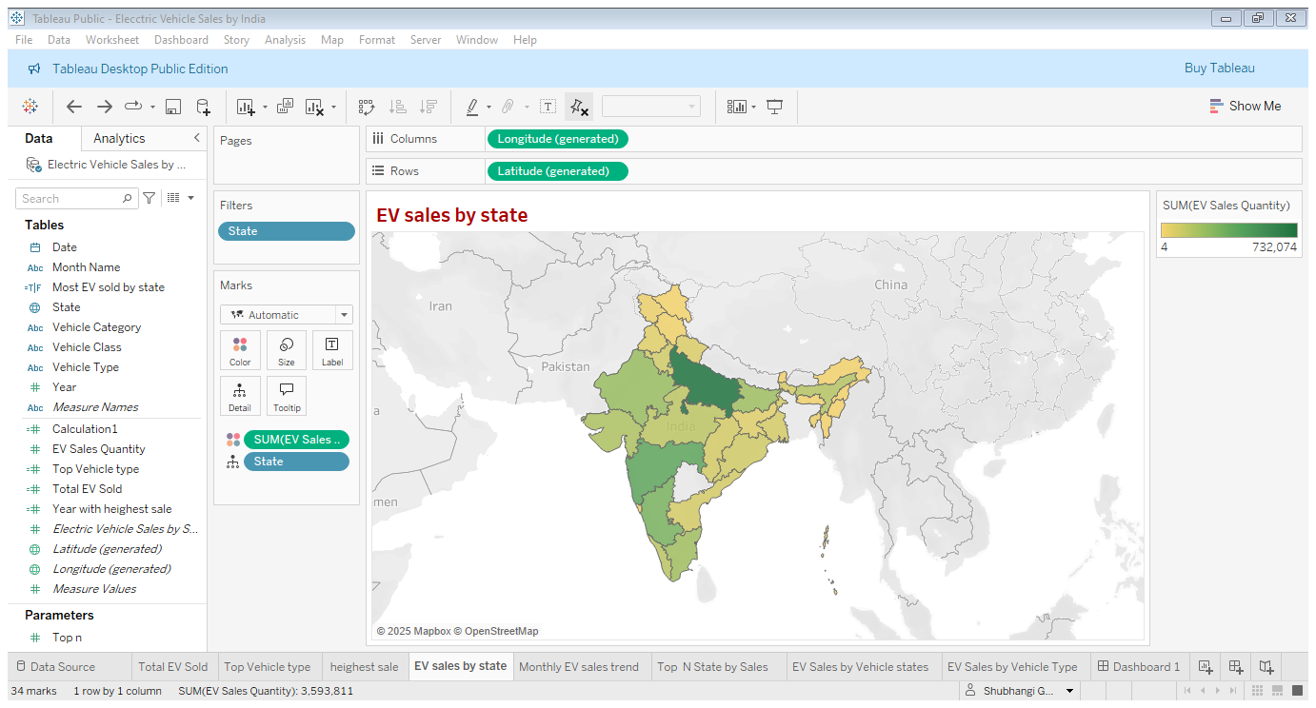
State-Wise EV Sales
The state-wise map highlights regions with the highest electric vehicle adoption. Uttar Pradesh, Maharashtra, and Karnataka lead in EV sales, indicating strong policy support and market growth in these states.

Slide 9
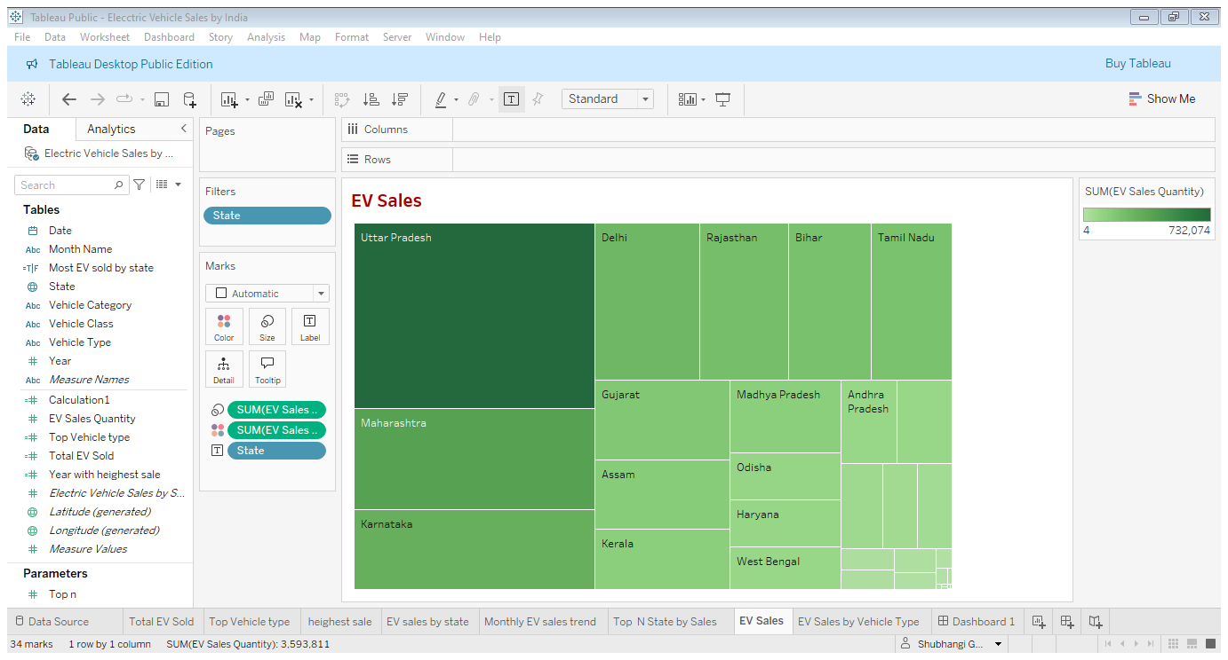
EV Sales by Vehicle states
The tree map shows how different vehicle types contribute to EV sales across various states.

Slide 10
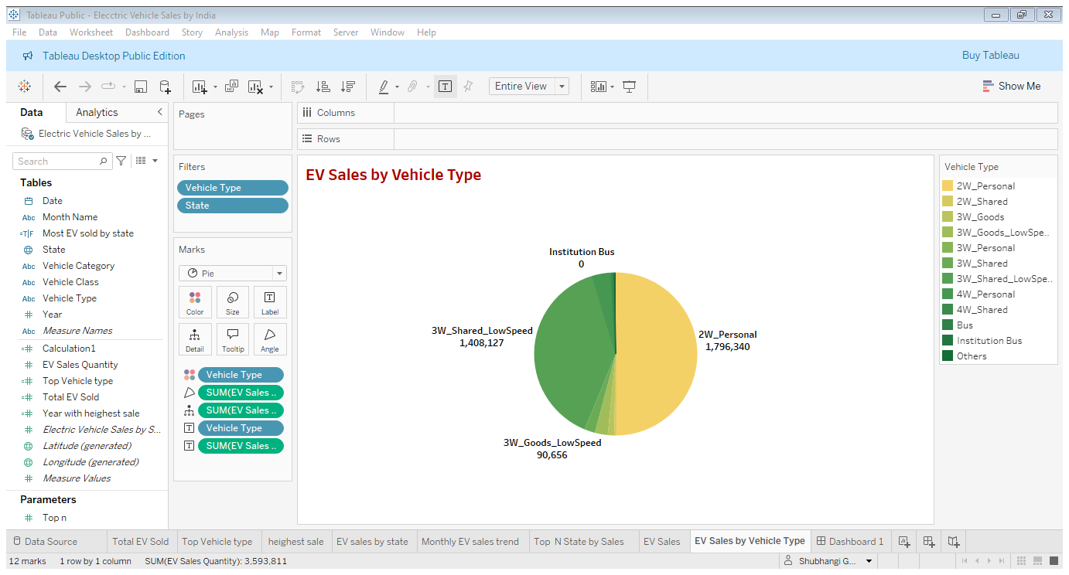
EV Sales by Vehicle Type
The pie chart highlights the share of different vehicle types in total EV sales. Two-wheelers make up the largest portion, followed by three-wheelers and e-rickshaws, indicating their popularity due to affordability and last-mile connectivity needs.

Slide 11
Key Insights & Recommendations
- EV adoption is rising sharply post-2019
- Uttar Pradesh and Maharashtra lead in total sales
- 2-wheelers dominate due to cost and accessibility
- Suggest promoting EVs in low-penetration states

Slide 12
Thank You…

