Slide 1
Supermart Grocery Sales Analysis Dashboard
📊 A Tableau-Based Retail Performance Report
-By: Shubhangi Rajaram Garje

Slide 2
Project Overview
Objective:
To analyze Supermart grocery sales performance using Tableau to identify trends, top products, profit centers, and the impact of discounts.
Tools Used:
- Tableau
- Supermart Grocery Sales Dataset (CSV)

Slide 3
Data Overview
Dataset Fields:
- Order Date
- Sales
- Profit
- Discount
- Category & Sub-Category
- Region & State
- Customer Segment
- Ship Mode
- Quantity

Slide 4
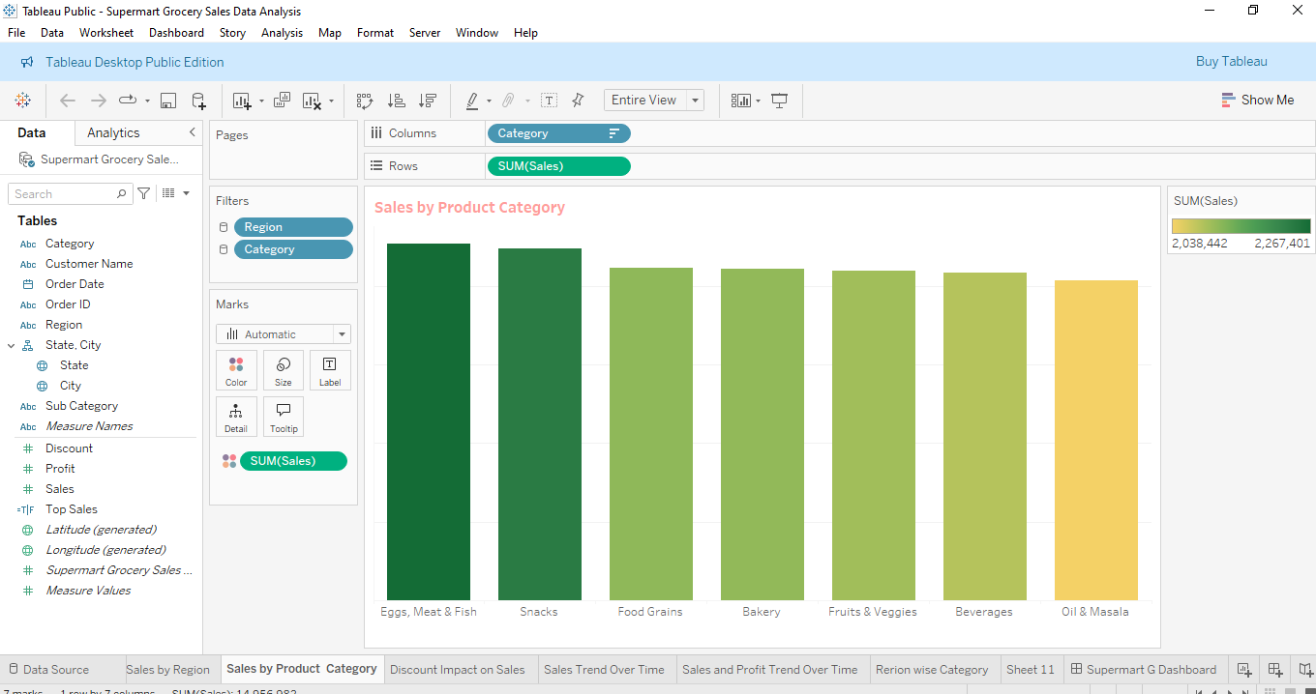
Sales by Product Category
Chart Type: Bar Chart
This bar chart shows the total sales for each product category in the Supermart Grocery dataset. "

Slide 5
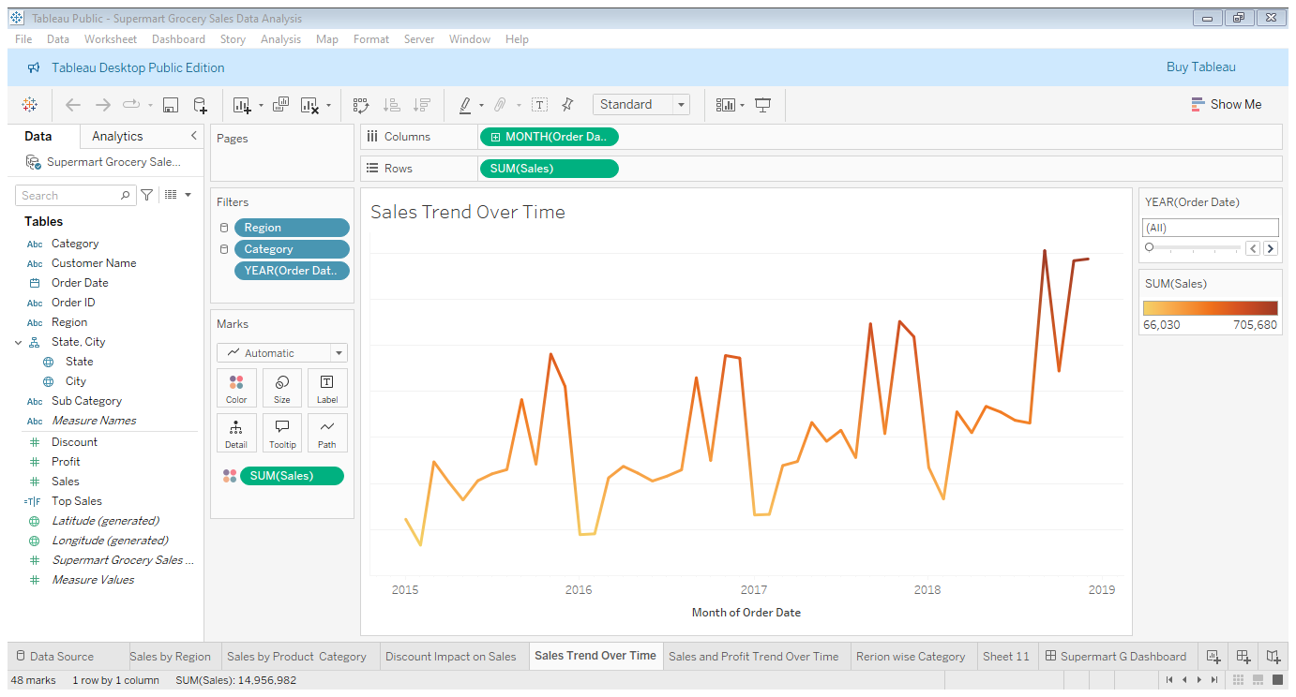
Sales & Profit Trend Over Time
Chart Type: Line Chart
Shows monthly sales and Profit trends to identify seasonal patterns and sales growth over time.

Slide 6
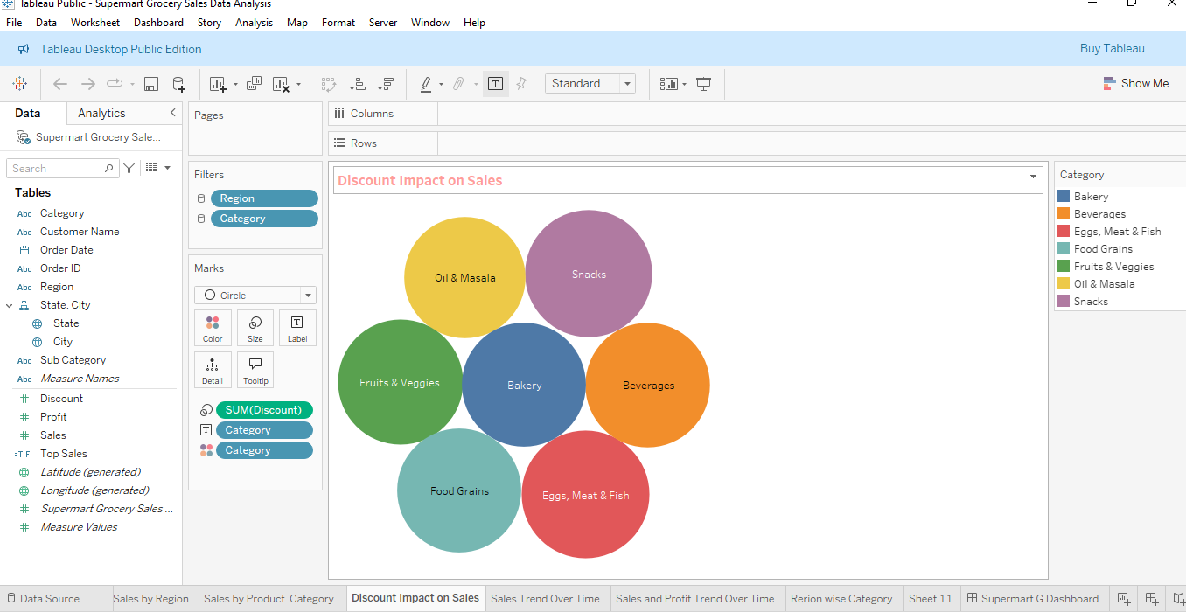
Discount Impact on Sales
Chart Type: Packed Bubbles
Helps identify if offering higher discounts increases or decreases sales performance.

Slide 7
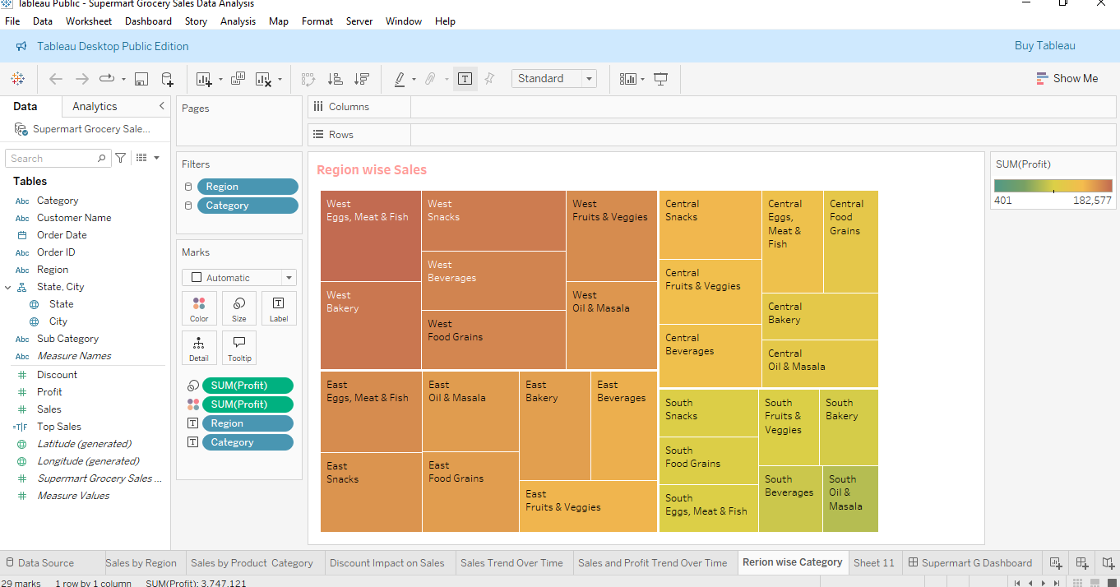
Profitability Tree map
Chart Type: Tree Map
Highlights where profit margins are strongest and weakest across product categories and regions.

Slide 8
Final Dashboard View
Includes:
- KPI Cards
- Sales Trend Chart
- Discount vs Sales Scatter
- Profitability Tree map
- Sales by Region
- Interactive Filters (e.g., Category, Region)

Slide 9
Key Insights
✅ Highest sales in the [West/North/Region based on your data]
✅ Discount has limited positive impact on high sales
✅ [Category Name] is the most profitable segment
✅ Monthly sales peak during [Month/Season]

Slide 10
Conclusion
- Tableau enabled easy exploration and visualization of complex sales data
- Filters helped in comparative analysis across segments
- Helps business make data-driven decisions on pricing, inventory & marketing

Slide 11
Thank You

