Slide 1

MAJOR PROJECT :SMART BINS
Submitted By :
Kanak varshney
Naman gupta
Prankur Tiwari
Shubhangi agrawal
Guided BY:MS rosy verma

Slide 2
Tools and Technology Used
Google web toolkit (gwt)
HTML ,CSS ,bootStrap
Java database connectivity (jdbc)
IntelliJ IDE
Postgresql DBMS
GIT version control system

Slide 3
DATA FLOW DIAGRAM
Context level diagram
Level 1st DFD

Slide 4
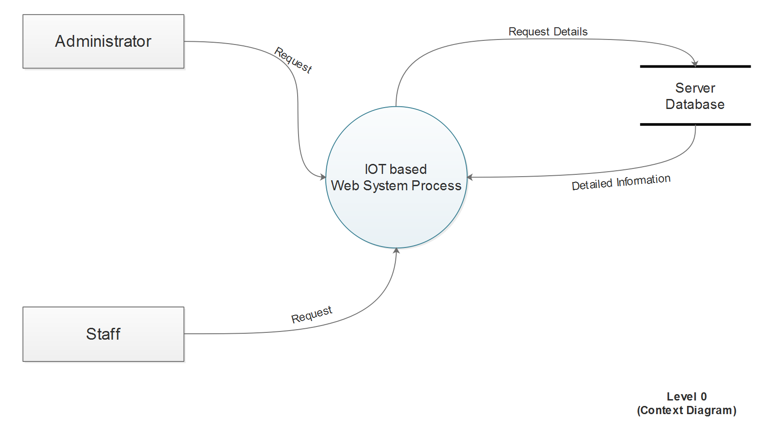
Staff
Garbage Collector

Slide 5
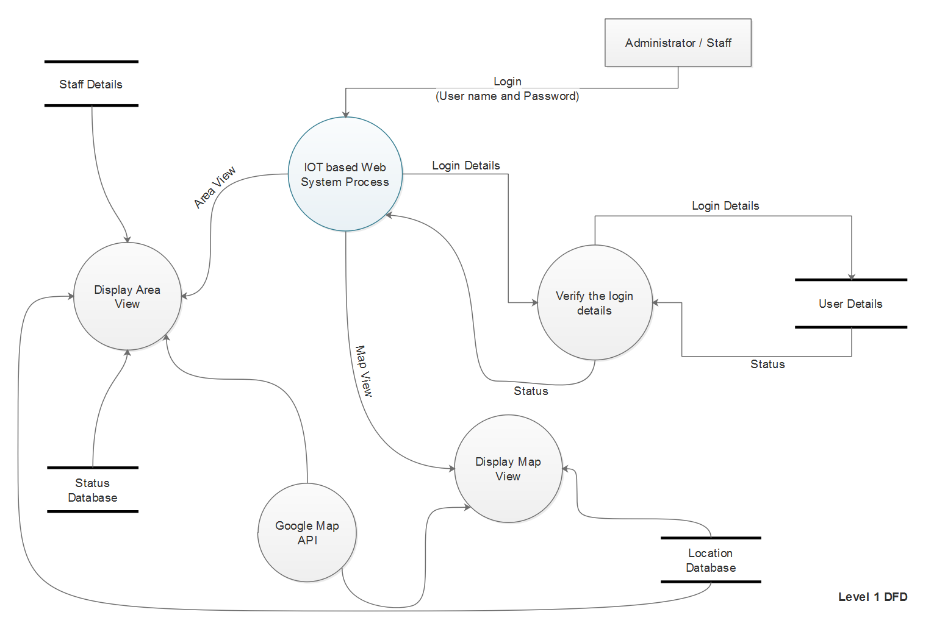
Staff / Garbage Collector
Garbage Collector Details
Garbage Collector Details

Slide 6
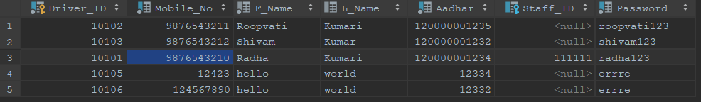
DATABASE
Table: Staff
Table:DRIver

Slide 7
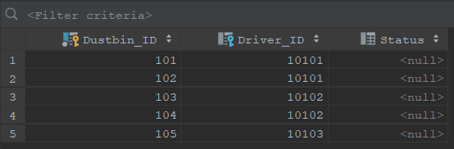
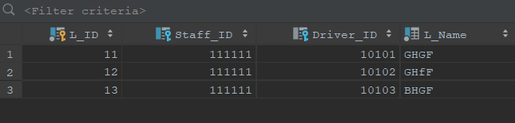
DATABASE (CONTINUE)
Table: Dustbin
Table: location

Slide 8
WORK COMPLETED TILL NOW
WEBSITE FRONTEND FUNCTIONALITIES COMPLETED
BACKEND COMPLETED
WEBSITE IS IN WORKING MODE
DATABASE FULLY FUNCTIONAL
CSS IN PROGRESS
WORKING ON ARDUINO CODING

Slide 9
REFERENCES
[1] http://www.gwtproject.org/javadoc/latest/(02-Feburary-2020)
[2] http://www.postgresqltutorial.com/postgresql-sample-database/ (28-July-2019)
[3] http://www.postgresqltutorial.com/postgresql-jdbc/connecting-to-postgresql-database/ (12-August-2019)
[4] https://www.youtube.com/watch?v=aUfPf-clLLs (20-July-2019)
[5] https://github.com/shubhangiagarwal76/SmartBins (02-Feburary-2020)
[6] https://www.postgresql.org/docs/10/sql-altertable.html (12-August-2019)
[7] https://jdbc.postgresql.org/download.html (11-August-2019)
[8] http://www.gwtproject.org/(25-January-2020)
[9] https://www.geeksforgeeks.com (02-Feburary-2020)

