Slide 1


GRAPHREACH: Position-Aware Graph Neural Network using Reachability Estimations
IJCAI 2021
Sunil Nishadª, Shubhangi Agarwal ª, Arnab Bhattacharya ª, Sayan Ranu^{b}
ªIndian Institute of Technology Kanpur, India
^{b}Indian Institute of Technology Delhi, India

Slide 2
Objectives
Position-aware inductive Graph Neural Network (GNN) model that outputs node embeddings that are:
Holistic: Maximum absorption of graph knowledge
Meaningful: Real-world semantics are attended to
Robust: Small edits to graph do not affect embeddings a lot
Node embeddings can be used for downstream tasks like link prediction, pairwise node classification and node classification

Slide 3
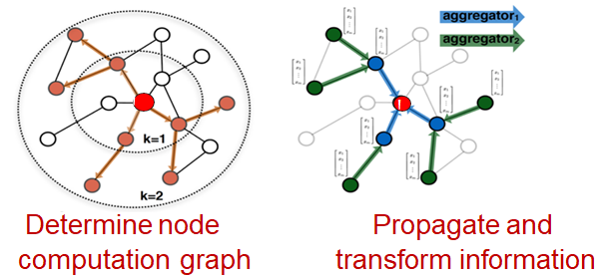
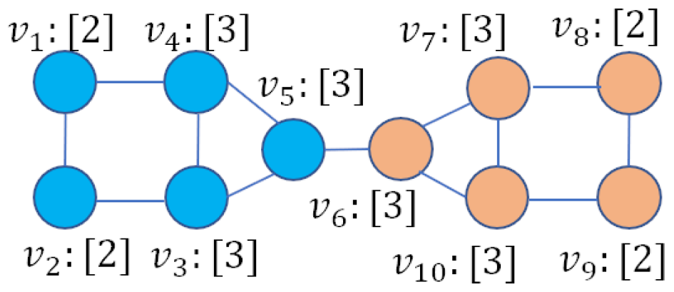
Motivation
Traditional node embedding methods rely on neighborhood information
GNNs are inductive
Most GNNs fail to distinguish nodes with similar neighborhoods
Example: v₁ and v₈
May prevent accurate performance in predictive tasks that rely on position information
2 Layer GCN incapable to predict v₁ and v₈ belongs to different class labels

Slide 4
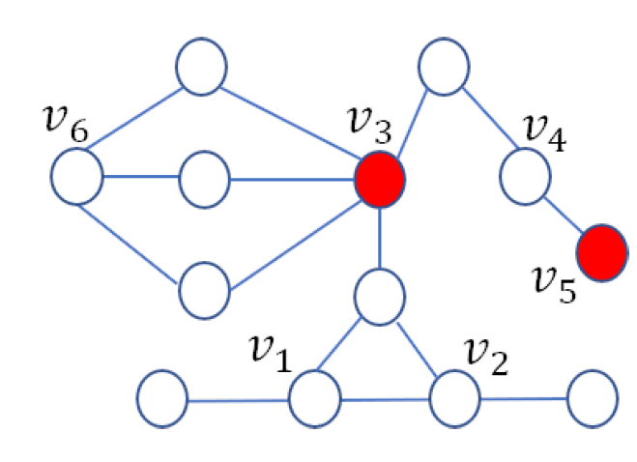
Motivation
DeepWalk and Node2Vec are transductive
P-GNN
Randomly select anchor-sets
Capture position of a node using shortest paths
Example: v₁, v₂ and v₆ have same embedding
Problem:
Remaining paths are ignored
Vulnerable to adversarial attacks
Anchors : v₃, v₅

Slide 5
GRAPHREACH
Reachability Estimation through Random Walks
Capture positions of nodes through random walks w.r.t. all paths
Anchor Selection
Select diverse and reachable nodes as anchors which acts as coordinate axes
Message Computation
Combine node attributes and position information
Message Aggregation
Aggregate messages across anchors

Slide 6

Reachability Estimation through Random Walks
Compute node’s visit count values
Generate n_{w} random walks for each node in the graph
Fixed length random walk of length l_{w}
Similarity measure:
-> v₆
v₂
Eg.- v₁
-> v₄
-> v₅
-> v₂
-> v₁
-> v₄
v₁ v₂ v₃ v₄ v₅ v₆ v₇
v₁ 2/7 1/7 0 2/7 1/7 1/7 0
v₁
v₅
Here, l_{w} = 7, n_{w} = 1
v₄
v₆
v₃
v₇

Slide 7

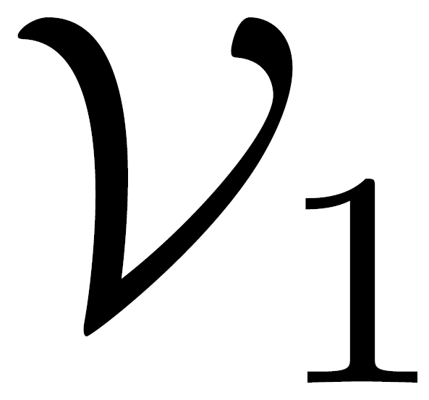
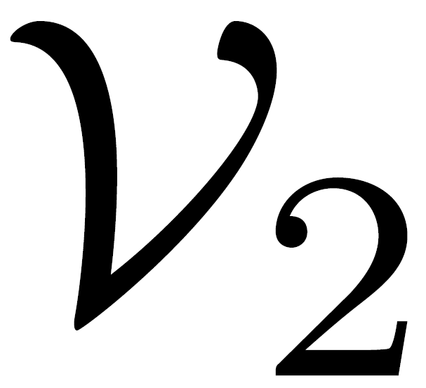
Anchor Selection
Anchors act as reference points while encoding node positions
Should be diverse and reachable from large portion of nodes
Represent reachability information in form of bipartite graph
Find k anchors that maximizes the reachability
1
1
2
2
=
4
1
Find k anchors
3
3
4
4
Repeat whole exercise multiple times
Anchors = Nodes selected highest no of times
5
5
6
6
7
7
Randomly Sample X% of walks to build bipartite graph

Slide 8


Message Computation
F
s(v,a₁) • h^{l}_{v1}
s(a₁,v) • h^{l}_{a1}
^
M^{l}_{v1}[1]
s(v,a₂) • h^{l}_{v1}
s(a₂,v) • h^{l}_{a2}
^
M^{l}_{v1}[2]
.
.
.
.
.
.
s(v,a₃) • h^{l}_{v1}
s(a₃,v) • h^{l}_{a3}
^
M^{l}_{v1}
M^{l}_{v1}[3]
………
s(v,a_{k}) • h^{l}_{v1}
s(a_{k},v) • h^{l}_{ak}
^
M^{l}_{v1}[k]

Slide 9

Message Aggregation
Mean Pool
Output Layer: Position-Aware Embedding
S
M^{l}_{v1}
h¹_{v1}
Hidden representation of node
M^{L}_{v1}
w_{z}
z_{v1}
Final layer message
Embedding

Slide 10
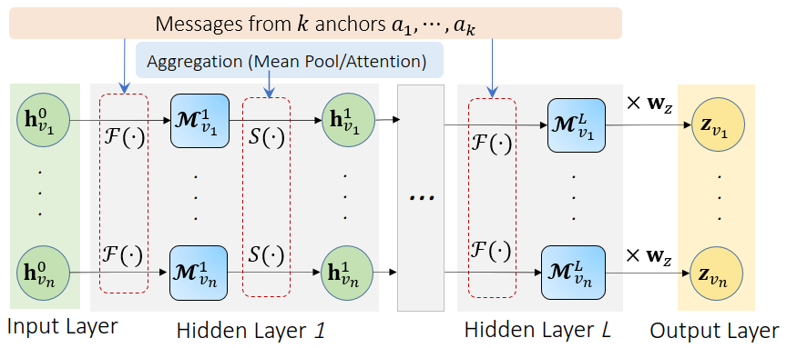
GRAPHREACH Architecture

Slide 11
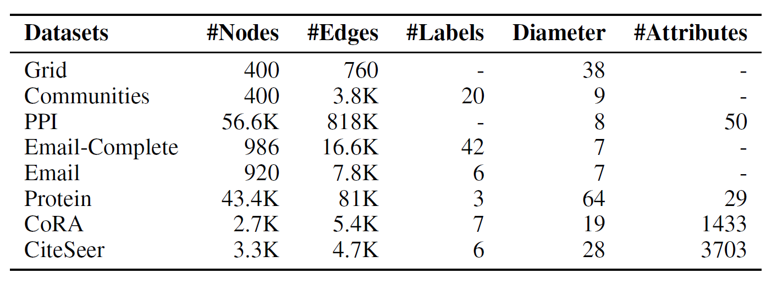
Experimental Setup
Prediction Tasks:
Pairwise Node Classification
Link Prediction
Node Classification
Datasets:
Train/Validation/Test Split
80/10/10
Metric
ROC AUC

Slide 12
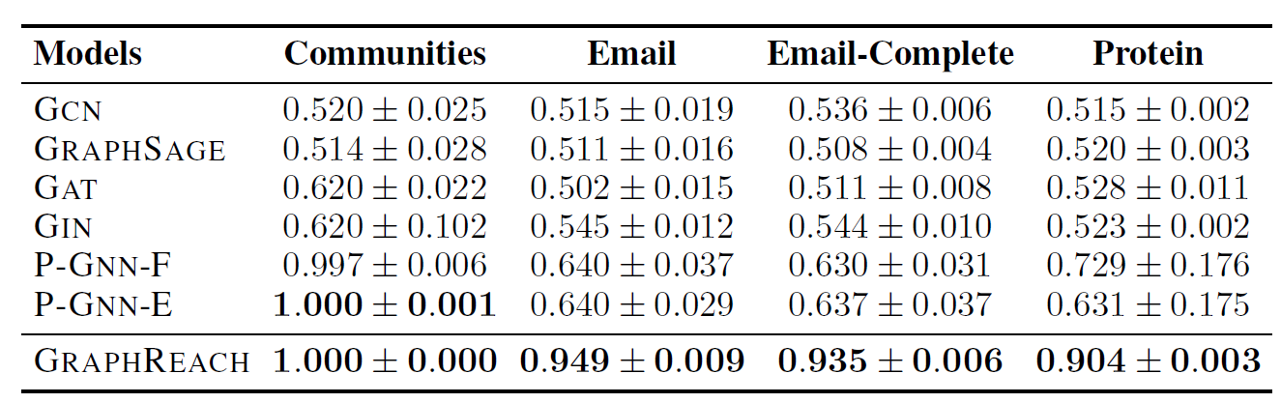
Results: Pairwise Node Classification
Holistic approach of encoding position with respect to all paths is necessary
Relative improvement of up to 40% in accuracy

Slide 13
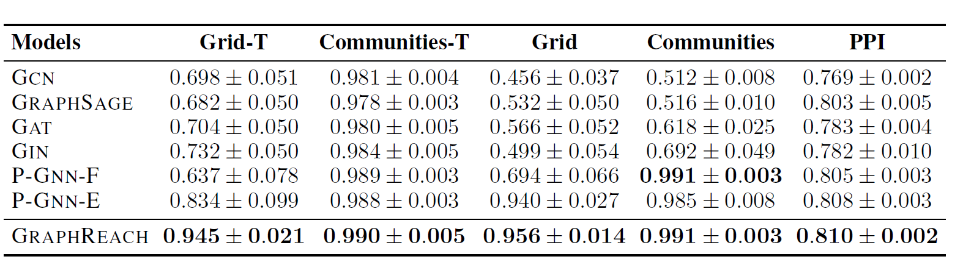
Results: Link Prediction
Position-unaware architectures are noticeably better in transductive settings
Ablation: Mean-pooling is simpler but almost as good as attention aggregators

Slide 14
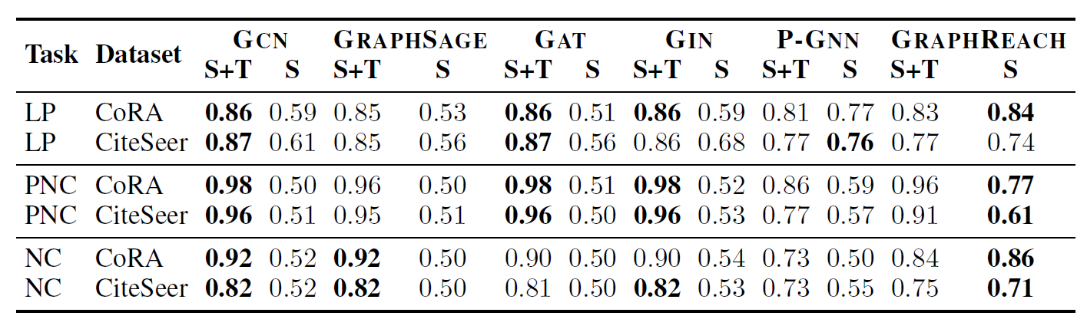
Results: Node Classification
GRAPHREACH utilizes structural information the best in absence of node features
Neighborhood-aggregation based GNNs may be better in exploiting the feature distribution in the neighborhood

Slide 15
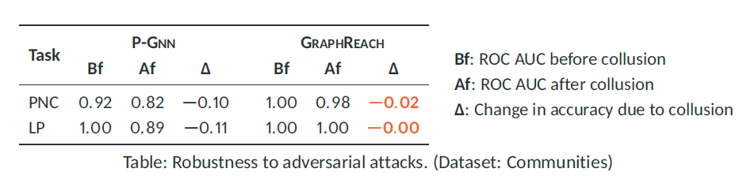
Adversarial Attacks
GRAPHREACH is more robust against graph modifications
Modify small subset (colluding group) of unseen test graph
Causing a significant perturbation in position with respect to all paths is difficult

Slide 16
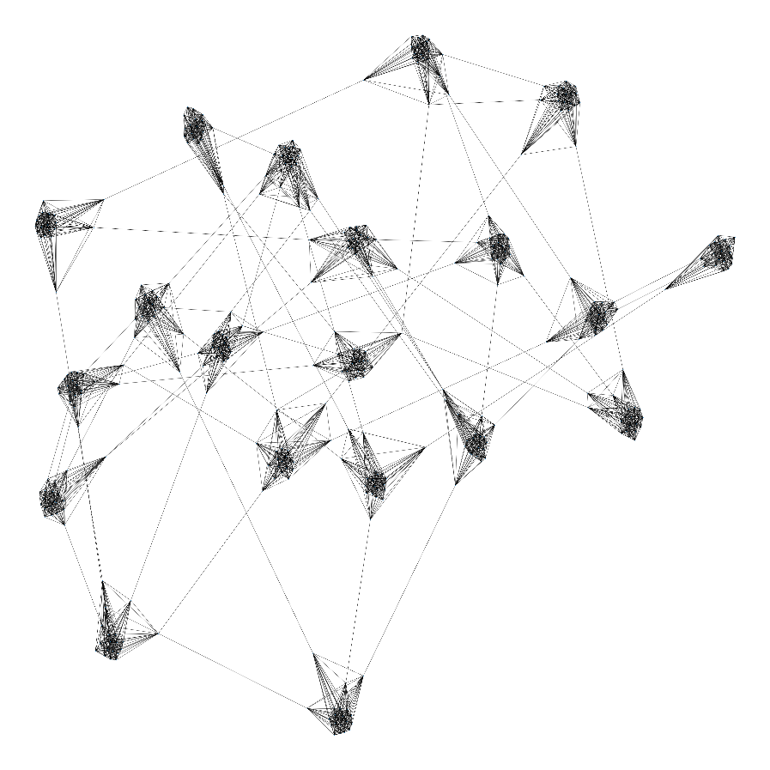
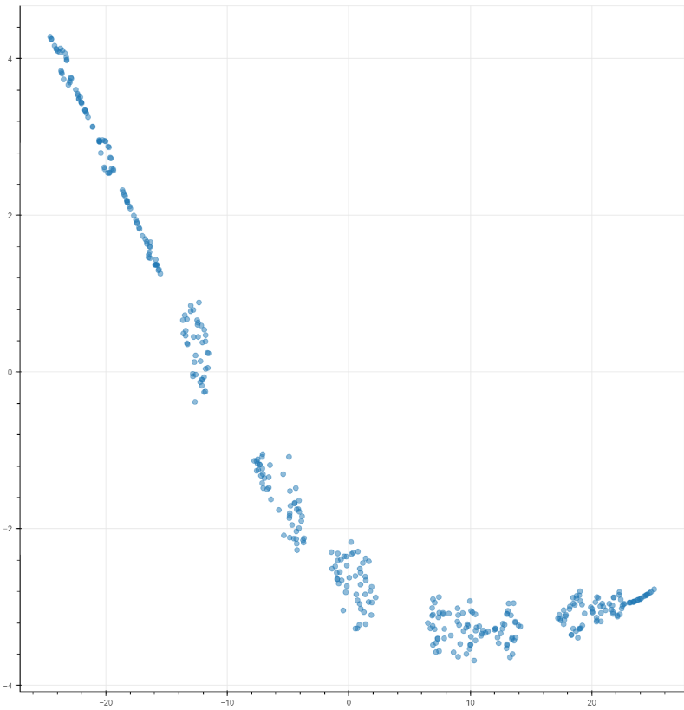
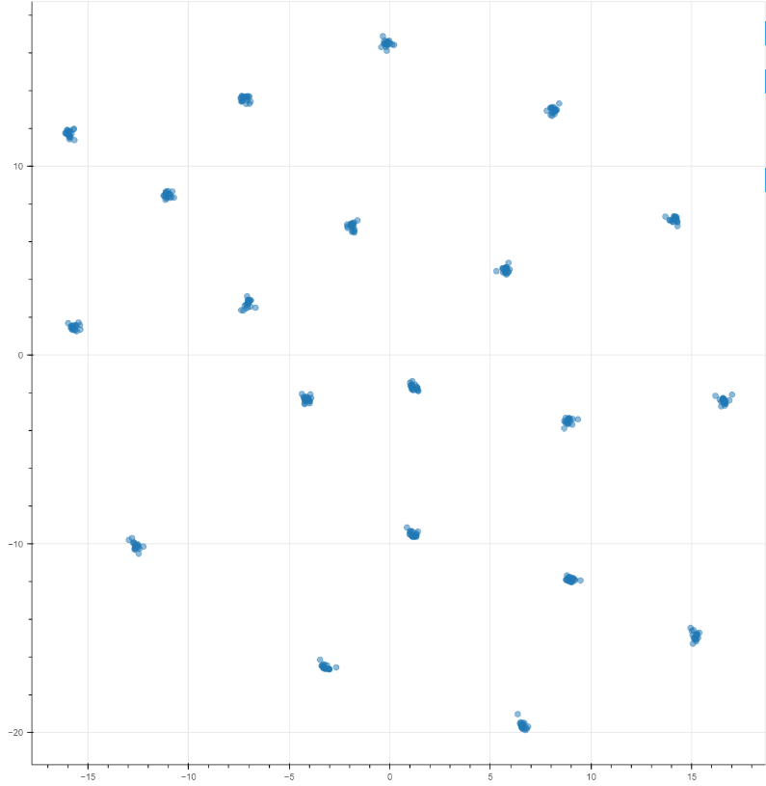
Visualization
Input : Communities Graph
GCN
GRAPHREACH

Slide 17
Conclusions
GRAPHREACH achieves relative improvement of up to 40% in accuracy
Reachability estimations to anchors computed through fixed length random walks​
Anchors are strategically selected so that node coverage is maximized​
Robust to adversarial attacks
Inductive model to cater to unseen graphs
Code : https://github.com/idea-iitd/GraphReach
Paper : https://arxiv.org/pdf/2008.09657.pdf

