Slide 1



CAPSTONE PROJECT-I
MUTUAL FUND ANALYTICS
Presented by- Shubhangi Chouhan
12 June 2026

Slide 2

PROBLEM
OBJECTIVE
STATEMENT
This project aims to synthesize disparate data sources into a cohesive analytical framework to evaluate fund performance and discern critical retail investor behavior.
The rapid expansion of India's capital markets has generated vast, decentralized datasets, complicating the extraction of clear market intelligence.

Slide 3

DATA SOURCES
1
DATA INTEGRITY
The study utilizes a structured repository of industry-wide metrics, including historical Net Asset Values (NAV), Asset Under Management (AUM) fluctuations, and comprehensive transaction logs.
2
METHODOLOGY
All data sets were verified for consistency to ensure the accuracy of the subsequent analytical modeling.

Slide 4


SYSTEM
ARCHITECTURE
Raw Data(Csv files)
Raw datasets were systematically cleansed, transformed, and migrated into a centralized SQLite database, facilitating efficient and scalable query performance
Processing (ETL)
Storage &output
(SQLite Database to Dashboard)

Slide 5
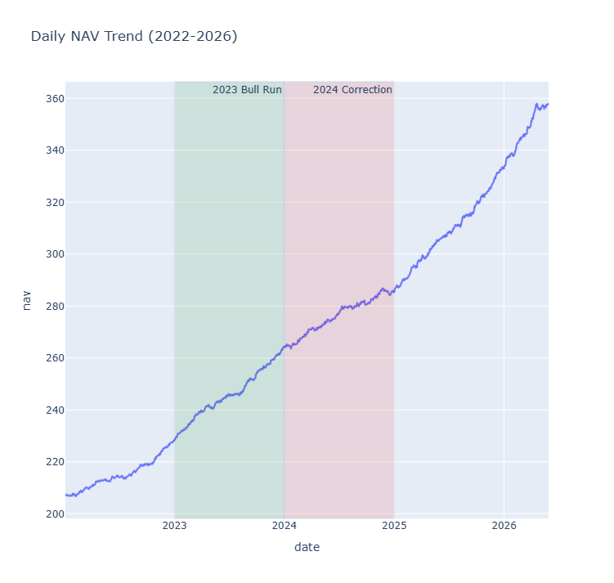
EDA HIGHLIGHTS
MARKET TRENDS
Longitudinal examination of NAV trends to identify resilience and patterns across diverse market cycles.
An assessment of portfolio weightage to determine strategic risk-mitigation approaches within major fund houses.

Slide 6
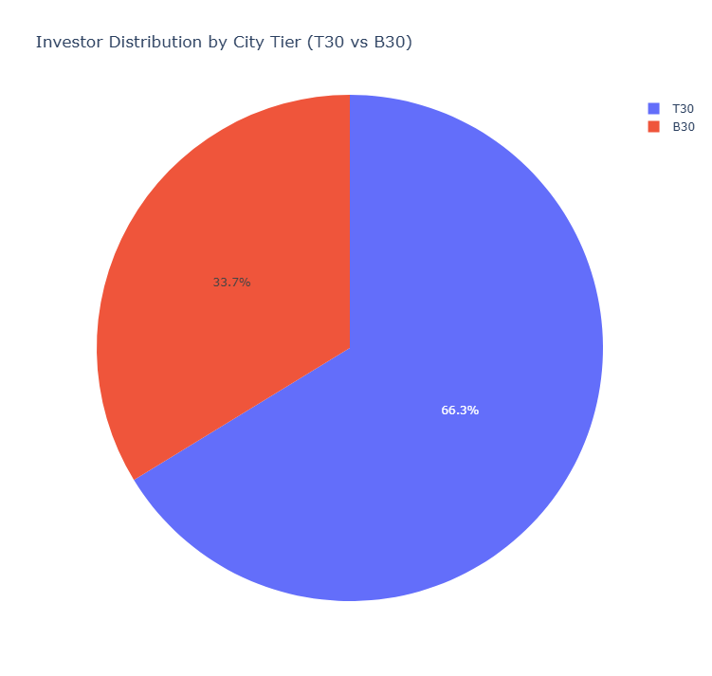
INVESTOR DEMOGRAPHICS
Advanced clustering of investor data by gender, geographic tier, and state distribution.
Evaluation of how regional shifts and demographic trends serve as indicators for future market penetration.

Slide 7
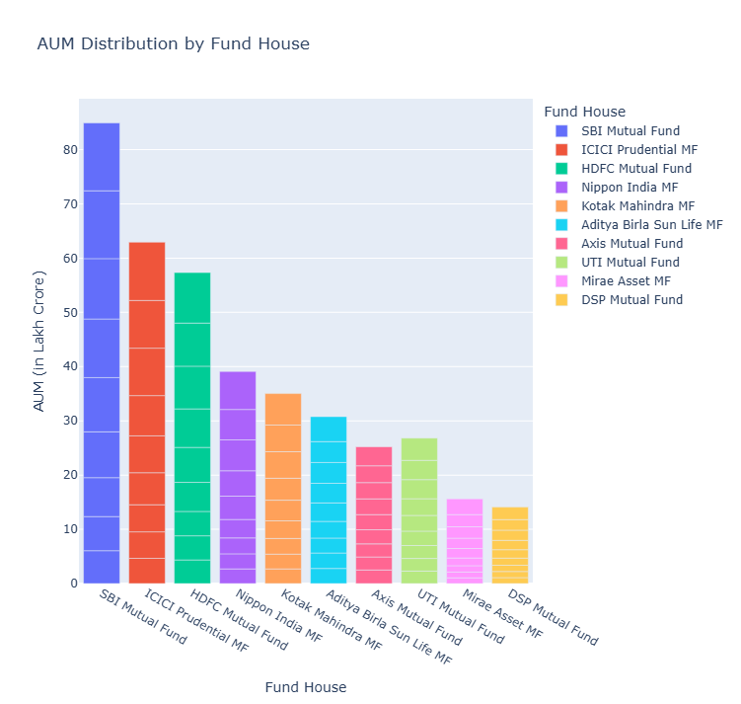
PERFORMANCE METRICS
FUND EVALUTION
Implementation of a rigorous scorecard methodology to assess fund performance against established market benchmarks.
Comparative study of growth-oriented equity schemes to identify sustainable performance drivers.

Slide 8
RISK ADJUSTED
RETURNS
Deployment of the Sharpe Ratio and volatility assessments to distinguish between tactical performance and sustained investment efficacy
Analysis of SIP inflow stability, serving as a vital proxy for retail investor sentiment and market long-term outlook.

Slide 9
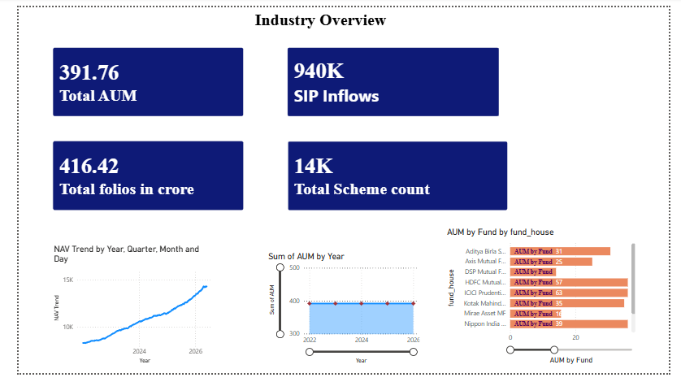
DASHBOARD
INSIGHTS

Slide 10
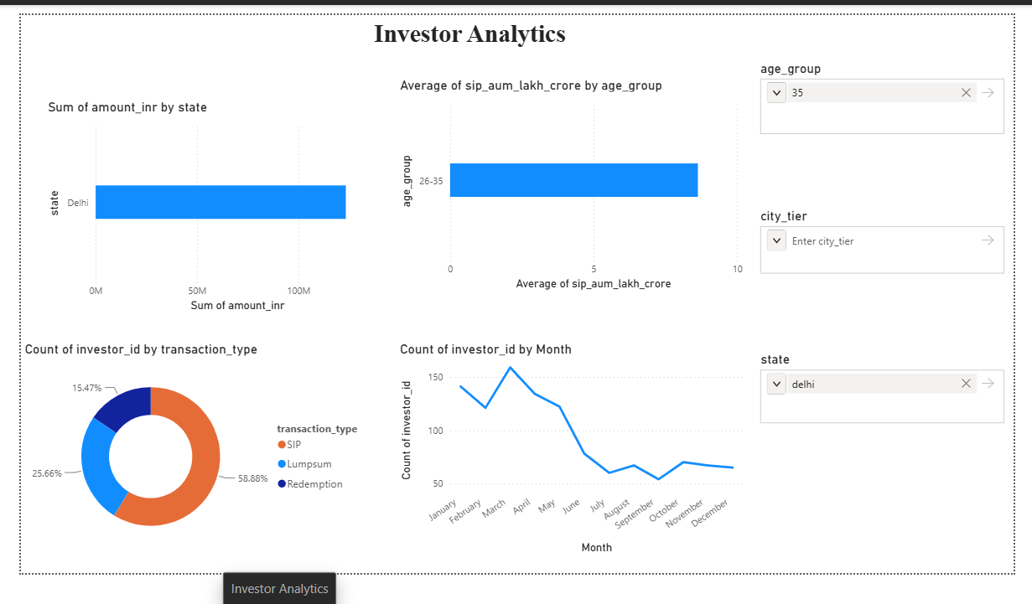
DASHBOARD
INSIGHTS

Slide 11
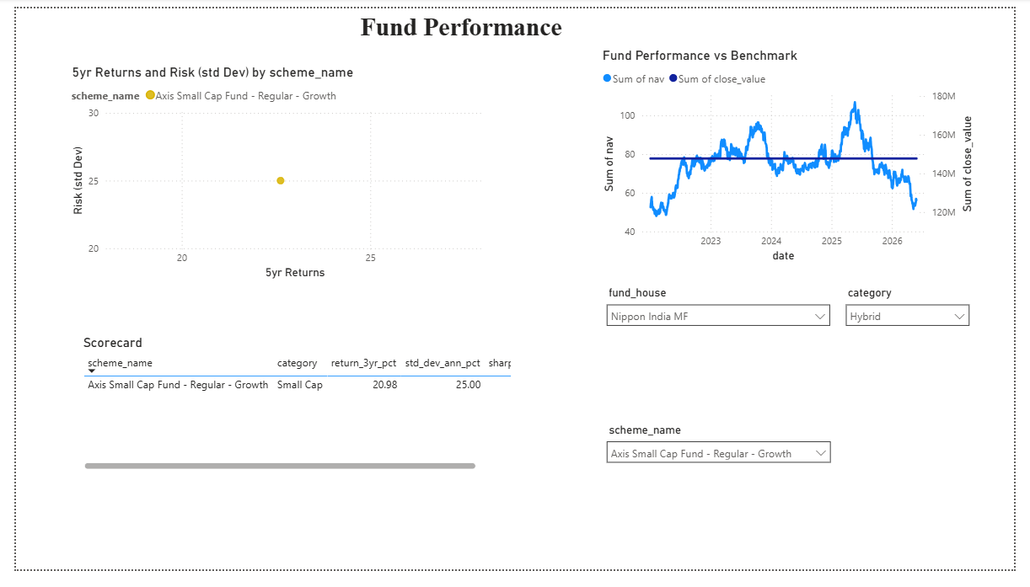
DASHBOARD
INSIGHTS

Slide 12
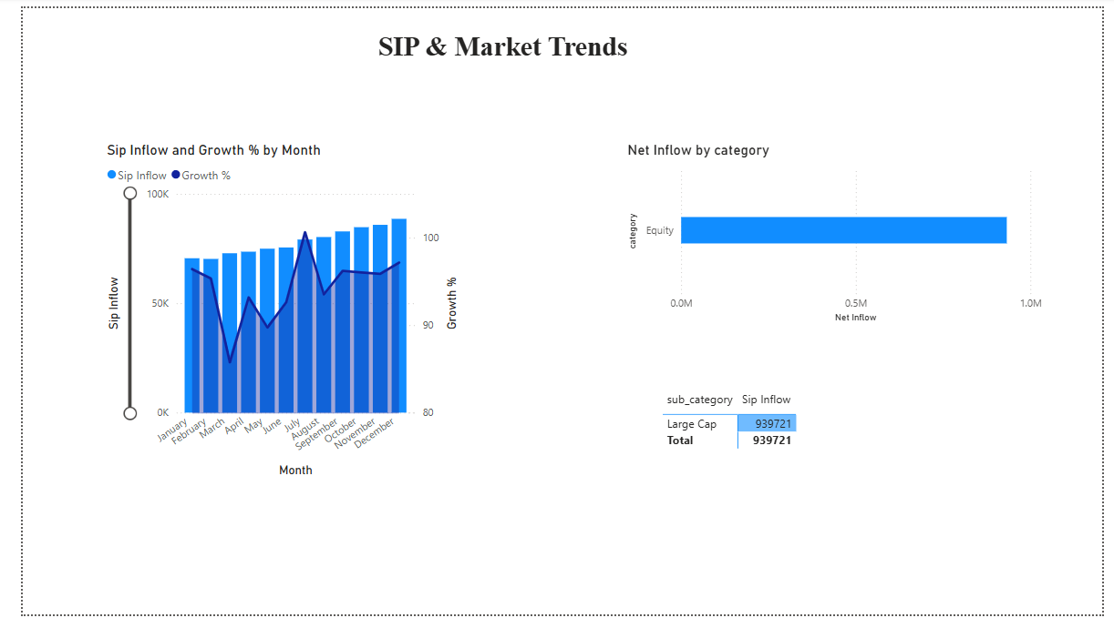
DASHBOARD
INSIGHTS

Slide 13
KEY FINDINGS
1
Systematic Investment Plans (SIPs) have established themselves as the primary stabilizer for retail capital in volatile environments.
2
Evidence indicates that B30 (beyond top 30 cities) regions are now pivotal drivers of long-term industry growth.
The industry is witnessing a definitive transition toward low-cost, passive management frameworks.
3

Slide 14

THANK YOU
I welcome further discussion on the analytical methodology
chouhanshubhangi2212@gmailcom

