Slide 1
Clustering
Data Mining and Data Warehousing
Symbiosis School for Liberal Arts
Shubhangi Hora
14060321085

Slide 2
machine learning
supervised
reinforcement
unsupervised
clustering

Slide 3
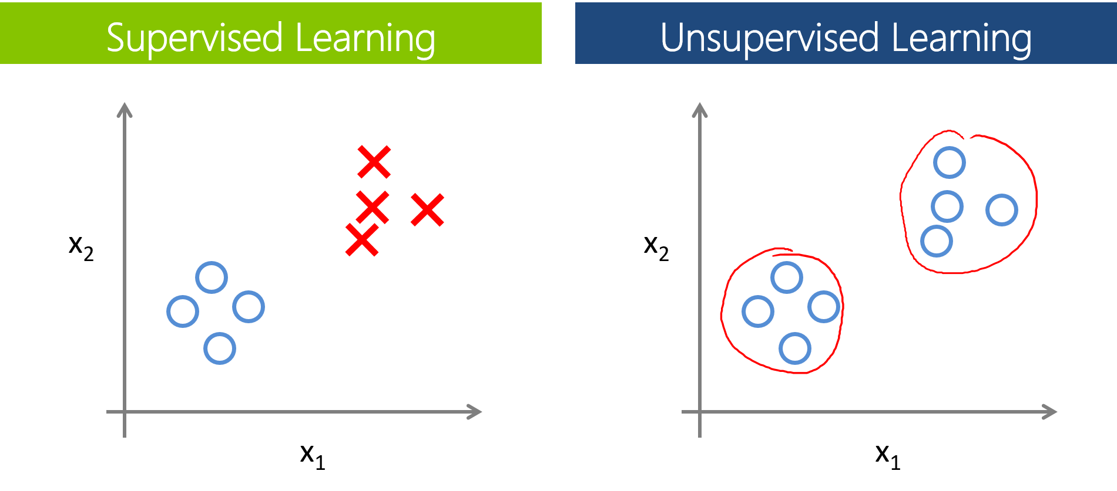

Slide 4
Clustering – a method to find hidden patterns in unlabelled data

Slide 5
K – Means Algorithm
number of clusters
input data = D = ( x₁, x₂, x₃, … , x_{n} )
every cluster has a centre, hence every point closest to that centre, belongs to that cluster
the centre is the mean average of the surrounding sample data points - µ, so, K clusters have µ_{1,} µ_{2,} µ_{3, … ,} µ_{k} unknown centroids

Slide 6
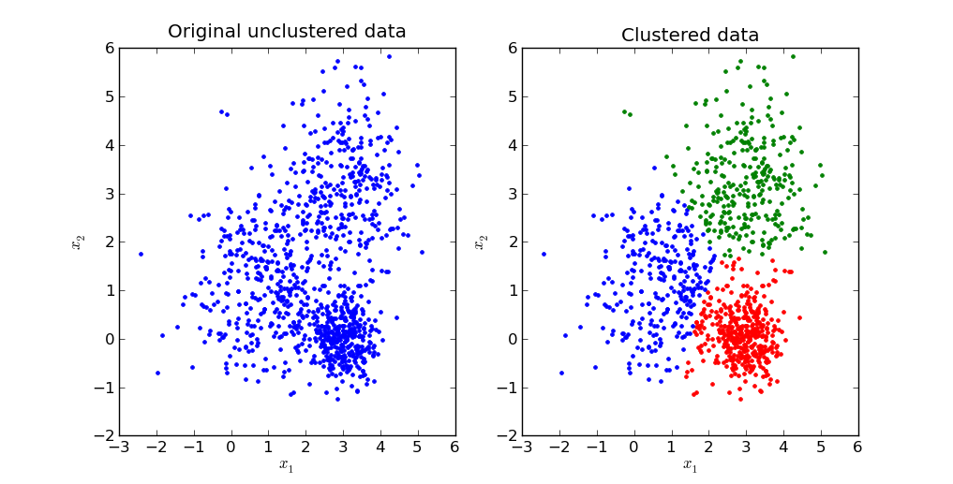

Slide 7
Initialize the number of clusters
Initialize the centroids
Assign all samples to the centroids based on their distances from the centroids
Calculate new centroids based on the samples that have been assigned to the previous centroids
Repeat the above steps until the value of the centroids remains the same (convergence)

Slide 8
Expectation – Maximization Algorithm
Generates the best hypothesis for the distributional parameters of a multivariate model
maximum likelihood hypothesis

Slide 9
Affinity Propagation
Passing messages between samples
Number of clusters doesn’t need to be predetermined
Exemplars – samples that are representatives of the clusters
Preference – determines likelihood of a sample becoming an exemplar

Slide 10
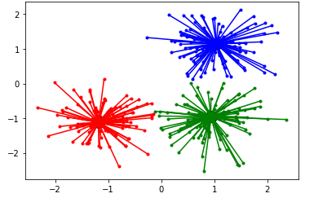
Affinity Propagation
If x_{i} is similar to a lot of samples and it is chosen by many samples, then it becomes an exemplar

Slide 11
Mean Shift
Locates the maxima of a density function, iteratively till convergence
Uses centroids
A function is shifted closer to the maxima during each iteration, using a mean shift vector, m, until the function reaches the maxima

Slide 12
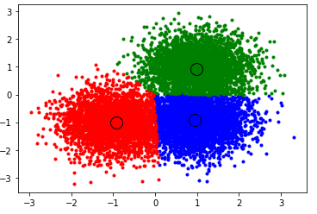

Slide 13
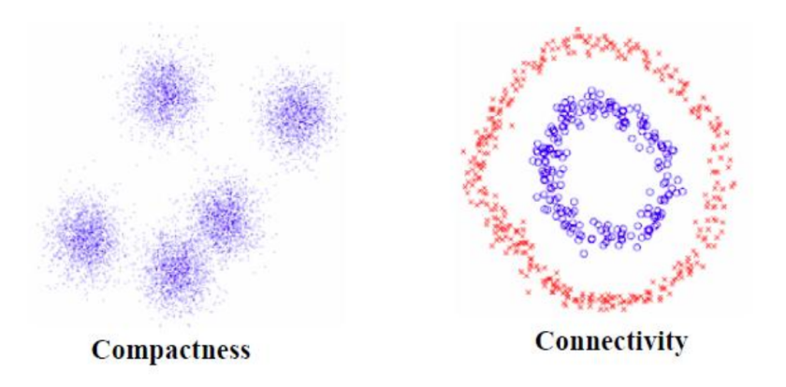
Spectral Clustering
Clusters data that is connected, but not always compact

Slide 14
Hierarchical Clustering
Agglomerative
Divisive
Bottom up
Top down

Slide 15
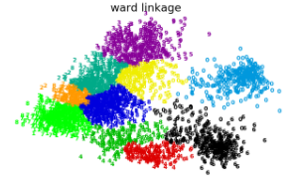
Agglomerative
Ward linkage

Slide 16
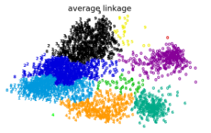
2. Average

Slide 17
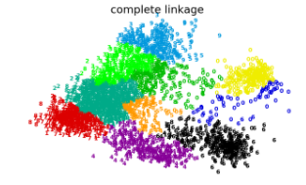
2. Complete

Slide 18
DBSCAN
Density – Based Spatial Clustering of Applications with Noise
Clusters points in regions of high density
Marks lower density points as outliers
Core and non – core samples

Slide 19
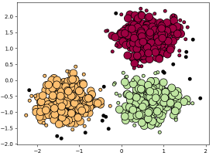

Slide 20
Clustering Algorithm | Parameters | Metric used
K – Means | Number of clusters | Distance between points
Affinity Propagation | Preference | Nearest neighbour distance
Mean – Shift | Bandwidth | Distance between points
Spectral | Number of clusters | Nearest neighbour distance
Hierarchical | Number of clusters | Distance between points
DBSCAN | Neighbourhood size | Distance between nearest points

