Slide 1
Bike Dekho – Bike Sales Analysis
Excel Dashboard Project
Submitted by: Shubhangi Kawale
Date: 20th July 2025

Slide 2
Project Overview
Analyze customer behavior, bike sales trends & performance using Excel
Tools used: Excel (Formulas, PivotTables, Charts, Dashboard)
Deliverables: Cleaned data, Dashboard, Insights, Recording

Slide 3
Project Objectives
Clean raw data for better analysis
Analyze customer demographics & sales
Identify top-performing regions & product lines
Create a dynamic Excel dashboard
Generate business insights for decision-makers

Slide 4
Data Cleaning Summary
Removed duplicates and fixed missing values
Standardized formats (Dates, Currency, Text)
Created calculated columns (Age, Profit Margin)
Ensured clean and analysis-ready dataset

Slide 5
Dashboard KPIs
- Units Sold (Bikes Purchased): 1,195
- Average Customer Income: ₹55,219
- Customer Count: 1,950

Slide 6
Key Insights
- Top Buyer Segment: Married males aged 30–45 with high income
- Best-Selling Bike Type: Mountain Bikes
- Top Region: Western region has highest sales volume
- Customer Trends: Income & occupation influence purchase patterns

Slide 7
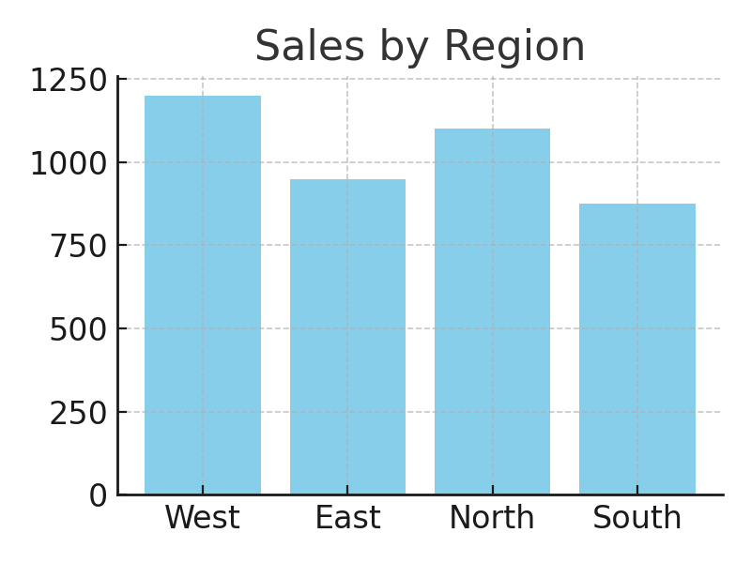
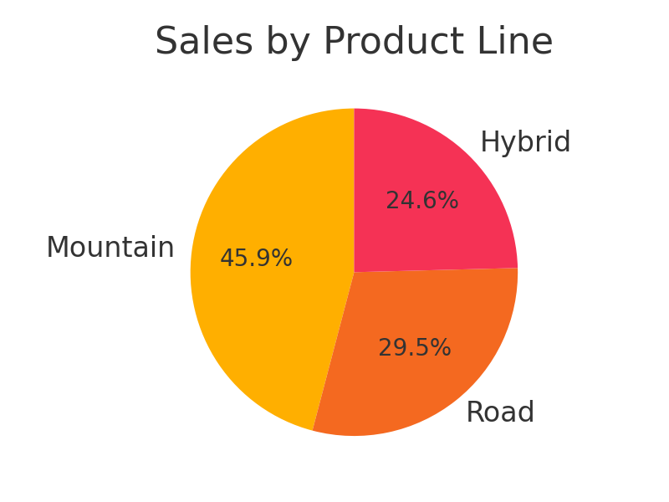
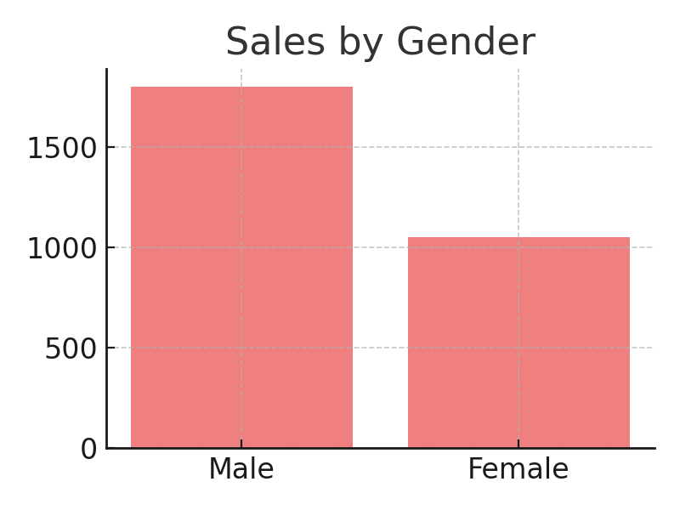
Visual Summary

Slide 8
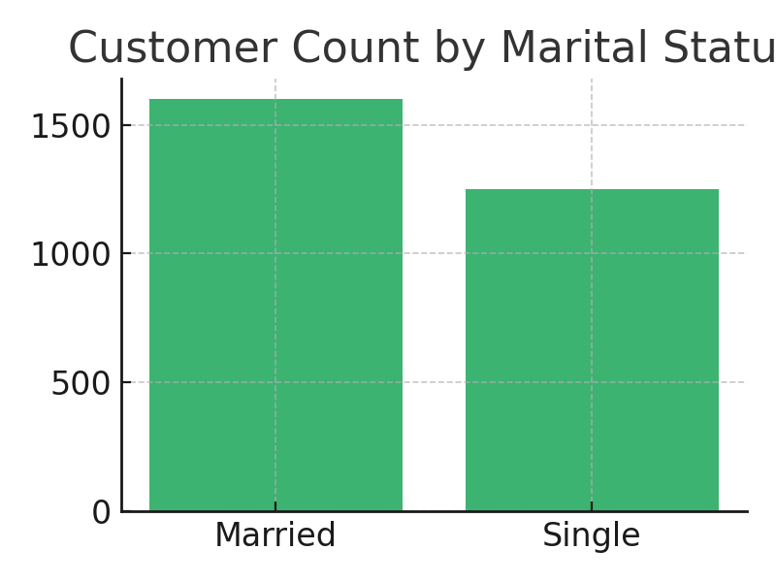
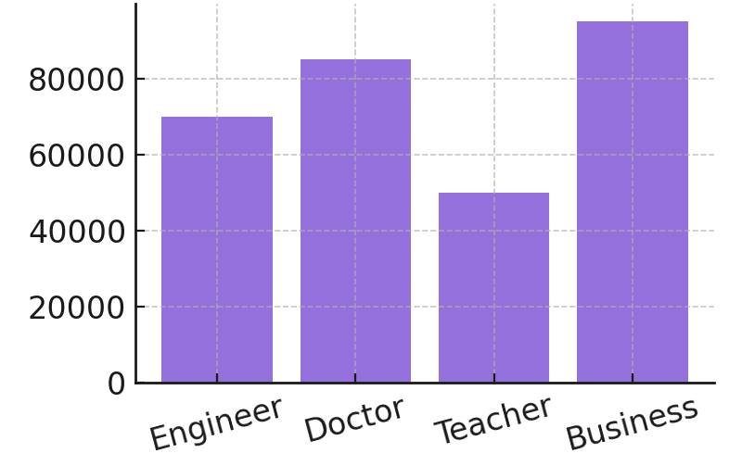
Customer count by marital status
Average income by occupation

Slide 9
Conclusion & Next Steps
- The dashboard highlights key buyer segments and regional sales strengths.
- Married males aged 30–45 are the most frequent buyers of mountain bikes.
- The Western region recorded the highest volume of bike purchases.
- Income and occupation significantly influence purchasing decisions.
- Deeper analysis by bike model and region can improve targeting.
- Recommend focused promotions on Western region and Mountain Bikes.
- Collecting actual sales amount data in the future can enhance revenue insights.

