Slide 1
Fly Emirates Performance Analysis
Prepared by: Shubhangi Kawale
Tools Used: PostgreSQL, Power BI
Date: July 2025

Slide 2
Introduction
This project analyzes Emirates Airlines' flight performance using a large dataset.
Goals:
- Identify delays and cancellation patterns
- Evaluate airline and airport performance
Tools:
- PostgreSQL for data processing
- Power BI for visualization

Slide 3
Dataset Overview
1. flights.csv – Detailed flight records (delays, times, status)
2. airlines.csv – Airline IATA codes and names
3. airports.csv – Airport codes and locations
Loaded and transformed in PostgreSQL, then visualized in Power BI.

Slide 4
SQL Analysis
Key Queries:
- Top 5 Airlines by Total Flights
- Delay Reason Aggregation
- Cancelled vs Diverted Flights
Data cleaned and transformed before loading into Power BI.

Slide 5
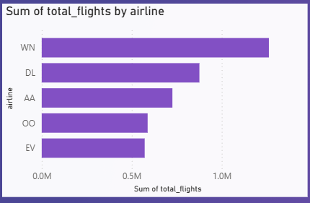
Top 5 Airlines by Total Flights
Power BI visualization showing the top 5 airlines by number of flights.
Observation:Emirates ranks among the top with high volume and consistent operations.

Slide 6
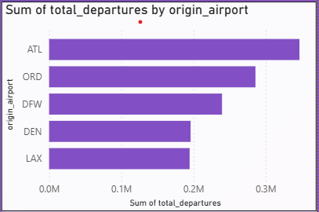
Delay & Cancellation Analysis
Charts:
- Stacked Column Chart: Delay Reasons (e.g. Weather, Security, etc.)
Insights:
- Most delays caused by late aircraft
- Cancellations far more frequent than diversions

Slide 7
Delay Reasons Breakdown
Stacked Column Chart
Axis Setup:
Axis: Delay Reason (weather_delay, carrier_delay, etc.)
Values: Sum of Delay Minutes
Insight:
Late Aircraft Delay is the leading cause across flights.
NAS (Air System) and Carrier delays follow.
Security and Weather delays are relatively lo

Slide 8
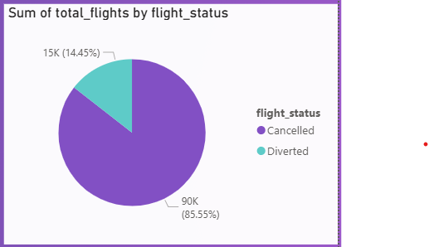
Flight Status Distribution
Pie Chart
Legend: Flight Status (Cancelled / Diverted)
Values: Count of Flights
Insight:
Out of all irregular flights, Cancellations make up the majority.
Only a small fraction are diverted.

Slide 9
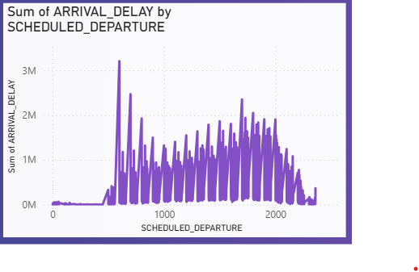
Average Delay by Hour of Day
Line Chart
Axis Setup:
X-Axis: hour_of_day
Y-Axis: Average Arrival Delay
Insight:
Delay spikes in early morning (around 5–7 AM) and late evenings.
Midday flights tend to be more punctual.

Slide 10
Key Insights
Late Aircraft is the top delay reason often avoidable.
Most cancellations are predictable,diversions are rare.
Peak delay hours are early morning and late evening.
Power BI helped in clear pattern detection with interactive visuals.
Emirates operates with high consistency across major routes.

Slide 11
Conclusion
SQL & PostgreSQL enabled clean data preparation.
Power BI visualizations revealed trends in delay and flight status.
These insights can assist Emirates in strategic planning and improving
on-time performance
This analysis delivered actionable insights into airline operations.

