Slide 1


HACKATHON 2024
LNRS HACKATHON 2024

Slide 2

ABOUT ME
Name: Shubhangi Ojha
Email Id: shubhangi.ojha96@nmims.in
Contact No: 9004282060
Github Account: shubhangiojha
Topic: Handwritten Notes Recognition
College: MPSTME, NMIMS
Student Id: 70092100096
Repo Link: https://github.com/shubhangiojha/LNRS_HACKATHON_ShubhangiOjha

Slide 3
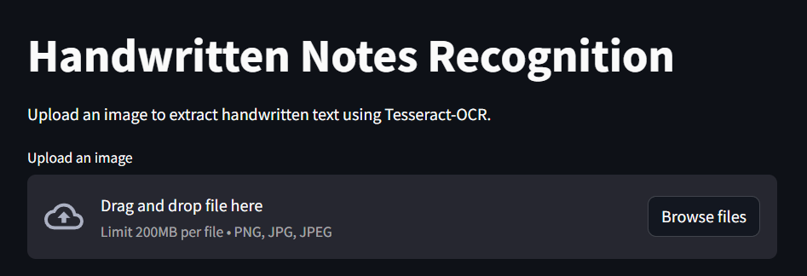
Handwritten Notes Recognition

Slide 4




Technologies Used
Tesseract-OCR:
Optical Character Recognition engine used for extracting text from images.
OpenCV:
For image preprocessing.
Streamlit:
Web-based interface for easy interaction.
Python:
Language used for scripting and integrating all components.

Slide 5
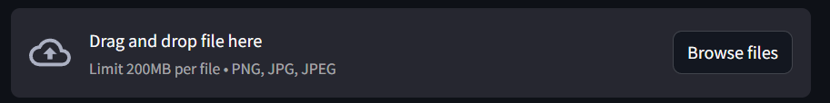
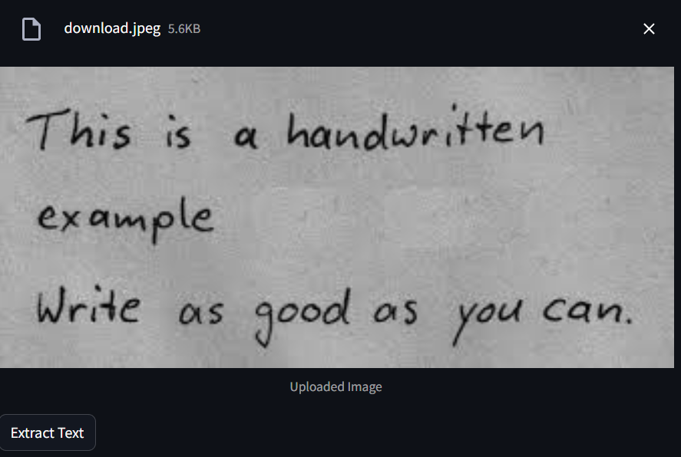
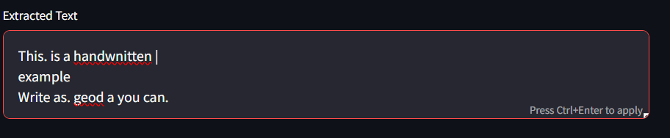
Workflow
Image Upload or Capture:
Load image using Streamlit.
Image Preprocessing:
Convert to grayscale and apply thresholding to improve text extraction accuracy.
OCR Extraction:
Use Tesseract-OCR to extract text from the preprocessed image.
Display Results:
Show extracted text in an editable form.

Slide 6
Video Link
https://drive.google.com/drive/folders/1eYL5f_jQKsjrXE2-VXEyM7hFgNUtkHYC?usp=drive_link

Slide 7
Thank You!

