Slide 1

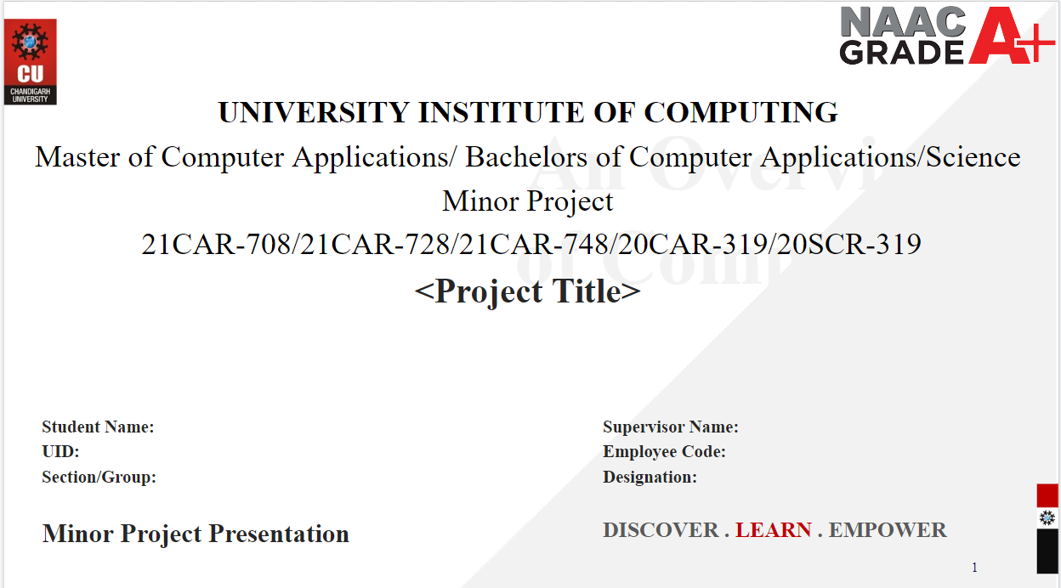
Best Friend Food Corner
Roma Singh & Shubhangi
Ms. Shivani
21MCC2016 & 21MCC2006
Assistant Professor
ON21MCD-1/A

Slide 2
Best Friend Food Corner
👨‍🍳
One-stop for your Hunger

Slide 3
Presentation Outline
Introduction To Project
Technology Used
Task Identification
Project Features
Project TimeLine
Future Scope
Conclusion
Bibliography

Slide 4
Introduction to Project
Develop the Food search website
Food search become easier
Instead physical searching turn Online
Easy and quick order
Feels like own home food

Slide 5





Technology Used

Slide 6
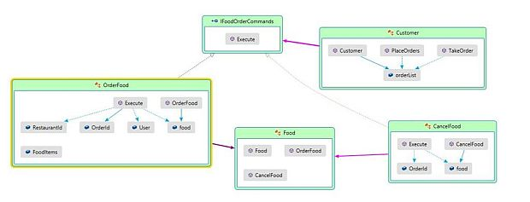
Task Identification

Slide 7
Features
Easy & Quick order
Variety of Food Available
Order Customization
Free Home delivery
Search and filtering
Best Deal Available

Slide 8








Facilities We Serve

Slide 9
Project Timeline
TASK NO | TASK NAME | STARTDATE | END DATE | TOTALNO.OFDAYS
1. | Requirement Analysis | 10-02-2023 | 12-02-2023 | 02
2. | Feasibility Study | 13-02-2023 | 20-02-2023 | 08
3. | System Analysis | 22-02-2023 | 28-02-2022 | 07
4. | Design | 01-03-2023 | 12-03-2023 | 12
5. | coding | 15-03-2023 | 15-04-2023 | 30
6. | Testing | 16-04-2022 | 26-04-2022 | 11
 |  |  | Total | 70 days

Slide 10
Future Scope
Backend technology (php)
Database technology (mysql)
Storing previous visiting data
Updated with new features
More user friendly access

Slide 11
Conclusion
One-stop solution for your Hunger.
Find food at affordable rates.
Order food with just a click.
Best for Foodie.

Slide 12
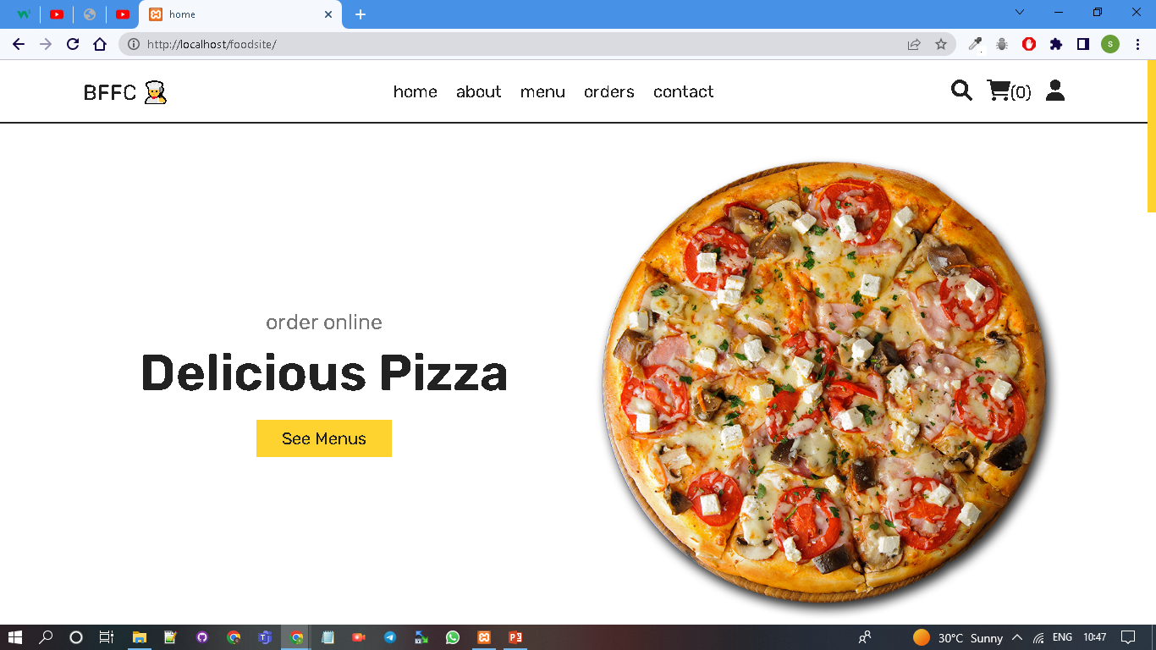
Conclusion

Slide 13
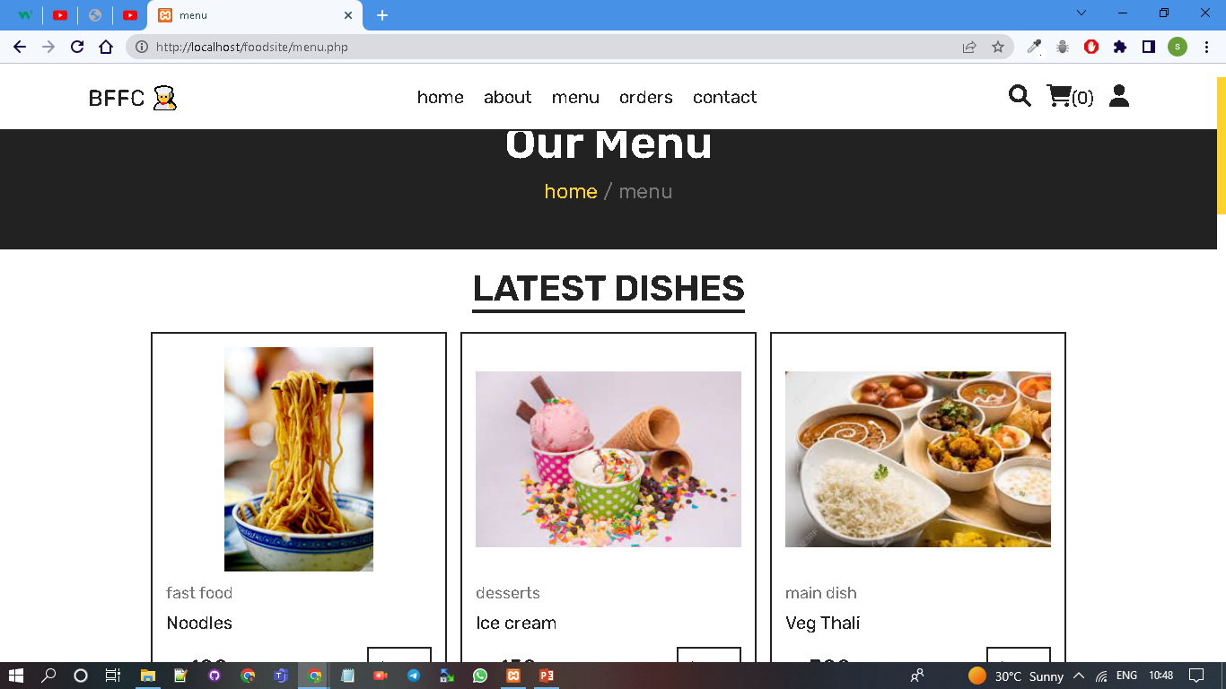
Conclusion

Slide 14
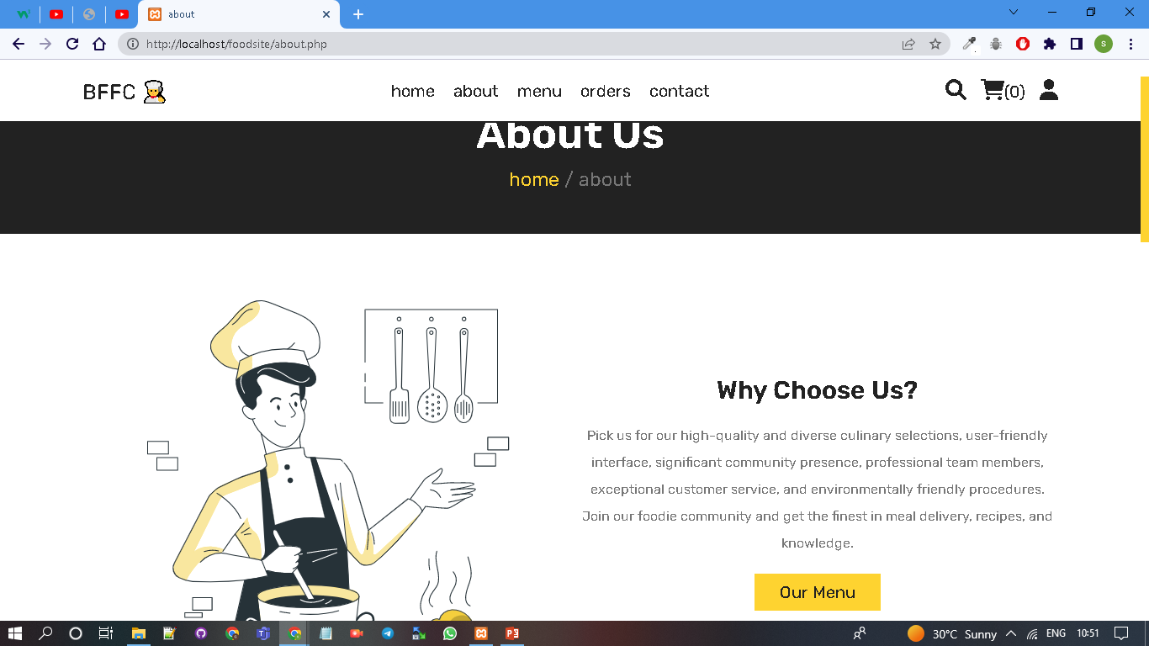
Conclusion

Slide 15
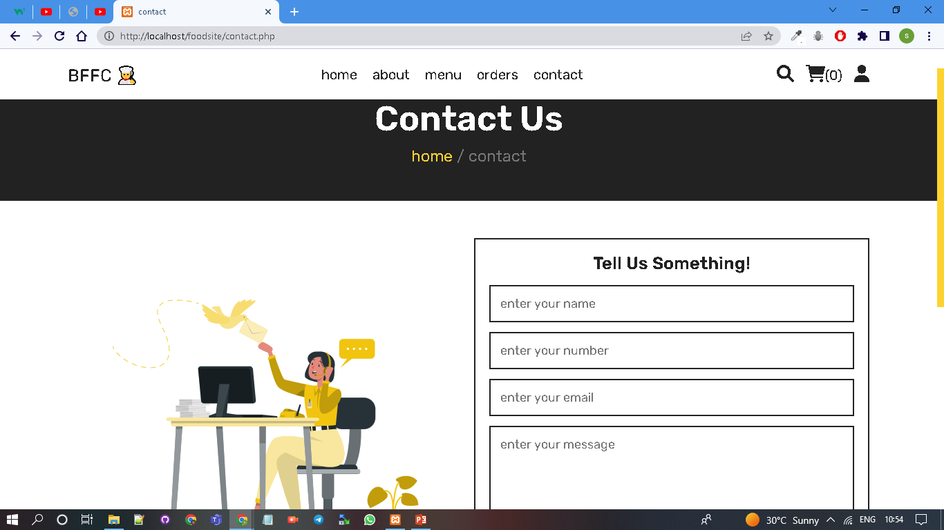
Conclusion

Slide 16
Bibliography
http://ur.aeu.edu.my/529/
https://www.sciencedirect.com/science/article/pii/S1877042812036361
https://ieeexplore.ieee.org/abstract/document/5288330
https://www.epj-conferences.org/articles/epjconf/abs/2014/05/epjconf_icas2013_00041/epjconf_icas2013_00041.html
https://www.sciencedirect.com/science/article/abs/pii/S0969698919302322

Slide 17


