Slide 1


Social Buzz - Big Data Audit and IPO Preparation
Presentation by Shubhangi V Patil
Date: 31/07/24

Slide 2


Agenda
Introduction
Project Recap
Problem Statement
The Analytics Team
Process Overview
Key Findings and Recommendations

Slide 3

Project Recap
Client Information:
Client Name: Social Buzz
Industry: Social Media & Content Creation
Established: 2010
HQ Location: San Francisco
Employees: 250
Client Background:
Founded by two former engineers from a large social media conglomerate
Focuses on content, keeping users anonymous and tracking reactions
Over 500 million active users monthly
Rapid growth requiring external expertise for scaling and IPO preparation
Project Recap

Slide 4

Problem Statement
Challenges:
Rapid Growth: Reached over 500 million active users monthly, necessitating effective scaling solutions.
Data Management: Generates vast amounts of unstructured data daily, requiring sophisticated technology.
Resource Limitations: Small company with limited resources, needs external expertise for IPO and scaling.

Slide 5
The Analytics Team
Andrew Fleming: Chief Technical Architect
Marcus Rompton: Senior Principal
Shubhangi V. Patil: Software Developer
Team Roles:
Andrew Fleming: Oversees technical architecture and strategy
Marcus Rompton: Provides senior leadership and guidance
Shubhangi V. Patil: Manages data extraction, analysis, and visualization

Slide 6
Process Overview
Big Data Best Practices Presentation:
Created an up-to-date presentation on industry best practices.
Data Extraction and Merging:
Extracted and merged sample data sets using SQL.
On-Site Data Center Audit:
Conducted an audit of Social Buzz's data center.
Technology Workshops:
Conducted workshops to understand their technology landscape.
Stress Testing and Analysis:
Performed stress tests to identify technology weak spots.
Analyzed data sets and created visualizations.
1
2
3
4
5

Slide 7
Exploratory Data Analysis
Key Visualizations and Insights

Slide 8
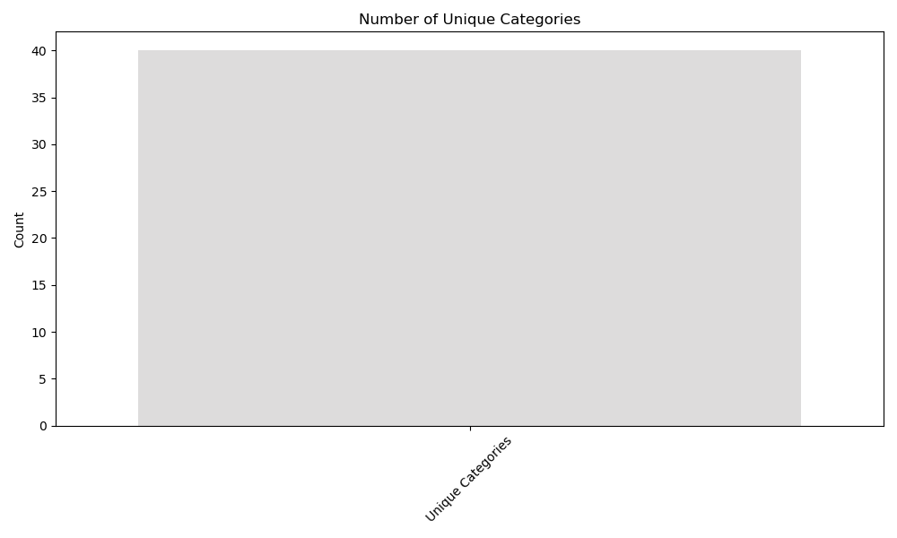
Unique Categories Bar Graph

Slide 9
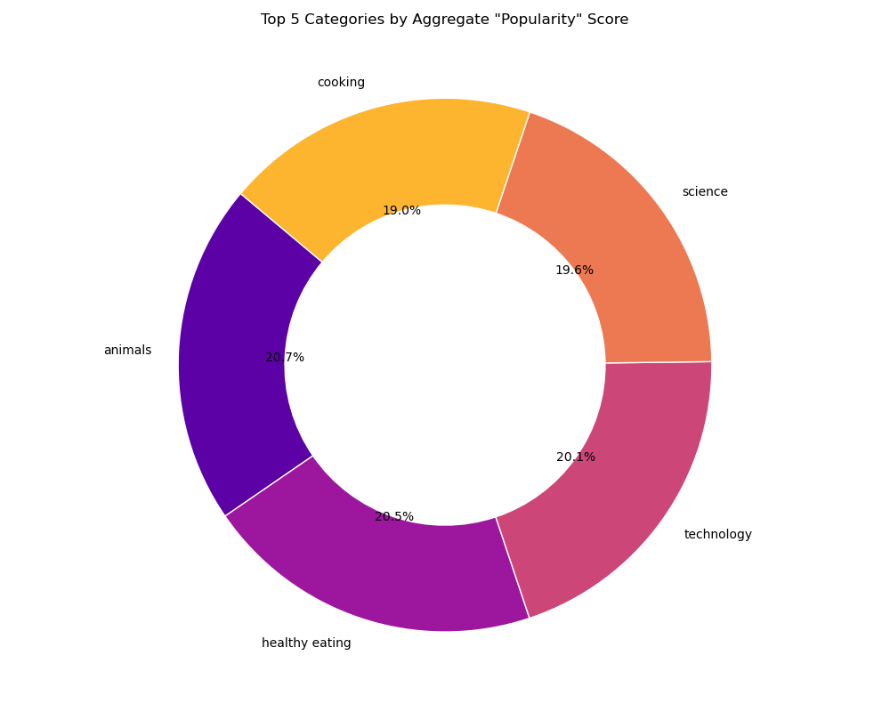
Top 5 Categories Pie Chart

Slide 10
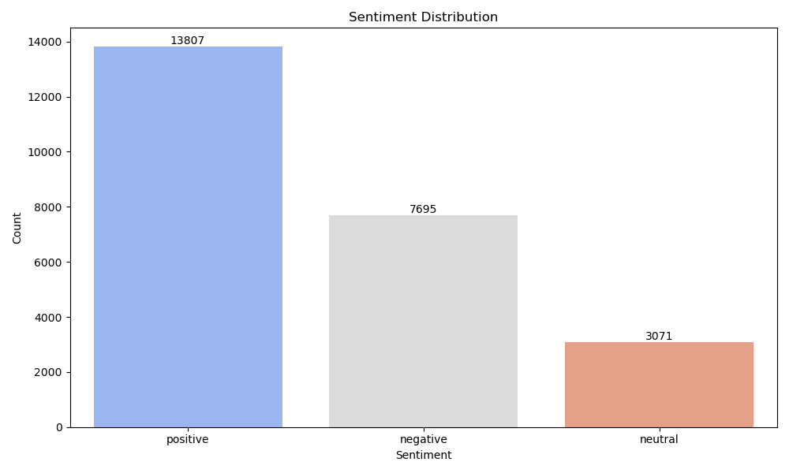
Sentiment Distribution Bar Chart

Slide 11
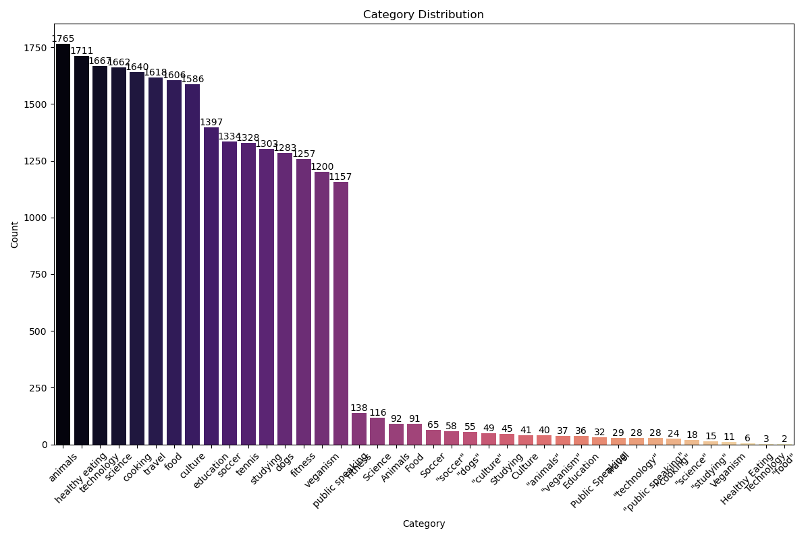
Category Distribution Bar Chart

Slide 12
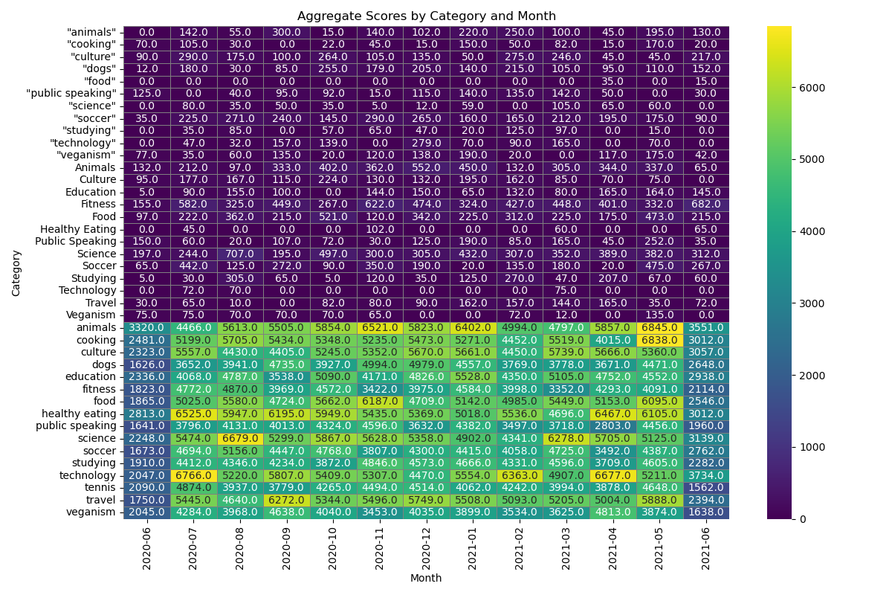
Heatmap of Aggregate Scores

Slide 13
Key Insights and Recommendations
Top 5 Content Categories Based on Aggregate Popularity:
Category Score
Animals 69,548
Healthy Eating 69,067
Technology 67,472
Science 66,043
Cooking 63,982
1. Number of unique categories: 40
2. Most popular category based on number of posts: animals
3. Reactions to the most popular category: 1765
Recommendations:
Focus on Trending Categories: Prioritize content creation in the top-performing categories.
Scalable Data Solutions: Implement scalable technology to handle growing data needs.
IPO Preparation: Follow best practices and guidelines to ensure a smooth IPO process.

Slide 14
Thank you!
ANY QUESTIONS?

