Slide 1
Mall Customer Segmentation Project
Segmentation using K Means Clustering
by
Shubhangi V Patil

Slide 2
Project Overview
This project segments mall customers based on their annual income and spending score using KMeans clustering. The goal is to identify distinct customer groups to help tailor marketing strategies.

Slide 3
Data Loading and Preprocessing
Loading Data
Handling Missing Values
Encoding Categorical Variables
Feature Selection: Annual Income (k$) and Spending Score (1-100)
Normalization: Using StandardScaler

Slide 4
Exploratory Data Analysis (EDA)
EDA helps in understanding the data distribution and relationships.
Histograms and Boxplots:
Annual Income (k$): Analyzes the income distribution.
Spending Score (1-100): Analyzes the spending behavior.
Pairplot: Examines relationships between features.
Correlation Heatmap: Analyzes correlations between numerical features.

Slide 5
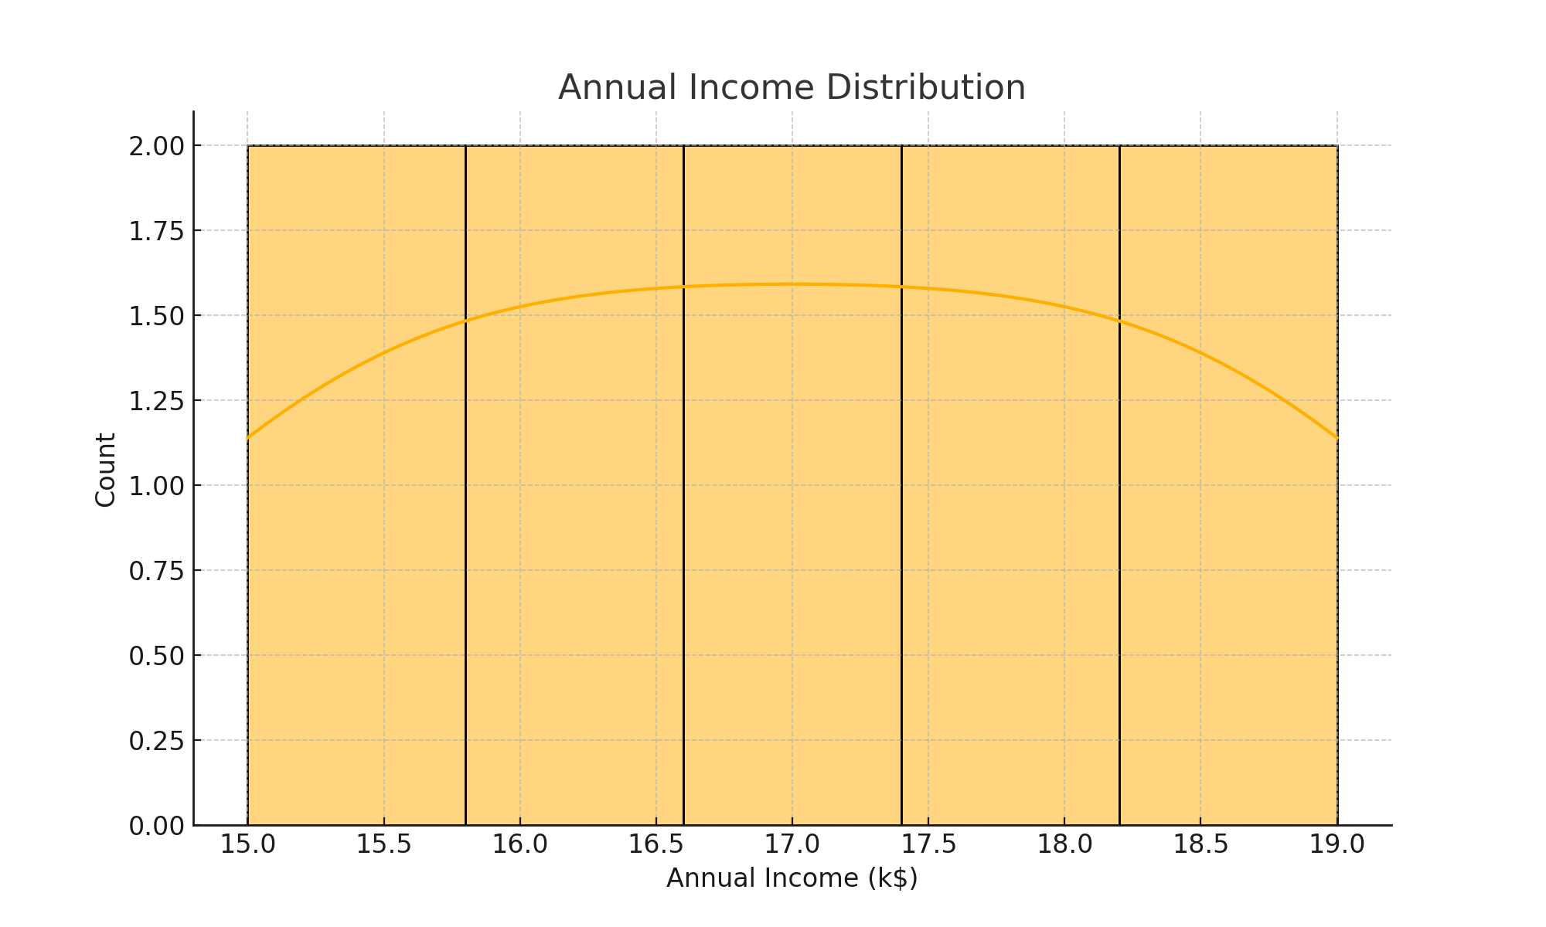
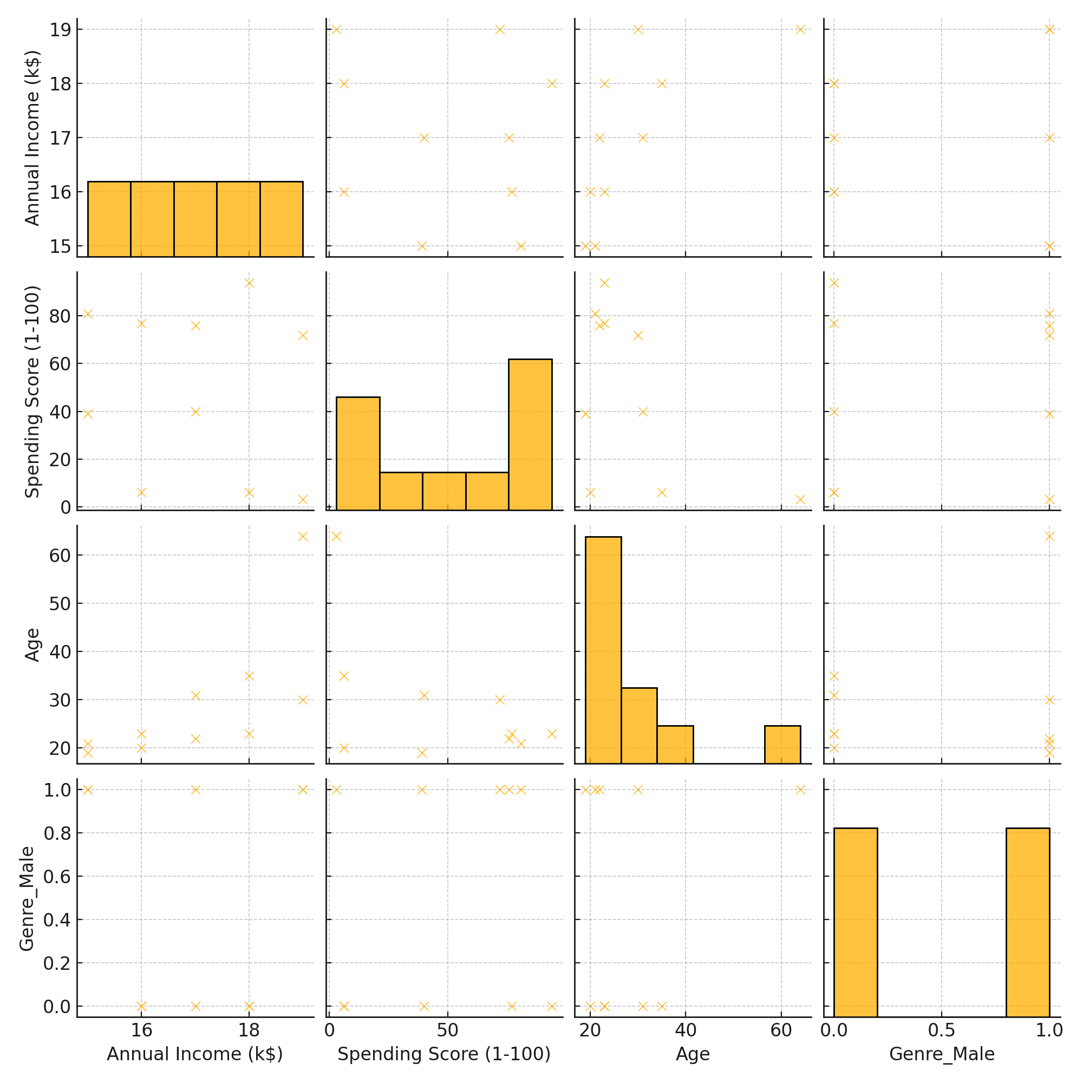
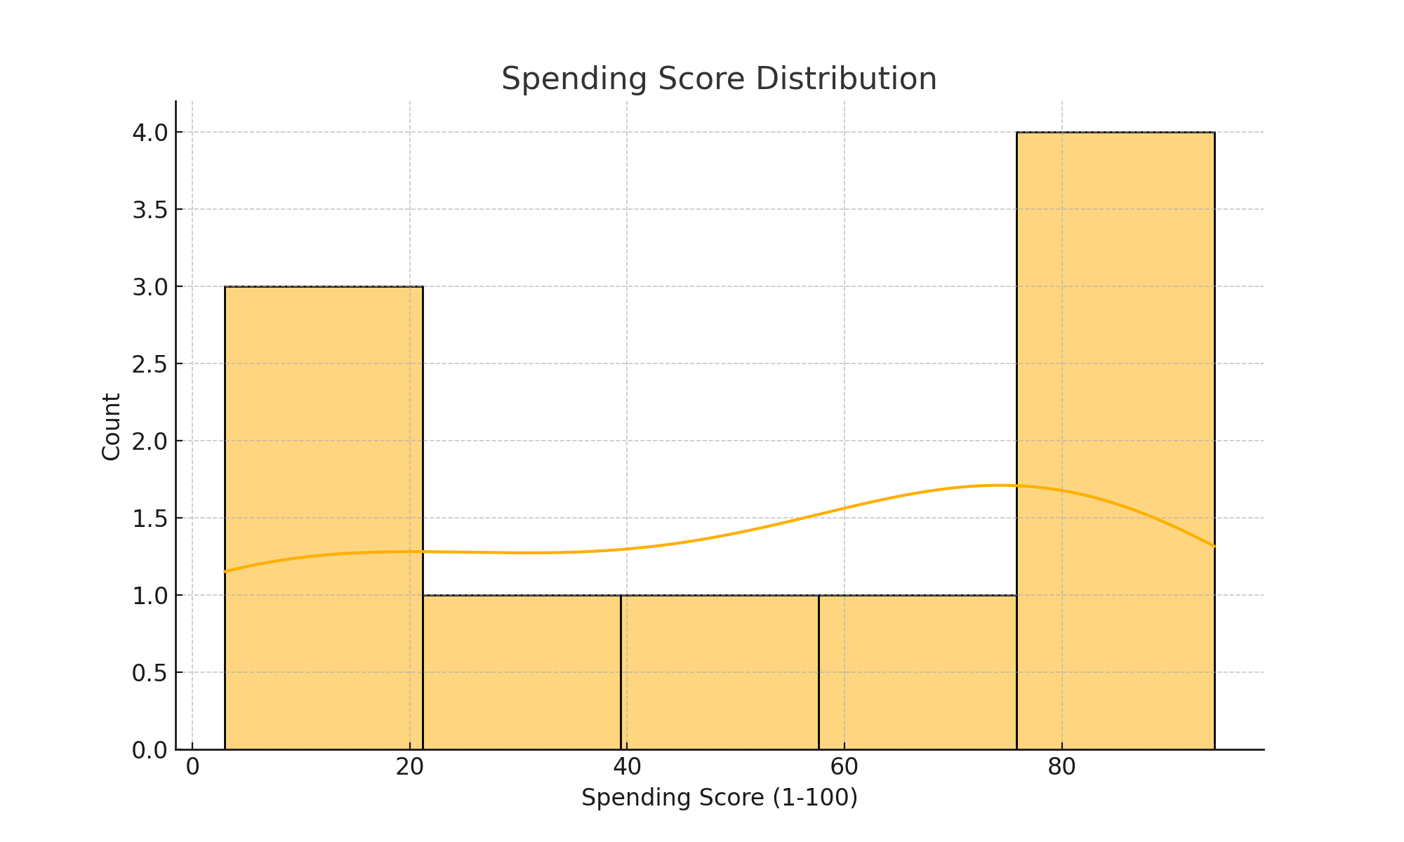
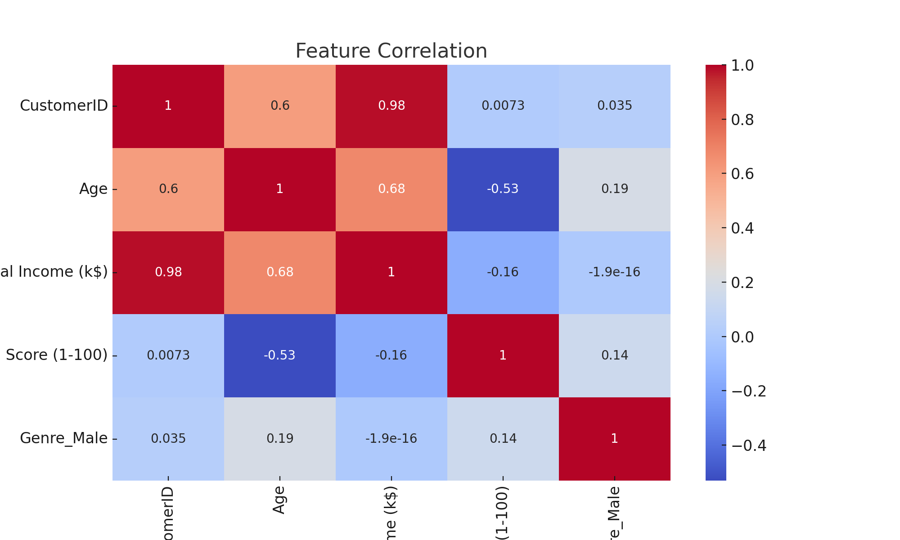
EDA Visualizations

Slide 6
Clustering with KMeans
• Elbow Method: Determining optimal number of clusters by plotting Within-Cluster Sum of Squares (WCSS) against the number of clusters.
• KMeans Training: Training the KMeans algorithm on the scaled features.
• Visualization: Visualizing the predicted clusters.

Slide 7
Dimensionality Reduction with PCA
• PCA Application: Reducing feature dimensions to 2 for better visualization.
• PCA-based Clustering: Repeating KMeans clustering on the PCA-reduced features and visualizing the results.

Slide 8
Cluster Analysis and Evaluation
Cluster Centers Analysis: Characteristics of each cluster are examined by analyzing the cluster centers.
Cluster Labels: Adding cluster labels to the original dataset.
Silhouette Score: 0.46658474418951484

Slide 9
Cluster Centers
PCA Feature 1 PCA Feature 2
0: -0.152972 1.580196
1: 1.577616 -0.175306
2: -0.452960 -0.432606

Slide 10
Cluster Profiles and Marketing Strategies
Cluster Profiles:
Cluster 0:
• CustomerID: 162.0
• Age: 40.39
• Annual Income (k$): 87.0
• Spending Score (1-100): 18.63
Cluster 1:
• CustomerID: 162.0
• Age: 32.69
• Annual Income (k$): 86.54
• Spending Score (1-100): 82.13
Cluster 2:
• CustomerID: 62.0
• Age: 40.33
• Annual Income (k$): 44.15
• Spending Score (1-100): 49.83
Marketing Strategies:
• Cluster 0: Offer loyalty rewards and exclusive deals.
• Cluster 1: Introduce premium products or services.
• Cluster 2: Implement budget-friendly promotions.
Thank You

