Slide 1
HUNGRY TERPS
DBMS Group Project
Project_0502_02
Dishant Vakte, Uzair Masih, Hrutwi Kakadia, Shubhangkar Girish Jain
Date - 12/08/2021

Slide 2
BACKGROUND
Who are the users?
The users of this database will primarily be but not limited to students. Anyone who wants to get reviews of a particular restaurant in College Park can use the database.
Data Sources
The data has been collected from Yelp website
https://www.yelp.com/search?find_desc=&find_loc=College+Park%2C+MD+20740&ns=1

Slide 3
INTRODUCTION
MISSION STATEMENT
To analyze the customer reviews and ratings for the restaurants in College Park, Maryland.
To alleviate the problems faced by students of finding quality restaurants by providing them insightful reviews.
MISSION OBJECTIVE
1. To find the top rated restaurants by all customers
2. To find the zip code that has maximum number of restaurants
3. To find the top restaurant in each price category based on number of reviews
4. How many dining restaurants in a particular zip-code
5. To find the reviews written by star customers
6. List of restaurants that offer delivery services
7. To find the top ten restaurants based on count of reviews
8. To find the list of restaurants that are present in multiple locations

Slide 4
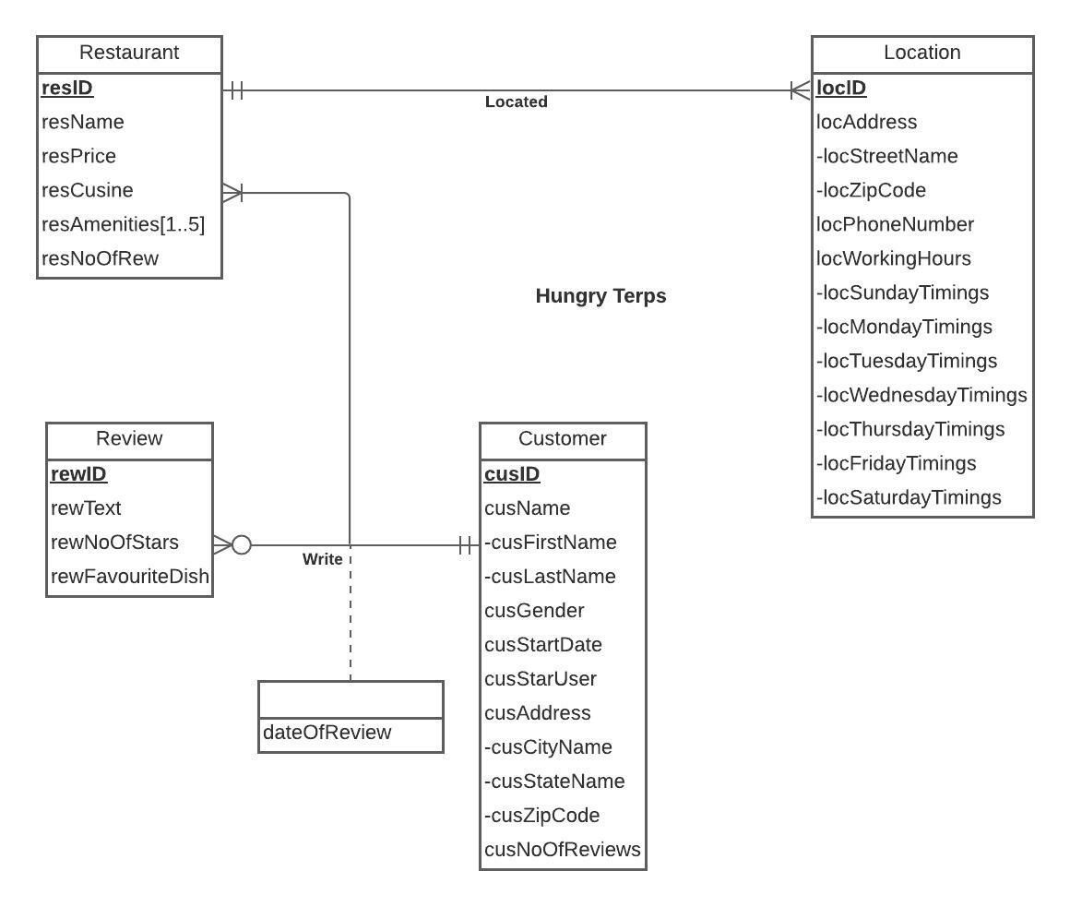
ER DIAGRAM

Slide 5
LOGICAL DATABASE DESIGN: RELATIONAL SCHEMA
RELATIONAL SCHEMA:
Restaurant(resID, resName, resPrice,resNoOfRew,resCuisine)
RestaurantAmenities(amID, resAmenities,resID)
Customer (cusID, cusFirstName, cusLastName, cusGender, cusStartDate, cusStarUser,cusCityName, cusStateName, cusZipCode, cusNoOfReviews)
Review (rewID, rewText, rewNoOfStars, rewFavouriteDish)
Location (locID, resID, locStreetName, locZipCode, locPhoneNumber, locSundayTimings, locMondayTimings, locTuesdayTimings, locWednesdayTimings, locThursdayTimings, locFridayTimings, locSaturdayTimings)
Write(resID,rewID, cusID,dateOfReview)

Slide 6
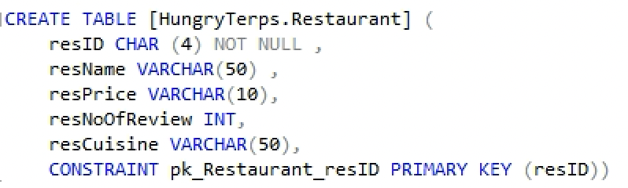
PHYSICAL DATABASE DESIGN: SQL CREATE TABLE -RESTAURANT

Slide 7
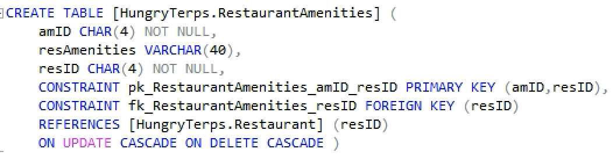
PHYSICAL DATABASE DESIGN: SQL CREATE TABLE -RESTAURANT AMENITIES

Slide 8
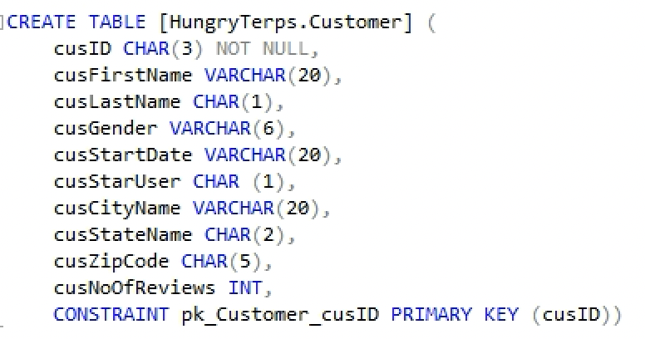
PHYSICAL DATABASE DESIGN: SQL CREATE TABLE -CUSTOMER

Slide 9
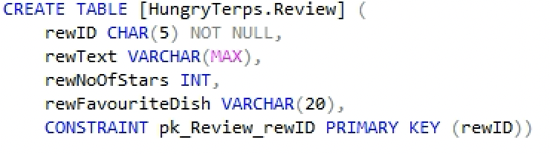
PHYSICAL DATABASE DESIGN: SQL CREATE TABLE -REVIEW

Slide 10
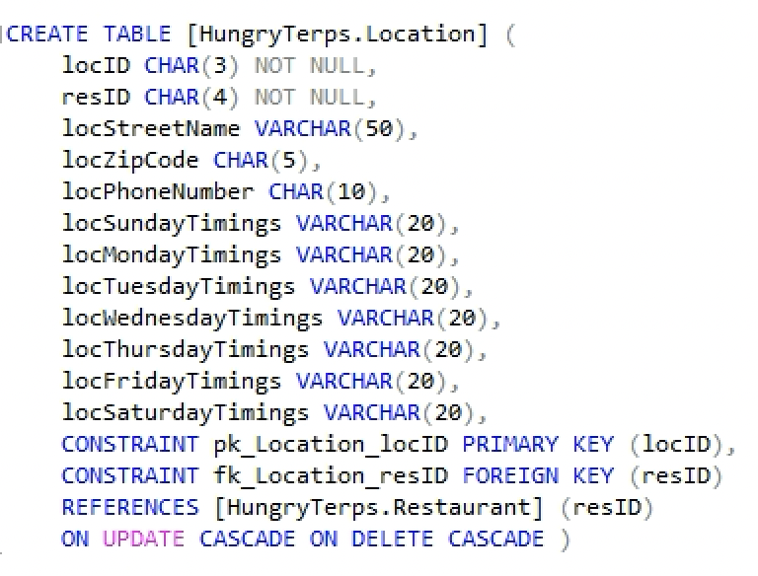
PHYSICAL DATABASE DESIGN: SQL CREATE TABLE -LOCATION

Slide 11
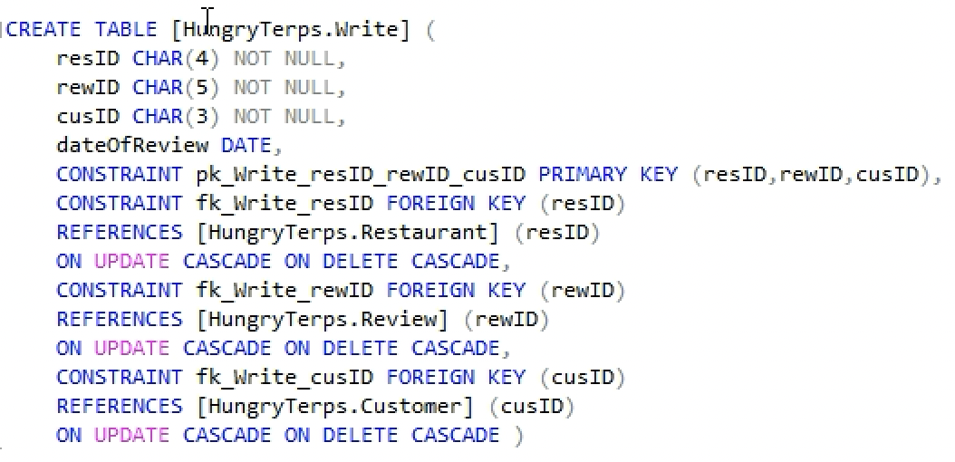
PHYSICAL DATABASE DESIGN: SQL CREATE TABLE -WRITE

Slide 12
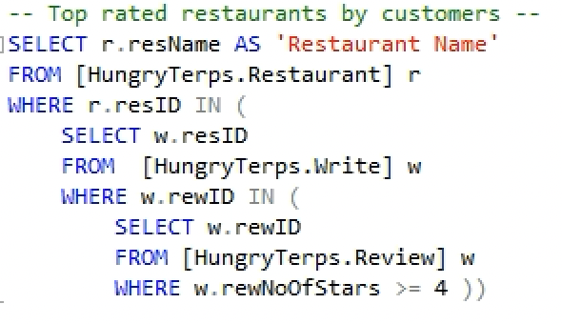
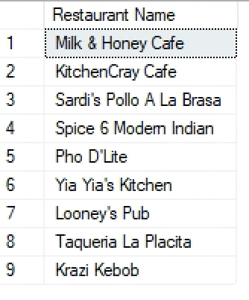
BUSINESS TRANSACTIONS
List of top rated restaurants by customers

Slide 13
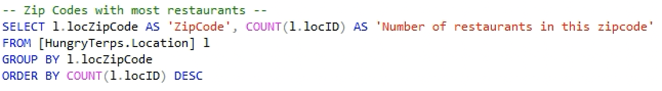
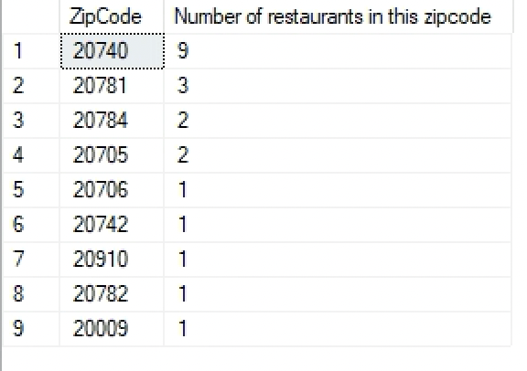
BUSINESS TRANSACTIONS
List of number of restaurants in all the zip-codes in College Park

Slide 14
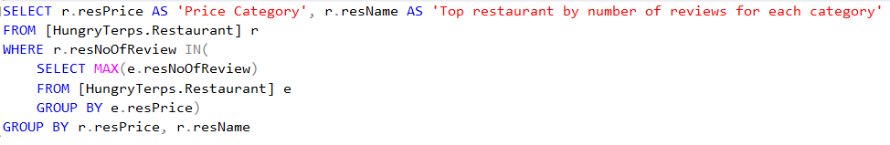
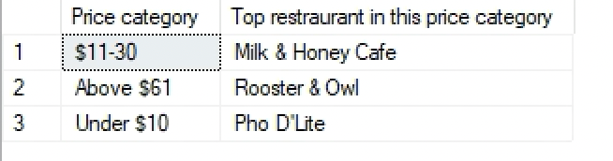
BUSINESS TRANSACTIONS
List of the top restaurant based on count of reviews in each price category

Slide 15
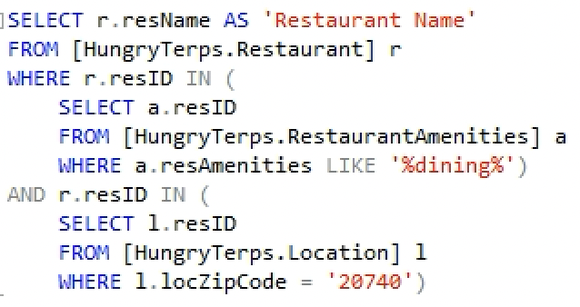
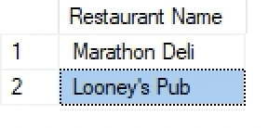
BUSINESS TRANSACTIONS
List of restaurants that have dining services in zip code 20740

Slide 16
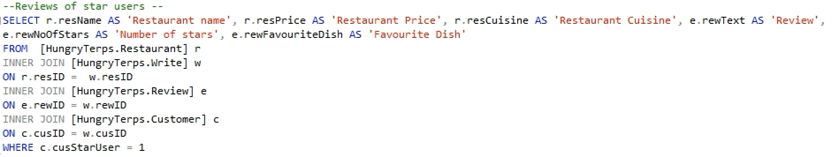
BUSINESS TRANSACTIONS
List of reviews given by star users

Slide 17
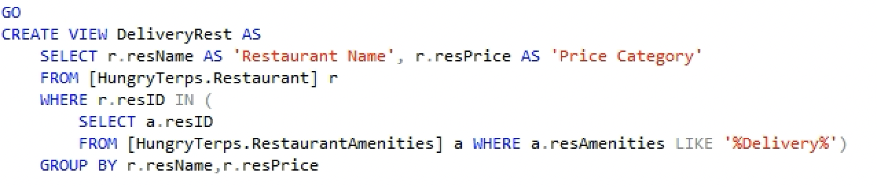
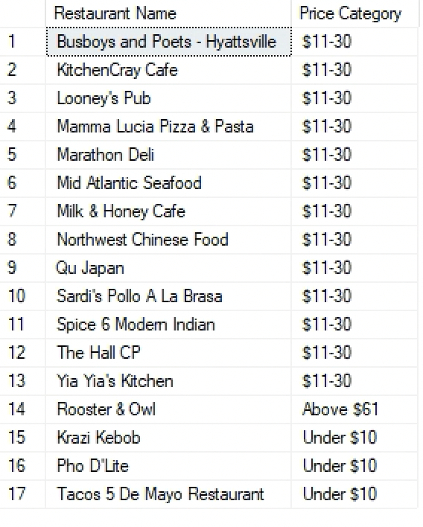
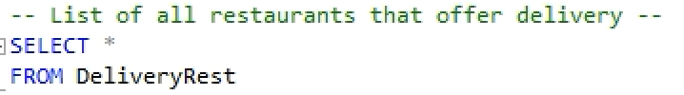
BUSINESS TRANSACTIONS
List of restaurants that offer delivery services

Slide 18
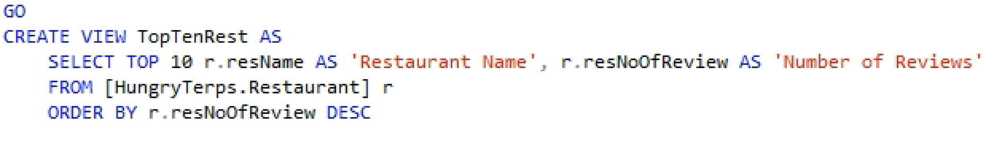
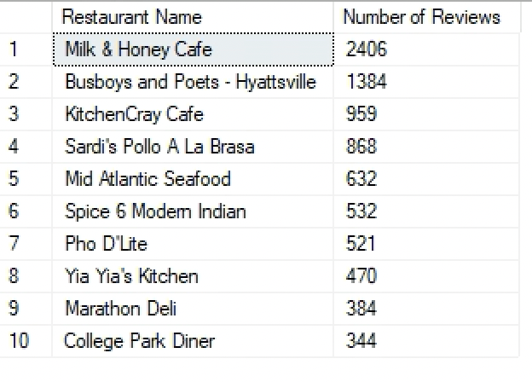

BUSINESS TRANSACTIONS
List of top ten restaurants based on count of reviews

Slide 19
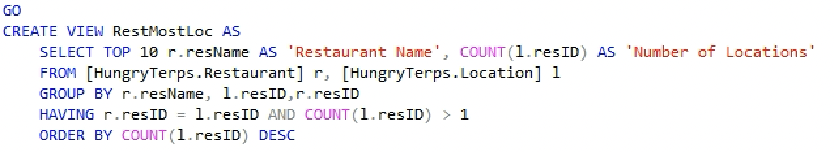


BUSINESS TRANSACTIONS
List of restaurants that are present in multiple locations

Slide 20

THANK YOU

