Slide 1








Fest Lifecycle Mgmt
festFLOW
Budget Tracking
Vendor Sourcing
From Chaos to Celebration — One Platform for Every Fest.
Ticket Sales
Submitted To: Prof. Anukreeti Chaudhary
Subject : Entrepreneurship
Submitted by: Tanvi Dave - 242126
Shubhangni Chawla - 242119
Akanksha Rajpurohit - 242111
Kavya Gajjar - 242164
Pari Rangrej - 242118
B.Tech - DIvision D
Sponsorship Pipeline
Team Coordination

Slide 2

THE PROBLEM
College fests run on chaos.
College fest organizers in India lack a unified digital platform to manage the complete lifecycle of a fest — from budgeting and vendor sourcing to ticketing, team coordination, and sponsorship acquisition — forcing them to rely on fragmented, manual tools that lead to financial mismanagement, operational inefficiency, and missed sponsorship opportunities.
Financial Chaos
Operational Mess
Missed Sponsorships
Budgets tracked on Excel sheets with no real-time visibility or audit trail.
Team coordination over WhatsApp with zero structure, missed tasks, and no accountability.
Sponsor outreach done manually with no pipeline — deals fall through the cracks.

Slide 3



THE SOLUTION
One platform. Every stakeholder.
ORGANIZER PORTAL
STUDENT PORTAL
VENDOR PORTAL
Manage Everything
Discover & Participate
Get & Close Deals
Budget tracking & expense log
Browse & buy fest tickets
Receive fest collaboration offers
Vendor sourcing marketplace
View event schedule by day
Review perk packages
Sponsorship pipeline
Accept volunteering invites
Accept, counter or decline
Team & volunteer management
Manage registrations
Manage all bookings in one place
Event scheduling & ticketing

Slide 4
TARGET USERS
Built for every stakeholder in the fest ecosystem.
PRIMARY
4,300+
SECONDARY
43M+
Fest Organizers
Students / Attendees
Cultural secretaries, tech fest heads, organizing committees at engineering, arts & management colleges.
fests/year in India
Fest-goers who discover events, purchase tickets, view schedules, and accept volunteer roles.
college students in India
TERTIARY
₹30K
ADJACENT
₹2L+
Vendors
Sponsors
Sound & lighting, decorators, food stalls, stage fabricators — gaining a structured digital channel.
avg. vendor deal per fest
Brands targeting college audiences with no reliable way to discover or evaluate fest opportunities.
avg. sponsorship deal

Slide 5
MARKET OPPORTUNITY
A massive, undigitized market — waiting to be served.
TAM
SAM
SOM
Total Addressable Market
Serviceable Addressable Market
Serviceable Obtainable Market
₹2,000–5,000 Cr
8,000–12,000 fests/yr
500–1,000 fests
Combined fest spend across all Indian colleges — vendors, ticketing, sponsorship, logistics. Entirely unorganized today.
Tier 1 & Tier 2 city colleges with larger budgets and higher digital adoption — our immediate reachable market.
Year 1–2 target: Maharashtra, Delhi, Karnataka & Tamil Nadu — states with the highest fest culture density.
⚡ Why Now: Post-COVID fest revival · UPI makes small-scale ticketing viable · Gen Z organizers are SaaS-native · No dominant competitor exists

Slide 6
BUSINESS MODEL
Low upfront cost. Earn on every transaction.
B2B
TRANSACTION
Platform Subscription
Ticketing Commission
University License: ₹14,999 / year (25 seats)
5–8% commission per ticket sold
Semester Plan: ₹4,999 / 3 months (7 seats)
Avg. ticket ₹400 × 500 tickets/fest
Fest Committee Direct: ₹1,999–₹3,499
= ~₹10,000 per fest at scale
TRANSACTION
V2
Vendor Deal Commission
Sponsor Connect
8–12% of closed vendor deal value
5–10% of sponsorship deal value
Avg. deal ₹30,000 × 3 vendors/fest
Avg. deal ₹2L per fest
= ~₹9,000 per fest
Unlocked in Year 2 once supply-side is live

Slide 7
REVENUE PROJECTION
Conservative Year 1 — proving the model, not scaling it.
Revenue Stream | Assumption | Year 1 Revenue
University Licenses | 5 universities × ₹14,999 | ₹75,000
Fest Committee Direct | 40 fests × ₹2,500 avg | ₹1,00,000
Ticketing Commission | 60 fests × ₹4,000 avg | ₹2,40,000
Vendor Commission | 40 fests × ₹5,000 avg | ₹2,00,000
TOTAL |  | ~₹6,15,000
3-YEAR GROWTH TRAJECTORY
Year 1
Pilot · 1–2 states · 40–60 fests · Build trust
~₹6 L
Year 2
Expand · 5 states · 300+ fests · University deals
~₹45 L
Year 3
Pan-India · Vendor marketplace · Sponsor connect live
~₹1.8 Cr

Slide 8
COMPETITOR ANALYSIS
No one owns this space. We will.
Capability | BookMyShow | District (Zomato) | AllEvents.in | WhatsApp+Sheets | FestFlow
Ticketing & Registration | ✓ | ✓ | ~ | ✗ | ✓
Budget Management | ✗ | ✗ | ✗ | ~ | ✓
Vendor Sourcing | ✗ | ✗ | ✗ | ~ | ✓
Sponsorship Pipeline | ✗ | ✗ | ✗ | ✗ | ✓
Team & Volunteer Mgmt | ✗ | ✗ | ✗ | ~ | ✓
Student Portal | ✗ | ✓ | ✓ | ✗ | ✓
Vendor Portal | ✗ | ✗ | ✗ | ✗ | ✓
College-Specific | ✗ | ✗ | ✗ | ✗ | ✓
✓ Full · ~ Partial · ✗ None

Slide 9
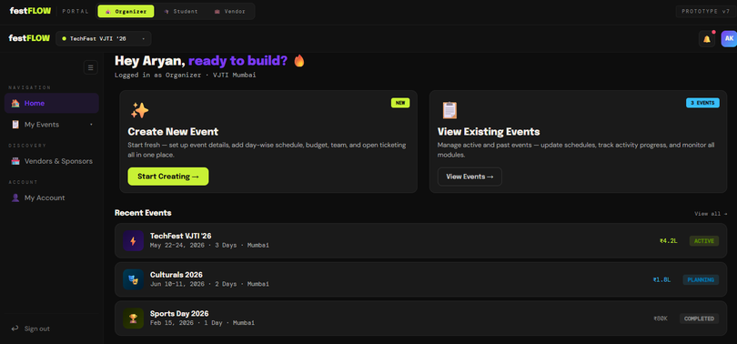
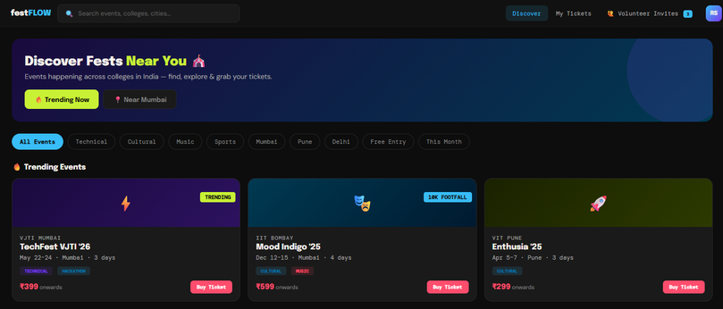
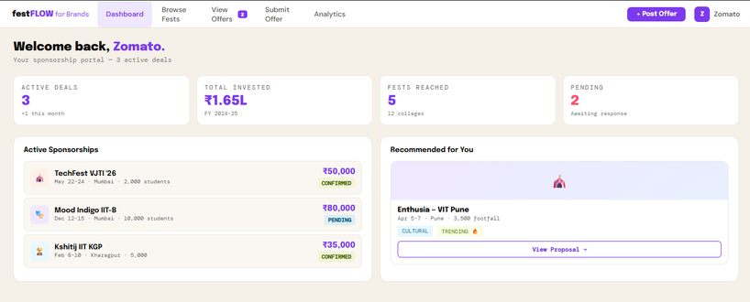
PROTOTYPE — v1
Three portals. One unified platform.
🎪 ORGANIZER PORTAL
🎓 STUDENT PORTAL
💼 VENDOR PORTAL
Dashboard with live fest stats & alerts
Fest discovery & event schedule
Incoming offer cards with deal terms
Budget tracker with expense categories
Ticket selection with tier pricing
Accept / Counter / Decline workflow
Vendor browsing & deal management
Volunteer invite accept / decline
Perk package visibility
Sponsorship pipeline with tier tracking
Personal account & ticket history
Booking status dashboard
Team & volunteer management
Live interactive prototype available at request.

Slide 10




CONCLUSION
Why FestFlow. Why Now.
Clear Problem
Full Solution
4,300+ college fests run on WhatsApp and spreadsheets. The pain is real, widespread, and unaddressed.
FestFlow is the only platform that covers the entire fest lifecycle — budgeting, vendors, tickets, teams, and sponsors.
Viable Business
Ready to Launch
Multiple revenue streams: subscription + ticketing + vendor commissions. Year 1 target: ~₹6 Lakhs.
Prototype v7 is complete. Three portals — Organizer, Student, Vendor — fully functional and demo-ready.

Slide 11
FUTURE SCOPE
The roadmap beyond v1.
Phase 1
0–6 Months
Phase 2
6–18 Months
Phase 3
18–36 Months
Launch in Maharashtra & Karnataka
Expand to Delhi, Tamil Nadu, Telangana
Pan-India rollout across all states
Onboard 40–60 fests
Unlock Sponsor Connect marketplace
AI-powered budget recommendations
University license pilots (5 institutions)
Mobile app for students (Android first)
Vendor rating & review system
Refine vendor commission flow
Analytics dashboard for organizers
FestFlow for schools & corporate events
festFLOW · From Chaos to Celebration — One Platform for Every Fest.

Slide 12
Thank You
TEAM FESTFLOW
festFLOW · From Chaos to Celebration — One Platform for Every Fest.

