Slide 1


Submitted To: Prof. Anukreeti Chaudhary
Subject: UI/UX
Submitted by: Tanvi Dave -242126
Shubhangni Chawla - 242119
Kavya Gajjar - 242164
Akanksha Rajpurohit - 242111
Pari Rangrej - 242118
B.Tech - Division D
snapdeal
UI/UX Revamp Proposal
A comprehensive analysis of usability problems and a redesigned experience
E-COMMERCE · UNICORN STARTUP · UI/UX REDESIGN

Slide 2
STARTUP OVERVIEW
About Snapdeal
🛒
📅
👥
🏪
E-Commerce
2010
100M+
500K+
Industry
Founded
Users
Sellers
Online Retail
New Delhi, India
Registered Buyers
Partner Merchants
Snapdeal is an Indian e-commerce unicorn founded in 2010 by Kunal Bahl and Rohit Bansal. Initially a daily deals platform, it pivoted to become a full-fledged online marketplace. Despite stiff competition from Amazon and Flipkart, Snapdeal serves millions of value-conscious shoppers across India — particularly in Tier 2 and Tier 3 cities — offering products across 800+ categories.
Target Users: Budget-conscious shoppers, first-time online buyers, and semi-urban/rural consumers aged 18–40.

Slide 3
CURRENT UI/UX ANALYSIS
5 Key Usability Problems Identified
01
04
Cluttered Homepage & Visual Noise
Confusing Navigation Structure
The original Snapdeal homepage overwhelms users with too many banners, promotions, and product grids all competing for attention simultaneously. There is no visual hierarchy guiding the user's eye — resulting in high cognitive load and decision fatigue.
Category navigation is buried and inconsistently placed. Users cannot easily browse by category from the home screen; mega-menus are slow and overcrowded, increasing the time-to-product and dropout rates.
02
05
Outdated & Inconsistent Visual Design
Weak Product Detail Page (PDP)
Typography, color usage, button styles, and card layouts vary inconsistently across pages. The UI feels dated compared to modern e-commerce standards, reducing perceived trustworthiness and brand quality.
Product pages display insufficient imagery, poor image zoom, vague descriptions, and unclear CTAs. Trust signals like verified reviews, delivery estimate, and return policy are not prominently visible, reducing purchase confidence.
03
Poor Search Experience
Search results lack proper filtering, sorting, and relevance ranking. Users searching for specific products receive irrelevant or poorly organized listings with no quick-filter sidebar, making product discovery frustrating.

Slide 4
REVAMP PROPOSAL
Design Improvements Based on UX Principles
🎯
🎨
🔍
Clear Visual Hierarchy
Consistent Design System
Enhanced Search & Filters
Applied Gestalt principles — size, contrast, and whitespace guide the user's eye from hero banner to categories to products. Reduced visual clutter significantly.
Unified color palette (Red #E8344A, Navy #1a1a2e), consistent typography, standardized button sizes, card corners, and spacing grid across all pages.
Prominent search bar with autocomplete, left-side filter panel (price, rating, brand, delivery), and relevance-sorted results with clean product cards.
🧭
📦
📱
Simplified Navigation
Trust-First PDP Design
Mobile-First Approach
Sticky top navbar with category icon strip, clear breadcrumbs, and a redesigned mega-menu with visual category cards instead of plain text links.
Product pages now highlight delivery dates, return policy, verified reviews, and image zoom prominently. Bold CTA buttons with clear price hierarchy.
All screens designed responsive-first. Bottom navigation bar for mobile, touch-friendly tap targets (min 44px), and thumb-zone optimised layouts.

Slide 5
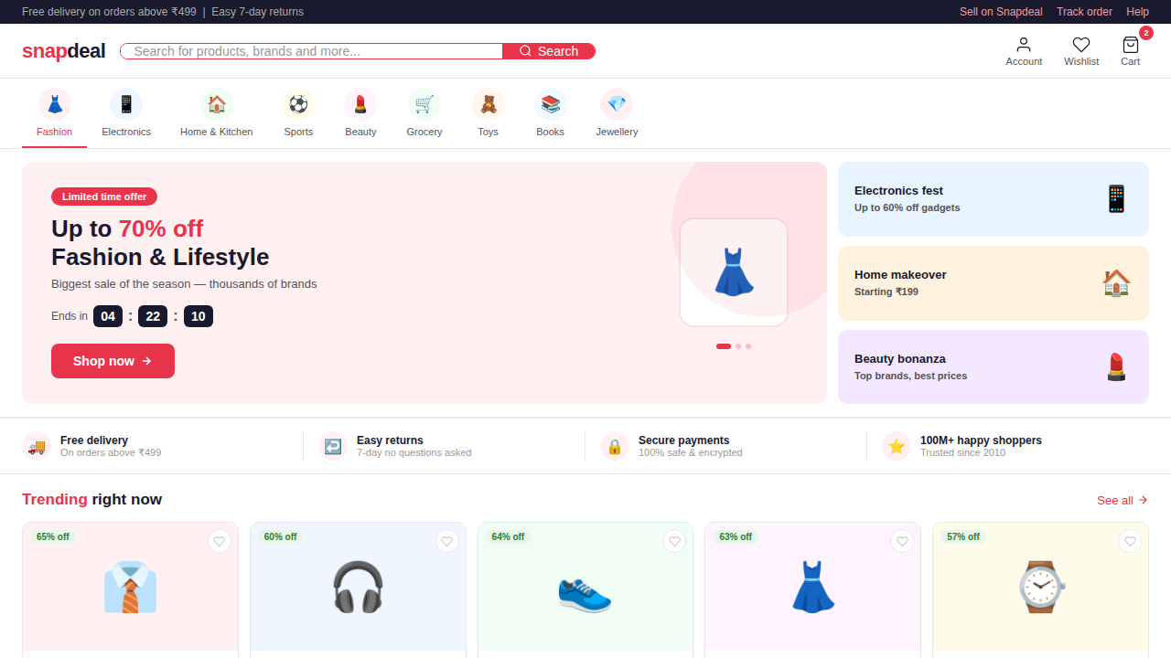
PROTOTYPE — HOMEPAGE
What Changed
Clean sticky navbar with prominent search
Category strip with emoji icons for quick scanning
Hero banner with countdown timer for urgency
5-column product grid with consistent cards
Trust bar: Free delivery, Easy returns, Secure payments
Dark footer with quick links and app badges

Slide 6
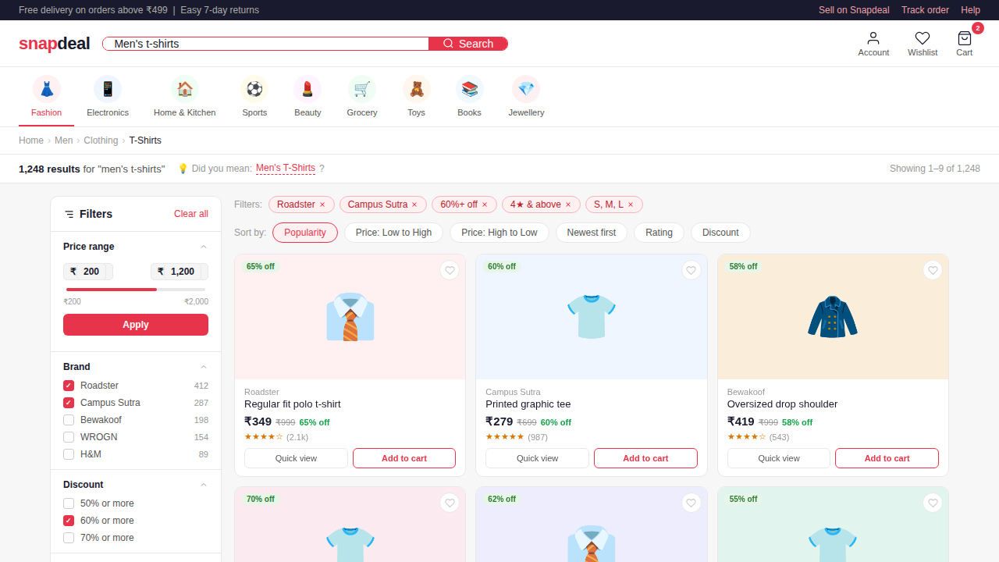
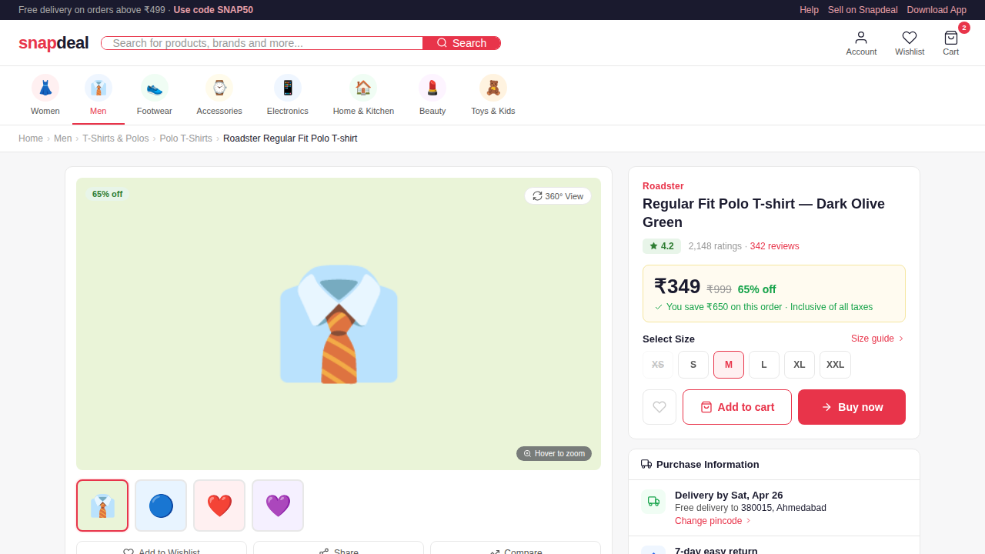
PROTOTYPE — SEARCH & PRODUCT DETAIL
Search & Listing Page
Product Detail Page (PDP)
Filter sidebar · Sort bar · Product grid
Image gallery · Price · Trust signals · CTA

Slide 7
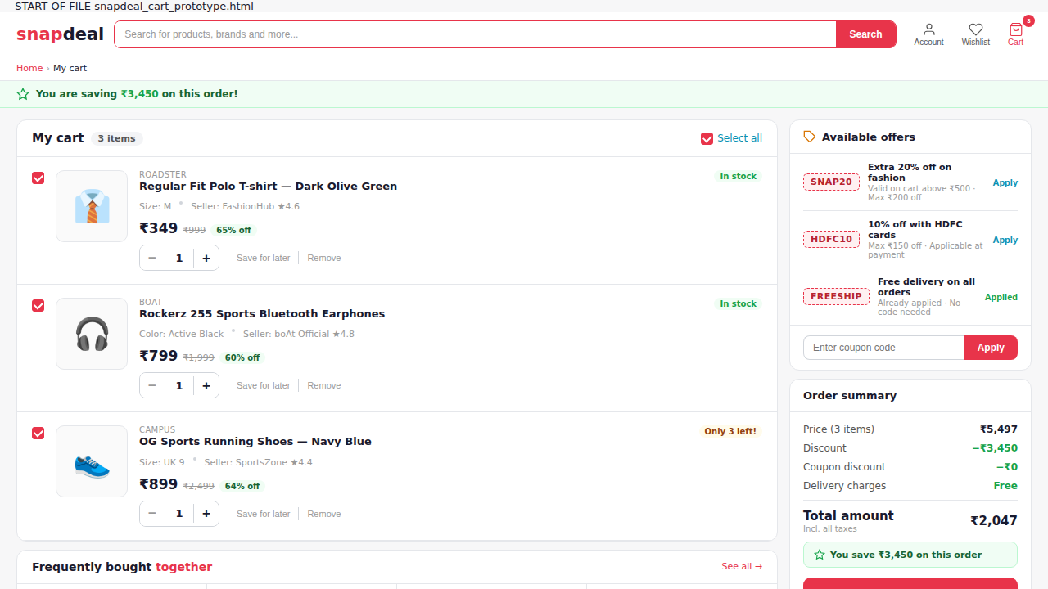
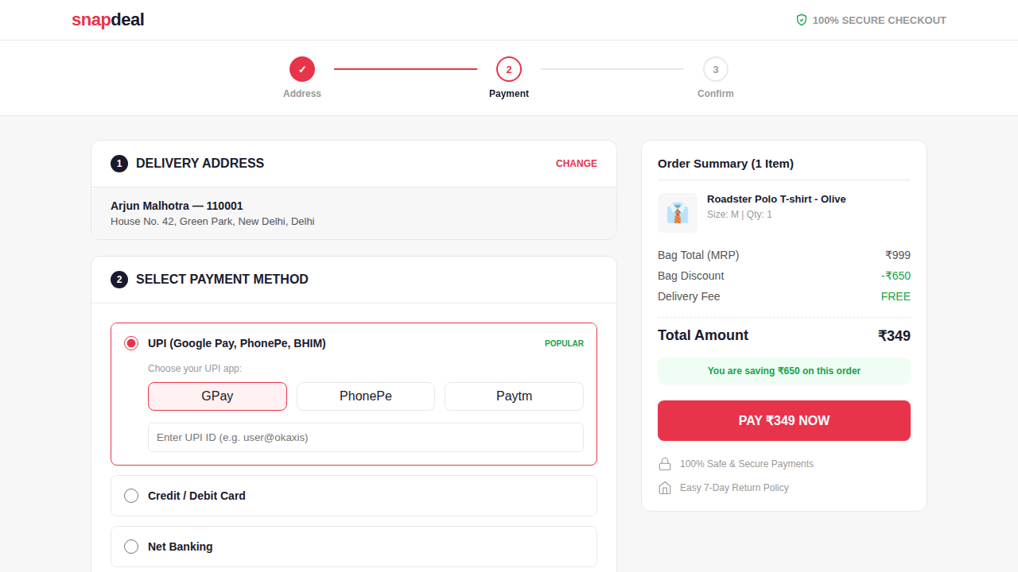
PROTOTYPE — CART & CHECKOUT FLOW
Cart Page
Checkout Page
Item summary · Promo code · Order total
Address · Payment · Order summary panel

Slide 8
BEFORE vs AFTER COMPARISON
❌ Current Snapdeal
✅ Revamped Design
Cluttered homepage, no hierarchy
→
Clean layout with clear visual flow
Inconsistent fonts, colors, spacing
→
Unified design system throughout
Basic search, no filter sidebar
→
Smart search + multi-filter panel
Confusing mega-menu navigation
→
Sticky navbar + icon category strip
Weak PDP, unclear CTAs
→
Trust-first PDP with bold CTAs
No mobile-optimised design
→
Fully responsive, thumb-friendly UI

Slide 9
Conclusion
This revamp addresses Snapdeal's core usability gaps by applying proven UX principles — visual hierarchy, consistency, and trust design. The redesigned prototypes demonstrate a modern, clean, and conversion-focused experience that can help Snapdeal better compete in India's hyper-competitive e-commerce market.
5 critical usability problems identified
6 UX-principle-backed improvements proposed
5 interactive HTML prototypes created
Full user journey: Home → Search → PDP → Cart → Checkout

Slide 10
Thank You
Team : Tanvi Dave
Shubhangni Chawla
Kavya Gajjar
Akanksha Rajpurohit
Pari Rangrej

