Slide 1
PAYTM BUILD FOR INDIA AI HACKATHON • MUMBAI EDITION
Paytm AI: Voice & Contextual Memory
for 30 Million Bharat Merchants
Triple-Track Autonomous AI Solution | Powered by Sarvam AI + Cognee + n8n
Track 1: VyaparDost (Voice Store Copilot) | Track 2: JanSuraksha (60s Micro-Claims) | Track 3: OpsGuard (Dispute Teammate)
Event Date: 3rd October 2026 • Mumbai, India • Team Submission Deck

Slide 2
PAYTM BUILD FOR INDIA AI HACKATHON • MUMBAI EDITION (OCT 3)
The Problem in Bharat: 30M Shopkeepers Left Behind by Text AI
1. Linguistic & Literacy Barrier
• 80%+ shopkeepers in Tier 2/3/4 operate exclusively in regional languages (Hindi, Marathi, Gujarati).
• Complex fintech apps and keyboards create severe operational friction.
• Shopkeepers want to talk to their business, not type numbers into spreadsheets.
2. Cashflow & Working Capital Blindspots
• Merchants lack formal bookkeeping and real-time cashflow visibility.
• Seasonal sales spikes and festival inventory runs lead to sudden stockouts.
• Micro-insurance & working capital loans require weeks of tedious paperwork.
3. Payment Disputes & Downtime Frustration
• Failed UPI transfers or chargebacks leave merchants feeling helpless.
• Calling customer care wastes hours of peak business time.
• Hardware soundbox issues disrupt daily shopkeeper trust and revenue.

Slide 3
PAYTM BUILD FOR INDIA AI HACKATHON • MUMBAI EDITION (OCT 3)
The Winning Formula: 100% Partner Tech Stack Synergy
SARVAM AI
Indic Voice Intelligence
• High-fidelity Indian English, Hindi, Marathi, Gujarati STT/TTS
• Seamless voice streaming with authentic regional accents
• Zero app friction: Merchants speak and listen via Paytm Soundbox
COGNEE
Contextual Memory Graph
• Dynamic knowledge graphs mapping merchant cashflow history
• Transaction stability, fraud geolocation maps, and vendor relationships
• Instant context recall for zero-hallucination decisions
N8N
Autonomous Agent Orchestrator
• Multi-agent event router executing real-world financial actions
• Automated WhatsApp coupon dispatch & customer retention
• Instant UPI refund & claims payout triggers (<60 seconds)
PAYTM ECOSYSTEM
Hardware & Core APIs
• Soundbox 4.0 / Voicebox live audio output & mic hardware
• Paytm Merchant POS & QR dynamic transaction feed
• Paytm Postpaid, Wallet & Instant UPI Disbursal Gateway

Slide 4
PAYTM BUILD FOR INDIA AI HACKATHON • MUMBAI EDITION (OCT 3)
System Architecture: From Soundbox Voice to Real-World Settlement
LAYER 1: EDGE & CLIENT LAYER
Paytm Soundbox Mic/Speaker • Paytm Merchant Mobile App • QR Scanner & POS Telemetry
LAYER 2: INDIC VOICE GATEWAY
Sarvam AI Multilingual Speech-to-Text & Text-to-Speech (Hindi, Marathi, Gujarati, Telugu)
LAYER 3: CONTEXTUAL MEMORY GRAPH
Cognee Graph Engine: Merchant Ledger Graph, Geo-Risk Nodes, Customer Visit Frequency Graph
LAYER 4: MULTI-AGENT ORCHESTRATION
n8n Autonomous Decision Workflows: Disbursal Engine, WhatsApp Campaigner, Dispute Arbiter
LAYER 5: PAYTM CORE INFRASTRUCTURE
Paytm UPI Instant Settlement Gateway • Postpaid Micro-Credit • Merchant Wallet API

Slide 5
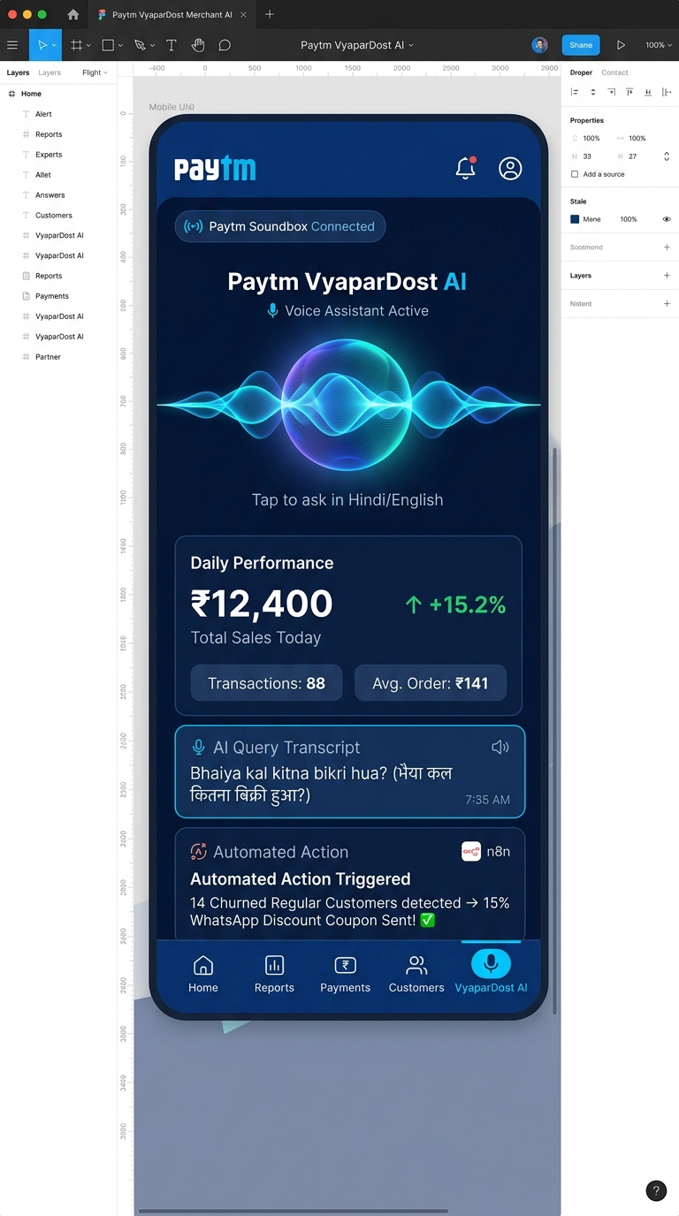
PAYTM BUILD FOR INDIA AI HACKATHON • MUMBAI EDITION (OCT 3)
Track 1: Paytm VyaparDost — Autonomous Voice Store Copilot
CORE INNOVATIONS FOR 30M SHOPKEEPERS
1. Conversational Voice Financial Insights
Merchant asks in Hindi: 'Aaj kitna dhandha hua? Kal ka kya plan hai?' Sarvam AI transcribes speech, Cognee queries the merchant's financial knowledge graph, and Paytm Soundbox vocalizes concise Hindi audio analysis.
2. Autonomous Customer Retention via n8n
n8n tracks repeat customer QR scans. If a regular customer hasn't visited in 14 days, the AI orchestrator automatically creates and dispatches a personalized WhatsApp discount coupon in their native language.
3. Predictive Inventory & Festival Purchasing
Graph memory detects festival surges (Diwali, Eid, Ganesh Utsav) and warns of stockouts 5 days in advance, providing automated supplier price comparisons and post-paid credit recommendations.

Slide 6
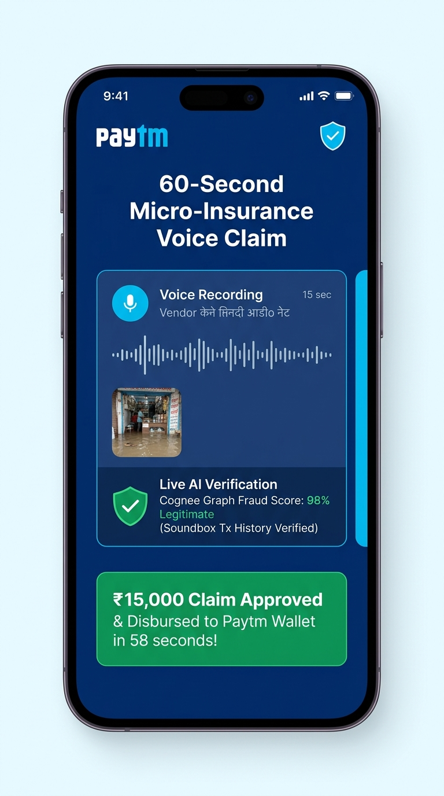
PAYTM BUILD FOR INDIA AI HACKATHON • MUMBAI EDITION (OCT 3)
Track 2: Paytm JanSuraksha AI — 60-Second Micro-Claims & Micro-Lending
ZERO-PAPERWORK FINANCIAL SECURITY FOR BHARAT
1. 15-Second Voice Claim Submission
Street vendors and stall owners file weather/flood damage claims using a quick voice note in their native tongue + a single camera snap. Zero forms, zero bureaucratic delay.
2. Cognee Multi-Graph Fraud Engine
Instead of slow manual assessors, Cognee validates the claim against historical Soundbox activity patterns, local meteorological flood feeds, and shop geolocation consistency scores.
3. Instant 60-Second Claim Payout via UPI
Upon AI verification, n8n executes the automated disbursal webhook to Paytm UPI / Wallet in under 60 seconds, restoring merchant business continuity on the exact same day.

Slide 7
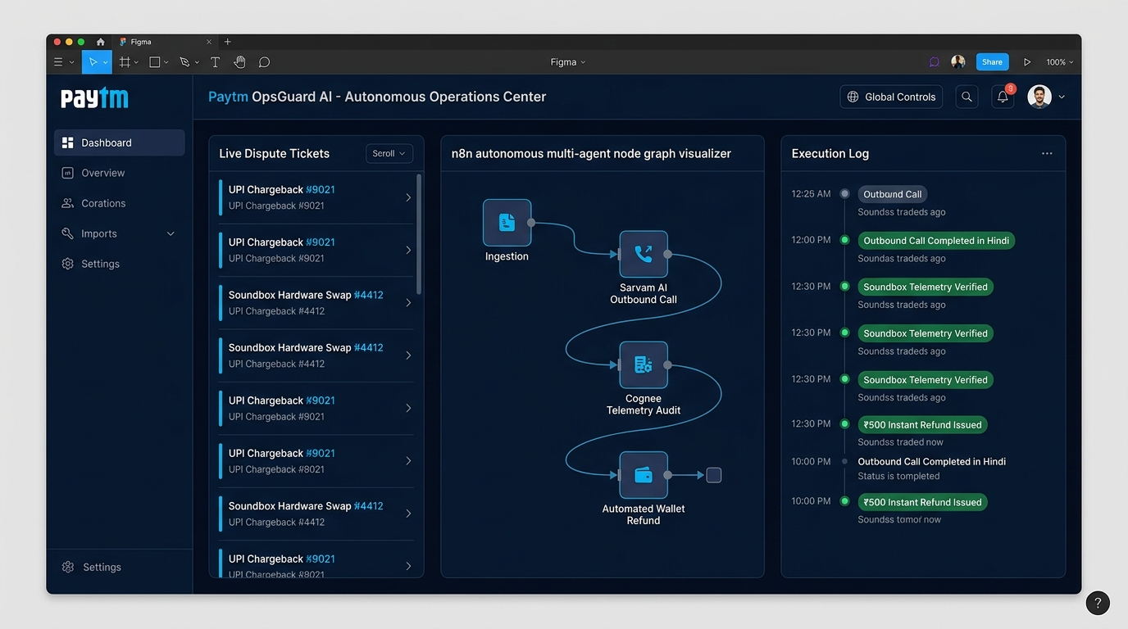
PAYTM BUILD FOR INDIA AI HACKATHON • MUMBAI EDITION (OCT 3)
Track 3: Paytm OpsGuard AI — Autonomous AI Operations Teammate
AUTONOMOUS RESOLUTION FOR HARDWARE & DISPUTES
1. Multi-Agent UPI Dispute Ingestion
Failed UPI debits or merchant chargebacks are ingested instantly by n8n and categorized with sub-second accuracy.
2. Outbound Native Voice Verification
When transaction status is ambiguous between banking rails, Sarvam AI triggers an autonomous outbound phone call to the customer/merchant in their regional dialect to confirm transaction context.
3. Self-Healing Hardware Logistics
Identifies faulty Soundbox battery or SIM errors via IoT diagnostics and automatically dispatches replacement units via logistics webhooks.

Slide 8
PAYTM BUILD FOR INDIA AI HACKATHON • MUMBAI EDITION (OCT 3)
36-Hour Hackathon Execution Roadmap & Milestones
Hours 00 – 12
Foundation & Pipeline
• Sarvam AI Speech STT/TTS pipeline setup
• Simulated Paytm Soundbox & POS telemetry stream
• Schema ingestion into Cognee Knowledge Graph
• Initial Hindi/Marathi voice loop verification
Hours 12 – 24
Intelligence & Orchestration
• Connect Cognee memory graph to decision agent
• Build n8n multi-agent routers & triggers
• Wire WhatsApp Cloud API for automated coupons
• Implement <60s micro-claim validation pipeline
Hours 24 – 36
Polish & Live Pitch Readiness
• Live Soundbox hardware audio output test
• Full end-to-end voice scenario stress testing
• Edge case validation on dialect variations
• Pitch deck rehearsal & live jury QA setup

Slide 9
PAYTM BUILD FOR INDIA AI HACKATHON • MUMBAI EDITION (OCT 3)
Jury Evaluation Criteria & The On-Stage Demo Strategy
AI INNOVATION — Integrated Sarvam Voice + Cognee Graph Memory
Key Metric / Impact: 10+ Indic languages supported with sub-second voice latency
AUTONOMOUS ACTION — n8n multi-agent workflows executing real financial APIs
Key Metric / Impact: <60s end-to-end claim and refund disbursal time
PAYTM SYNERGY — Direct fit for Soundbox, Merchant App, QR and Postpaid
Key Metric / Impact: Addresses 30M+ active Paytm merchants immediately
STAGE 'WOW' FACTOR — Live voice conversation through actual Soundbox speaker
Key Metric / Impact: Real-time WhatsApp alert firing on audience phone
PRO-TIP FOR MUMBAI STAGE: Start the demo by speaking a live Hindi question to the Soundbox. Let the judges hear the Soundbox speak back in Hindi while showing the n8n execution graph live on the projector screen!

