Slide 1
VISUAL ANALYTICS OF AIRLINE DATA
BY-
SHUBHANKAN SHINDE

Slide 2

Table of Contents
INTRODUCTION
EXPLORE THE DATA
CALCULATIONS
VISUALIZATIONS
CONCLUSION

Slide 3
INTRODUCTION
This project aims to improve operational efficiency and elevate passenger experience in the airline industry by leveraging data-driven insights. Using Tableau for visual analytics, it examines important metrics such as travel time, stoppages, ticket prices, and market share from a rich dataset covering multiple airlines. The goal is to uncover patterns that impact airline performance and customer preferences, supporting better decision-making for both stakeholders and travelers. The report outlines the data exploration process, answers key business questions, and presents findings through impactful, easy-to-understand visualizations.

Slide 4
EXPLORE THE DATA
This section outlines the methods and visualizations applied in analyzing airline data using Tableau. It involves steps such as importing and cleaning the dataset, segmenting it by variables like airline and airport, and integrating dynamic parameters to compare flight durations. Each visualization is designed to reveal specific insights—for instance, identifying airlines with the highest travel time and stoppages, assessing ticket price variations, and exploring the relationship between stoppages and cost. Additional visuals illustrate patterns in flight frequency, pricing trends, market share, and departure timing. Altogether, this approach offers a structured and insightful view of airline operations through focused visual analysis.

Slide 5
CALCULATIONS
This section details the processes involved in cleaning, transforming, and preparing the airline dataset for analysis. Major steps included renaming columns for clarity, converting data types (such as formatting ticket prices as currency), and splitting specific fields to enable more granular analysis of stoppage times. Redundant data was removed, and date/time fields were properly formatted to support time-based insights. Geocoding was also applied to enable spatial analysis using airport locations. Several calculated fields were developed to extract key metrics, such as average waiting time per stop, total stoppages, cumulative delay time, and cost per flight hour. Additionally, dynamic parameters were introduced—such as a travel time slider—allowing users to interactively explore performance across different flight durations. These enhancements, combined with table calculations and comparative views, helped produce highly interactive and informative visualizations.

Slide 6
VISUALIZATIONS

Slide 7
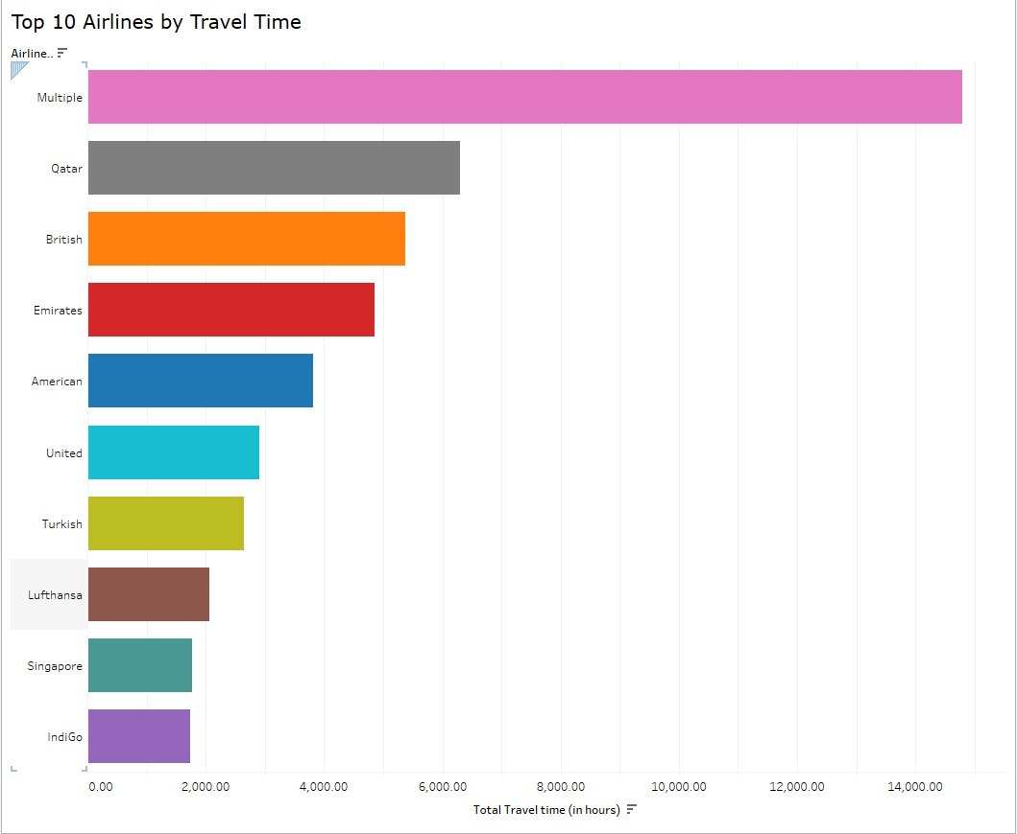
Q1: WHICH AIRLINE HAS THE MOST TOTAL TRAVEL TIME?
“Multiple" airlines have the highest total travel time, followed by Qatar Airways, reflecting extensive long-haul operations.
Insight: High cumulative travel time indicates broad route networks, possibly driven by codeshare agreements or alliance partnerships.

Slide 8
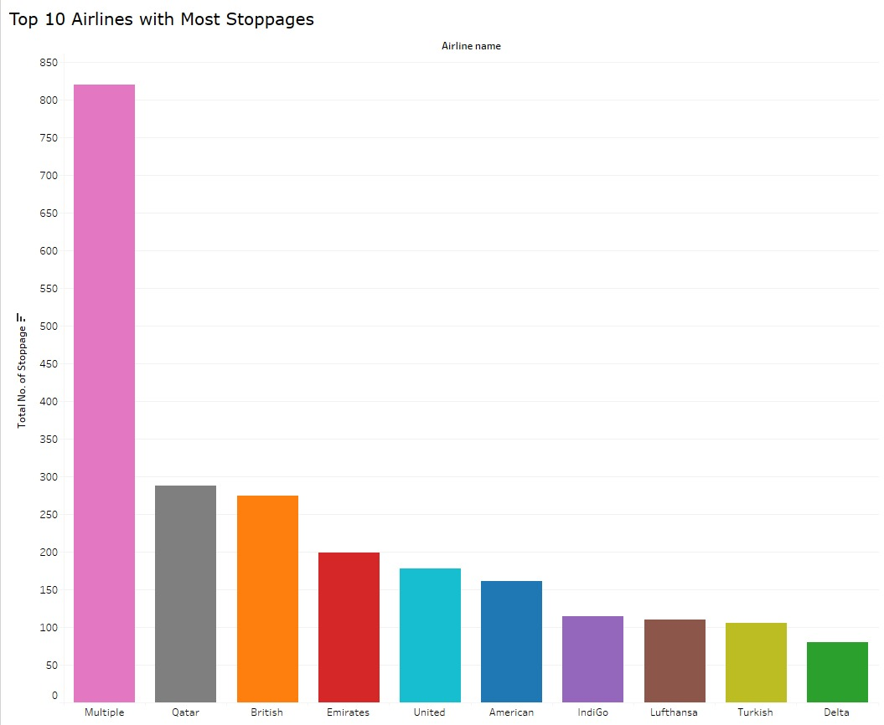
Q2: WHICH AIRLINE HAS THE MOST STOPPAGES?
The "Multiple" category leads in stoppages, with Qatar Airways also showing a high number due to its global hub strategy.
Insight: A higher number of stops may reflect a hub-and-spoke model, offering wider connectivity but potentially longer journeys for passengers.

Slide 9
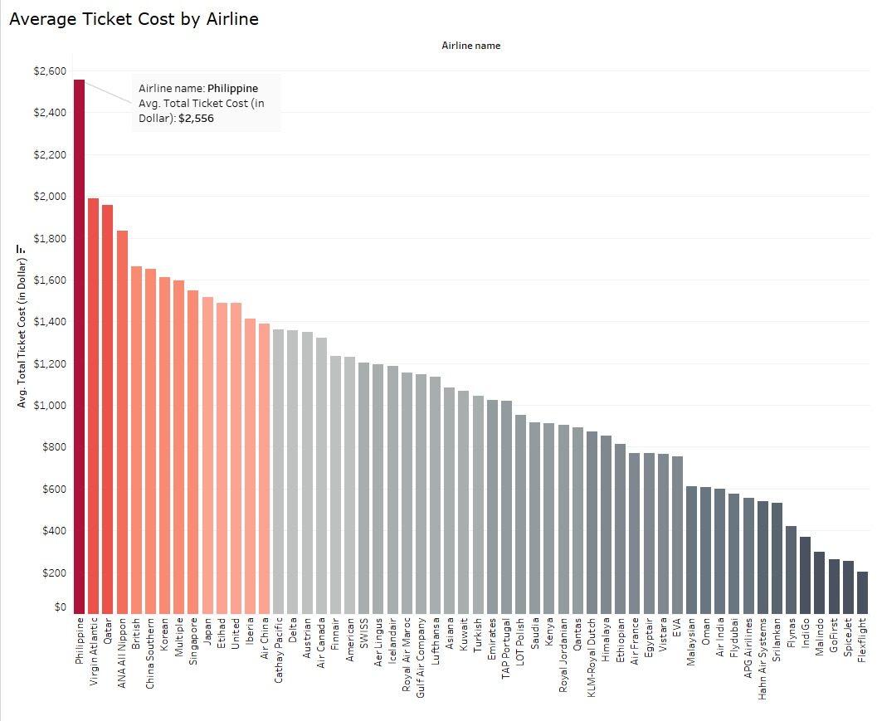
Q3: WHICH AIRLINE HAS THE HIGHEST AVERAGE TICKET COST?
Philippine Airlines records the highest average ticket cost across all airlines in the dataset.
Insight: This may be driven by exclusive long-haul routes, premium service positioning, or limited competition on select corridors.

Slide 10
Q4: HOW DOES THE NUMBER OF STOPPAGES AFFECT TICKET COST?
Flights with one stop have the highest total ticket cost, followed by two-stop and three-stop flights. Surprisingly, nonstop flights are the cheapest, likely due to fewer available options or data concentration.
Insight: While passengers may assume nonstop is pricier, data shows that operational factors like layovers and fuel costs on multi-stop flights drive prices up. Airlines can analyze whether adding direct routes might attract price-sensitive travelers.

Slide 11
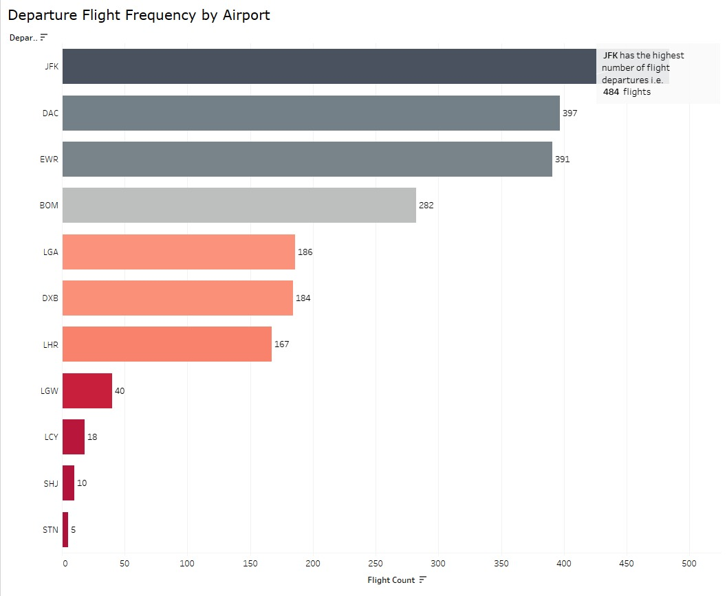
Q5: WHICH AIRPORT HAS THE HIGHEST NUMBER OF FLIGHT DEPARTURES?
JFK Airport leads with the highest flight departures, followed by DAC and EWR.
Insight: JFK’s dominance aligns with its status as a major global hub. High flight frequency implies the need for efficient scheduling, optimized gate allocation, and well-planned infrastructure to reduce congestion.

Slide 12
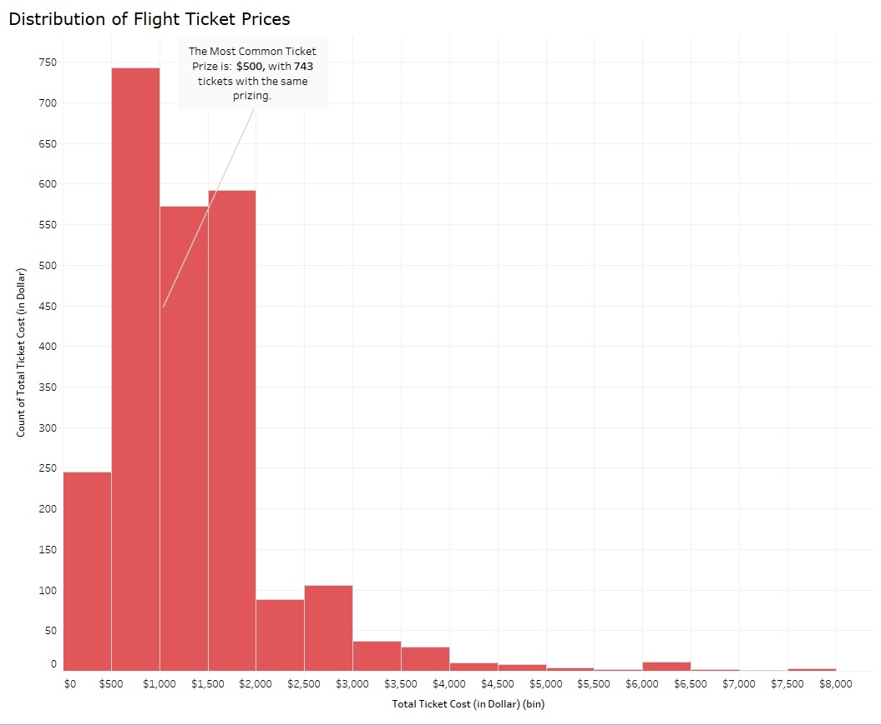
Q6: WHAT IS THE MOST COMMON PRICE RANGE FOR FLIGHT TICKETS?
The $500 price point is the most frequent, with 743 tickets sold in this range.
Insight: This suggests a pricing sweet spot where both passengers and airlines find mutual value. Airlines might target this range to balance affordability and profitability.

Slide 13
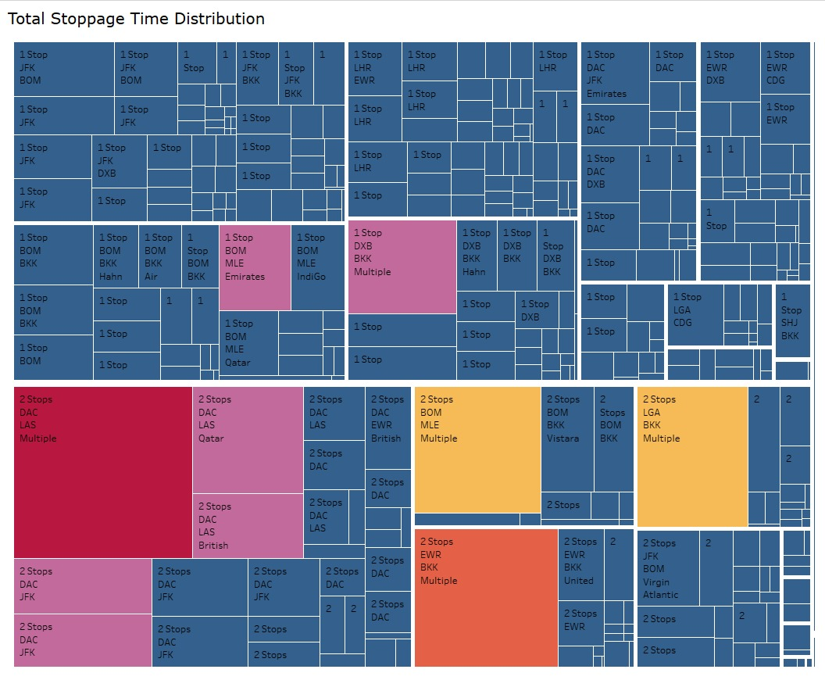
Q7: HOW IS STOPPAGE TIME DISTRIBUTED ACROSS DIFFERENT FLIGHTS AND AIRLINES?
The Tree Map shows that DAC (Dhaka) has the longest total stoppage time among all airports.
Insight: This highlights operational inefficiencies at specific hubs. Airlines can use this to reassess layover scheduling and work with airports to streamline processes.

Slide 14
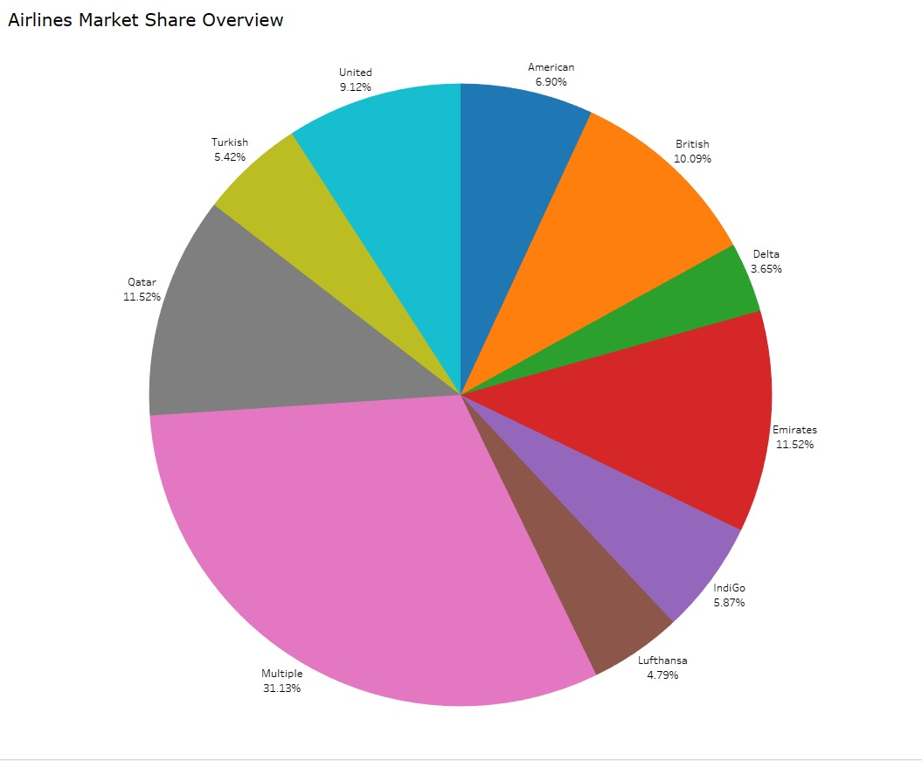
Q8: HOW IS THE MARKET SHARE DISTRIBUTED AMONG TOP AIRLINES?
The "Multiple" category leads the pie chart, followed by Qatar Airways, Emirates, and British Airways.
Insight: Code-shared and partner flights dominate, showing the strength of airline alliances. Larger players leverage scale and hub locations to capture a wider market.

Slide 15
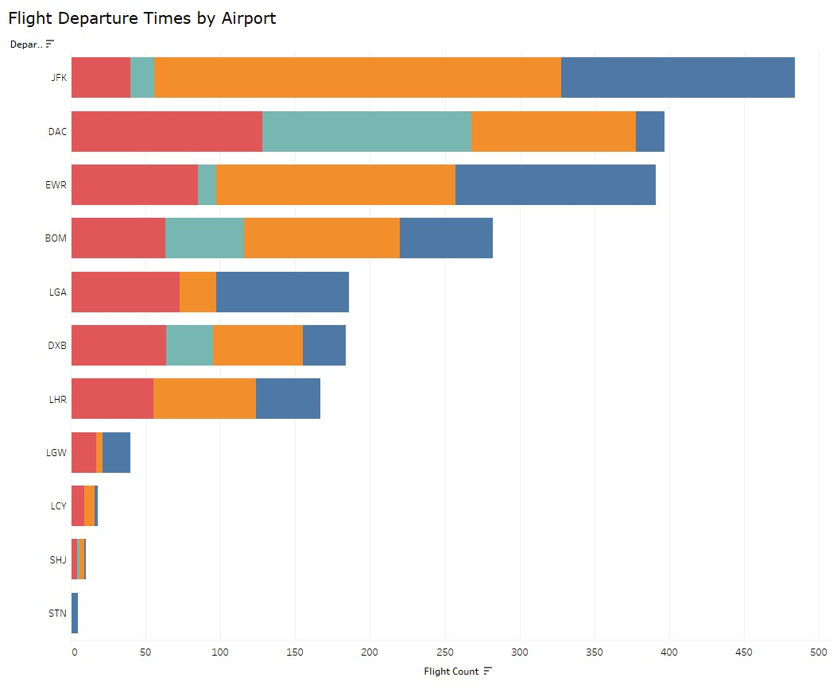
Q9: WHAT ARE THE PEAK DEPARTURE TIMES AT MAJOR AIRPORTS?
Evening departures dominate, especially from JFK, where the orange segment peaks.
Insight: Airlines schedule long-haul and international flights in the evening. Airports can allocate staff and gate availability accordingly to avoid delays and crowding.

Slide 16
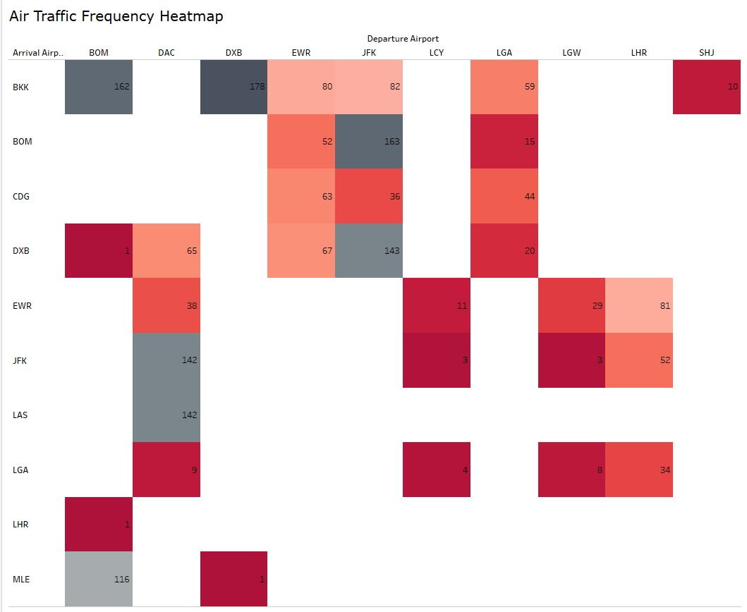
Q10: WHAT PATTERNS CAN BE OBSERVED IN AIR TRAFFIC FREQUENCY BETWEEN DIFFERENT AIRPORTS?
Routes like DAC → DXB and BOM → DXB have the highest flight frequencies.
Insight: This indicates strong economic or labor travel demand. Airlines should continue prioritizing high-demand routes and could explore premium services or larger aircraft.

Slide 17
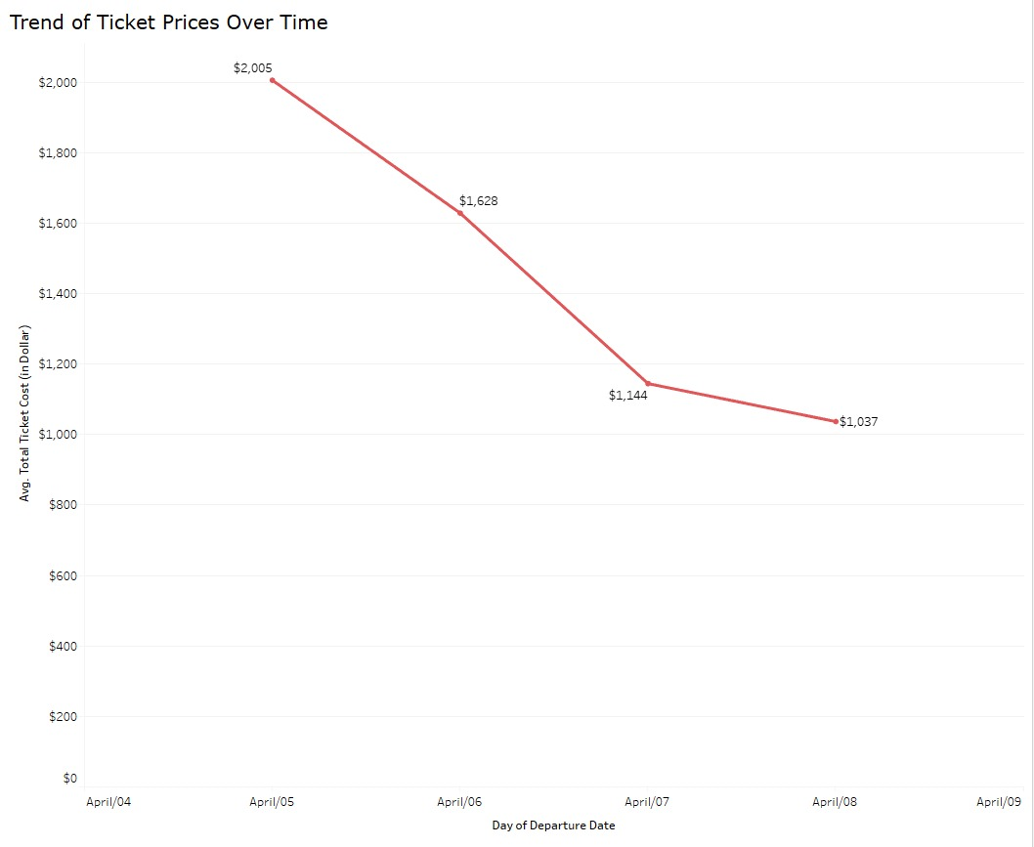
Q11: HOW DO TICKET PRICES CHANGE OVER TIME?
The line chart shows a drop from $2,005 to $1,037 over 4 days.
Insight: Prices decrease as departure approaches, possibly due to demand shifts or yield management strategies. Passengers could benefit from last-minute deals, but airlines should monitor over-discounting.

Slide 18
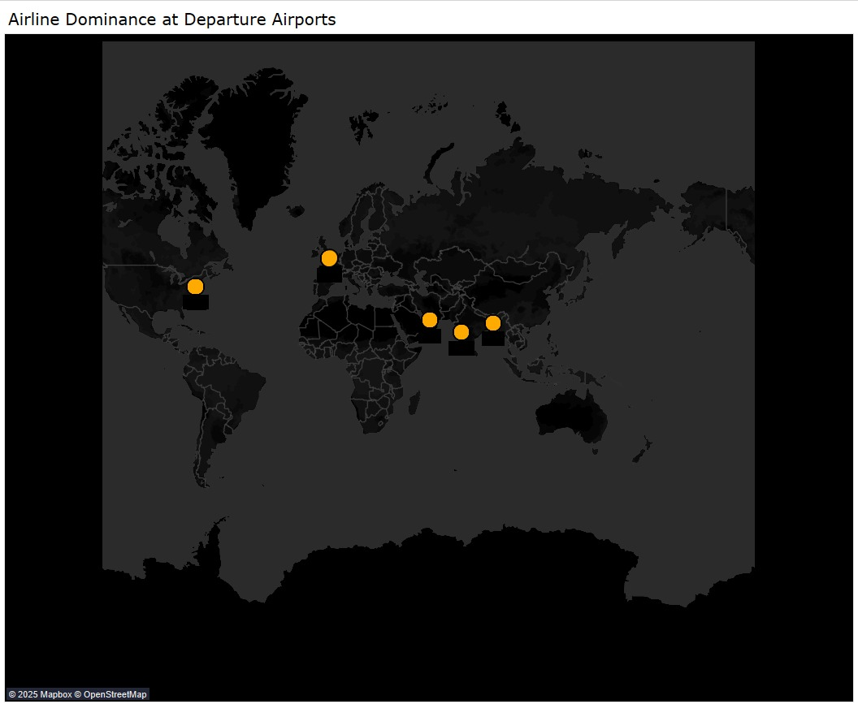
Q12: WHICH AIRLINE HAS THE DOMINANCE AT WHICH DEPARTURE AIRPORT?
Air India dominates at Mumbai (BOM), while IndiGo leads at Sharjah (SHJ).
Insight: Airlines are focusing on regional hubs for high-demand corridors, especially India–Middle East travel. These insights help in planning gate capacity and crew allocation.

Slide 19
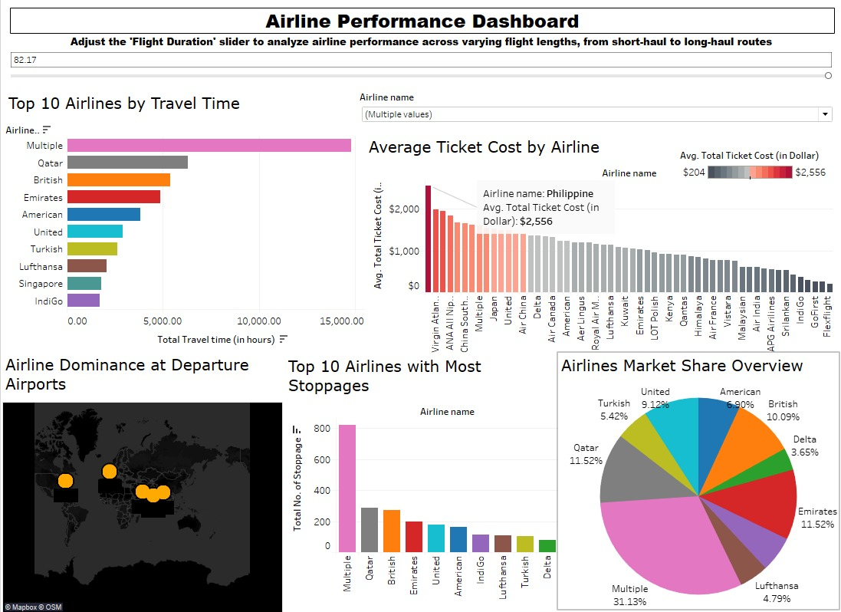
AIRLINE PERFORMANCE DASHBOARD
Interactive summary of performance metrics
- Flight Duration Parameter for customized insights
- Charts link cost, delays, airport dominance, and traffic
- Helps with route optimization and airport operations
- Supports strategic airline decisions

Slide 20
CONCLUSION
This analysis of airline data reveals key operational and pricing patterns that can guide strategic decision-making. The dominance of the "Multiple" category in both travel time and stoppages highlights the growing influence of airline alliances and shared routes. Philippine Airlines' high average ticket cost suggests a premium positioning or niche market targeting. Additionally, one-stop flights were found to be more expensive than nonstop or multi-stop options, indicating a need for route optimization. Evening flight peaks at major airports like JFK call for improved scheduling and resource allocation. The clear dominance of certain airlines on specific international routes, such as Air India and IndiGo on India Middle East corridors, underscores the importance of route specialization. Overall, leveraging these insights can help airlines enhance efficiency, improve passenger satisfaction, and align services with market demand.

Slide 21
THANK YOU

