Slide 1
IMDb Top 1000 Movies - Power BI Dashboard
SHUBHANKAN SHINDE

Slide 2
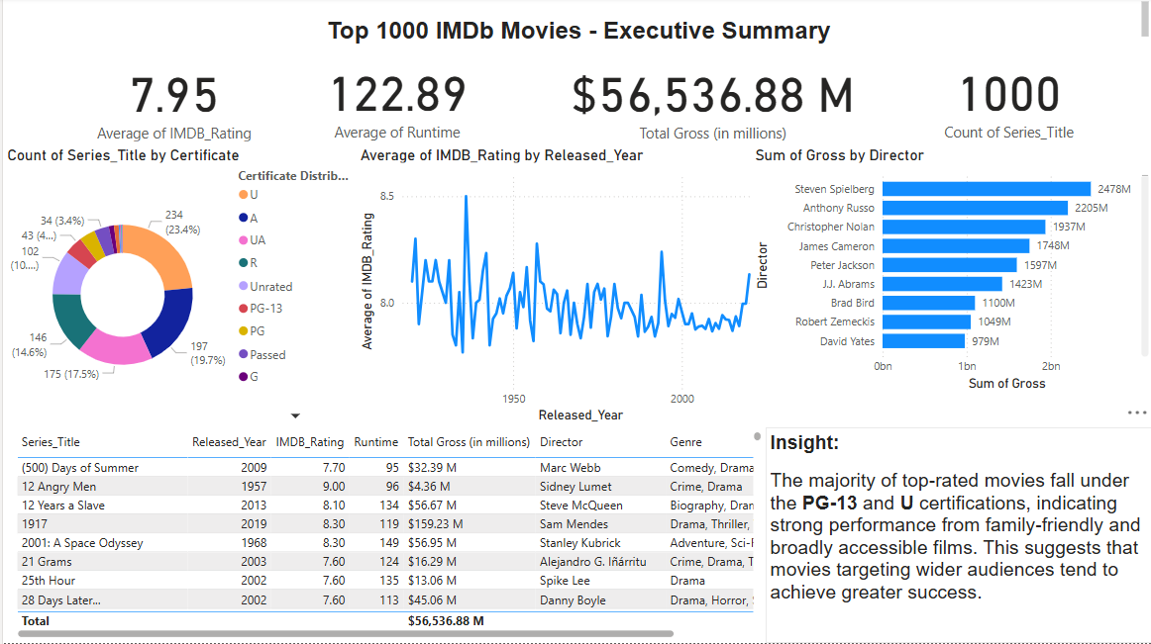
Interactive Power BI Dashboard
1.Aggregated top 1000 IMDb movie data across genres and decades.
2. Visualizes KPIs including: - Average IMDb Rating
- Average Runtime - Total Gross (in $Millions) - Total Series Titles
3.Includes interactive visuals: - Ratings over Time (Line Chart) - Certificate Breakdown (Donut Chart) - Top Directors by Gross (Bar Chart)
4.Dynamic filters allow slicing by year, genre, rating,certificate, and director.
5.Supports users in identifying high-quality films based on performance metrics.

Slide 3
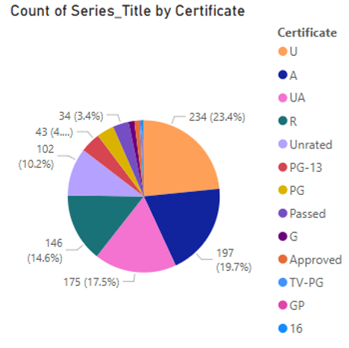
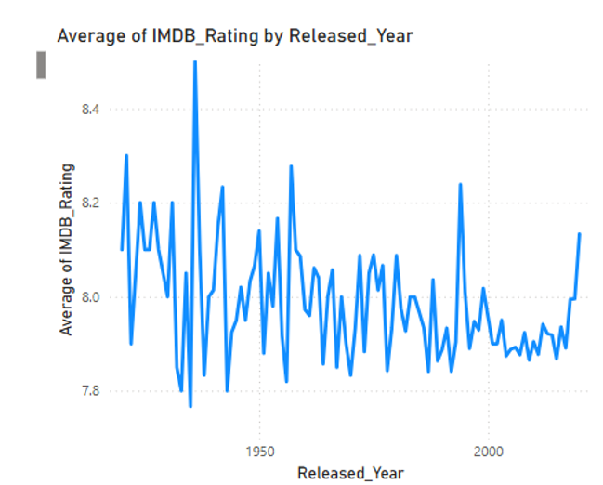
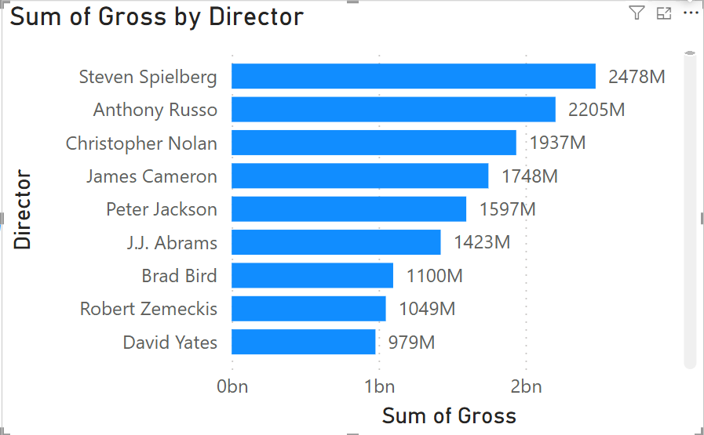
Key Insights from the Dashboard
Average IMDb Rating: 7.95
Total Gross Revenue: $56.54B
Average Runtime: 122.89 minutes
Total Titles Analyzed: 1000
Top Certifications: U rated movies dominate.
Rating Trends: Peaks observed around the 1900s.
Top Directors: Spielberg, Nolan, and Russo lead in gross revenue.

Slide 4
Actionable Decisions from Insights
Recommendation Engine for Viewers: The dashboard reveals that PG-13 and U certified movies consistently perform best in both ratings and gross. Platforms like Netflix or Prime could build filters or recommendation engines around these certifications, helping users pick high-quality, family-accessible content.
Genre-Based Promotion Strategy: Drama and Drama-Romance dominate the dataset in volume and ratings. Marketing efforts for classic or emotional titles can be prioritized on streaming platforms, especially during awards season or themed content weeks.
Director-Specific Campaigns: Steven Spielberg, Christopher Nolan, and Anthony Russo top the list in gross. Platforms or cinemas can create spotlight campaigns or collections focused on these directors, leveraging their high audience pull and legacy.
Runtime Optimization for Producers: Movies between 120–130 minutes have the highest ratings. Production studios can use this insight during planning to optimize storytelling within this range, balancing depth with viewer attention span.

Slide 5
THANK YOU

