Slide 1
Predicting Medical Insurance Costs Using Personal Attributes
Shubhankan Shinde
INT 6203 - Introduction to Machine Learning
Prof. Dr. Kamel Rushaidat
Date: 2024

Slide 2
Introduction
In this project, my goal is to predict the medical insurance costs of individuals based on various demographic and health attributes. This task is crucial for insurance companies because it helps in efficiently assessing and predicting client premiums. By leveraging machine learning, I aim to identify the factors that significantly influence insurance charges and develop a strong model for accurate cost prediction.
Objectives:
Build a model to predict insurance charges.
Identify key factors influencing insurance costs.

Slide 3
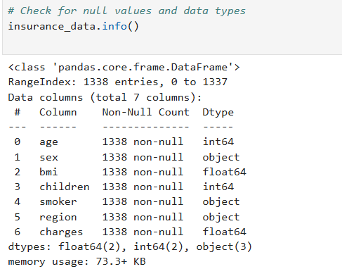
Data Overview
Shape: 1338 rows, 7 columns.
Data Types:
Numerical: age, bmi, children, charges
Categorical: sex, smoker, region
Missing Values: None (all columns have 1338 non-null entries).
Memory Usage: 73.3 KB.
Summary:
charges is the target column (insurance cost).
Clean dataset with mixed data types, ready for analysis.

Slide 4
Exploratory Data Analysis
Graphs Used:
1. Histograms: Show distribution of age, BMI, and charges.
2. Box Plots: Highlight smoker status and charges.
3. Correlation Heatmap: Show relationships between numerical features.
4. Pairplot: Visualize trends like smoker status and BMI with charges.

Slide 5
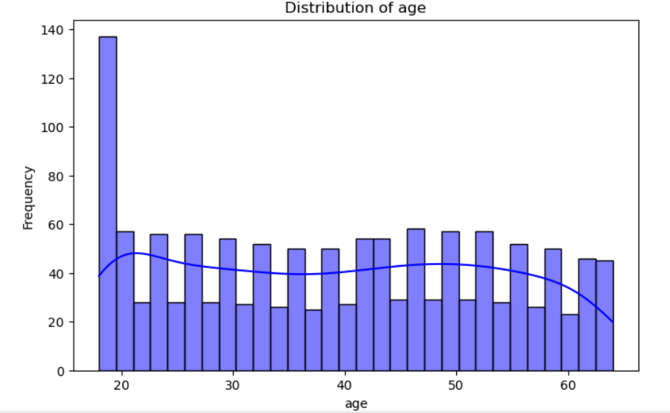
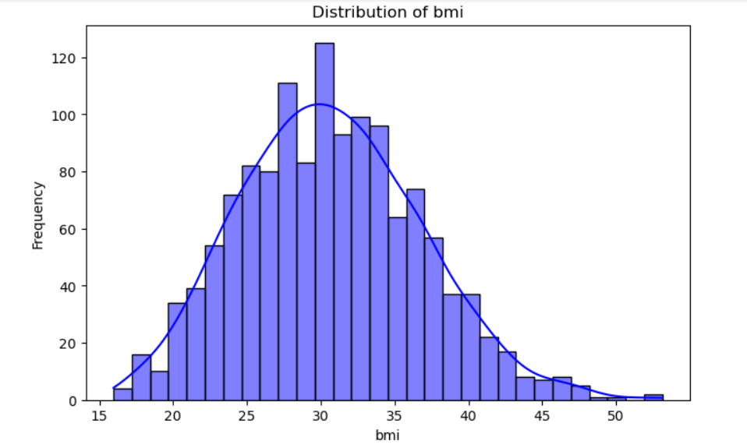
Histograms (Distribution of Numerical Features)

Slide 6
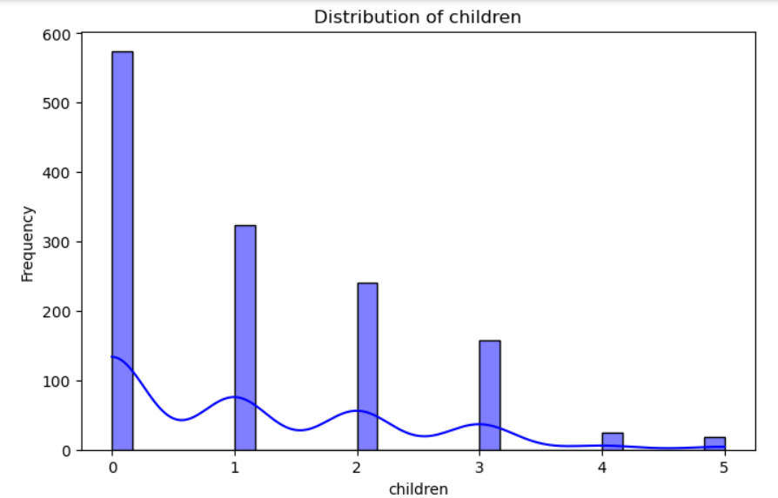
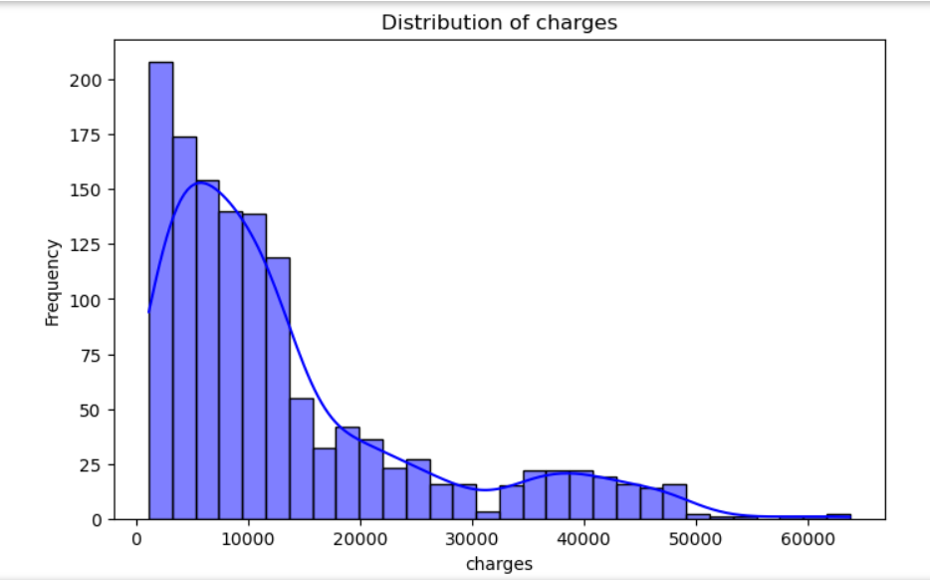

Slide 7
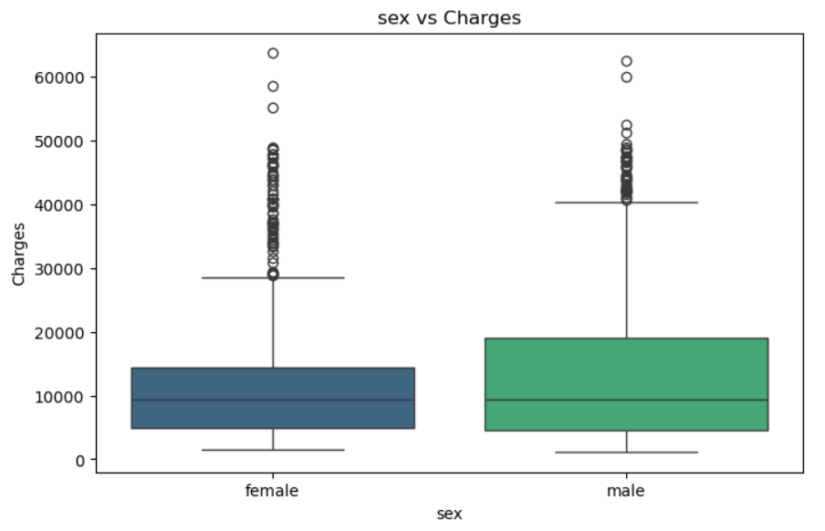
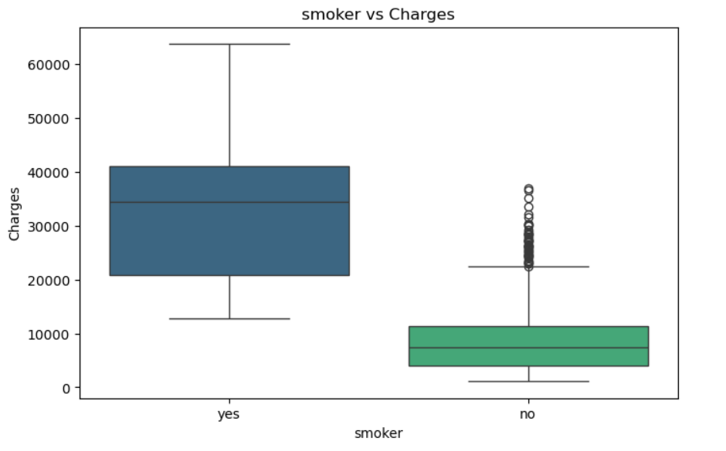
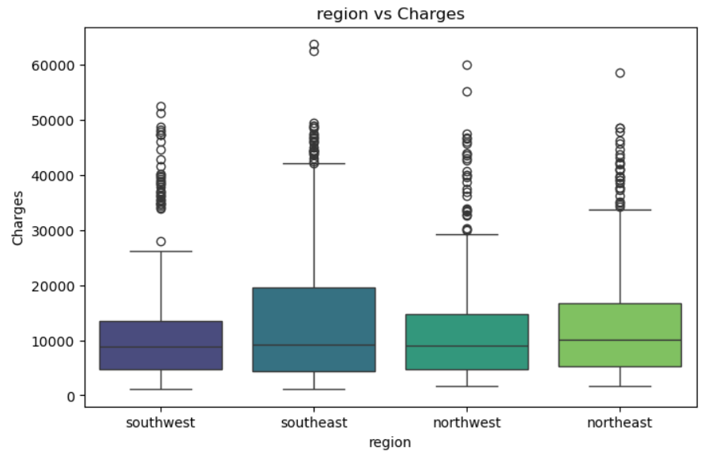
Boxplots for Categorical Features

Slide 8
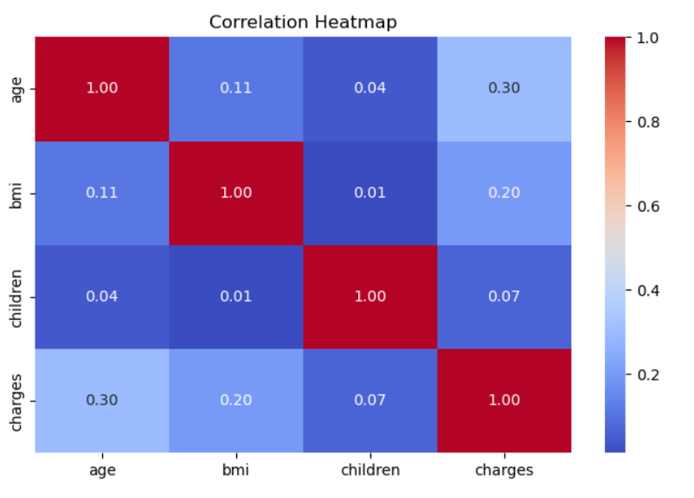
Correlation Heatmap

Slide 9
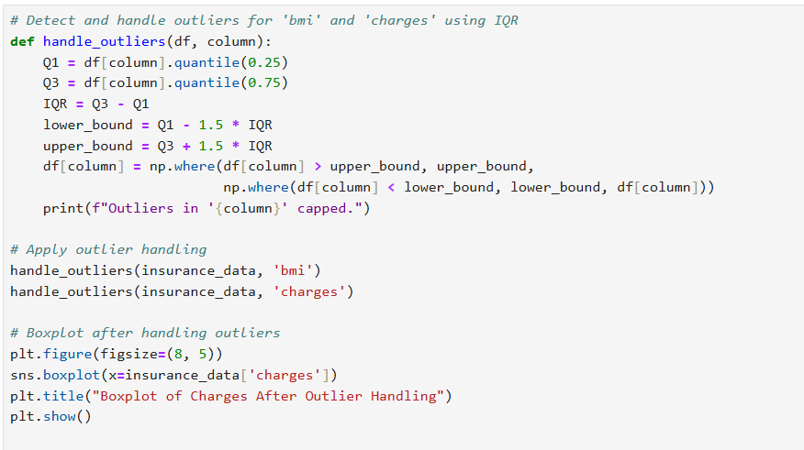
Data Preprocessing
Handled outliers using IQR method.
Scaled numerical features using StandardScaler.
Encoded categorical features with OneHotEncoder.
Partitioned data into 80% training and 20% testing.

Slide 10
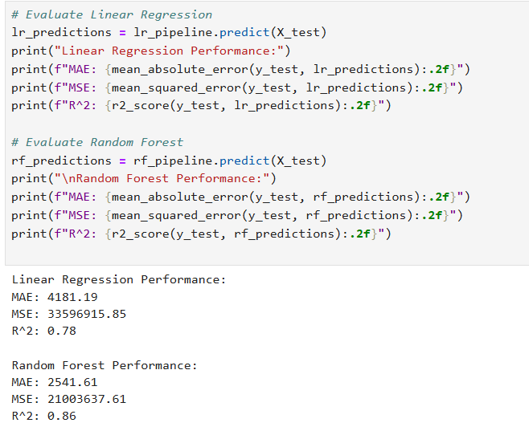
Model Selection
Models Used:
1. Linear Regression
2. Random Forest
Why These Models:
- Linear Regression: Simple and interpretable.
- Random Forest: Handles non-linear relationships and reduces overfitting.

Slide 11
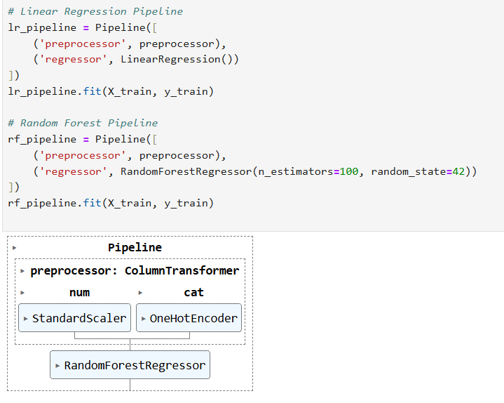
Model Evaluation
Metrics Used:
R² Score: Measures variance explained by the model.
Mean Absolute Error (MAE): Indicates average prediction error.
Mean Squared Error (MSE): Penalizes large errors more heavily.
Performance: Random Forest outperformed Linear Regression.

Slide 12
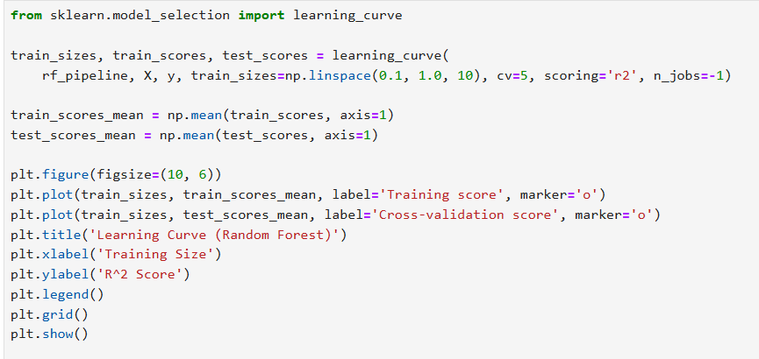
Learning Curve
Insight:
High training score, slightly lower validation score indicates mild overfitting.
Model generalization improves as training data increases.

Slide 13
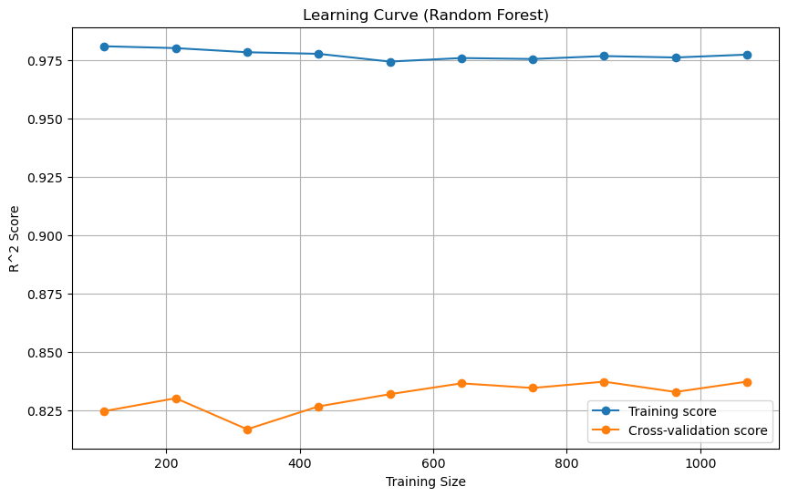

Slide 14
Challenges and Solutions
Challenges:
Outliers in charges and BMI.
Overfitting during model training.
Solutions:
Addressed outliers using IQR method.
Hyperparameter tuning with Grid Search to improve generalization.

Slide 15
Recommendations
1. Focus on lifestyle factors: Higher BMI and smokers incur higher costs.
2. Adjust premiums for older individuals while promoting healthier habits.
3. Use insights on key predictors (smoker, BMI, age) for risk assessment.

Slide 16
Future Work
1. Incorporate additional features like diet, exercise, and medical history.
2. Explore advanced models like XGBoost or Neural Networks.
3. Automate hyperparameter tuning for improved scalability and performance.

Slide 17
Conclusion
Identified key predictors influencing insurance costs.
Built an accurate Random Forest model.
Provided actionable recommendations based on findings.
Impact: Insights can help insurers refine pricing strategies and individuals make healthier choices.

