Slide 1
NBA STATISTICS Dataset Analysis Python Code and Analysis
SHUBHANKAN SHINDE

Slide 2
NBA Statistics Dataset Analysis
6. Analysis
1. Loading data set
Visualization and analysis
5. Visualization
2. Exploring Data Origins
4. Data preparation
3. Data cleaning

Slide 3
Introduction
The dataset we're exploring in this presentation is the "NBA Statistics" dataset, offering a detailed look at player performances and game statistics across various seasons. Providing a rich source of information for analyzing player trends, team strategies, and overall league performance. We'll leverage this dataset for our data analysis and visualization to gain insights into player dynamics, team efficiencies, and game trends within the NBA.

Slide 4
01
Dataset Exploration

Slide 5
1. Load the dataset into a Pandas dataframe and display the first 10 rows.
We used pandas read_excel() function to load the dataset.
With the use of head() function we displayed the first ten rows.

Slide 6
2. Display the shape of the dataset (i.e. number of rows and columns).
We used shape() function to display the total rows and columns of the data set.
The dataset has 5459 rows and 26 columns.

Slide 7
3. Identify the data types of each column and check for any missing values (number of missing values in each column).
We used the dtypes() function to identify the data types of each column.
To check for missing values in each column, we used the isnull() function, and to display the sum of missing values, we used the sum() function.
We found 1054 missing values in 3 columns out of 26 columns

Slide 8
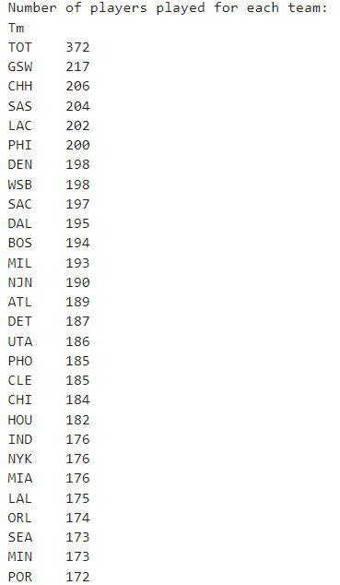
4. For the entire dataset (in its current form), list how many players played for each team in the NBA
We gathered the count of players who have played for each NBA team.
We used the value_counts() function to organize this data
"This analysis unveiled that there are 29 distinct teams represented in the dataset, along with the corresponding number of players for each team. Additionally, it was discerned that 372 players have played for multiple teams."

Slide 9
02
Data Cleaning and Preparation

Slide 10
Data Cleaning and Preparation
Removing Duplicates: The dataset underwent cleaning with the removal of duplicate entries to ensure data integrity and accuracy.
Column Renaming: Key columns were renamed for clarity and consistency, such as 'Tm' to 'Team' and 'MP' to 'Mins_Played', enhancing readability and usability.
Excluding Total Team Entries: Entries with the label 'TOT' under the 'Team' column were excluded, focusing analysis on individual team performances rather than aggregated team stats.

Slide 11
Calculating Derived Metrics
Free Throw Percentage Calculation: The dataset was enriched by calculating the free throw percentage ('FT_PERCENT') by dividing successful free throws ('FT') by attempted free throws ('FTA').
Total Rebounds Computation: Total rebounds ('TRB') were calculated by summing offensive rebounds ('ORB') and defensive rebounds ('DRB'), providing a comprehensive view of player performance in rebounding.

Slide 12
Data Formatting
Column Reordering: To enhance data organization, columns were reordered, placing 'TRB' after 'DRB' for logical and intuitive data representation.
Percentage Conversion: Percentage columns such as '3P%' and '2P%' were converted to string format and appended with '%' for better readability and interpretation.

Slide 13
03
Data Analysis and Visualization

Slide 14
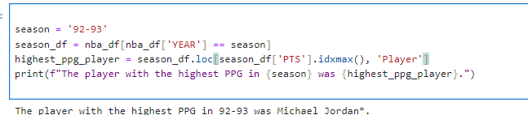
Identifying Highest Scoring Player in a Season
This code snippet extracts the player with the highest points per game (PPG) in a specified NBA season>
By filtering data for the chosen season, the analysis targets a specific timeframe, offering a detailed look into individual player performance.
The identified player for the specified season 92-93 is Michael Jordan, reflecting his exceptional scoring ability and dominance on the court.

Slide 15
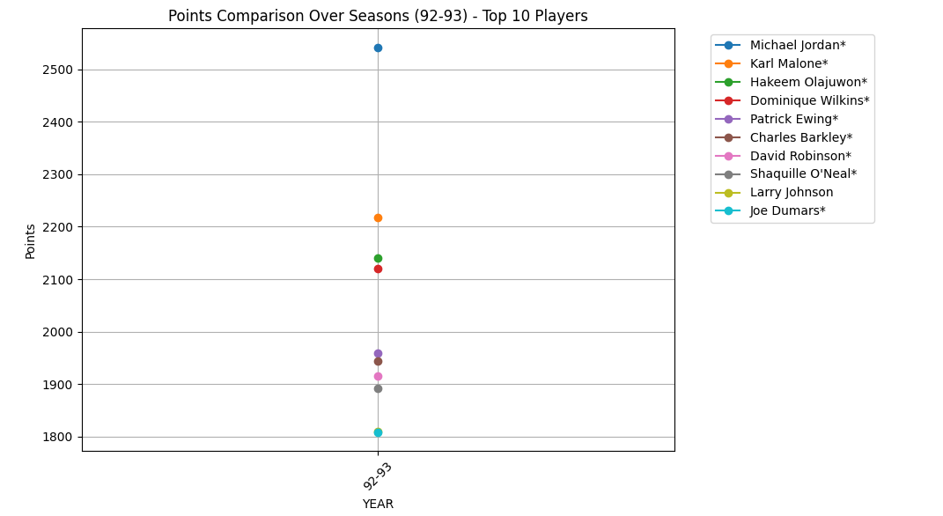
Points Comparison Over Seasons (1992-1993) - Top 10 Players
This line plot illustrates the points scored over multiple seasons for the top 10 players in the 1992-1993 NBA season.
Each player's cumulative points across seasons are depicted, offering a comprehensive view of their scoring contributions throughout the specified timeframe.
Players with consistently high point totals stand out, showcasing their dominance in scoring over the seasons considered.

Slide 16
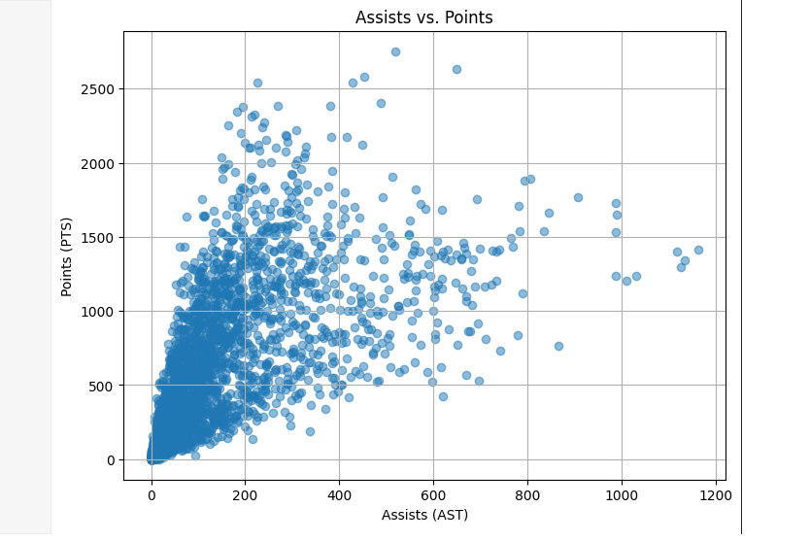
Exploring the Relationship Between Assists and Points in NBA Dataset
We have conducted an in-depth analysis on an NBA dataset to uncover the intricate relationship between assists and points.This Analysis shows
Visualizing Player Performance: The scatter plot illustrates the correlation between assists (AST) and points (PTS) in basketball, showcasing each player's performance.
Identifying Playmaking Ability: we can spot players excelling in playmaking by focusing on the upper right quadrant, indicating high-scoring players with significant assist contributions.
Tactical Insights: we can also leverage this visualization to identify strategic opportunities, such as involving players with high assist rates but low scoring in more scoring plays or adjusting team tactics for optimal effectiveness.

Slide 17
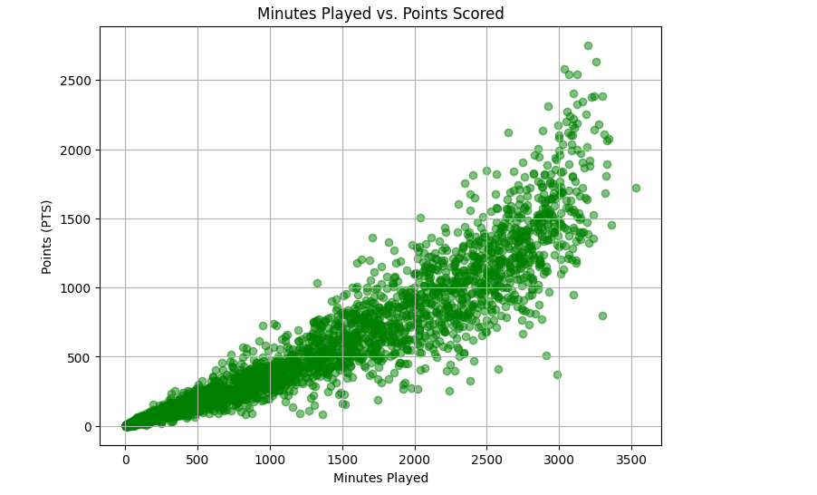
Investigating the Connection Between Minutes Played and Points Scored
We have conducted an in-depth analysis on an NBA dataset to uncover the connection between Minutes and Points Scored .This Analysis shows
Performance Insight: This scatter plot illustrates the relationship between minutes played and points scored in basketball, offering insights into player performance.
Efficiency Analysis: we can identify who efficiently convert playing time into scoring output, especially those positioned in the upper right quadrant.
Strategic Decision-Making: Utilizing this visualization, we can make informed decisions regarding player rotation and game tactics to maximize scoring potential.

Slide 18
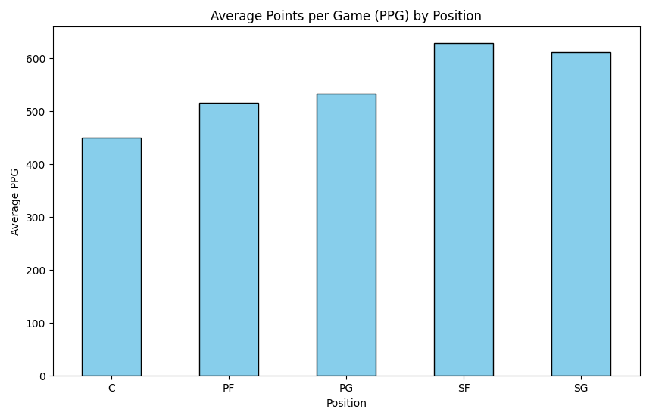
Analyzing Average Points per Game (PPG) by Position
We have conducted an in-depth analysis on an NBA dataset to uncover the Average points per Game by position .This Analysis shows
Positional Scoring Overview: This bar chart visualizes the average points per game (PPG) across different positions in basketball.
Positional Performance Comparison: By grouping players by position and calculating the mean PPG, we gain insights into the scoring tendencies of each position
.
Strategic Insights: we can use this visualization to understand positional scoring strengths and weaknesses, informing lineup decisions and offensive strategies.

Slide 19
Recommendation to further improve the dataset and Analysis
Standardize Team Abbreviations: Ensure consistent team abbreviations across all seasons by mapping variations to a single format (e.g., "LAL" to "LALakers" and "LAC" to "LAClippers").
Include Player Salaries: Add player salary information to provide insights into contracts and team salary cap management, enhancing analysis.
Expand Player Biographical Data: Include birthplace, college attended, and NBA experience to enrich the dataset for deeper analysis of player backgrounds and careers.
Historical Team Performance: Include regular season standings, playoff results, and championship wins to provide context for player statistics and enable analysis of team success over time.

Slide 20
Thank You!

