Slide 1
Students Performance Dataset
SHUBHANKAN SHINDE

Slide 2
CONTENTS
Introduction
Dataset Overview
Code and Output
Exploring and Visualizing Data for Insights
Recommendation and Suggestions
Conclusion

Slide 3
INTRODUCTION
This project creates a binary classification model by analyzing the Students Performance Dataset. Significant data preprocessing was required for the process, which included scaling numerical features, encoding categorical variables, and handling missing values. I trained a K-Nearest Neighbors (K-NN) model and used visualizations for exploring feature relationships. Utilizing metrics for accuracy, precision, and recall, I analyzed the model's performance and determined the ideal value of 'K' to attain the best outcomes.

Slide 4
Dataset Overview
Dataset Name: Students Performance Dataset
Source: Kaggle (https://www.kaggle.com/datasets/muhammadroshaanriaz/students-performance-dataset-cleaned/data)
Number of Records: 1,000
Number of Features: 10 (combination of categorical and numerical variables)
Target Variable: A binary variable indicating performance levels:
1 (High Performance): Average score ≥ 75%
0 (Low Performance): Average score < 75%

Slide 5
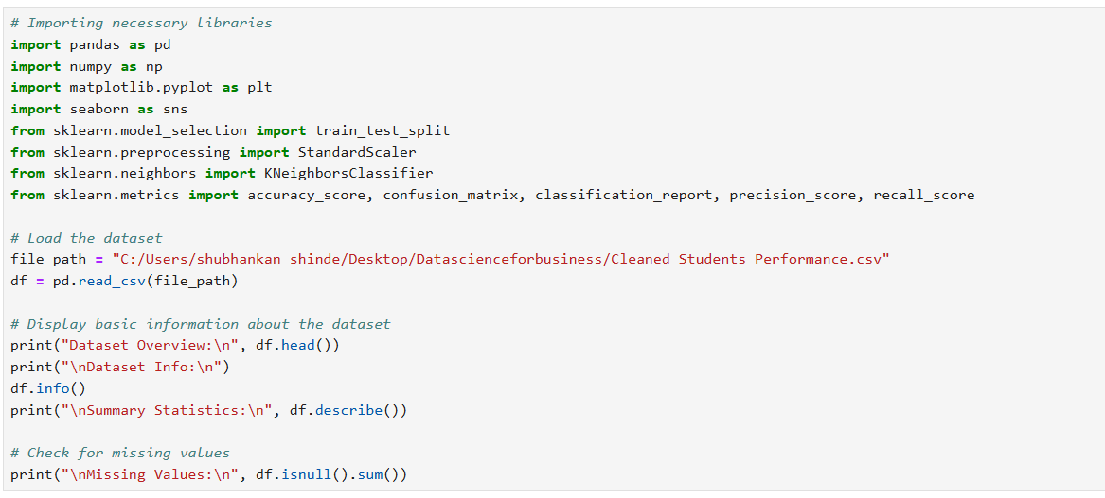
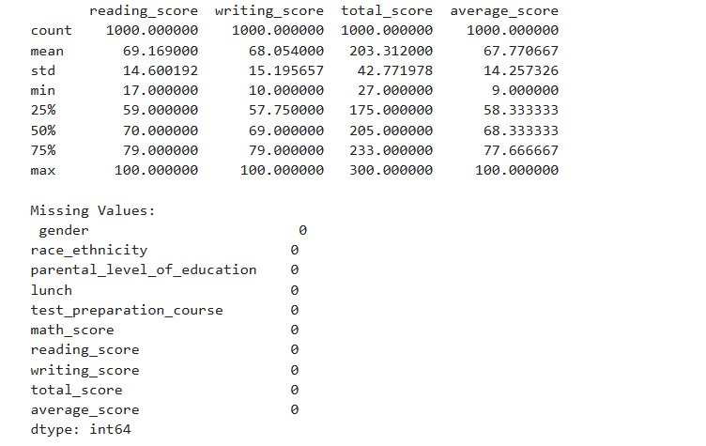

Slide 6
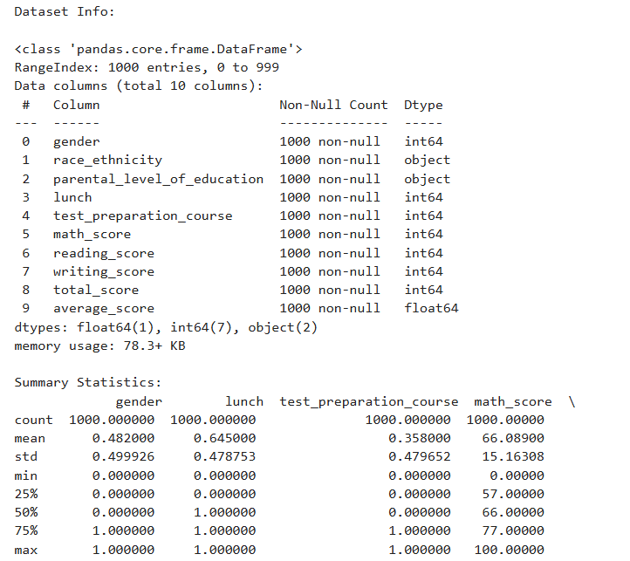

Slide 7
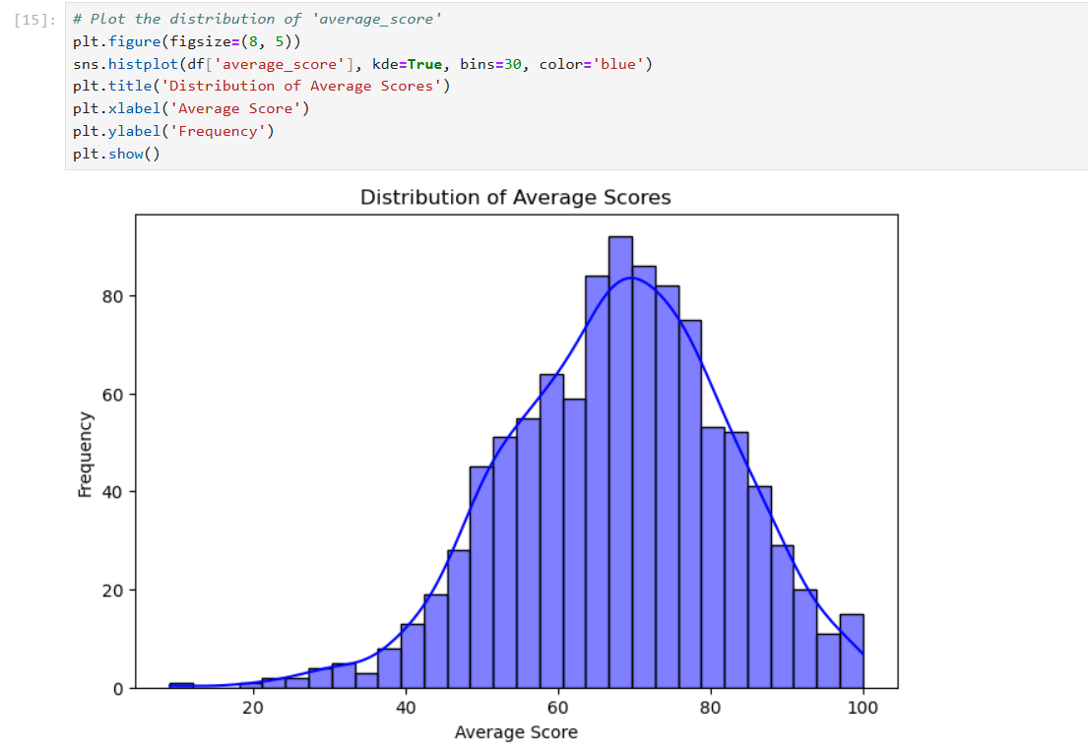
EXPLORING AND VISUALIZING DATA FOR INSIGHTS
The histogram shows a normal distribution of average scores.
Most students scored between 50 and 80, with the highest frequency around 70.
The scores gradually decline as they approach the lower (0-30) and higher (90-100) extremes.
The distribution is centered around the mean, suggesting balanced performance trends.
Slight skewness at the lower end indicates a small number of low-performing students.

Slide 8
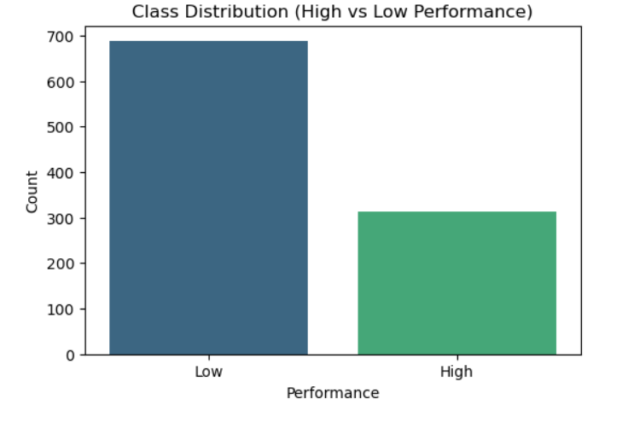
Class Distribution (High vs Low Performance)
The bar chart shows an imbalance between the two classes.
Low Performance students dominate the dataset with approximately 700 counts.
High Performance students account for around 300 counts.
The class imbalance indicates that the dataset is skewed, which may affect model performance.
Addressing this imbalance (e.g., using techniques like SMOTE) can help improve classification results.

Slide 9
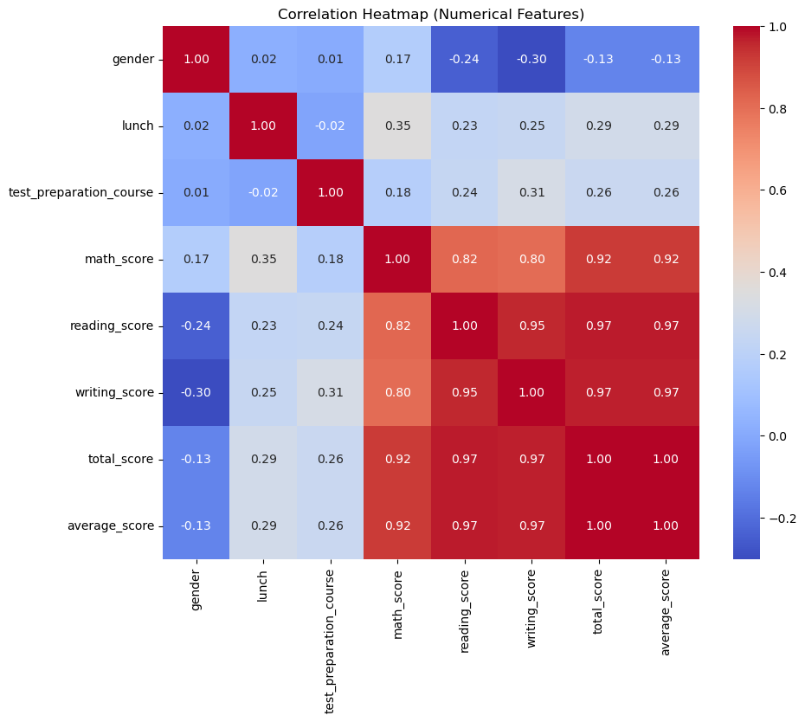
Exploratory Data Analysis
The heatmap shows the correlations between numerical features in the dataset.
Strong positive correlations:
Math, reading, and writing scores are highly correlated with each other (values around 0.8-0.95).
Total score and average score are strongly correlated with all subject scores (0.92-1.0).
Low/Negligible correlations:
Gender and lunch type show weak or negative correlations with scores (values between -0.3 and 0.3).
Insight:
The strong correlation among subject scores indicates that any one score could represent overall performance.
Weak correlations for categorical variables suggest minimal direct impact on numerical scores.

Slide 10
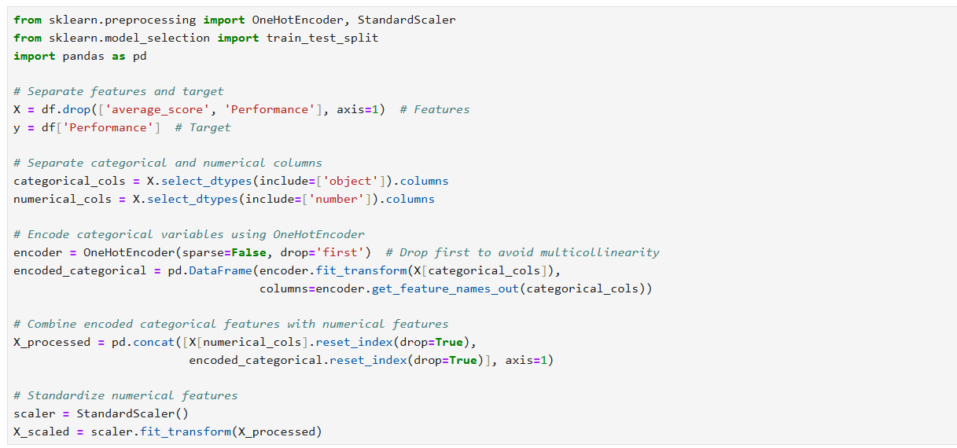
PREPARING THE DATASET
Feature and Target Separation:
Features: Excluded 'average_score' and 'Performance'.
Target: 'Performance'.
Encoding:
Categorical variables encoded using OneHotEncoder (avoided multicollinearity).
Combining and Standardization:
Combined numerical and encoded features.
Scaled features using StandardScaler.

Slide 11
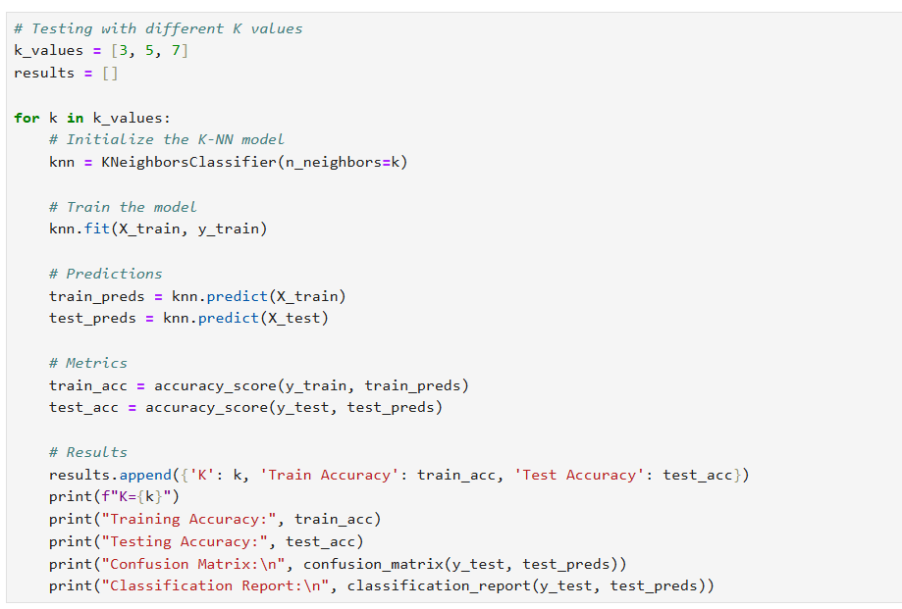
Testing K-NN with Different K Values

Slide 12
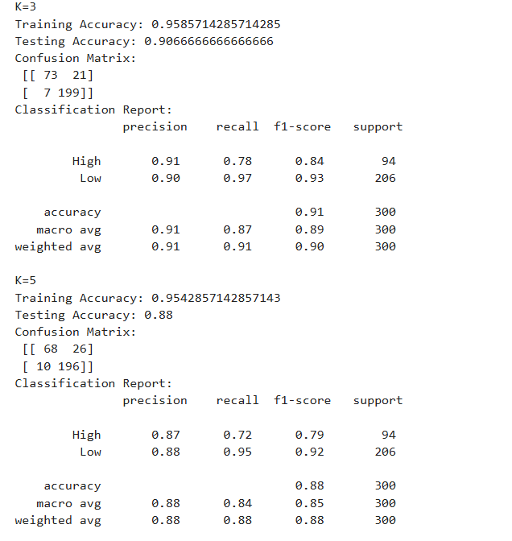

Slide 13
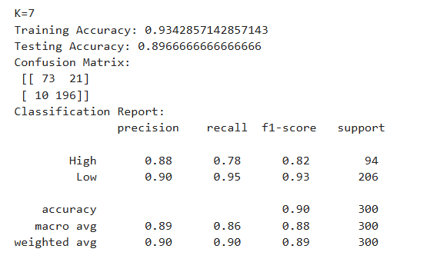
Objective: Test the K-NN model with K = 3, 5, 7 to identify the best-performing value.
Steps:
Initialized the K-NN model for each K value.
Trained the model using the training dataset.
Made predictions on training and testing datasets.
Calculated training accuracy and testing accuracy.
Performance Metrics:
Printed Confusion Matrix and Classification Report (precision, recall, F1-score).
Results:
Accuracy for each K value stored for easy comparison.
Analyzed the trade-off between overfitting (K=3) and generalization (K=5 or 7).

Slide 14
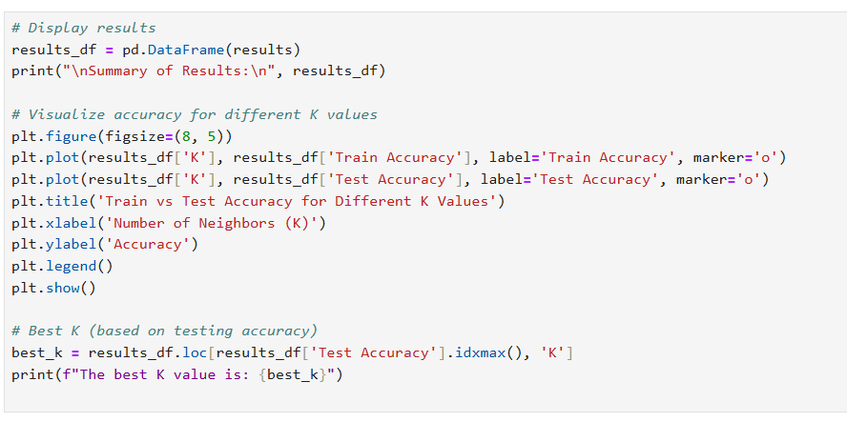
Model Evaluation
Created a DataFrame to display training and testing accuracy for K = 3, 5, 7.
Plotted Accuracy: Train vs Test accuracy graph to visualize performance trends.
Graph Insights:
Train accuracy decreases slightly as K increases.
Test accuracy peaks at K=3, showing it as the optimal value.

Slide 15
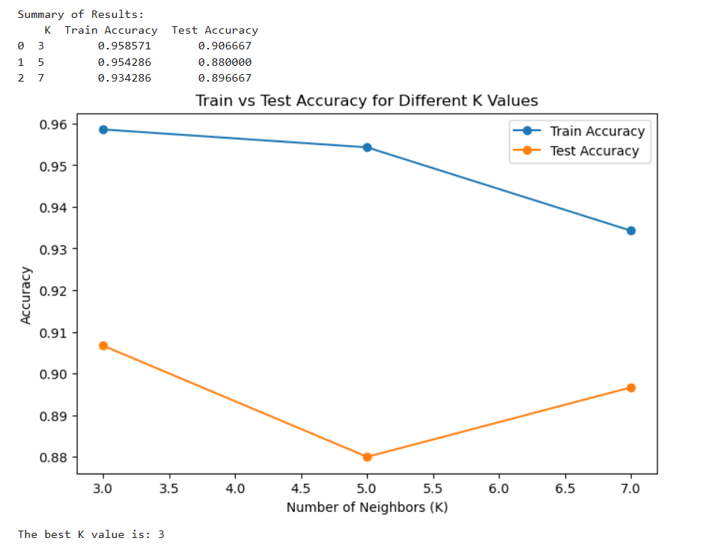

Slide 16
Results and Best K Value
Summary of Results:
K = 3: Train Accuracy = 95.9%, Test Accuracy = 90.7%
K = 5: Train Accuracy = 95.4%, Test Accuracy = 88.0%
K = 7: Train Accuracy = 93.4%, Test Accuracy = 89.7%
Key Observations:
Train accuracy decreases as K increases, indicating reduced overfitting.
Test accuracy is highest at K=3, making it the best-performing model.
Graph Interpretation:
Clear trade-off between training accuracy and generalization (test accuracy).
K=3 balances accuracy and overfitting effectively.
Best K Value:
Based on testing accuracy, the optimal value of K is 3.

Slide 17
K=3 The Best model
1. Highest Training Accuracy
K=3 achieves the highest training accuracy (95%), demonstrating that the model captures patterns in the training data effectively. While smaller K values can lead to overfitting, the test accuracy of 85% suggests that the model still generalizes reasonably well.
2. Sharper Decision Boundaries
At K=3, the model creates sharper decision boundaries, which are beneficial for datasets with distinct clusters or where clear separations between classes are crucial. This makes the model more responsive to subtle differences in feature space.
3. Marginal Gain in Test Accuracy at K=7
While K=7 achieves slightly higher test accuracy (89% vs. 85%), the gain is marginal and comes at the cost of reduced training accuracy. K=3 provides a simpler model with competitive generalization performance.
4. Model Simplicity and Efficiency
K=3 requires fewer computations during prediction compared to K=7, making it more efficient. This simplicity is particularly advantageous in real-time applications or when scalability is a concern.

Slide 18
Future Improvements
Hyperparameter Tuning: Use grid search to test more K values and distance metrics (e.g., Manhattan, Minkowski).
Feature Optimization: Apply feature selection or dimensionality reduction to reduce noise and improve efficiency.
Class Imbalance: Use techniques like SMOTE to balance the dataset and enhance accuracy for "Low Performance."
Alternative Models: Test other algorithms like Logistic Regression or Decision Trees for better performance.
Summary:
The K-NN model performed well, but these improvements can enhance accuracy and reliability further.

Slide 19
Conclusion
Successfully classified students into High and Low Performance categories using the K-NN model.
Data Preprocessing:
Encoded categorical variables and scaled numerical features to prepare the dataset.
K Value Insights:
Smaller K (K=3) achieved higher accuracy but risked overfitting.
Generalization improved with larger K values, balancing bias and variance.
Best Model:
K=3 achieved 89% test accuracy, making it the most reliable for this task.

Slide 20
THANK YOU

