Slide 1
Cats Data Analysis
By : Shubhankar Chaturvedi

Slide 2
Contents
  Introduction
  Process
  Regression Problem
  Data Understanding
  Data Wrangling
  Exploration
  Data Modelling

Slide 3
Introduction
Using Python, I analysed a data collection of 300 rows and 7 columns of cats, including age at death, breed, date of last vet visit, hair length, height, number of vet visits, and weight.
The Problem is a regression Problem and contains Data Wrangling, Exploratory Data Analysis and ML Model Building.

Slide 4
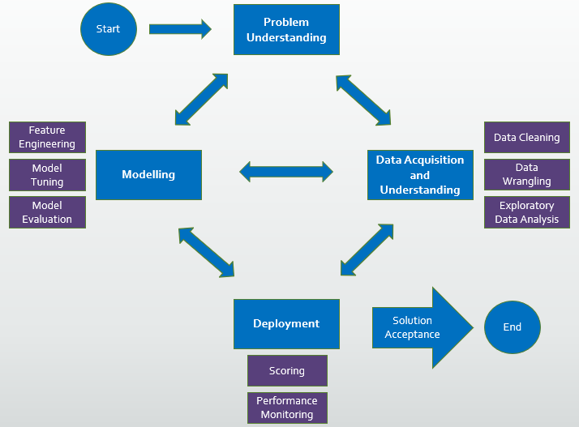
Process

Slide 5
Regression Problem
The job of estimating a mapping function (f) from input variables (X) to a continuous output variable is known as regression predictive modelling (y)

Slide 6
Data Understanding
Importing Libraries & Csv File
Data Wrangling & EDA
Machine Learning Models

Slide 7
Data Wrangling
Date time check
Category check
Numerical check

Slide 8
Exploration
Bivariate Analysis
Correlation Matrix

Slide 9
Data Modelling
Linear Regression
Ridge Regression
AdaBoost Regressor
Gradient Boosting Regressor
Random Forest
Lasso Regression
SGD Regression

Slide 10
Conclusion
Linear Model
Tree Based Model
Data does not fit properly in Linear Model.
Random Forest Model works better

Slide 11
Thankyou

