Slide 1









Today’s challenges: the store shelf audit.
HOW STORE VISITS ARE CHECKED TODAY
Merchandiser
Merchandiser
Brand team
Brand team
Brand team
Visits the store and walks the shelf with a manual checklist.
Judges each check by eye and labels every photo by hand.
Reads each visit report against agreements and price lists.
Writes follow-up emails to each store and the sales team.
Builds weekly scores by store and KPI in spreadsheets.
WHERE IT BREAKS DOWN
THE RESULT
Results vary by person
No evidence behind a finding
=
Each merchandiser reads the same shelf differently
Findings carry no photo or agreed clause
Shelf problems fixed late
Manual follow-up
No ranked view of stores
Promotions go unchecked
Store emails and re-visits are prepared by hand
The brand team reviews each visit on its own
Notes:
As-is flow for a store compliance visit: the merchandiser visit, manual judgement, brand team review, follow-up and reporting. The steps and pain points are inferred from the Brand Compliance scope and build; validate with the VIP team.

Slide 2



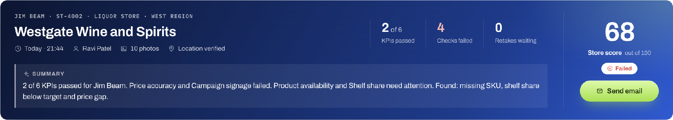
Reinvented: a scored visit in 10–15 seconds.
FROM SHELF PHOTO TO SCORED VISIT
Photos in, in one go
AI scores the shelf
A scored visit
Any order, nothing to tag
Six KPIs checked at once
Ready in 10–15 seconds
10–15 sec
6 KPIs
100%
From shelf photos to a scored visit
Scored from one set of shelf photos
Failed checks linked to a photo and clause
Notes:
To-be flow in the UnifyApps build of AI-Powered Retail Brand & Shelf Compliance. Photo to scored visit takes 10 to 15 seconds. The result banner is a live capture from the app: Westgate Wine and Spirits, Jim Beam, store score 68.

Slide 3
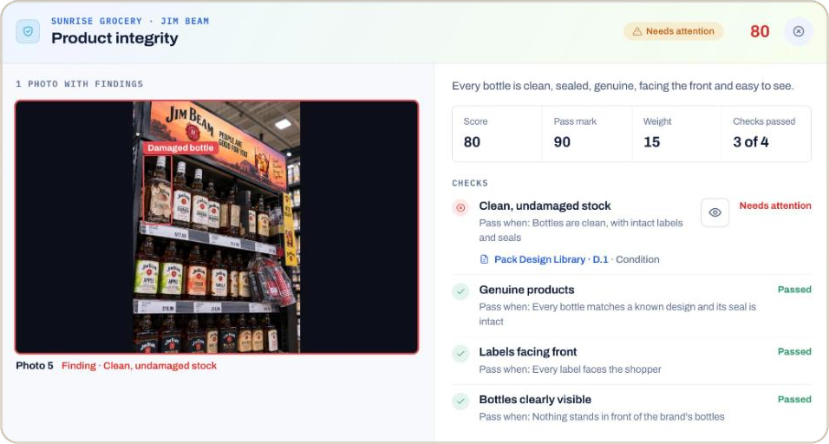




Every finding comes with its proof.
WHAT THE BRAND TEAM GETS
Boxed on the photo
The problem is marked where it sits on the shelf.
Linked to the rule
Each failed check cites the clause in the brand’s own documents.
Follow-up drafted
AI drafts the store email. The brand team edits and sends it.
A damaged bottle, found by AI
Rolled up by brand
Live result from the demo: the problem is boxed on the merchandiser’s own photo, next to the checks it passed and failed.
Score trends, weakest KPIs and competitor facings across stores.
Notes:
The screen is a live capture from the demo. The brand team edits and approves every store email before it is sent.

