Slide 1
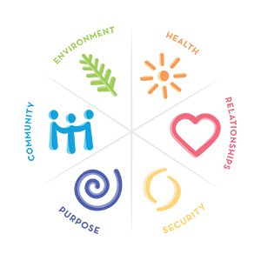
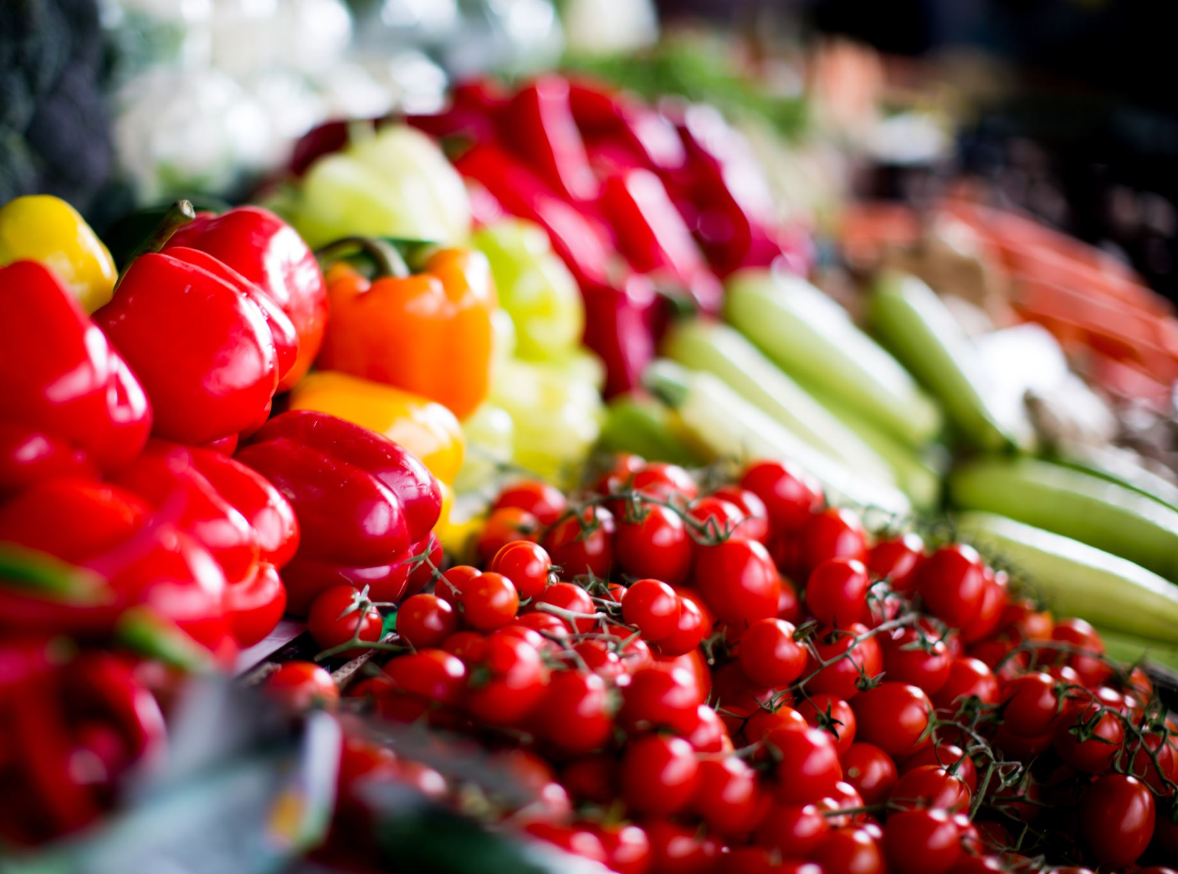
Promoting Health and Well Being of Workers through Automatic SENSING AND Goal Setting
- Shubhankar Gupta
UC Davis Computer Science

Slide 2

ProblemS

Slide 3




Workers often end up working for more than 8 hours a day
Less physical activity
Prone to musculoskeletal disorders, chronic pain and heart diseases
Unaware of their personal health and well being

Slide 4
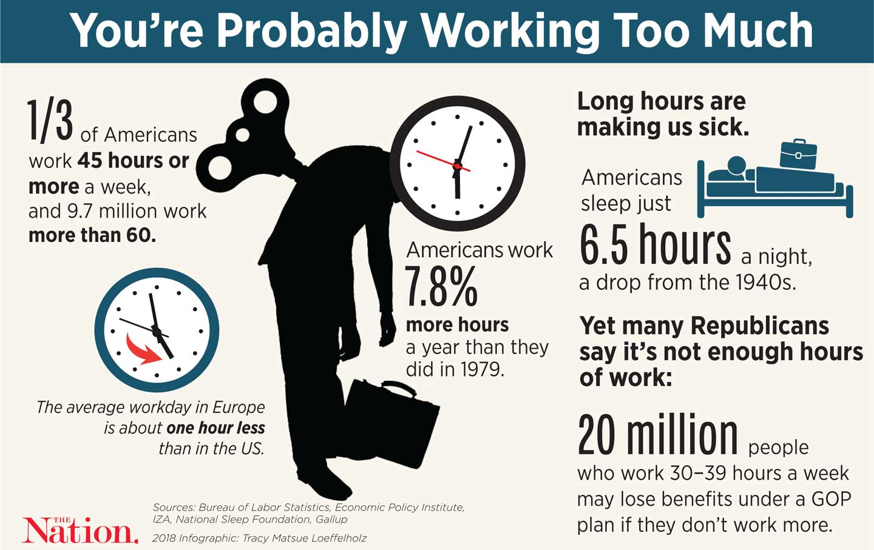
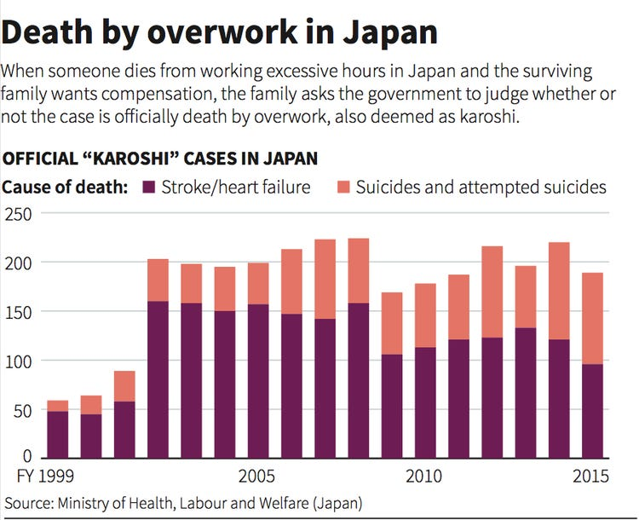
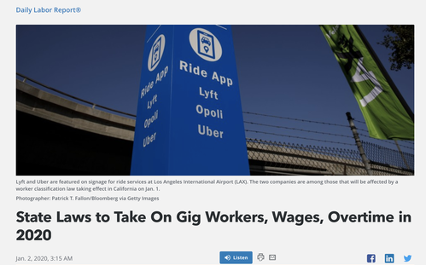

Slide 5

PROPOSED SOLUTION

Slide 6






Help workers make aware of daily physical activity through automatic sensing i.e. Fitbit device
Calories burned
Number of steps taken
Hourly heart rate
Miles Taken
Set Goals for Workers

Slide 7
Challenges for Goal Setting
What goals to set?
Duration of Goals?
Who will set goals?

Slide 8




Goals Setting
Provide workers with a supporter to help them set goals and track their progress
Set mini goals for workers on daily basis
Goals should be exercises and activities that help workers reach their daily target
Workers can also play the role of supporter

Slide 9
Activity | Range/Day
Jogging | 1 mile, 2 miles, 3 miles
Biking | 5 miles, 6 miles, 7 miles
Walking | 1.5 miles, 2.5 miles
Push-up | 10 reps, 15 reps, 20 reps
Planks | 10 sec, 20 sec, 30 sec
Squats | 36 reps, 39 reps, 42 reps, 45 reps

Slide 10

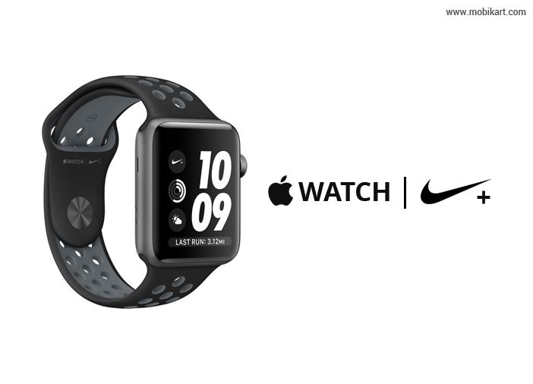

Can only update Steps, Distance, Calories, Weight and Water Intake
Three Rings: Move, Exercise, Stand
Can only change Move Ring
Update target number of calories to be burnt
Set daily, weekly, monthly goals. For ex: Jogging for 20 miles in 1 month
No Guidance, can set unrealistic goals

Slide 11




Worker’s Fitbit Device
Send sensing data for every 24 hours
Set/Revise Daily Goals for supporters
Set/Revise Goals for Workers
Supporter
Workers
Rate the supporter
Rate the user
Well Being App

Slide 12
References
Ockenfels-Martinez M, Farhang Lili. 2019. Human Impact Partners and Gig Workers Rising. Driving Away Our Health: The Economic Insecurity of Working for Lyft and Uber. Oakland, CA
Apantaku-Onayemi F, Baldyga W, Amuwo S, et al. 2012. Driving to Better Health: Cancer and Cardiovascular Risk Assessment among Taxi Cab Operators in Chicago. J Health Care Poor Underserved, 768-780. doi:10.1353/hpu.2012.0066.
Wendell C Taylor, Ross Shegog, Vincent Chen, David M Rempel, Marybeth Pappas Baun, Cresendo L Bush, Tomas Green, and Nicole Hare-Everline. 2010. The Booster Break program: description and feasibility test of a worksite physical activity daily practice. Work 37, 4: 433–443.
Dean Cooley and Scott Pedersen. 2013. A pilot study of increasing non-purposeful movement breaks at work as a means of reducing prolonged sitting. Journal of environmental and public health.
Robert A Henning, Eric A Callaghan, Anna M Ortega, George V Kissel, Jason I Guttman, and Heather A Braun. 1996. Continuous feedback to promote self- management of rest breaks during computer use. Int. Journal of Industrial Ergonomics 18, 1: 71–82.
Derek Burkland. 2013. The Effects of Taking a Short Break: Task Difficulty, Need for Recovery and Task Performance.
Scott A. Cambo, Daniel Avrahami, and Matthew L. Lee. 2017. BreakSense: Combining Physiological and Location Sensing to Promote Mobility during Work-Breaks. Proc. of the 2017 CHI Conference on Human Factors in Computing Systems (CHI ’17). Association for Computing Machinery, New York, NY, USA,3595–3607.
Sunny Consolvo, Predrag Klasnja, David W. McDonald, and James A. Landay. 2009. Goal-setting considerations for persuasive technologies that encourage physical activity. In Proceedings of the 4th International Conference on Persuasive Technology (Persuasive ’09). Association for Computing Machinery, New York, NY, USA, Article 8, 1–8.
Wei, Xiahua & Chen, Wei & Zhu, Kevin. 2015. Motivating User Contributions in Online Knowledge Communities: Virtual Rewards and Reputation. 2015. 3760-3769. 10.1109/HICSS.2015.452.

Slide 13
Chrysanthi Konstanti and Evangelos Karapanos. 2018. An Inquiry into Goal-Setting Practices with Physical Activity Trackers. In Extended Abstracts of the CHI Conference on Human Factors in Computing Systems (CHI EA ’18). Association for Computing Machinery, New York, NY, USA, Paper LBW587, 1–6.
Sandra Gabriele and Sonia Chiasson. 2020. Understanding Fitness Tracker Users’ Security and Privacy Knowledge, Attitudes and Behaviours. In CHI Conference on Human Factors in Computing Systems (CHI '20), April 25–30, 2020, Honolulu, HI, USA. ACM, New York, NY, USA 13 Pages.
Allison, C. (2018, December 20). How to set or change your goals on Fitbit. https://www.wareable.com/fitbit/how-to-change-goals-on-fitbit-6847
Stables, J. (2019, July 20). How to change Garmin goals: Set workout, activity and weight goals. https://www.wareable.com/garmin/how-to-change-garmin-connect-goals-7421
Bower, G. (2015, October 31). How to set personal fitness goals with Apple Watch. https://www.cultofmac.com/395069/setting-fitness-goals-apple-watch/
Fitzgerald, J. How Far Should You Run? Active. https://www.active.com/running/articles/how-far-should-you-run
Maloney, L. (2019, May 28). How Many Miles to Ride a Bike to Lose Weight? https://www.livestrong.com/article/324842-how-many-miles-to-ride-a-bike-to-lose-weight/
Bumgradener, W. (2019, December 6). The Average Daily Steps People Walk. https://www.verywellfit.com/whats-typical-for-average-daily-steps-3435736
Zielinksi, L. (2020, April 3). This Is How Many Push-Ups Experts Say You Should Do to Build Muscle. https://www.openfit.com/how-many-push-ups-a-day
Solan, M. (2019, November 23). Straight talk on planking. https://www.health.harvard.edu/blog/straight-talk-on-planking-2019111318304
Davis, N. (2018, June 15). How Many Squats Should I Do a Day? A Beginner’s Guide. https://www.healthline.com/health/fitness-exercise/how-many-squats-should-i-do-a-day

