Slide 1
ReNew Power Hiring Hackathon
Objective : To predict the rotor bearing temperature of wind turbines
Shubhankar Mishra
13 Sep, 2022

Slide 2
Overview
Import training dataset
Create new relevant features with available data
Anomaly detection and removal using PCA transformation
Clustering based on climate/weather features to segregate data into two clusters (most likely hot and cold seasons)
Data transformation:
Skewness correction
Concatenation of different turbines data into single df
Remove outlier based on visualization wrt. target column
OHE for turbine_id
Finalize features based on impact on the model and also remove high correlated columns
Split data into train-test with stratification on turbine_ids (train-test should have proportioned data of each turbine)
Construct Tensorflow sequential neural network
Define learning rate schedule, optimizer and loss function
Model training
Plot losses and metrics wrt. epochs
Save/load model
Submission:
Repeat same transformations on the test df
Prediction from the loaded model
Check the predicted data
Save the submission file

Slide 3
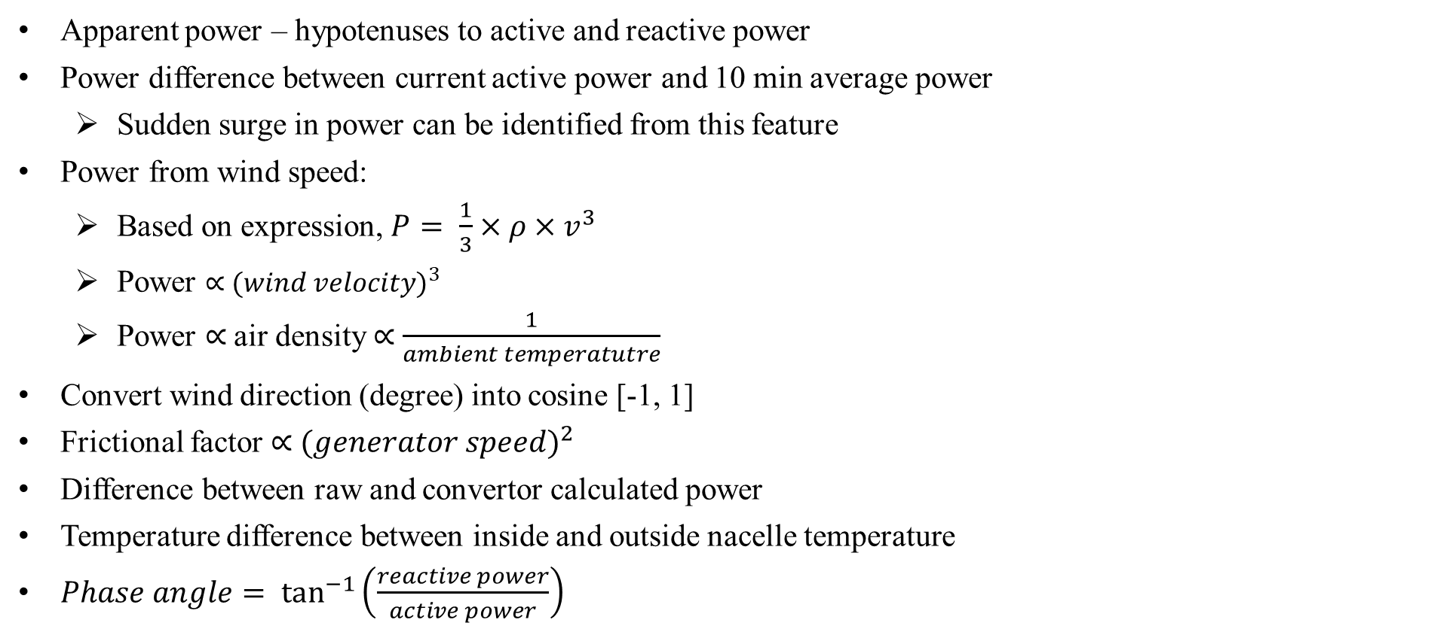
Create new features
relevant to wind energy system
Apparent power – hypotenuses to active and reactive power
Power difference between current active power and 10 min average power
Sudden surge in power can be identified from this feature
Power from wind speed:
Based on expression, $P= \frac{1}{3}×ρ×v^{3}$
Power ∝ ${(wind velocity)}^{3}$
Power ∝ air density ∝ $\frac{1}{ambient temperatutre}$
Convert wind direction (degree) into cosine [-1, 1]
Frictional factor ∝ ${(generator speed)}^{2}$
Difference between raw and convertor calculated power
Temperature difference between inside and outside nacelle temperature
$Phase angle= \tan^{−1}\left(\frac{reactive power}{active power}\right)$
Apparent power
Reactive power
Phase angle
Active power

Slide 4
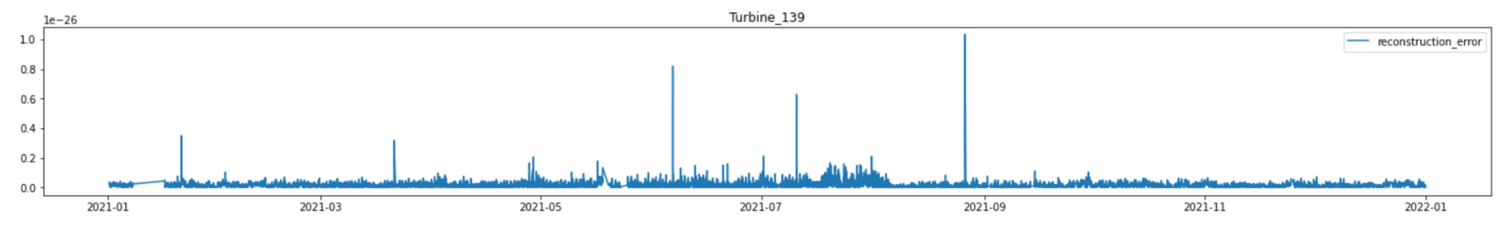
Anomaly detection and removal
Divide df based on ‘turbine_id’:
Use pandas Groupby function
Sort data based on ‘timestamp’ (only for visualization)
Save dependent and independent variables separately
PCA transformation of independent variables into same number of features of original data
Use this transformed features to reconstruct the original data
Anomaly will have relatively large difference between the original data and the reconstructed data
Use z-score to eliminate data with extreme reconstruction error
*
* Anomalies
*
*

Slide 5
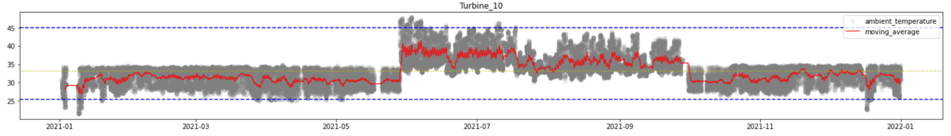
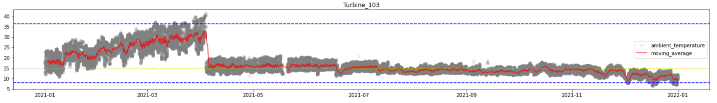
Visualizing features trend of different turbines
Plot different features separately for each turbine based on sorted timestamp variable
Use average rolling for better inference on the data
Some features show different trends in different parts of year
This could be seasonal effects, such as:
power increases with demand surge in summer or good wind conditions
ambient and nacelle temperatures increases in hot conditions
'ambient_temperature', 'wind_direction_raw', 'wind_speed_turbulence', 'wind_speed_raw'
Different trends in feature for same turbine
Different trends in same feature for different turbine

Slide 6
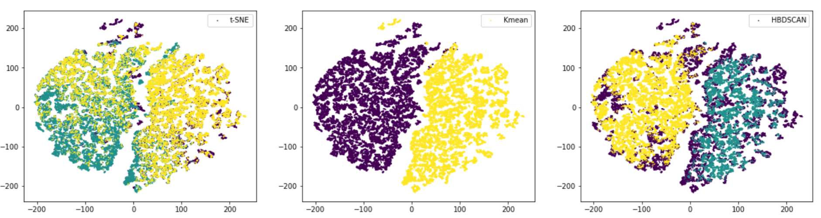
Clustering to label the data
For each turbine, data can be clustered into two labels
This label can be used as a new feature for modelling
Scale the data before clustering to avoid feature dominance
k-mean and hdbscan clustering based on seasonal features from previous visualization
The formed clusters labels can be compared with seasons/months extracted from timestamp variable (only for inference)
Seasons based on timestamp
Clusters are able to segregate the data similar to seasons/months from timestamp

Slide 7
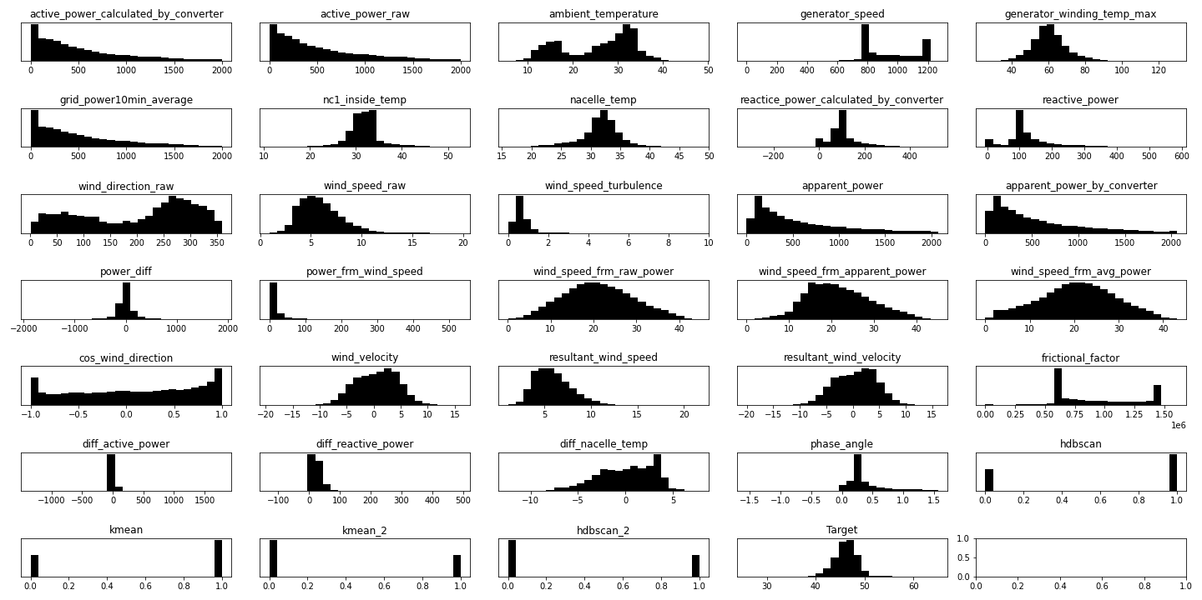
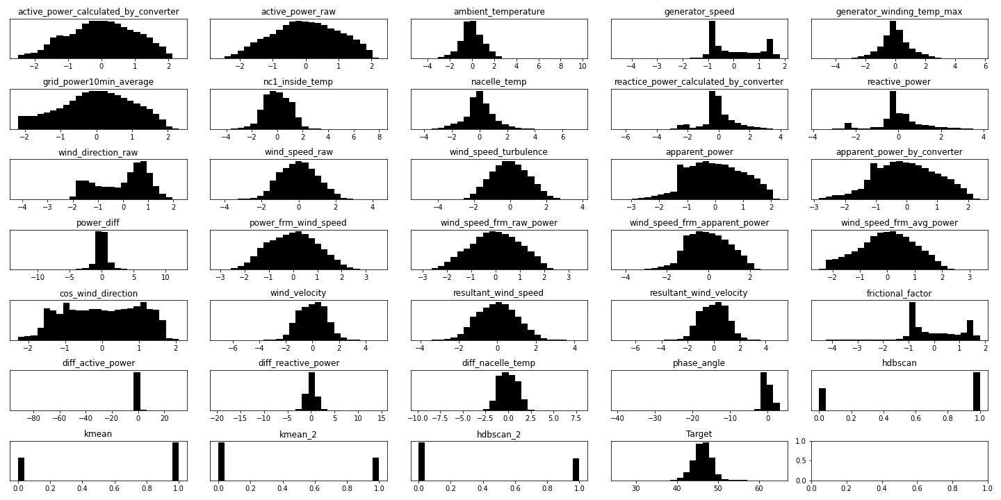
Skewness correction
Many features are highly skewed which can affect distance based models and neural networks
Skewness can be corrected with PowerTransformer from sklearn
yeo johnson transformation will be used as some features contains negative values
It saves the lambda value hence same can be used for the skewness correction of test data
Before
After correction

Slide 8
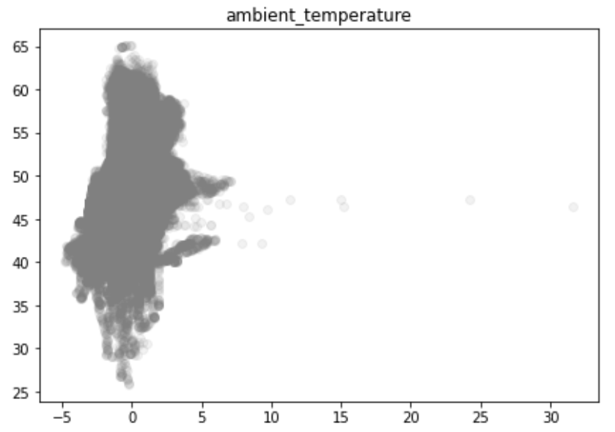
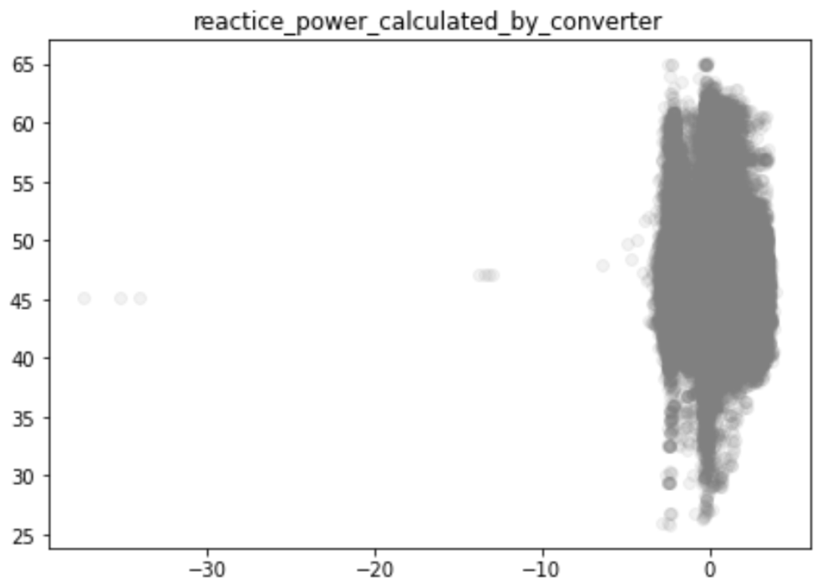
Outliers removal
Outliers can be detected and removed after skewness correction
Scatter plot between Target column and normalized feature columns can be used to distinguish outliers
After detection these can be removed for performance enhancement
Outliers

Slide 9
Other transformations & EDA
One Hot Encode turbine_id column
Create profile report to check dependencies, cardinality of the features
Check Correlation between columns
Feature selection:
Many columns are highly correlated (> 0.9). Drop columns with multi-collinearity
Drop columns which doesn't impact the model by hit & trail
Stratified kfold split of data into train-test
Ensure proportional split of data based on turbine groups for better model training and evaluation

Slide 10
Modelling
Different models such as KNN, LinearRegression, RandomForest, XGBoost, Catboost were trained on train split of the data with default parameters
Simplistic vanilla neural network was also trained with fixed learning rate and SGD optimizer
Models evaluated based on MAPE and R2 score on test split of the data
Neural network outperformed other models and was choosen for optimization
Final Neural Network schematic structure
Input
Output
256 neurons
2048 neurons
2048 neurons
2048 neurons
3072 neurons
Batch normalization

Slide 11
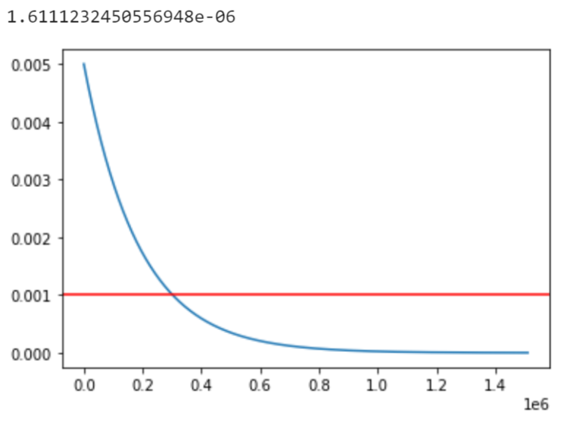
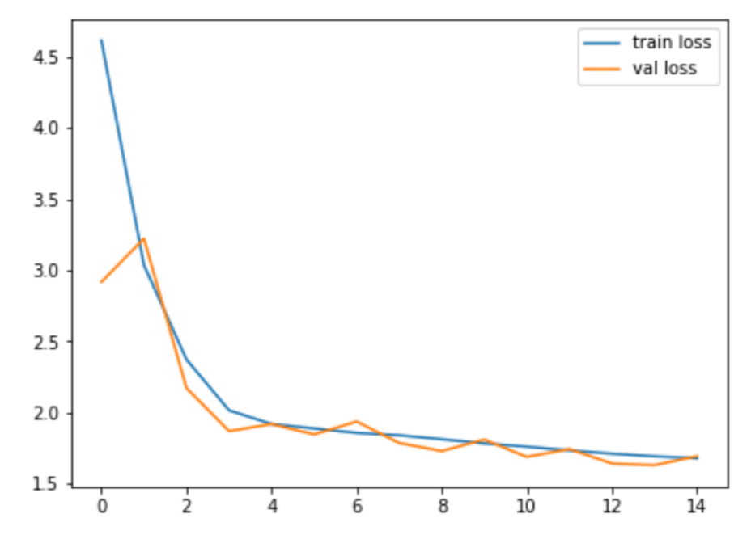
Modelling
Final sequential neural network was constructed with TensorFlow-Keras
To continue the learning process, decaying learning rate schedule was fed instead of constant learning rate
Different optimizers such as RMSProp, Adam, SGD were tried; Adam outperformed others
Error functions such as MSE, MAE, MAPE and MSLE were used; Optimization on MAPE gave best score for the competition
Regularization techniques such as dropout and batch-normalization were employed to avoid overfitting
Last learning rate
Learning rate
MAPE loss
Training steps
First 15 epochs

Slide 12
Results
Model trained on complete data for 1000 epochs with 600 batch size
Training loss ~ 0.00925 MAPE
Run time ~ 7 hrs
MachineHack public score: 0.01042
Trained model and weights saved as json and h5 file resepectively
Loaded saved model for prediction on test dataset
Submission file:
Repeat same transformations on the test df
Prediction from the loaded model
Check the predicted data
Save the submission file

Slide 13
Inferences / Improvement prospects:
Clustering of data (most likely seasonal) had significant impact on the model improvement
Features such as ‘ambient_temperature’ and ‘generator_winding_temp_max’ are found to be extremely important for Target prediction (dropping these affect the model performance)
Highly correlated features such as ‘active_power_raw’, ‘active_power_calculated_by_convertor’, ‘generator_speed’ etc., provide similar information during training (keeping one and dropping others doesn’t impact the model significantly)
New features can be derived from high correlated features to increase their importance
Increasing perceptron/neurons in the first layer improves the optimization
Increasing the neural network capability of extracting low level features in the front layers
Local anomaly/outlier removal can be tried
Training neural network takes approx. 7 hrs. Tuning of epoch, batch_size and learning rate can decrease computational time

Slide 14
Conclusion
How can ReNew predict failure of a component by looking at target temperature and prevent such failures before they happen?
If the model is highly accurate then the residual between predicted value and actual value of the new data can be indicative of wind turbine’s abnormal behavior
A threshold (based on training error µ and σ) can be set to consider if the residual value is significant enough
An indicator which counts the instances of residual crossing this threshold in a fixed time period can be made
If for a particular turbine, indicator value is relatively high then it can examined and called to maintenance

Slide 15
THANK YOU

