Slide 1
Getting Started with Express.js
Setting up basic project in Express.js
Ashish Alok
Kunal Singh Chauhan
Shubhankar Shankar

Slide 2
Introduction
Express is a minimal and flexible Node.js web application framework that provides a robust set of features for web and mobile applications. It is an open source framework developed and maintained by the Node.js foundation.

Slide 3
Advantages of Express.js
Makes Node.js web application development fast and easy.
Easy to configure and customize.
Allows you to define routes of your application based on HTTP methods and URLs.
Includes various middleware modules which you can use to perform additional tasks on request and response.
Easy to serve static files and resources of your application.
Allows you to create REST API server.
Easy to connect with databases such as MongoDB, Redis, MySQL

Slide 4
Installing Express.js
npm install -g express

Slide 5
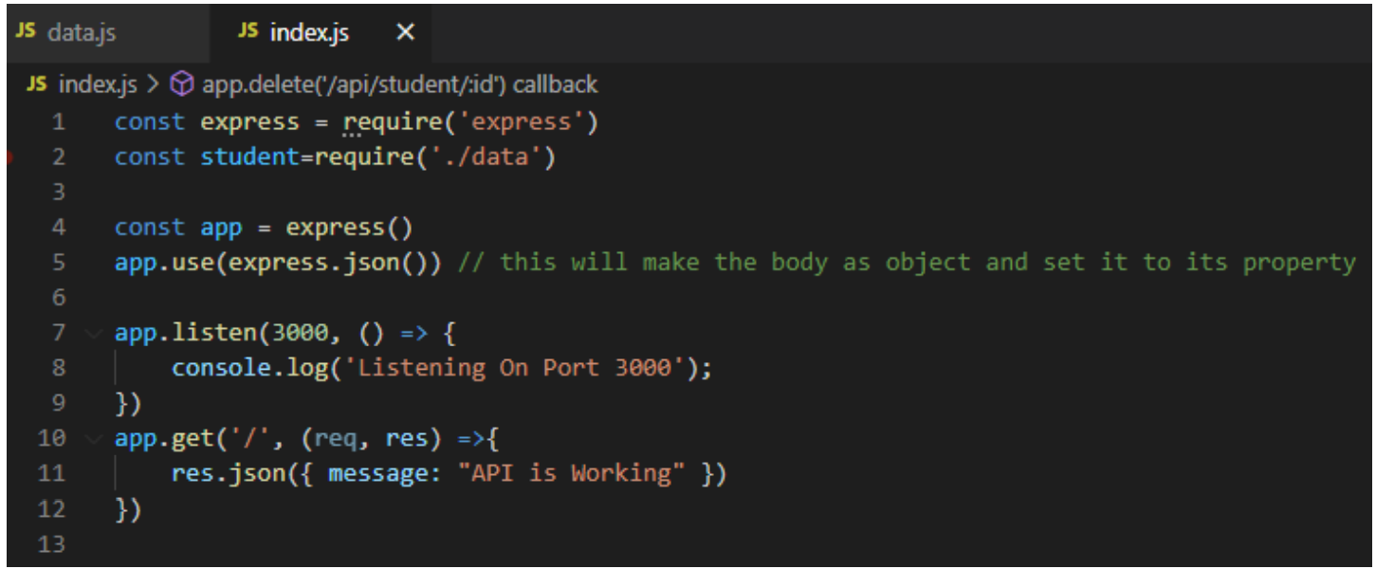
Listening on Port

Slide 6
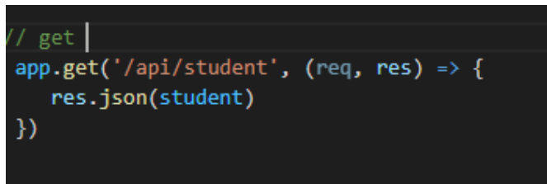
HTTP GET Request

Slide 7
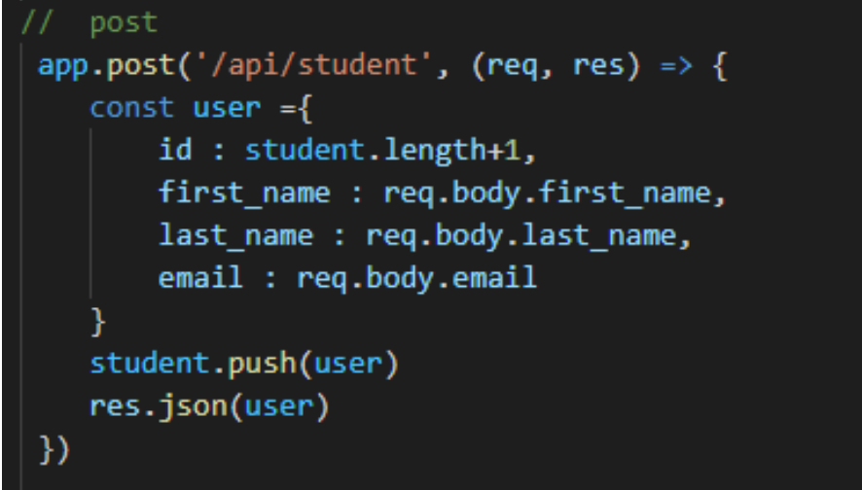
HTTP POST Request

Slide 8
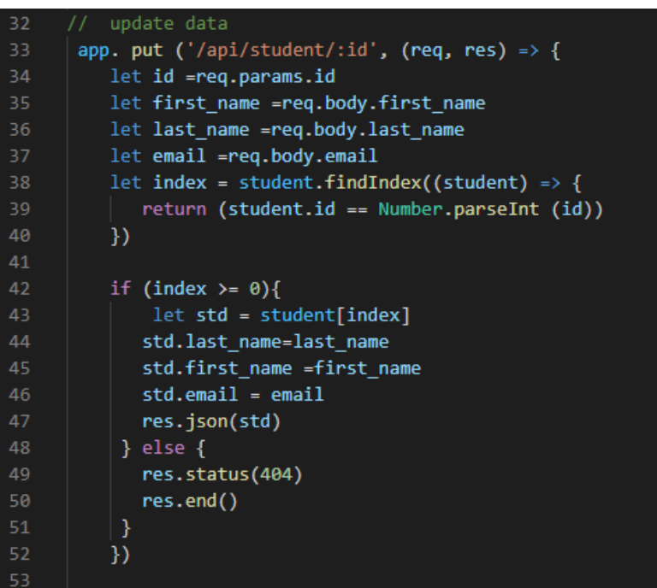
HTTP PUT Request

Slide 9
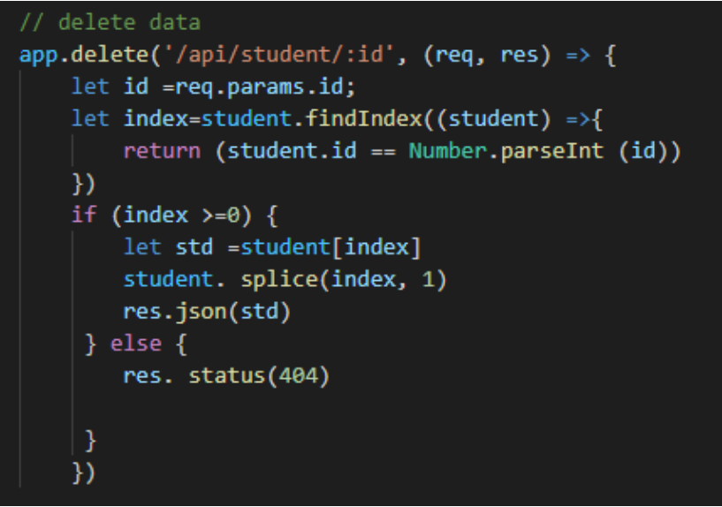
HTTP DELETE Request

Slide 10
Thank You!

