Slide 1
Using Generative AI to Predict Data to Improve Latency at the Client
Stagiaire de recherche Supervisor : Mathieu
AI Group
Shubhankar

Slide 2
Agenda
1
Introduction
2
Problem Statement
3
Related Work
4
Implementation
5
Future Work
6
Q & A

Slide 3
Introduction
Aim
Explore generative AI for byte-level prediction and data compression at the client side.
Reduce frequent server communications by predicting data, thereby lowering latency.

Slide 4

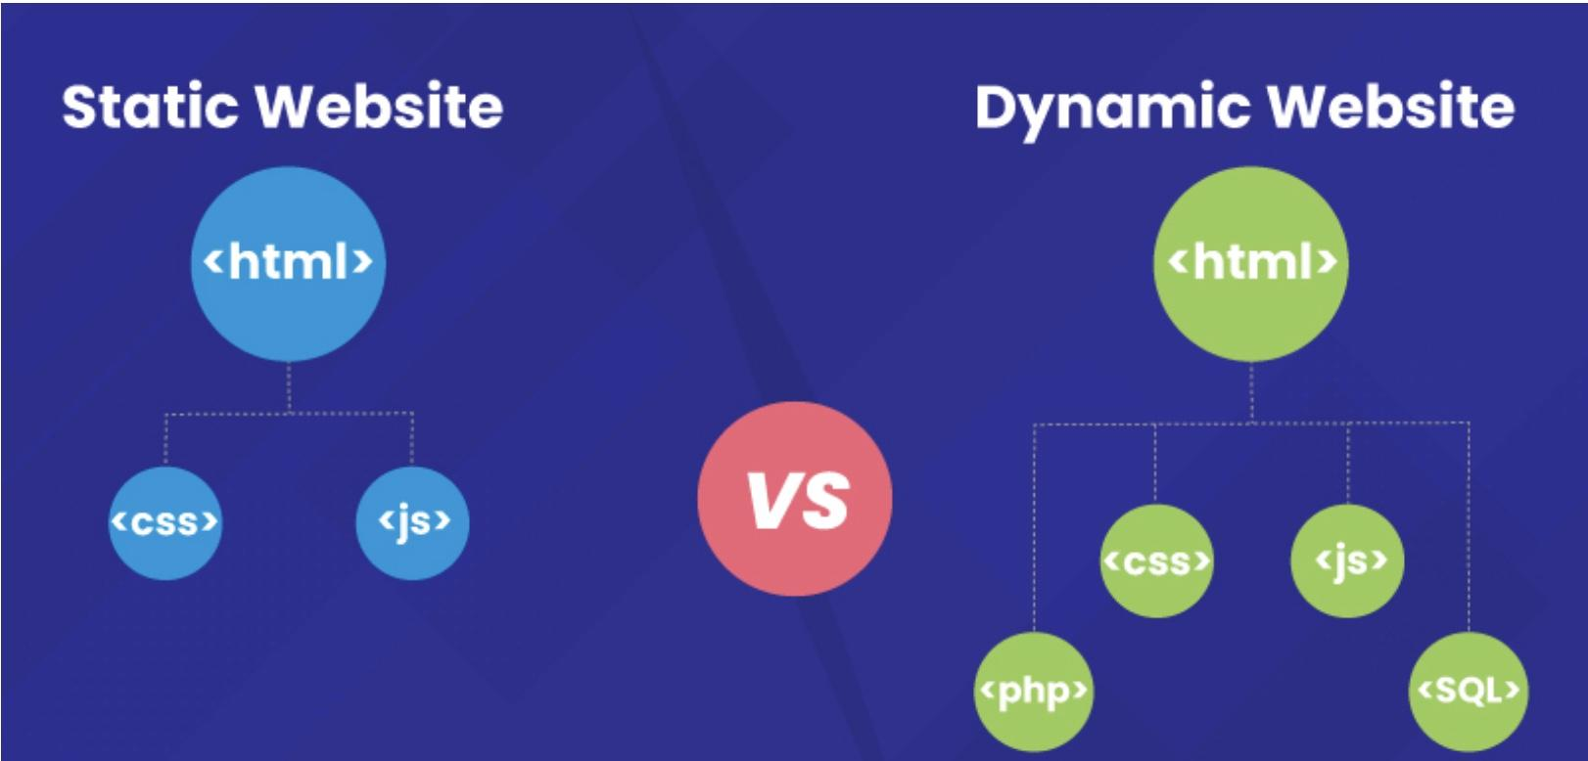
Introduction
Problem Statement
Hypotheses : Investigate transformer-based generative models to enhance prediction accuracy and efficiency.
Expectation: A runtime-adaptive dictionary acting as a specialized cache for server-to-client transmissions.
Step 1: Static Dictionary Approach: Leverage known data values (as in PonySDK) by representing them with concise codes.
Step 2: Dynamic Dictionary Model : Develop a system to detect and map known paths in a directed graph using key/value pairs.

Slide 5
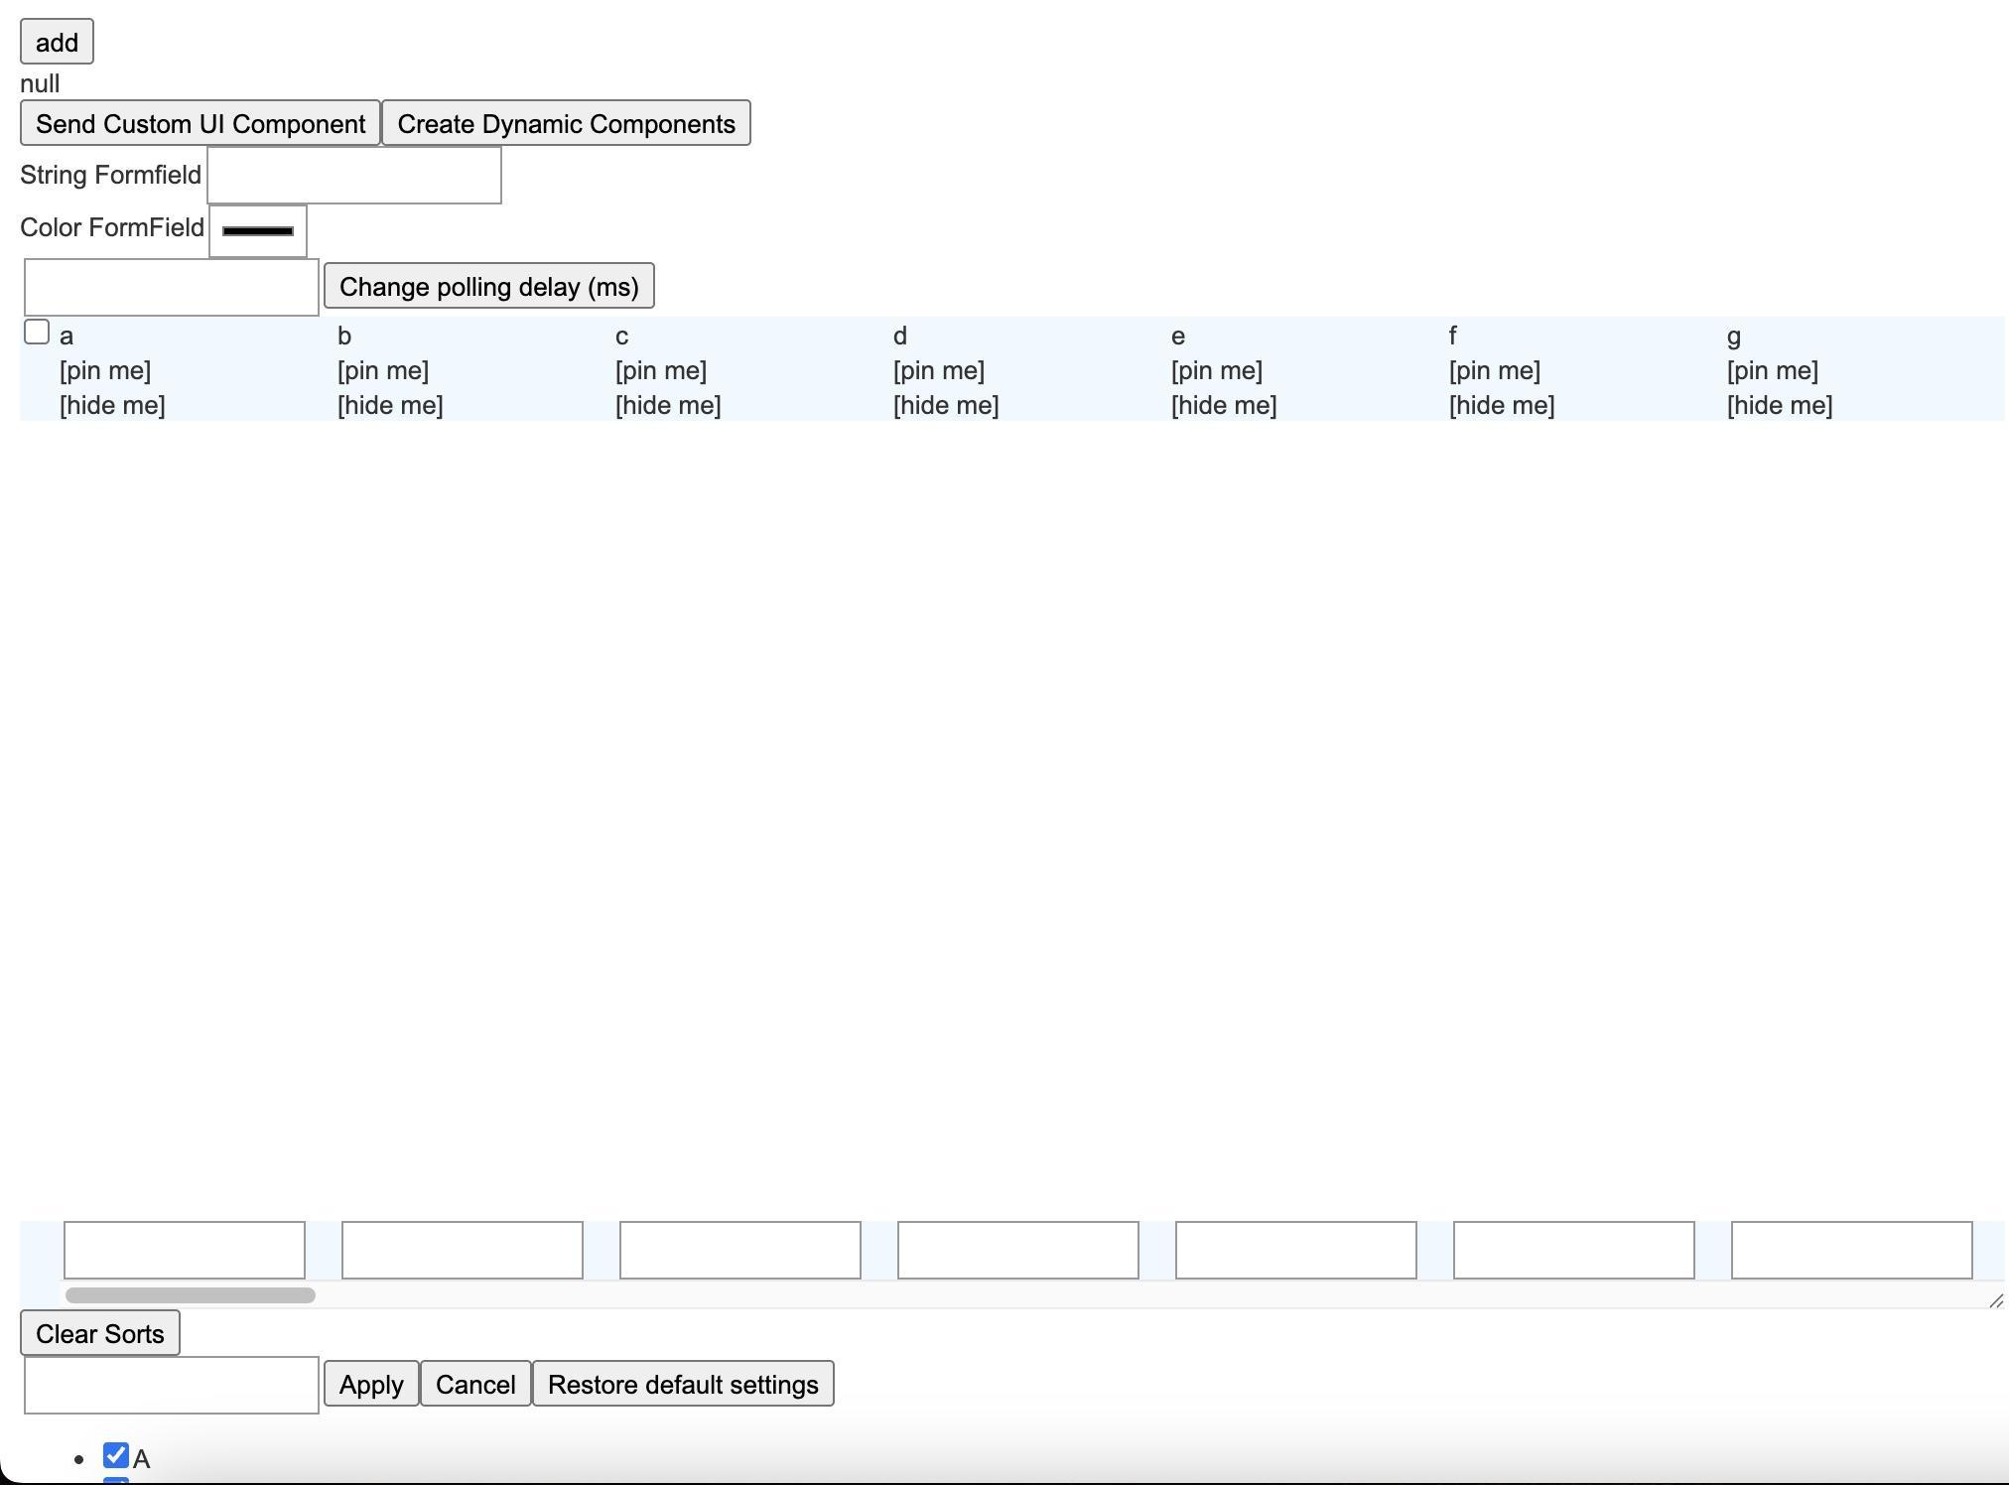
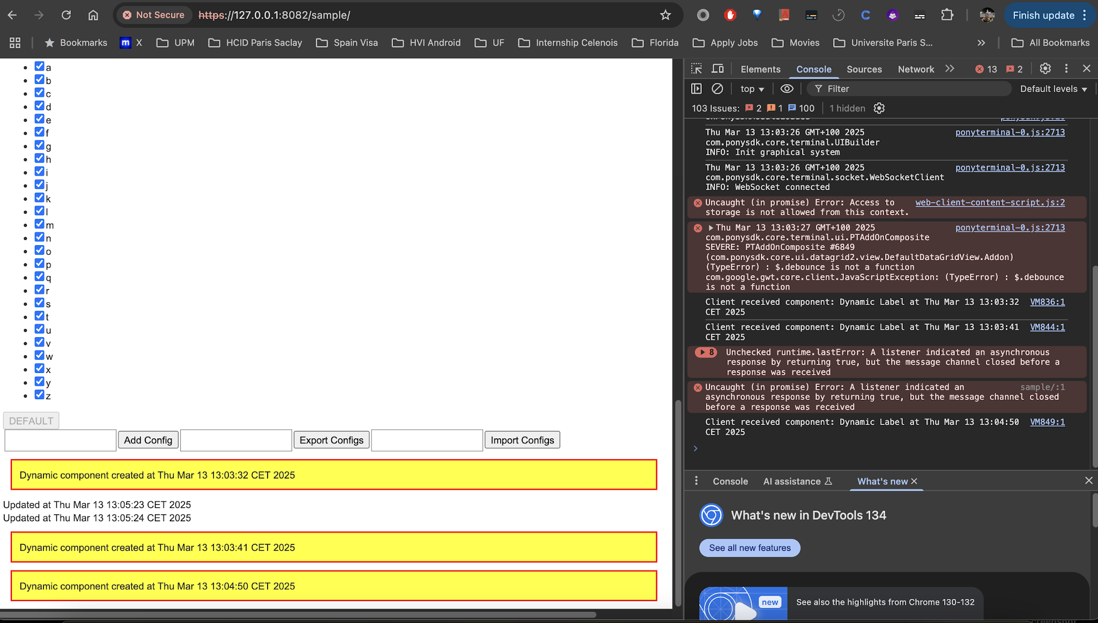
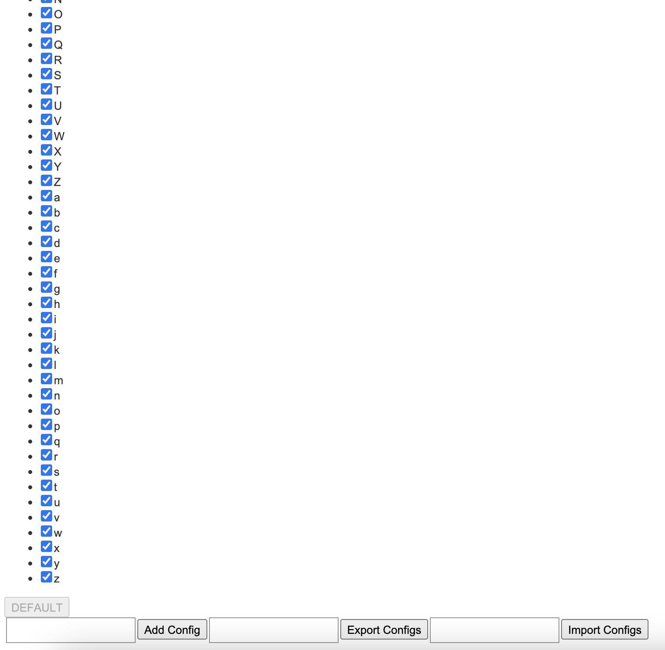
Introduction
Current Limitations:
Traditional optimizations (network tweaks, caching) fall short when data is dynamic.
WebSocket-based communications (via PonySDK) currently encode structured data (primitive types, strings, arrays) sequentially, causing inefficiencies.

Slide 6
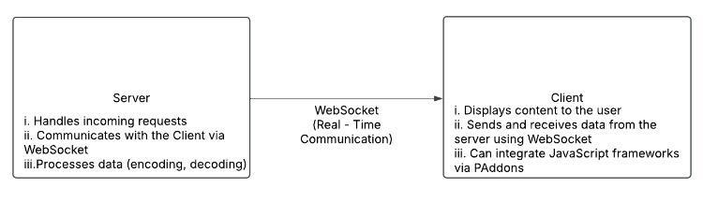
Problem Statement
Able to encode something we want to predict
Do not encode something we can not predict

Slide 7
Problem Statement
Research Focus?
Leverage transformer-based generative models
Develop a dynamic dictionary approach to identify recurring data paths.
Encoding/Decoding
Latency & Real Time Management
2
4
1
3
Bandwidth constraints
Redundant data transmission

Slide 8
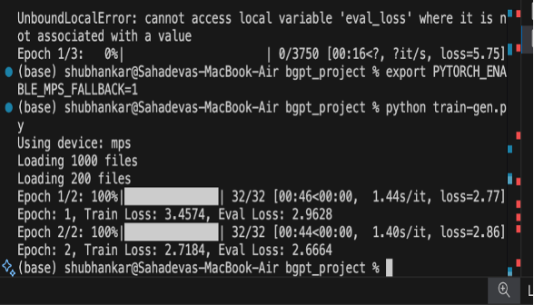
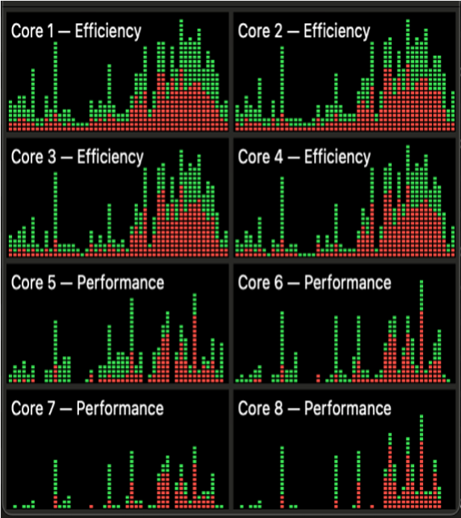
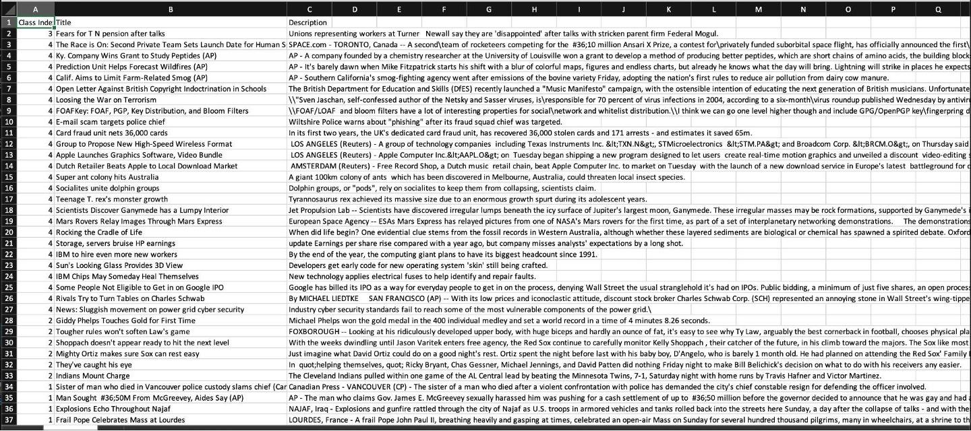
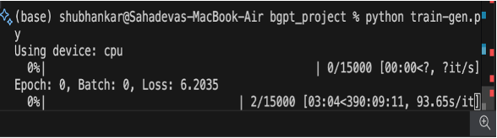
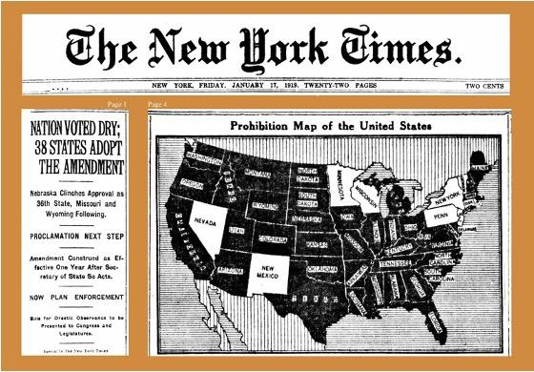
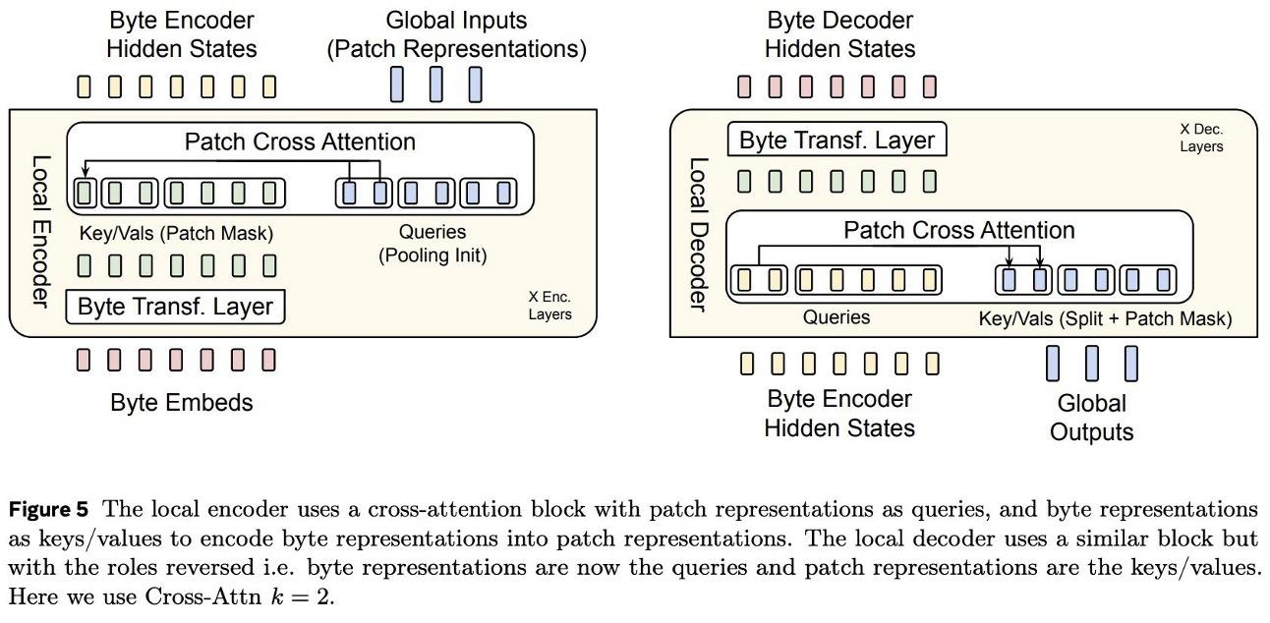
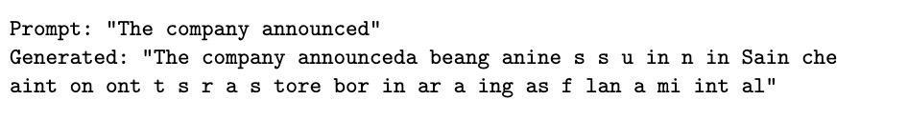
Implementation
Dataset & Preprocessing
Performance Analysis
2
4
1
3
Model Architecture and Training
Implications

Slide 9
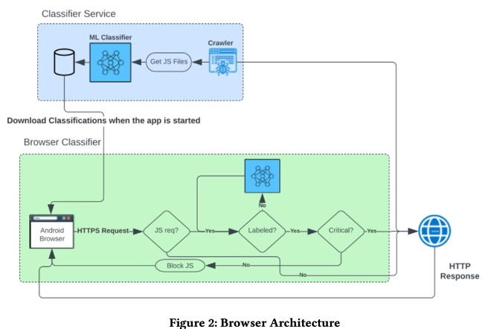
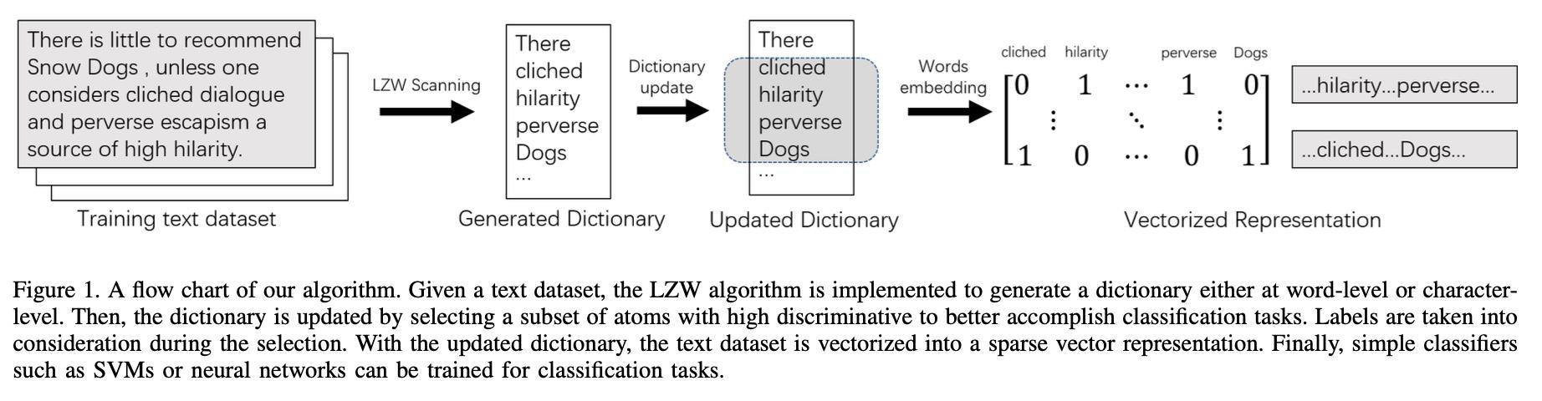
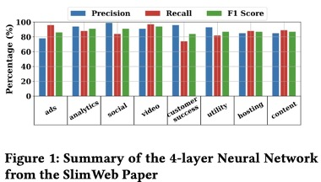
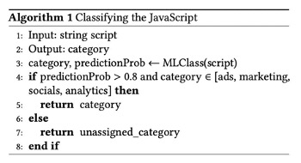
Classification & Compression

Slide 10
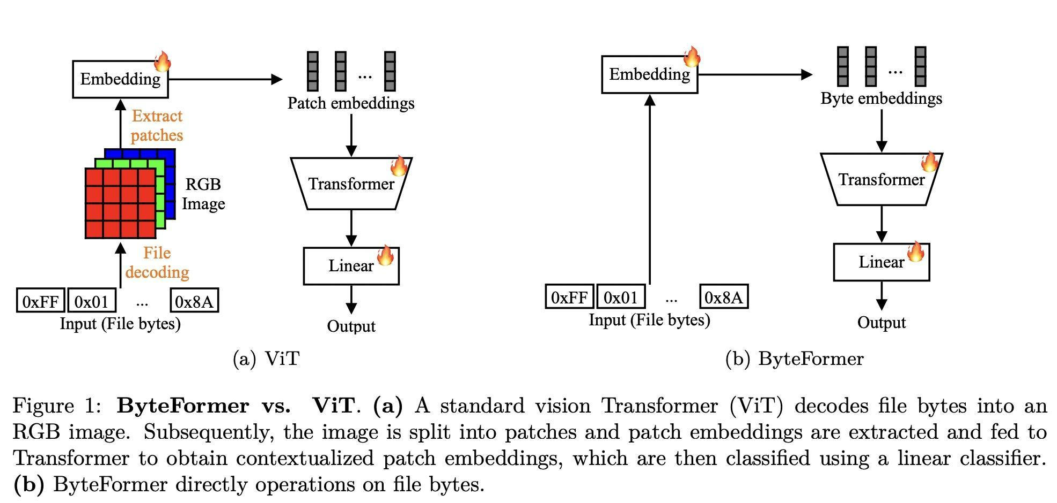
Byte Transformer
Process raw bytes
without intermediate tokenization.
Employ patching mechanisms
to break long sequences into manageable units.
Hierarchical designs:
local (intra-patch) and global (inter-patch) modules.
Dual-decoder strategies
(e.g., patch-level decoder and byte-level decoder).
Ex: ByteGPT, MegaByte, MambaByte, Byte Latent Transformer.
why we will not use it

Slide 11
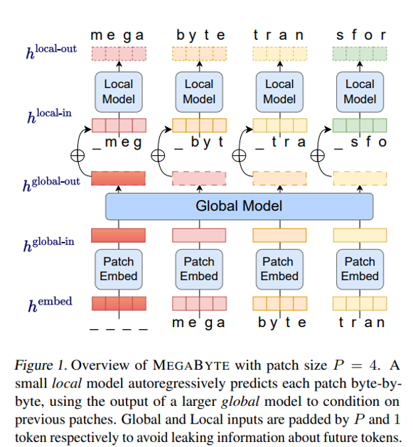
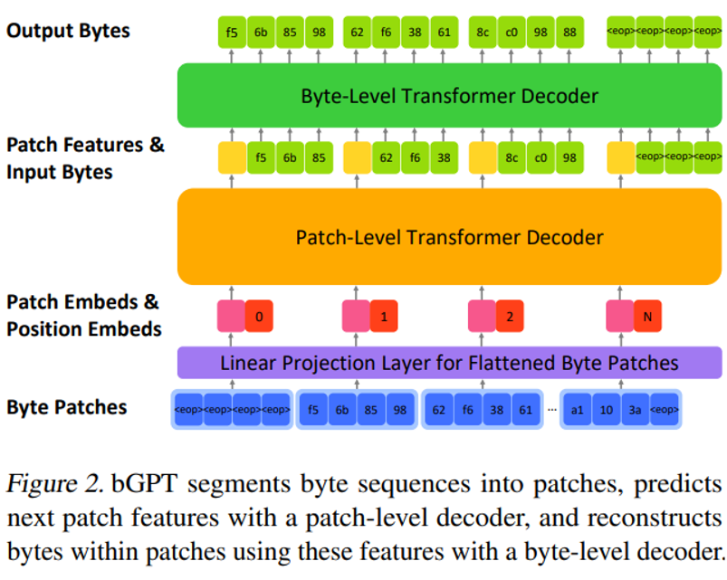
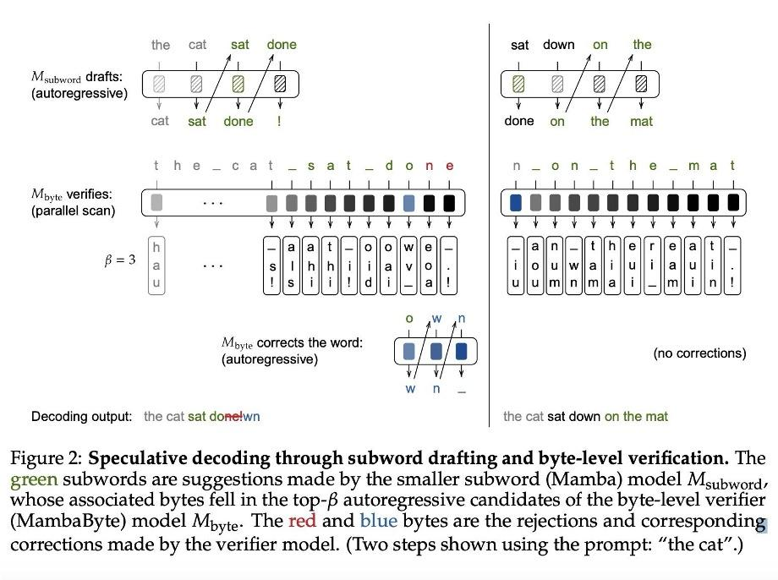
Byte Transformer I

Slide 12
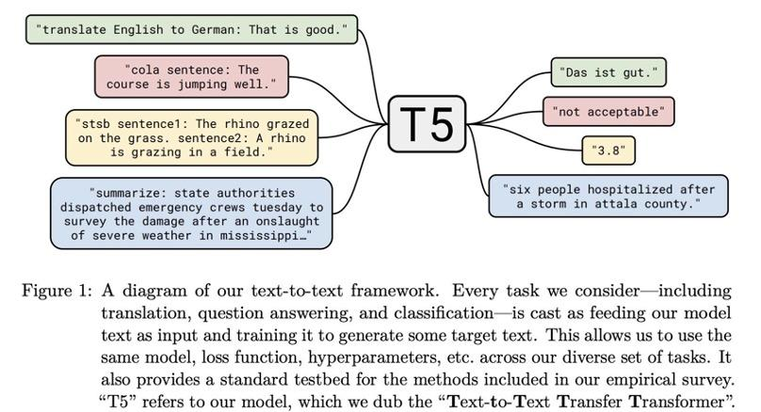
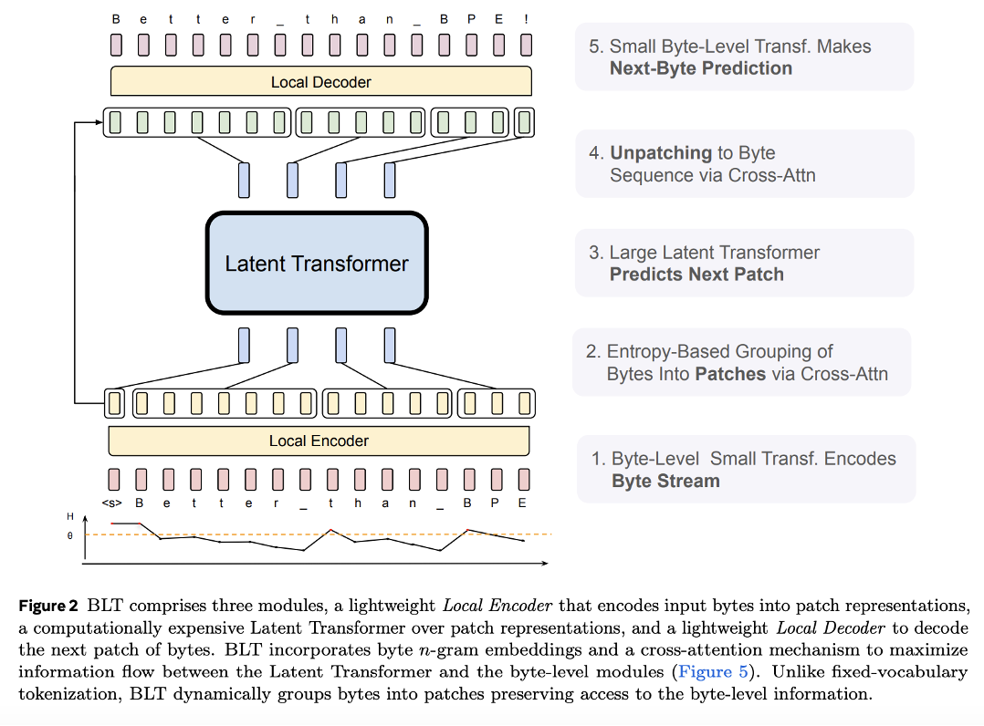
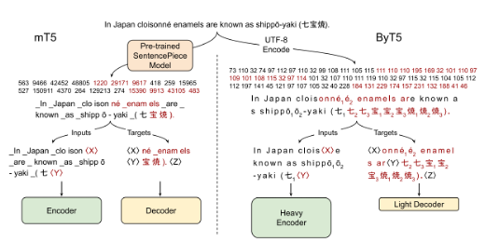
Byte Transformer II

Slide 13
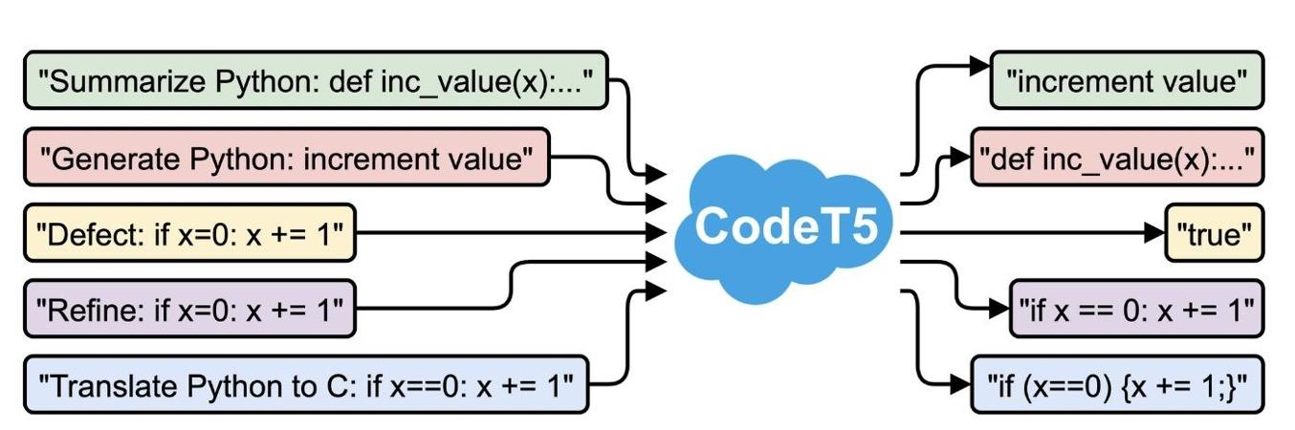
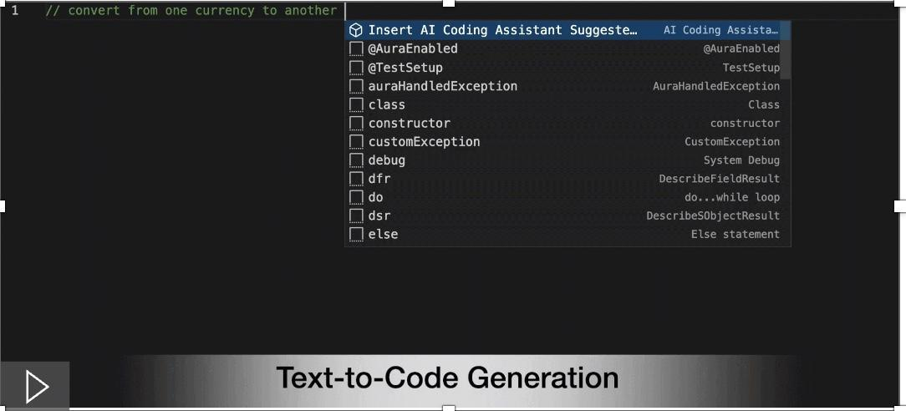
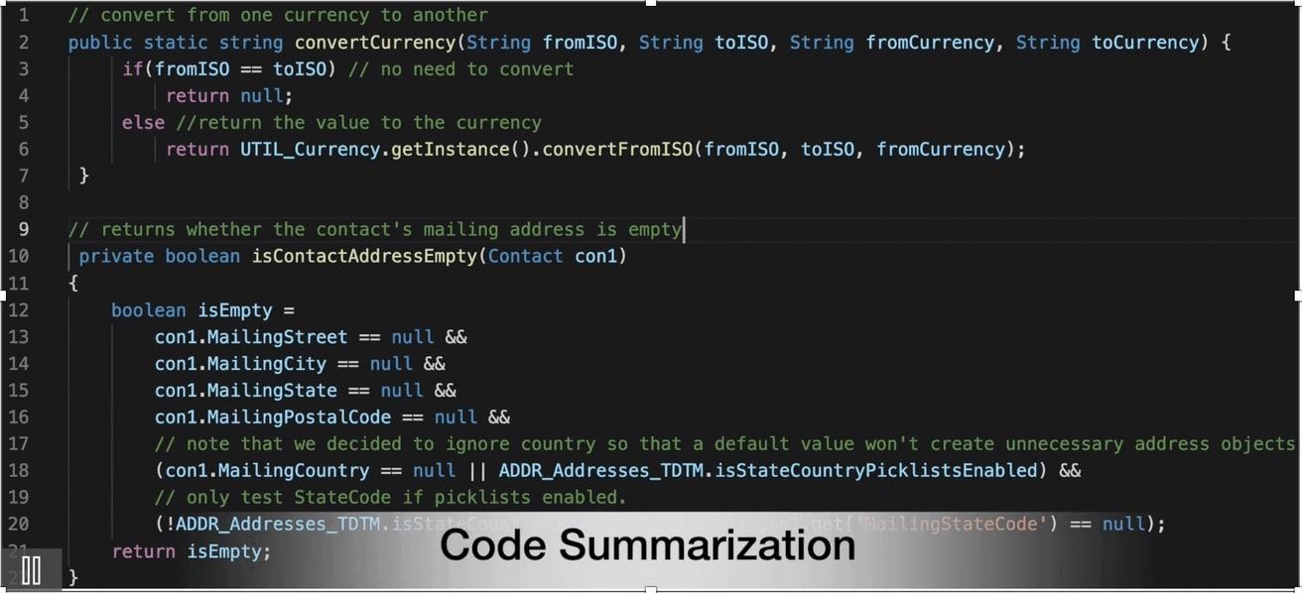
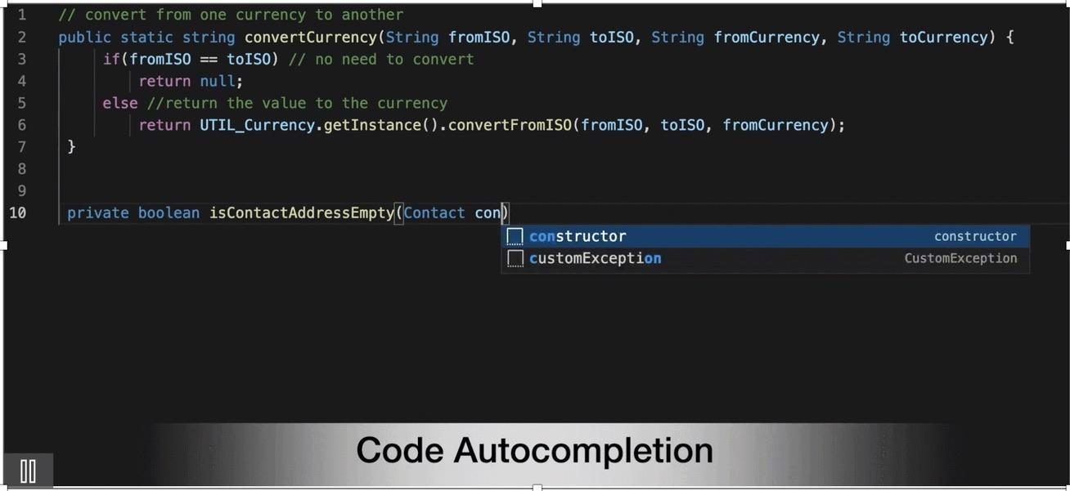
Byte Transformer : Code T5

Slide 14
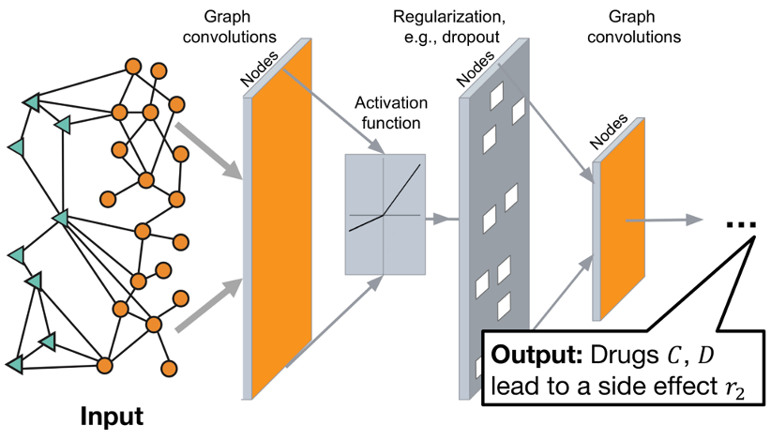
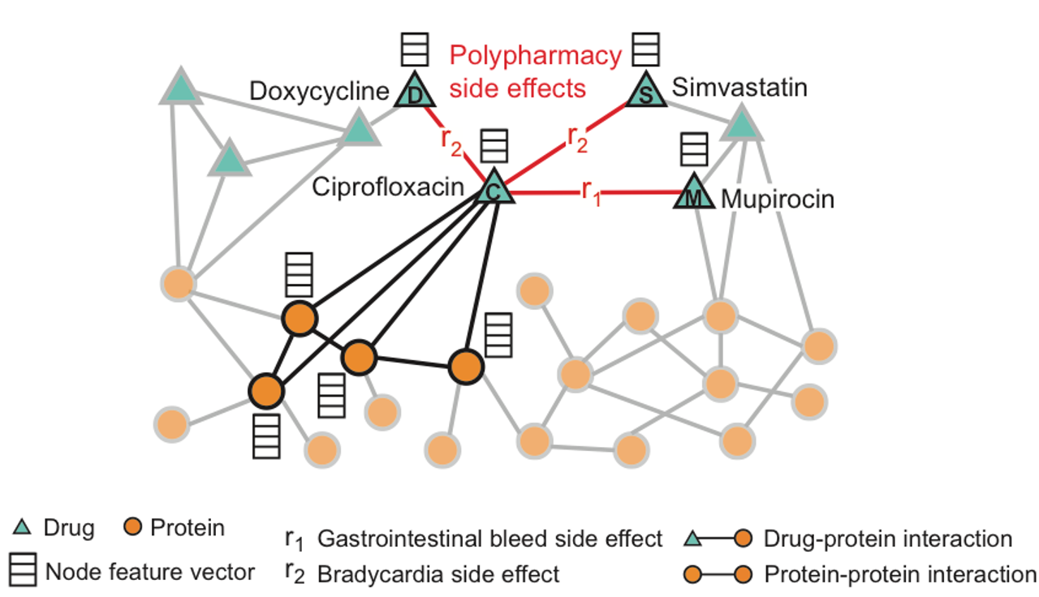
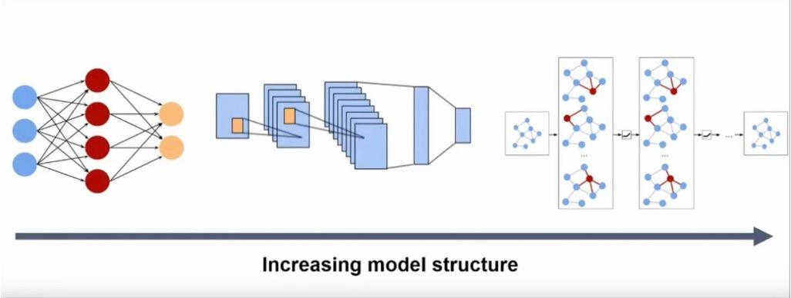
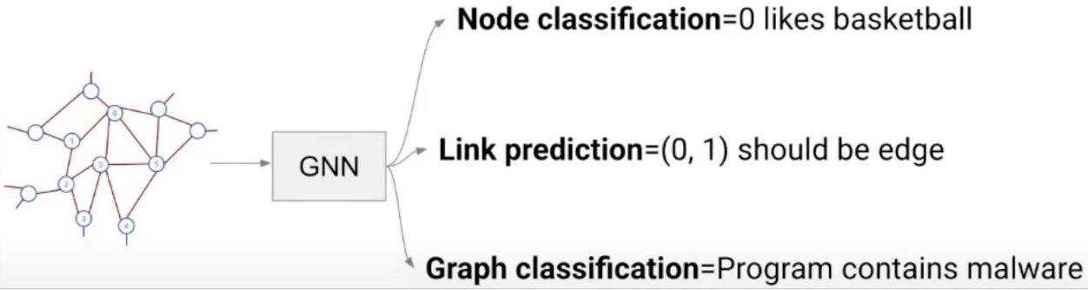
Graphs?

Slide 15
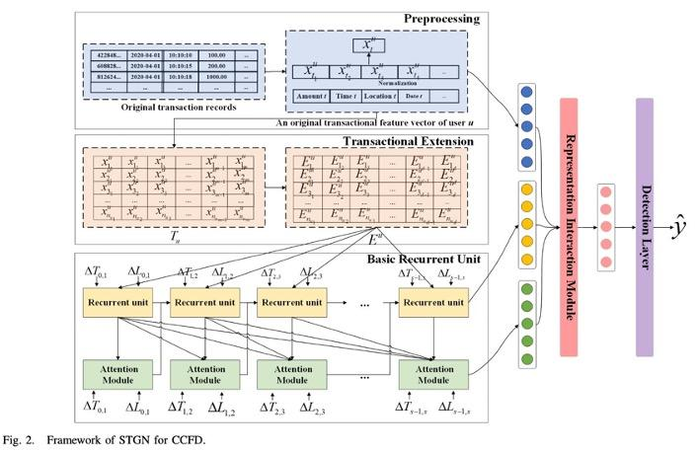
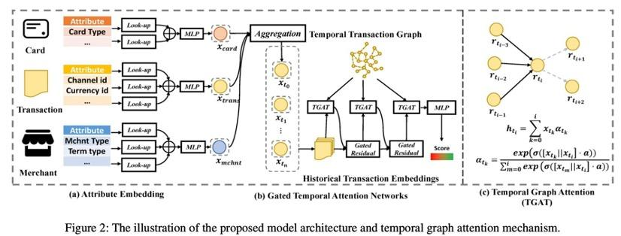
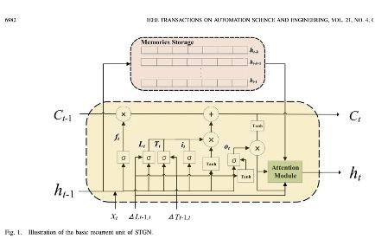
Gates?

Slide 16
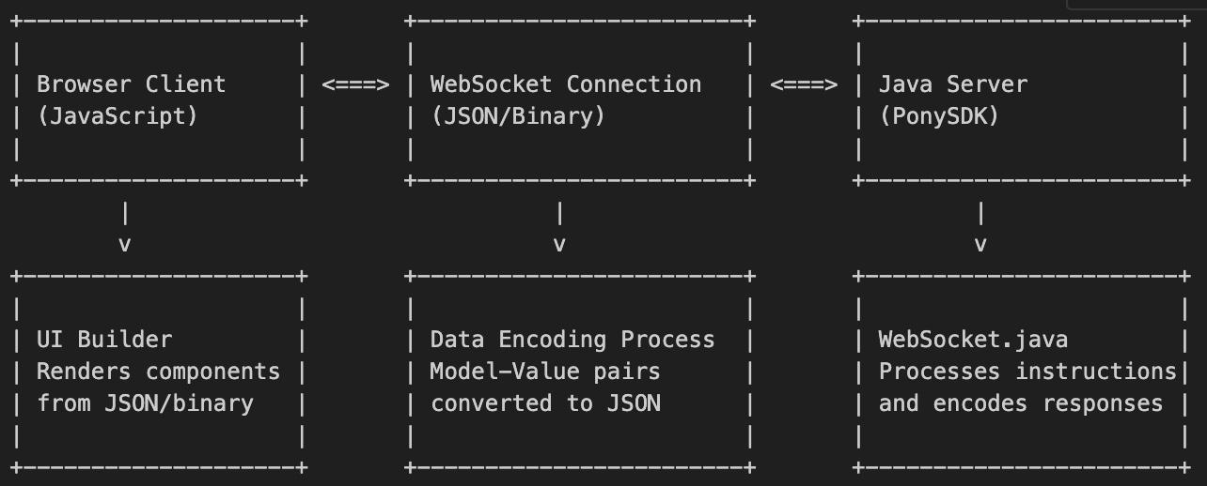
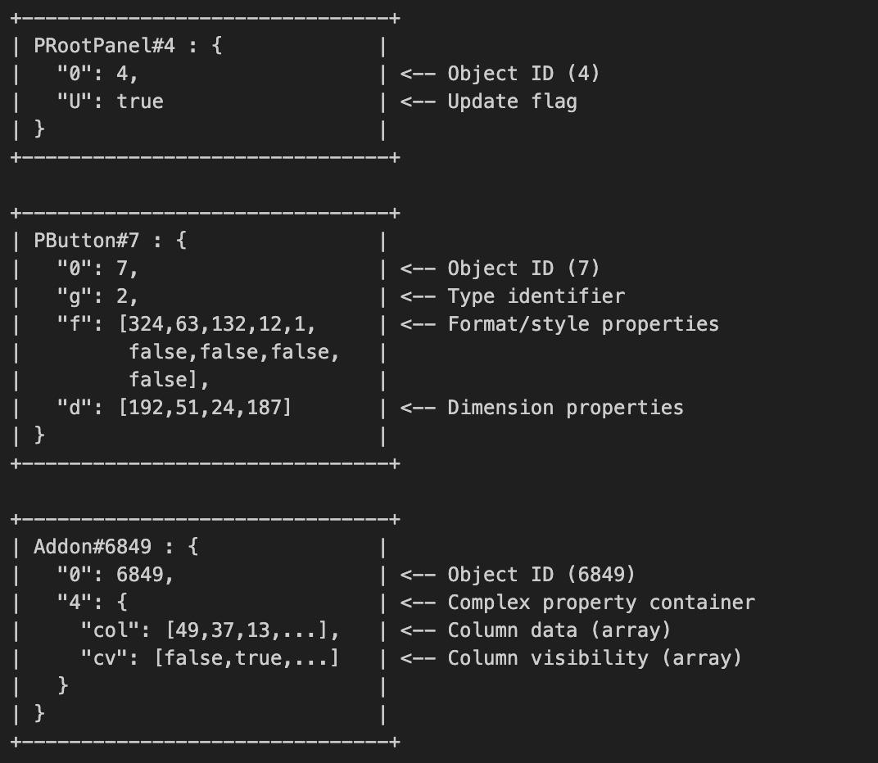
Mise à jour du statut : 1 mois
Document Object Model - it's the programming interface for web documents that represents the page structure as a tree of objects
Message Reception & Classification
Instruction Interpretation
change the pictures
See if the client already has it
change the graph
Received at Web Socket Server
2
4
1
3
Embedded in Dictionary And Checked at Client
Data Extraction
UI Manipulation
handled by
UIBuilder & Component specific handler
Notes:
application instruction -> encode
application instructiçon -> encode -> predict

Slide 17
Future Plan
what to do with dynamic dictionary
updating dictionary
pushing in server and client side
all the important things, also explained and with schema
Step 1 : static (ongoing)
step 2: dynamic
Notes:
application instruction -> encode
application instructiçon -> encode -> predict

Slide 18
References
ByteGPT: Beyond Language Models for Byte-Level Digital World Simulation. Zheng, Yao et al. 2024. arXiv preprint arXiv:2402.19155.
MegaByte: Predicting Million-byte Sequences with Multiscale Transformers. Yu, Lili et al. 2023. arXiv preprint arXiv:2305.07185.
MambaByte: Token-Free State Space Models for Byte-Level Language Modeling. Dao, Tri et al. 2024. arXiv preprint arXiv:2401.13660.
ByT5: Towards a token-free future with pre-trained byte-to-byte models. Xue, Linting et al. 2021. Transactions of the Association for Computational Linguistics.
CodeT5: Identifier-aware Unified Pre-trained Encoder-Decoder Models for Code Understanding and Generation. Wang, Yue et al. 2021. EMNLP 2021.
Byte Latent Transformer: Patches Scale Better than Tokens. Meta AI Research. 2024. Meta AI Research Publication.
DocScript: Document-level Script Event Prediction.. 2024. LREC 2024.
Annotating FrameNet via Structure-Conditioned Language Generation. 2024. arXiv preprint arXiv:2406.04834.
How Powerful are Graph Neural Networks? Xu, Keyulu et al. 2018. arXiv preprint arXiv:1810.00826.
CodeBERT: A Pre-Trained Model for Programming and Natural Languages. Feng, Zhangyin et al. 2020. EMNLP 2020.
CodeXGLUE: A Machine Learning Benchmark Dataset for Code Understanding and Generation. Lu, Shuai et al. 2021. arXiv preprint arXiv:2102.04664.
Accelerating Mobile Web Performance through JavaScript Classification on the Browser. Silwal, Sashank. 2023. NYUAD Capstone Project 2 Reports, Spring 2023 ​.
Lightweight Text Classification Using LZW Compression. Wan, Li et al. 2024.

Slide 19
Q & A
Notes:
Recommendation : 5 minutes

