Slide 1
Aid Escalating Internet Coverage
Santhil Kalantre MT2022102
Shubhanshi Bhandari MT2022112

Slide 2
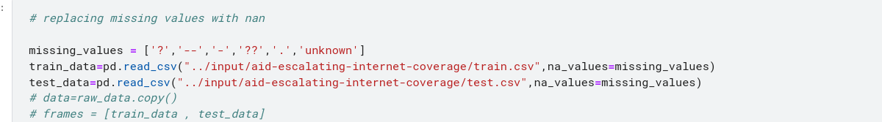
EDA and Preprocessing
1.Replacing ‘?’ with nan
2. Merging train and test dataset for uniform preprocessing
3. Columns with na values are 'alchemy_category', 'alchemy_category_score', 'is_news', 'news_front_page'
4.is_news has only null or 1 , frame_based has only 0, news_front_page 1, 0 and nan.have dropped all three of these.
5. Dataset has no duplicate rows

Slide 3
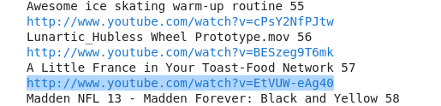
6. Alchemy category and alchemy score are tightly coupled and so are is_news and news_front_page as they have null values for same rows
7.common_word_link_ratio_1 ,common_word_link_ratio_2 common_word_link_ratio_3 are highly correlated and also, common_word_link_ratio_3 are highly correlated with common_word_link_ratio_4 and embedded ratio and commpressed ratio are highly correlated.
Therefore have dropped "embed_ratio", "common_word_link_ratio_2", "common_word_link_ratio_3".
8. Used outlier detection and removal using iqr and also used robust scaler on numerical features..
9.link , page description and alchemy category are having categorical data specifically text.
10. page _descprition is column with json decoded strings which contained ‘url’ ,’title’ and ‘body’ keys.
11. We dropped link as in almost all the cases it is already included in the url key of page description and 60 rows in which url is not present the link does not contribute to nay information and is youtube link like:

Slide 4
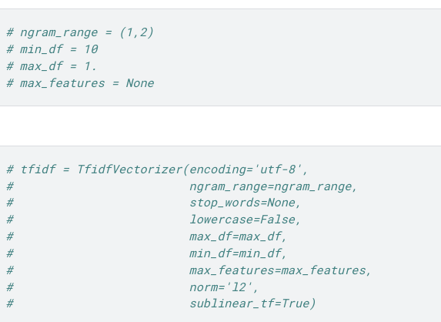
Nlp for page description features
First we used tfidf with the regular expression for text cleansing and stop word removal and lemmatization

Slide 5
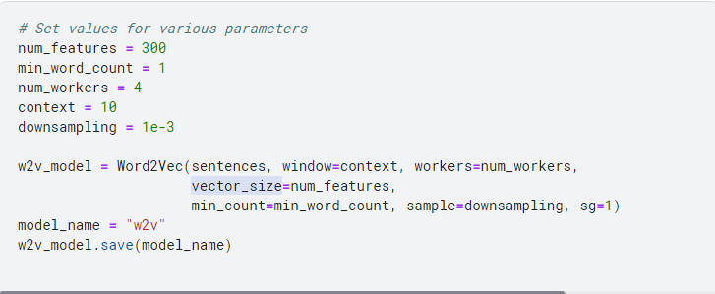
2. We used word2vec after similar kind text preprocessing as in tfidf , to form vectors we used vector averaging
After both tfidf and word2 vec we dropped pagedescriptions,link ,link_id as after getting the vectors they are redundant.

Slide 6
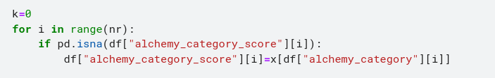
Last thing that we did in preprocessing was to predict the alchemy category where it was nan . for that we used decision tree classifier on the vectors from tfidf or word2vec and the not nan alchemy category as train .
For alchemy score we replaced it with category wise mean for its corresponding alchemy category.

Slide 7
Firstly , we applied various model on the dataset after TFIDF we also did hyper parameter tuning for every model mentionioned below, and following are the models and their kaggle score:
Random forest : kaggle score-.8747
Logistic regression: kaggle score-.8767(The best result with TFIDF )
Decision tree : kaggle score-.7370
Xgboost : kaggle score-.87212
Model Training and prediction

Slide 8
Next , we applied all those model on the dataset after Outlier Detection and removal and with hyper parameter tuning, and following are the models and their kaggle score:
Random forest with Outlier : kaggle score-.8441
Logistic regression with outlier : kaggle score-.8491
Decision tree with outlier : kaggle score-.6804
Xgboost : kaggle score-.83771

Slide 9
Next , we applied all those hyper-parameter tuned model on the dataset after Word2Vec and Outlier Detection and removal, and following are the models and their kaggle score:
Random forest with Outlier : kaggle score-.8769
Logistic regression with outlier : kaggle score-.8746
Decision tree with outlier : kaggle score-.75105
Xgboost with outlier: kaggle score-.8796
SVC with outlier: kaggle score-.8764

Slide 10
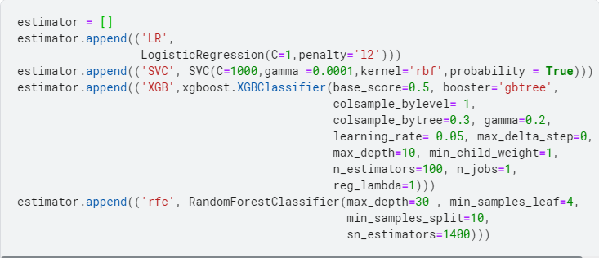
Finally, we decided upon using Voting Classifier with LogisticRegression, SVC, Xgboost and RandomForestClassifier with all parameters from previously run models which were hyper parameter tuned.

Slide 11
With voting classifier finally ready the score we got on Kaggle was 0.88284.
This was the best result till now !!!
Finally to conclude, we used:
Decision Tree Classifier( For alchemy category prediction).
IQR Method of outlier detection.
Word2Vec for vectoring the page description column.
Voting classifier ensemble with above mentioned Models.

Slide 12
Team Contributions:
Shubhanshri Bhandari (MT2022112):
EDA
Preprocessing
NLP(Word2Vec)
Model Implementation
Santhil Kalantre (MT2022102):
Preprocessing(Cont.)
NLP (TFIDF)
Model (Cont.)
HyperParameter Tuning

Slide 13
Scope for improvement :
1. We could have used more models in alchemy category prediction and could have done hyper parameter tuning of those model.
2. Alchemy category score could be predicted with some model
3. Other approaches like bertor glove could have been used .
4.is_news and new_front_page could be analysed more or maybe predicted via webscraping or some other models
5. Could have used mlp or other nn models.

