Slide 1




Git & Github Introduction (1)
Elaine Ding
Digital Developer in Fenwick Library
George Mason University

Slide 2
Objectives
Version Control
Git , Git repository
Git vs Github
Setup git environment
Create a git repository ( adding file, adding folder)
Checkout different version/ignore files…
Git tools

Slide 3
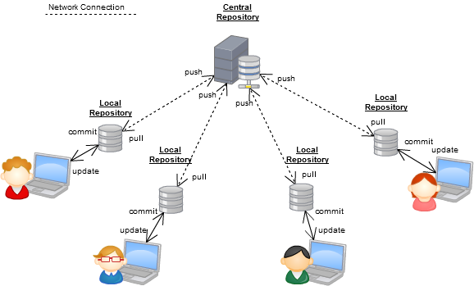
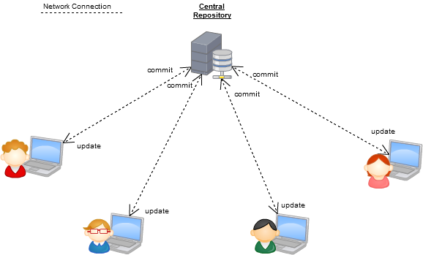
Version Control Systems
Some well-known version control systems are CVS, Subversion, Mercurial, and Git

Slide 4
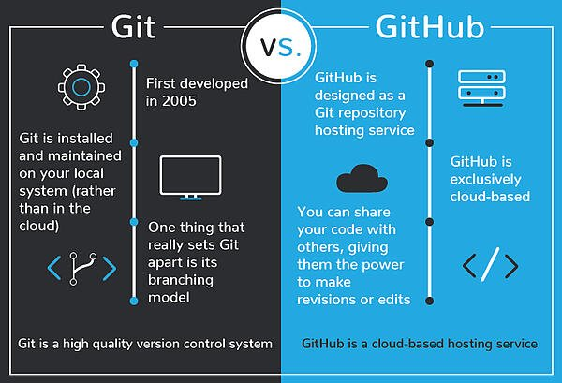
Git vs GitHub

Slide 5
Download and install Git
Here’s the standard one:
http://git-scm.com/downloads
Git Repository is a place where Git can store versions of our files
  $ cd ~/gitclass
  $ mkdir demo
  $ cd demo
  $ git init
  $ dir /ah or $ ls -a (* .git directory to store all the tracing info)

Slide 6
Introduce yourself to Git
Enter these lines (with appropriate changes):
  git config user.name "John Smith"
  git config user.email jsmith@gmu.edu
--global param

Slide 7
command | description
git clone url [dir] | copy a git repository so you can add to it
git add files | adds file contents to the staging area
git commit | records a snapshot of the staging area
git status | view the status of your files in the working directory and staging area
git diff | shows diff of what is staged and what is modified but unstaged
git help [command] | get help info about a particular command
git pull | fetch from a remote repo and try to merge into the current branch
git push | push your new branches and data to a remote repository
others: init, reset, branch, checkout, merge, log, tag
Git Command

Slide 8
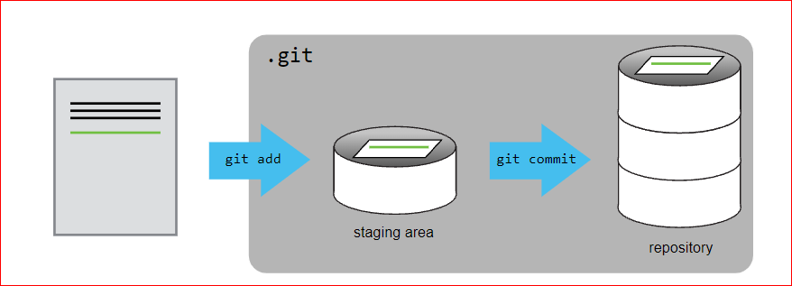
Adding a file to git repository

Slide 9
Adding a file to git repository
Create a rose.txt file ,copy rose.txt to demo folder
$git checkout -b main
Git status $git status
$ git add rose.txt
$ git status
$ git commit -m “my first file checked in “
$ git log

Slide 10
Continue…
Change rose.txt file
$git status
$git diff
$git commit -a –m “new message….”

Slide 11
git diff HEAD~1 mars.txt
Adding new folder
$mkdir poem
copy two text files to that poem folder
$git add poem

Slide 12
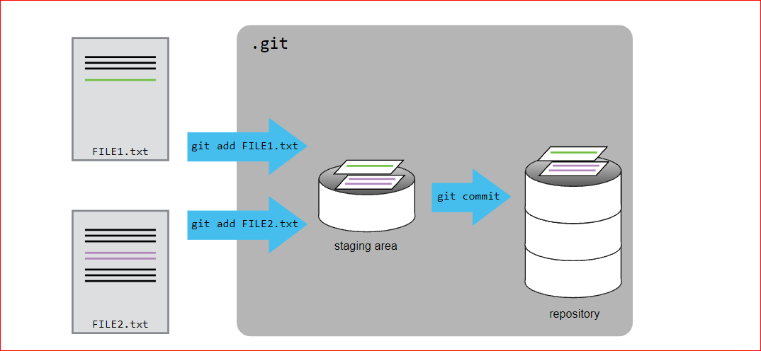
Adding Multimpule files…

Slide 13
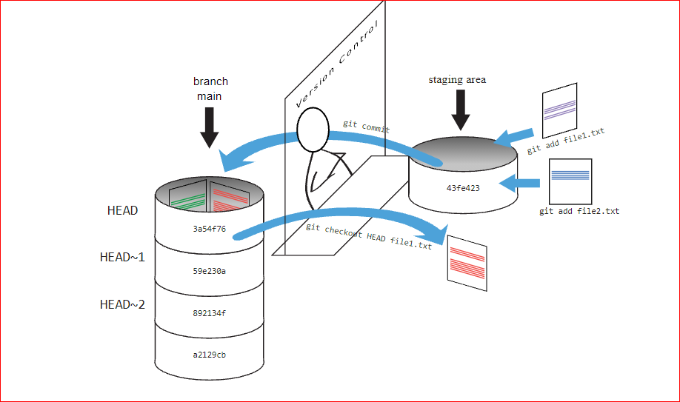

Slide 14
Checking previous version
$ git diff HEAD~1 rose.txt
$git checkout HEAD~1 rose.txt
$git checkout HEAD rose.txt

Slide 15
Ignoring Things
Configure Git to ignore specific files.
Explain why ignoring files can be useful.
Copy results folder with files
Create .gitignore file
Add
    *.dat
    results/

Slide 16
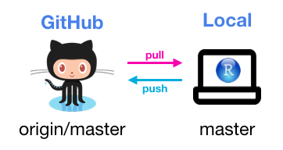
Thank You

