Slide 1

introduction,
searching,

Slide 2
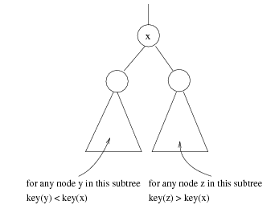
Binary Search Trees (BST)
A data structure for efficient searching, insertion and deletion
Binary search tree property
  For every node X
  All the keys in its left
  subtree are smaller than
  the key value in X
  All the keys in its right
  subtree are larger than the
  key value in X

Slide 3

Binary Search Trees
A binary search tree
Not a binary search tree

Slide 4

Binary Search Trees
The same set of keys may have different BSTs
Average depth of a node is O(log N)
Maximum depth of a node is O(N)

Slide 5
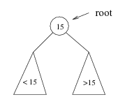
Searching BST
If we are searching for root (15), then we are done.
If we are searching for a key < root , then we should search in the left subtree.
If we are searching for a key > root, then we should search in the right subtree.

Slide 6
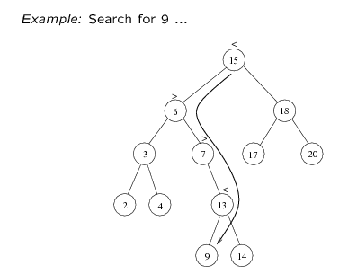
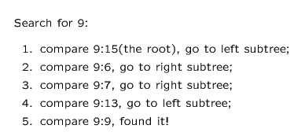

Slide 7
Searching (Find)
FIND(info, left, right, root, item, loc, par)- finds the item in tree T with root is root and info, left and right is three linked represented in memory. This algorithm returns loc i.e. location of item and par i.e. parent.
[Tree Empty??]
        if root==NULL, then set LOC=NULL & PAR=NULL and return.
[Item root ??]
      If item==INFO[ROOT], then LOC=ROOT & PAR=NULL and return.
[Initialize pointer ptr and save]
      If item<INFO[ROOT]
      then set PTR = LEFT[ROOT] and SAVE=ROOT
      Else
      set PTR = RIGHT[ROOT] and SAVE=ROOT
      [End of if]
Repeat 5 and 6 while ptr!=NULL
[item found??]
    If ITEM==INFO[PTR], then set LOC=PTR and PAR=SAVE, and return.
If ITEM<INFO[PTR], then SAVE=PTR and PTR=LEFT[PTR]
  Else
  Set SAVE=PTR and PTR=RIGHT[PTR]
[Search unsuccessful] Set, LOC=NULL and PAR = SAVE
Exit
Time complexity: O(height of the tree)

Slide 8


