Slide 1

sorting
insertion

Slide 2
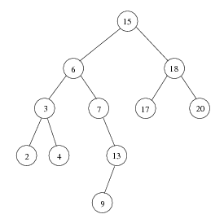
Sorting: Inorder Traversal of BST
Inorder Traversal of BST prints out all the keys in sorted order
Inorder: 2, 3, 4, 6, 7, 9, 13, 15, 17, 18, 20

Slide 3
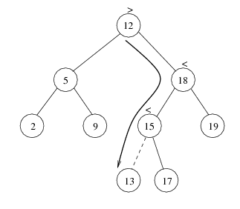
Insertion
Proceed down the tree as you would with a find
If X is found, do nothing (or update something)
Otherwise, insert X at the last spot on the path traversed
Time complexity = O(height of the tree)

Slide 4
Inserting (ADD node)
INSBST(info, left, right, root, item, loc, avail)- insert the item in tree T with root is root and info, left and right is three linked represented in memory. This algorithm returns loc i.e. location of item or ADD item as new node in tree.
Call FIND(INFO, LEFT, RIGHT, ROOT, ITEM, LOC, PAR)
If LOC!=NULL, then Exit.
[Copy ITEM into new node in AVAIL list]
      If AVAIL==NULL, Print “OVER FLOW”;
      Set NEW=AVAIL, AVAIL=LEFT[AVAIL] and INFO[NEW]=ITEM.
      Set LOC=NEW,LEFT[NEW]=RIGHT[NEW]=NULL
[ADD ITEM to TREE]
  If PAR=NULL then, Set ROOT=NEW.
  Else IF ITEM<INFO[PAR] , Set LEFT[PAR]=NEW
  Else Set RIGHT[PAR]=NEW
Exit
Time complexity: O(height of the tree)

Slide 5


