Slide 1

deletion

Slide 2


Deletion
When we delete a node, we need to consider how we take care of the children of the deleted node.
This has to be done such that the property of the search tree is maintained.

Slide 3
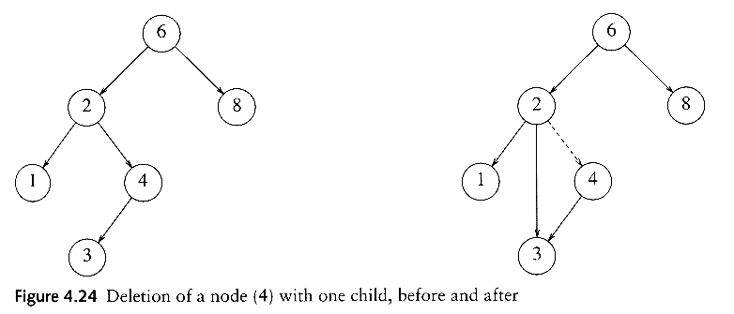
Deletion under Different Cases
Case 1: the node is a leaf
  Delete it immediately
Case 2: the node has one child
  Adjust a pointer from the parent to bypass that node

Slide 4
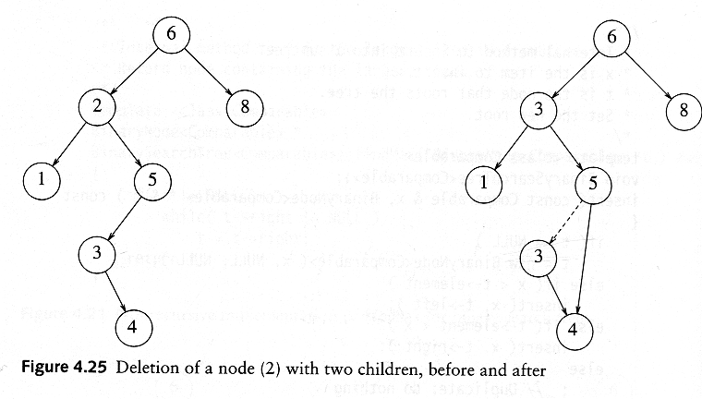
Deletion Case 3
Case 3: the node has 2 children
  Replace the key of that node with the minimum element at the right subtree
  Delete that minimum element
    Has either no child or only right child because if it has a left child, that left child would be smaller and would have been chosen. So invoke case 1 or 2.
Time complexity = O(height of the tree)

Slide 5
Deletion Algorithm
DEL(INFO, LEFT, RIGHT, ROOT, AVAIL, ITEM)
A binary search tree T is in memory, and an ITEM of information is given. This algorithm delete ITEM from the tree.
Call FIND(INFO, LEFT, RIGHT, ROOT, ITEM, LOC, PAR)
If LOC=NULL, then write ITEM not in tree and Exit
If RIGHT[LOC]!=NULL and LEFT[LOC]!=NULL, then:
Call CASEB(INFO, LEFT, RIGHT, ROOT, LOC, PAR)
Else:
Call CASEA(INFO, LEFT, RIGHT, ROOT, LOC, PAR)
Set LEFT[LOC]:=AVAIL and AVAIL :=LOC.
Exit

Slide 6
CASEA: only one or, no child
CASEA(INFO, LEFT, RIGHT, ROOT, LOC, PAR)-delete the Node N at location LOC, where N doesn’t have two Children. PAR is location of parent node or, PAR=NULL i.e. ROOT node.
[initialize CHILD]
  If LEFT[LOC]=NULL and RIGHT[LOC]=NULL, then
  CHILD=NULL
  Else if LEFT[LOC]!=NULL , then CHILD=LEFT[LOC]
  Else CHILD=RIGHT[LOC]
If PAR != NULL then: (i.e. NOT A ROOT NODE)
  If LOC=LEFT[PAR], then set LEFT[PAR]=CHILD
  Else RIGHT[PAR]=CHILD
  [End of IF]
  Else set ROOT=CHILD.
  [End of IF]
Exit

Slide 7
CASEB: has 2 children
CASEB(INFO, LEFT, RIGHT, ROOT, LOC, PAR)-delete the Node N at location LOC, where N has two Children. PAR is location of parent node or, PAR=NULL i.e. ROOT node. SUC gives location of inorder successor and PARSUC gives location of parent of inorder successor .
[Find SUC and PARSUC]
  Set PTR=RIGHT[LOC] and SAVE=LOC
  Repeat while LEFT[PTR]!=NULL
    Set, SAVE=PTR and PTR=LEFT[PTR]
    [END OF LOOP]
  Set SUC=PTR and PARSUC=SAVE.
[Delete SUC] Call CASEA(INFO, LEFT, RIGHT, ROOT, SUC,PARSUC)
[replace node N by SUC]
a) If PAR != NULL then: (i.e. NOT A ROOT NODE)
  If LOC=LEFT[PAR], then set LEFT[PAR]=SUC
  Else RIGHT[PAR]=SUC
  [End of IF]
  Else set ROOT=SUC.
  [End of IF]
  b) Set, LEFT[SUC]=LEFT[LOC] and
  RIGHT[SUC]=RIGHT[LOC]
4. Exit

Slide 8


