Slide 1

Introduction

Slide 2
Balance Binary Search Tree
Worst case height of binary search tree: N
  Insertion, deletion can be O(N) in the worst case
We want a tree with small height
Height of a binary tree with N node is at least Θ(log N)
Goal: keep the height of a binary search tree O(log N)
Balanced binary search trees
  Examples: AVL tree, red-black tree

Slide 3
Balanced Tree?
Suggestion 1: the left and right subtrees of root have the same height
Suggestion 2: every node must have left and right subtrees of the same height
Our choice: for each node, the height of the left and right subtrees can differ at most 1,-1,0.

Slide 4
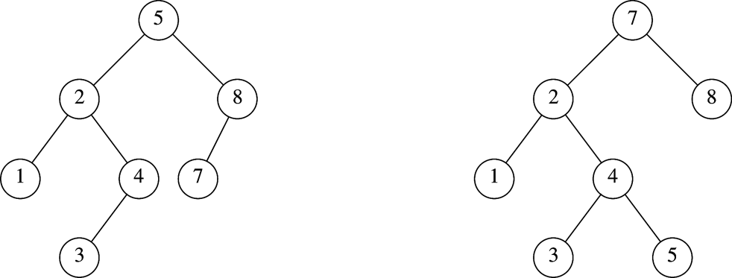
AVL Tree
An AVL (Adelson-Velskii and Landis 1962) tree is a binary search tree in which
  for every node in the tree, the height of the left and right subtrees differ by at most 1.
AVL tree
AVL property violated here

Slide 5

N₁ = 1
N₂ = 2
N₃ =4
N₄ = N₂+N₃+1=7

Slide 6
Height of AVL Tree
Denote N_{h} the minimum number of nodes in an AVL tree of height h
N₁=1, N₂ =2 (base)
N_{h}= N_{h-1} + N_{h-2} +1 (recursive relation)
many operations (i.e. searching) on an AVL tree will take O(log N) time

Slide 7



