Slide 1

Arithmetic expressions: polish notation, evaluation and transformation of expressions.

Slide 2
Postfix Notation(RPN)
Polish notation, also known as prefix notation.
It is a symbolic logic invented by Polish mathematician Jan Lukasiewicz in the 1920's.
Most compilers convert an expression in infix notation to postfix
  the operators are written after the operands
So a * b + c becomes a b * c +
Advantage:
  expressions can be written without parentheses

Slide 3
Postfix and Prefix Examples
INFIX POSTFIX PREFIX
A + B
A * B + C
A * (B + C)
A - (B - (C - D))
A - B - C - D
A B +
+ A B
A B * C +
+ * A B C
A B C + *
* A + B C
A B C D---
-A-B-C D
A B-C-D-
---A B C D
Prefix : Operators come before the operands

Slide 4

"By hand" (Underlining technique):
1. Scan the expression from left to right to find an operator.
2. Locate ("underline") the last two preceding operands
and combine them using this operator.
3. Repeat until the end of the expression is reached.
Example:
2 3 4 + 5 6 - - *
→ 2 3 4 + 5 6 - - *
→ 2 7 5 6 - - *
→ 2 7 5 6 - - *
→ 2 7 -1 - *
→ 2 7 -1 - * →
2 8 * →
16
2 8 * →

Slide 5
Evaluating RPN Expressions
P is an arithmetic expression in Postfix Notation.
Add a right parenthesis “)” at the end of P.
Scan P from left to right and Repeat Step 3 and 4 for each element of P until the sentinel “)” is encountered.
If an operand is encountered, put it on STACK.
If an operator @ is encountered, then:
(a) Remove the two top elements of STACK, where A is the top element and B is the next to top element.
(b) Evaluate B @ A.
(c) Place the result of (b) back on STACK.
[End of if structure.]
[End of step 2 Loop.]
Set VALUE equal to the top element on STACK.
Exit.

Slide 6
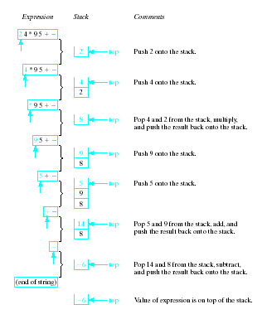
Evaluating
RPN
Expressions
Note the
changing
status of the
stack

Slide 7

By hand: "Fully parenthesize-move-erase" method:
1. Fully parenthesize the expression.
2. Replace each right parenthesis by the corresponding operator.
3. Erase all left parentheses.
Examples:
A * B + C →
((A * B) + C)
A * (B + C) →
(A * (B + C) )
→ ((A B * C +
→ A B * C +
→ (A (B C + *
→ A B C + *

Slide 8
Stack Algorithm
POLISH (Q, P)
PUSH “(” on to STACK and add “)” to the end of Q.
Scan Q from left to right and Repeat steps 3 to 6 for each element of Q until the STACK is empty:
If an operand is encountered, add it to P.
If a left parenthesis is encountered, push it onto STACK.
If an operator is encountered, then:
(a) Repeatedly POP from STACK and add to P each operator (On the TOP of STACK) which has the same precedence as or higher precedence than @.
(b) Add @ to STACK.
[End of If structure.]
If a right parenthesis is encountered, then:
(a) Repeatedly POP from STACK and add to P each operator (On the TOP of STACK.) until a left parenthesis is encountered.
(b) Remove the left parenthesis. [Don’t add the left parenthesis to P.]
[End of If Structure.]
[End of step 2 Loop.]
7. Exit.

Slide 9

By hand: "Fully parenthesize-move-erase" method:
1. Fully parenthesize the expression.
2. Replace each left parenthesis by the corresponding operator.
3. Erase all right parentheses.
Examples:
A * B + C →
((A * B) + C)
A * (B + C) →
(A * (B + C))
→ + * A B) C)
→ + * A B C
→ * A + B C ))
→ * A + B C

Slide 10
Thank You

