Slide 1

Queues:
  Array and list representation,
  Operations (traversal, insertion)

Slide 2
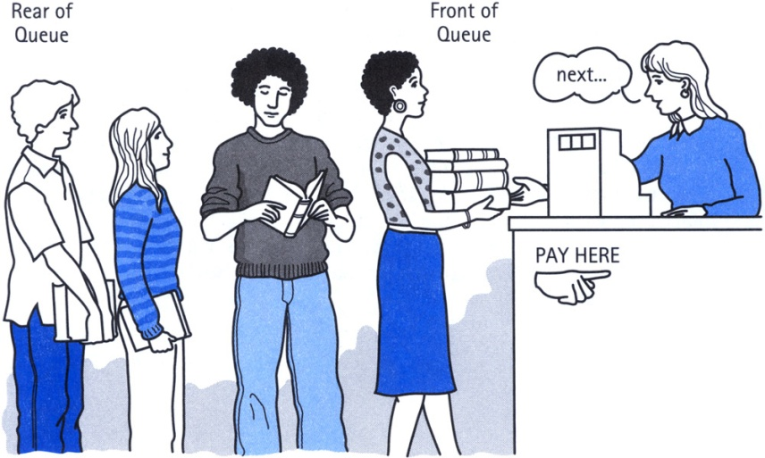
Definition of Queue
A Queue is an ordered collection of items from which items may be deleted at one end (called the front of the queue) and into which items may be inserted at the other end (the rear of the queue).
The first element inserted into the queue is the first element to be removed. For this reason a queue is sometimes called a FIFO (first-in first-out) list as opposed to the stack, which is a LIFO (last-in first-out).

Slide 3
Queue
items[MAXQUEUE-1]
. | .
. | .
. | .
items[2] | C
items[1] | B
items[0] | A
Rear=2
Front=0

Slide 4
Insert an item A
A new item (A) is inserted at the Rear of the queue
items[MAXQUEUE-1]
. | .
. | .
items[3]
items[2]
items[1]
items[0] | A | Front=0, Rear=0

Slide 5
Insert an item B
A new item (B) is inserted at the Rear of the queue
items[MAXQUEUE-1]
. | .
. | .
items[3]
items[2]
items[1] | B | Rear=1
items[0] | A | Front=0

Slide 6
Insert an item C
A new item (C) is inserted at the Rear of the queue
items[MAXQUEUE-1]
. | .
. | .
items[3]
items[2] | C | Rear=2
items[1] | B
items[0] | A | Front=0

Slide 7
Insert an item D
A new item (D) is inserted at the Rear of the queue
items[MAXQUEUE-1]
. | .
. | .
items[3] | D | Rear=3
items[2] | C
items[1] | B
items[0] | A | Front=0

Slide 8
Insert Operation(Array)
QINSERT(QUEUE, N, FRONT, REAR, ITEM)
If FRONT = 1 and REAR = N, or FRONT = REAR + 1, then :
write OVERFLOW, and Return.
2. If FRONT = NULL, then:
Set FRONT := 1 and REAR := 1.
Else if REAR = N, then:
Set REAR := 1.
Else :
Set REAR := REAR + 1.
3. Set QUEUE[REAR]:= ITEM.
4. Return.

Slide 9
Insert Operation(LL)
LINKQ_INSERT(INFO, LINK, FRONT, REAR, AVAIL, ITEM)
If AVAIL = NULL, then :
write OVERFLOW, and Exit.
2. Set NEW := AVAIL and AVAIL := LINK[AVAIL]
3. Set INFO[NEW]:= ITEM and LINK[NEW]=NULL
4. If (FRONT = NULL), FRONT := REAR := NEW
Else set LINK[REAR] := NEW and REAR := NEW
5. Exit

Slide 10
Thank You

