Slide 1

Introduction: List and Array representations,
Operations on stack (traversal, push and pop)

Slide 2
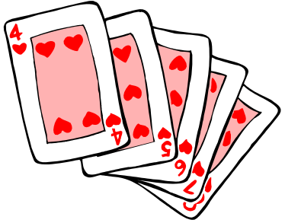
Introduction to Stacks
Consider a card game with a discard pile
  Discards always placed on the top of the pile
  Players may retrieve a card only from the top
We seek a way to represent and manipulate this in a computer program
This is a stack
What other examples can you think of that are modeled by a stack?

Slide 3
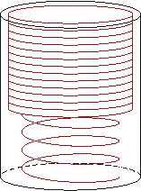
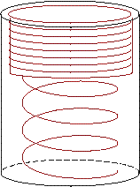
Introduction to Stacks
A stack is a last-in-first-out (LIFO) data structure
Adding an item
  Referred to as pushing it onto the stack
Removing an item
  Referred to as
  popping it from
  the stack

Slide 4
Stack
Definition:
  An ordered collection of data items
  Can be accessed at only one end (the top)
Operations:
  construct a stack (usually empty)
  check if it is empty
  Push: add an element to the top
  Top: retrieve the top element
  Pop: remove the top element

Slide 5
Stack
items[N-1]
. | .
. | .
. | .
items[2] | C
items[1] | B
items[0] | A
Top=2

Slide 6

Insert an item A
A new item (A) is inserted at the Top of the stack
items[N-1]
. | .
. | .
items[3]
items[2]
items[1]
items[0] | A | Top=0

Slide 7
Insert an item B
A new item (B) is inserted at the Top of the stack
items[N-1]
. | .
. | .
items[3]
items[2]
items[1] | B | Top=1
items[0] | A

Slide 8
Insert an item C
A new item (C) is inserted at the Top of the stack
items[N-1]
. | .
. | .
items[3]
items[2] | C | Top=2
items[1] | B
items[0] | A

Slide 9
Insert an item D
A new item (D) is inserted at the Top of the stack
items[N-1]
. | .
. | .
items[3] | D | Top=3
items[2] | C
items[1] | B
items[0] | A

Slide 10
Insert Operation(Array)
PUSH(STACK, N, TOP, ITEM)
If TOP=N-1: //LB=0
then write OVERFLOW, and Return.
2. Set TOP := TOP + 1.
3. Set STACK[TOP]:= ITEM.
4. Return.

Slide 11
Delete D
an item (D) is deleted from the Top of the stack
items[N-1]
. | .
. | .
items[3] | D
items[2] | C | Top=2
items[1] | B
items[0] | A

Slide 12
Delete C
an item (C) is deleted from the Top of the stack.
items[N-1]
. | .
. | .
items[3] | D
items[2] | C
items[1] | B | Top=1
items[0] | A

Slide 13
Delete B
an item (B) is deleted from the Top of the stack
items[N-1]
. | .
. | .
items[3] | D
items[2] | C
items[1] | B
items[0] | A | Top=0

Slide 14
Delete A
an item (A) is deleted from the Top of the stack.
items[N-1]
. | .
items[4]
items[3] | D
items[2] | C
items[1] | B
items[0] | A | Top=-1

Slide 15
Delete Operation(Array)
POP(STACK, N, TOP, ITEM)
If TOP = -1 then : //LB=0
write: UNDERFLOW, and Return.
2. Set ITEM := STACK [TOP].
3. Set TOP := TOP - 1.
4. Return.

Slide 16
Insert Operation(LL)
PUSH(INFO, LINK, TOP, AVAIL, ITEM)
If AVAIL = NULL, then :
write OVERFLOW, and Exit.
Set NEW := AVAIL and AVAIL := LINK[AVAIL]
Set INFO[NEW]:= ITEM
Set LINK[NEW] := TOP
Set TOP := NEW
Exit

Slide 17
Delete Operation(LL)
POP(INFO, LINK, TOP, AVAIL, ITEM)
If TOP = NULL, then :
write UNDERFLOW, and Exit.
Set TEMP := TOP and ITEM :=INFO[TEMP]
Set TOP :=LINK[TOP]
LINK[TEMP] = AVAIL and AVAIL = TEMP
Exit

Slide 18
Thank You

