Slide 1

Insertion

Slide 2
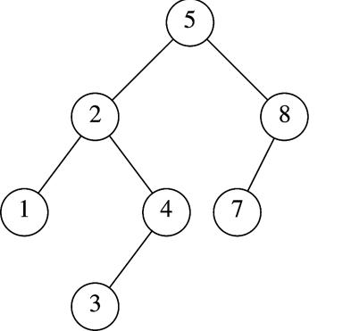
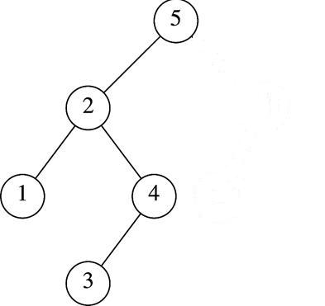
Insertion in AVL Tree
Basically follows insertion strategy of binary search tree
  But may cause violation of AVL tree property
Restore the destroyed balance condition if needed
7
6
8
6
Insert 6
Property violated
Original AVL tree
Restore AVL property

Slide 3
Some Observations
After an insertion, only nodes that are on the path from the insertion point to the root might have their balance altered
  Because only those nodes have their subtrees altered
Rebalance the tree at the deepest such node guarantees that the entire tree satisfies the AVL property
7
6
8
6
Node 5,8,7 might
have balance altered
Rebalance node 7
guarantees the whole tree be AVL

Slide 4
Different Rebalancing Rotations
The rebalancing rotations are classified as LL, LR, RR and RL as illustrated below, based on the position of the inserted node with reference to α.
  LL rotation: Inserted node is in the left subtree of the left subtree of node α
  RR rotation: Inserted node is in the right subtree of the right subtree of node α
  LR rotation: Inserted node is in the right subtree of the left subtree of node α
  RL rotation: Inserted node is in the left subtree of the right subtree of node α

Slide 5

Insertion Analysis
Insert the new key as a new leaf just as in ordinary binary search tree: O(logN)
Then trace the path from the new leaf towards the root, for each node x encountered: O(logN)
  Check height difference: O(1)
  If satisfies AVL property, proceed to next node: O(1)
  If not, perform a rotation: O(1)
The insertion stops when
  A single rotation is performed
  Or, we’ve checked all nodes in the path
Time complexity for insertion O(logN)
logN

Slide 6



