Slide 1

Shortest path algorithm Floyd Warshall Algorithm (modified Warshall algorithm)

Slide 2
Floyd Warshall Algorithm
Repeat for I, J = 1, 2,…, M: [Initializes P.]
  If A[I, J] = 0, then: Set P[I, J] := ∞;
  Else Set P[I, J] := W(I, J).
  [End of loop.]
Repeat Steps 3 and 4 for K = 1, 2,…, M: [Updates P.]
Repeat Step 4 for I = 1, 2,…, M:
Repeat J= 1, 2,…, M:
Set P[I, J] := MIN(P[I, J], (P[I, K]+P[K, J])).
  [End of loop.]
  [End of Step 3 loop.]
  [End of step 2 loop.]
Exit

Slide 3
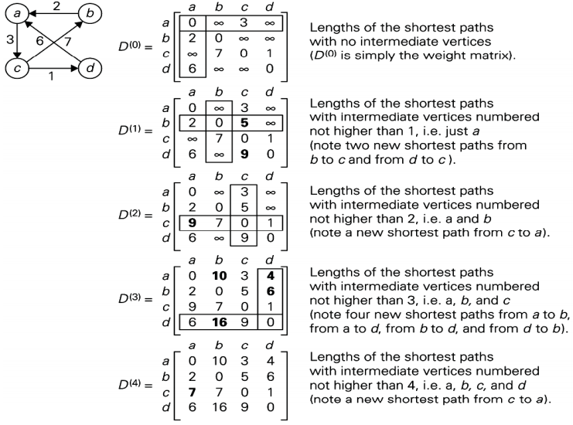
Example:

Slide 4
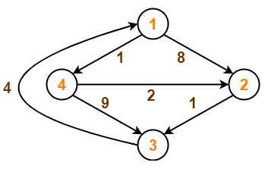
Practice Question:

Slide 5
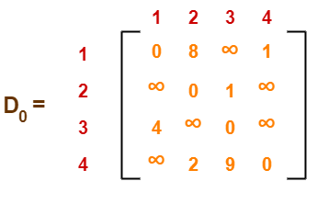
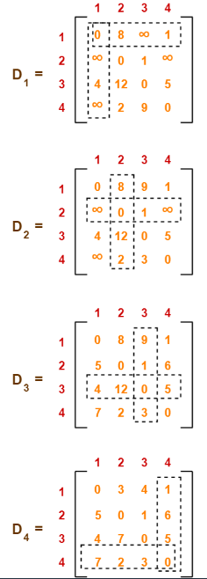
Solution:

Slide 6
Thank You

