Slide 1

Closed hashing(open addressing)
  Linear Probing
  Quadratic Probing
  Double hashing

Slide 2
Collision Resolution
Suppose we want to add a new record R with key K to our file F, but suppose the memory location address H(k) is already occupied. This situation is called Collision.
There are two general ways to resolve collisions :
    Open addressing,(array method)
    Separate Chaining (linked list method)
The particular procedure that one choose depends on many factors. One important factor is load factor (λ=n/m)i.e. ratio of number n of keys in K (number of records in F) to m of hash address in L.
e.g. suppose a student class has 24 students and table has space for 365 records.
The efficiency of hash function with a collision resolution procedure is measured by the average number of probes (key comparison) needed to find the location of record with a given k. The efficiency mainly depend on load factor.
Specially we are interested in following two quantities:
  S(λ) = average number of probes for a successful search
  U(λ) = average number of probes for an unsuccessful search

Slide 3

Open Addressing: Liner Probing and Modifications
Suppose that new record R with key k is added to memory table T, but that the memory location with hash address H(k)=h is already filled.
One natural way to resolve the collision is to assign R to the first variable locating following T[h] (we assume that the table T with m location is circular i.e. T[1] comes after T[m]).
  With such a collision procedure, we will search for record R in table T by linearly search the locations T[h], T[h+1], T[h+2], …………. Until finding R or meeting empty location, which indicates an unsuccessful search.
  The above collision resolution is called Linear probing.
  The average number of probes for load factor (λ =n/m) are:

Slide 4

Ex: Linear Probing

Slide 5
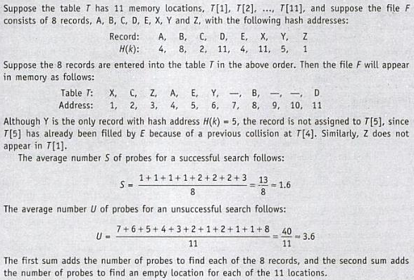
Ex: Linear Probing(cont…)

Slide 6
Open Addressing
One main disadvantage of linear probing is that records tend to cluster, that is, appear next to one another, when the load factor is greater then 50%.
The two technique that minimize the clustering are as:
1. Quadratic probing: Suppose the record R with key K has the hash address H(k)=h. Then instead of searching the locations with address h, h+1, h+2, …….. ., we search the location with address
h,h+1,h+4,h+9, …………..,h+i^2,……
2. Double hashing: here the second hash function H’ is used for resolving a collision, as follows. Suppose a record R with key k has a hash address H(k)=h and H’(k)=h’≠m. Then we linearly search the locations with address
h, h+h’, h+2h’, h+3h’, …………

Slide 7
Ex: Quadratic probing:

Slide 8
Ex: Double hashing: :
H’(k): 2, 1, 3, 4, 2, 4, 1, 1

Slide 9


