Slide 1

Open hashing(separate chaining)

Slide 2
Chaining
Chaining involves maintaining two tables in memory.
First of all, as before, there is a table T in memory which contains the records in F, except that T now has an additional field LINK which is used so that all record in T with same hash address h may be linked together to form a linked list. Second, there is a hash address table LIST which contain pointers to linked lists in T.
Suppose a new record R with key k is added to the file F. we place R in the first available location in the table T and then add R to the linked list with pointer LIST[H(k)].
  The average number of probes for load factor (λ =n/m may be greater than 1) are:
  S(λ)≈1+ λ/2 and U(λ)≈e^(- λ)+ λ.

Slide 3

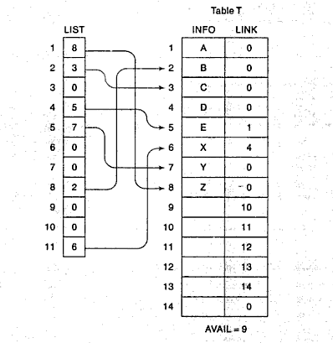
Ex: Chaining
Using chaining, the record will appear in memory as:

Slide 4


