Slide 1



CSE310
Programming in Java
Lecture #0
The kick start session

Slide 2
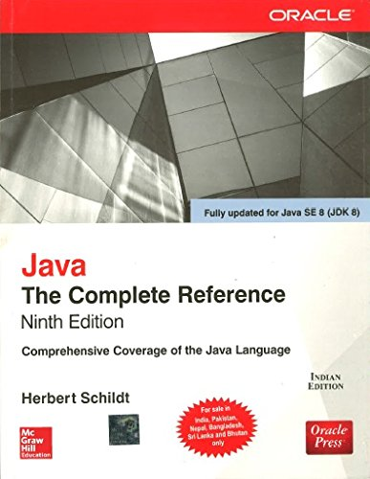
Course details
LTP – 3 0 2 [Five hours/week]
Text Book
Java: The Complete Reference by Herbert Schildt, Mcgraw Hill Education

Slide 3
Course Assessment Model
Marks break up*
Attendance 5
CA (Daily Practice Problems, Project, and CBT) 50
MTE -
ETE 45
Total 100

Slide 4
* Proposed Plan of Course Assessment:
Daily Practice problems including code based questions and MCQ. [15]
One best out of two Code Based Tests. [20]
One compulsory project (to be performed in group of three students). [15]

Slide 5

Some Programming Tips......
“Some of the best programming is done on paper, really. Putting it into the computer is just a minor detail. “
“First, solve the problem. Then, write the code.”
So Let’s Gear up for challenge
ahead.............

Slide 6

Get Certified to Stand Out in a Crowd
Expand your knowledge base and validate your skills to appeal to potential employers.
Improve your potential earning power to command a higher salary.
Learn to perform complex, hands-on activities through lab, study and practice sessions.
Access a secure digital badge you can add to your social media profiles.
Gain exposure to a wide variety of important features, functions and tasks to use on the job.

Slide 7
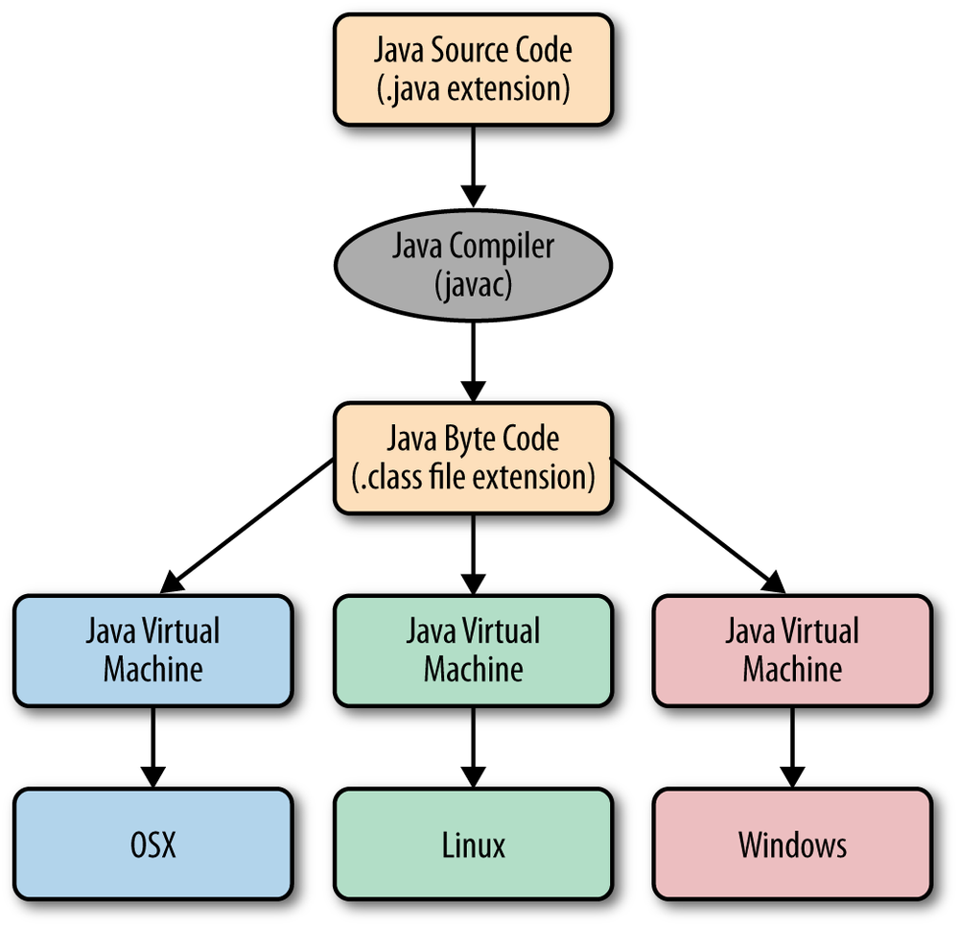

Division of course
Syllabus is divided into a total of 6 units:
Unit I-
  Introduction to Java : History and Features of Java, Java program structure, Writing simple Java class and main() method, Command-line arguments, Understanding JDK, JRE and JVM
  Data In the Cart : Using primitive data types, Type conversion, Keywords, Identifiers, Variables, Access modifiers, static keyword, Wrapper class
  Operators : Working with Bit-wise, arithmetic, logical, and relational operators, Unary, assignment and Ternary operator, Operator precedence Conditional Statements : Using if/else constructs and switch-case statements.

Slide 8
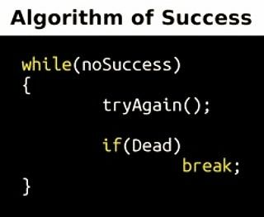
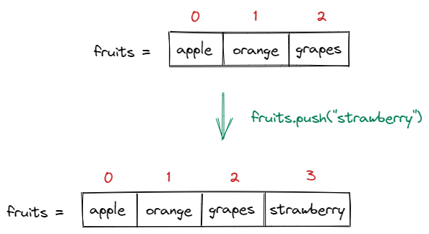
Division of course
Unit II-
  Loops : Working with for loop, while loop, do-while loop and for-each loop
  Arrays and Enums : Fundamentals about Arrays, Multi-dimensional arrays, Array Access and Iterations, Using varargs, Enumerations

Slide 9
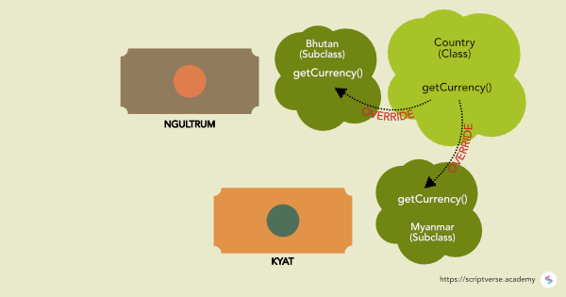
Division of course
Unit II-
  OOP Concepts : Basics of class and objects, Writing constructors and methods, Overloading methods and constructors, this keyword, initializer blocks
  String Class : Constructors and methods of String and String Builder class

Slide 10
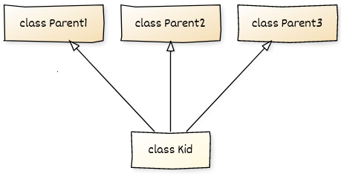

Division of course
Unit III
  Inheritance and Polymorphism : Inheritance, Method overriding, super keyword, Object class and overriding toString() and equals() method, Using super and final keywords, instanceof operator
  Abstract Class and Interface : Abstract method and abstract class, Interfaces, static and default methods,

Slide 11

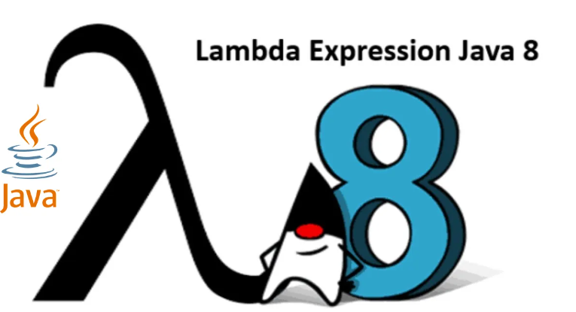
Division of course
Unit IV
  Functional Interface and Lambda Expressions : Using Lambda expressions, Implementing Threads using Lambda expressions, Implementing Listener using Lambda expressions
  Nested Class : Understanding the importance of static and non-static nested classes, Local and Anonymous class
  Utility Classes : Working with Dates
Hi, anonymous

Slide 12
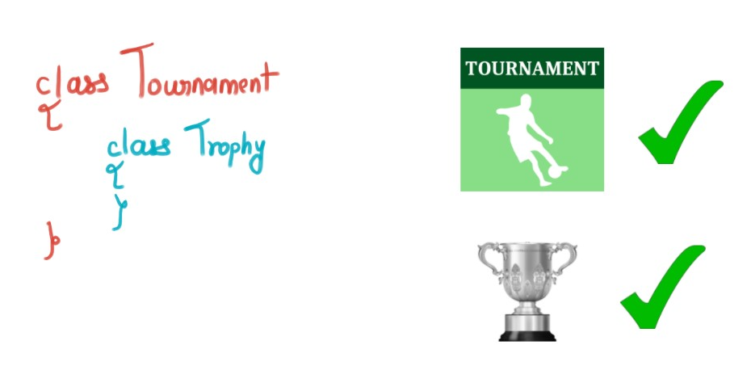
Division of course
Unit IV
  Nested Class : Understanding the importance of static and non-static nested classes, Local and Anonymous class
  Utility Classes : Working with Dates

Slide 13
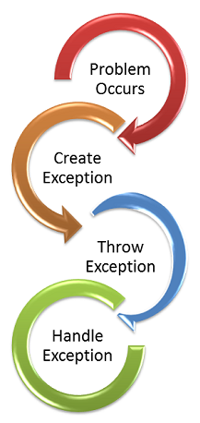
Division of course
Unit V
  Exceptions and Assertions : Exception overview, Exception class hierarchy and exception types, Propagation of exceptions, Using try, catch and finally for exception handling, Usage of throw and throws, handling multiple exceptions using multi-catch, Autoclose resources with try-with resources statement, Creating custom exceptions, Testing invariants by using assertions
  I/O Fundamentals : Describing the basics of input and output in Java, Read and write data from the console, Using streams to read and write files, Writing and read objects using serialization

Slide 14
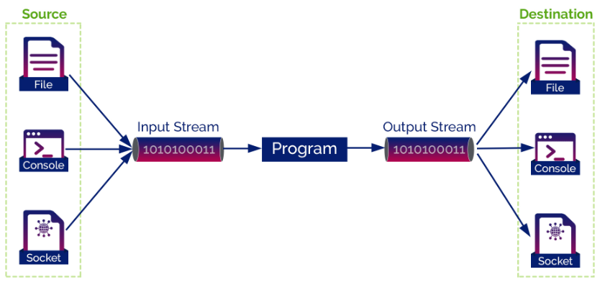
Division of course
Unit V
  I/O Fundamentals : Describing the basics of input and output in Java, Read and write data from the console, Using streams to read and write files, Writing and read objects using serialization

Slide 15
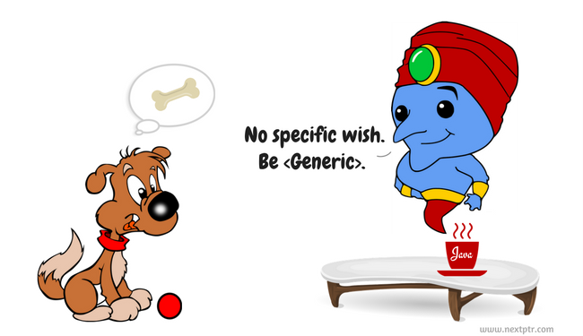
Division of course
Unit VI
  Collections and Generics : Creating a custom generic class, Using the type inference diamond to create an object, Using bounded types and Wild Cards, Creating a collection by using generics, Implementing an ArrayList, Implementing TreeSet using Comparable and Comparator interfaces, Implementing a HashMap, Implementing a Deque

Slide 16
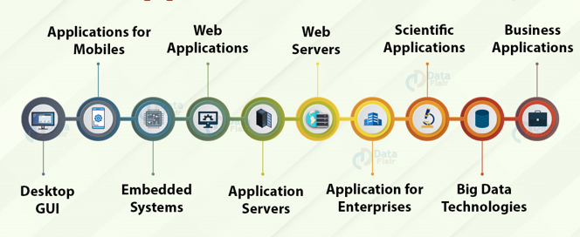
IoT Applications
  IoT programmers gravitate towards Java because of its security, flexibility, and versatility.
  health gears, smartphones, wearables, smart lighting, TVs, etc.
Big Data Technology
  Java is widely used in ETL applications such as Apache Camel and Apache Kafka. It is used to extract and transform data, and load in big data environments.
  tool Hadoop HDFS platform is written in java.
Game Development
  widely used by game development companies.
  most powerful 3D engine.
  Minecraft, Mission Impossible III, etc.
Web-based Applications
  provides vast support for web development through Servlet, JSP, and Struts.
  LinkedIn, AliExpress, web.archive.org, IRCTC, etc.
GUI in Java
  Swing and JavaFX are the most commonly used applications.

Slide 17

Top Companies that Use Java

Slide 18
Go to link. Click on JDK Download for Java download JDK 8.
Next,
  Accept License Agreement
  Download Java 8 JDK for your version 32 bit or JDK download 64 bit.
  Step 3) When you click on the Installation link the popup will be open. Click on I reviewed and accept the Oracle Technology Network License Agreement

Slide 19
You will be redirected to the login page. If you don’t have an oracle account you can easily sign up by adding basics details of yours
Once the Java JDK 8 download is complete, run the exe for install JDK. Click Next

Slide 20
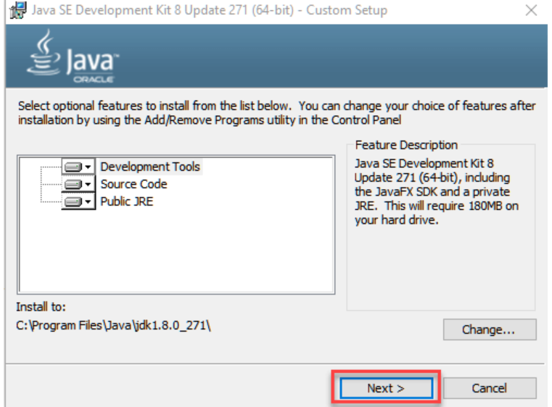
Select the PATH to install Java in Windows… You can leave it Default. Click next.

Slide 21
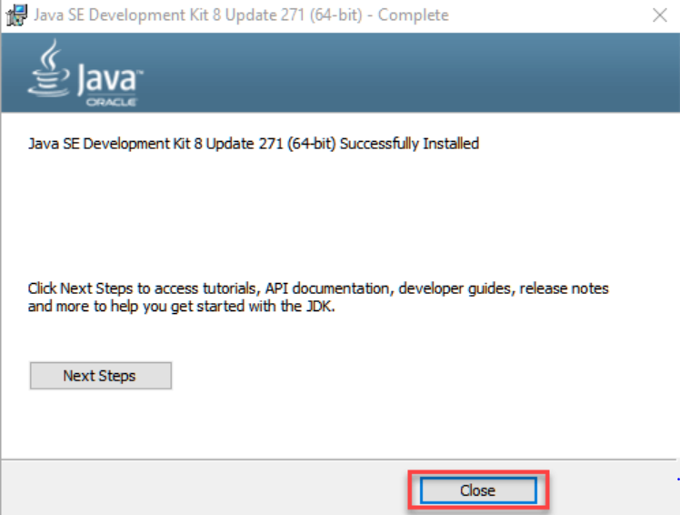
Once you install Java in windows, click Close

Slide 22
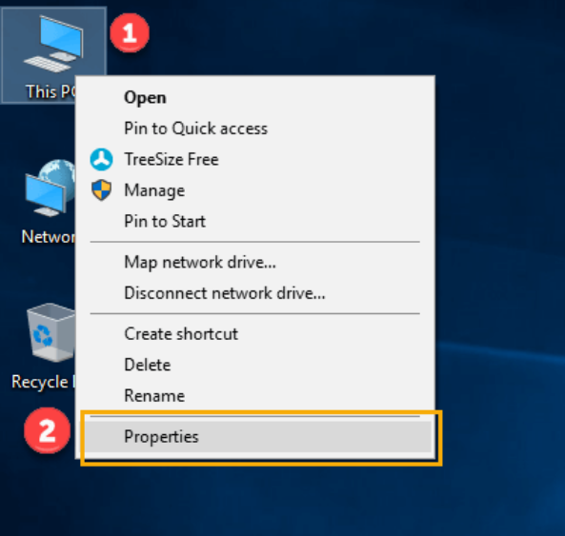
Set Environment Variables in Java: Path and Classpath
Step 1) Right Click on the My Computer and Select the properties

Slide 23
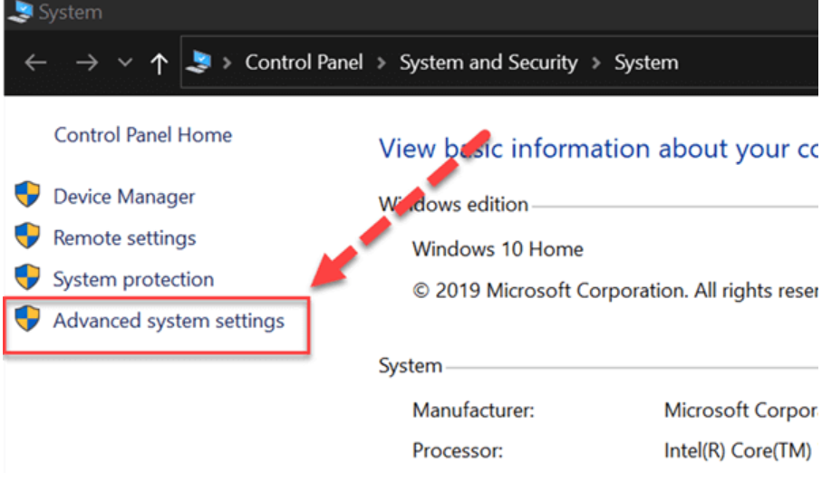
Step 2) Click on advanced system settings

Slide 24
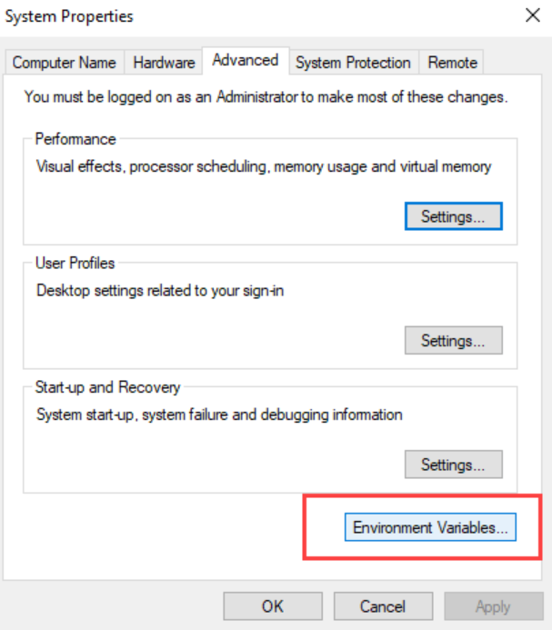
Step 3) Click on Environment Variables to set Java runtime environment

Slide 25
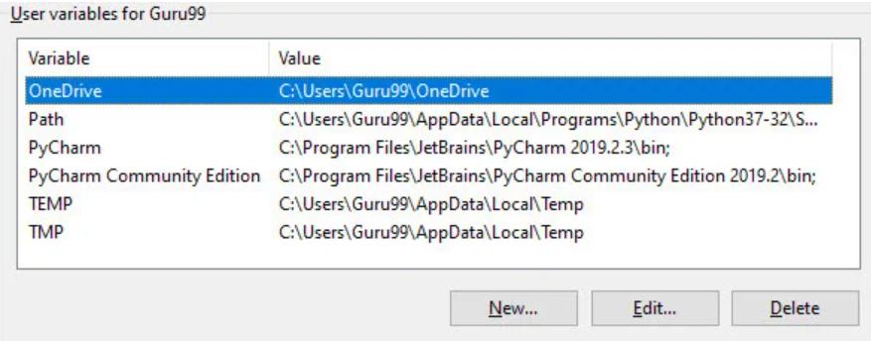
Step 4) Click on new Button of User variables

Slide 26
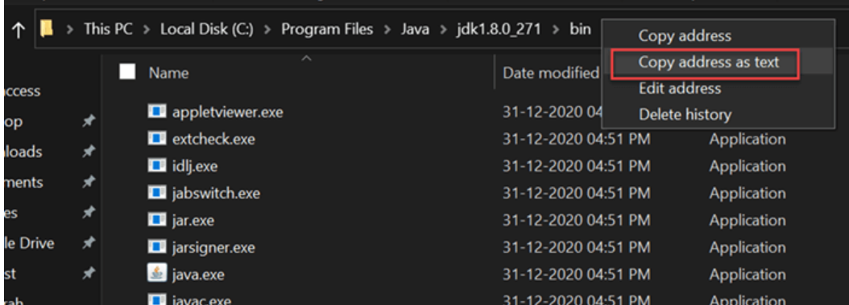
Step 5) Select the Path and Copy the path of bin folder which is installed in JDK folder.

Slide 27
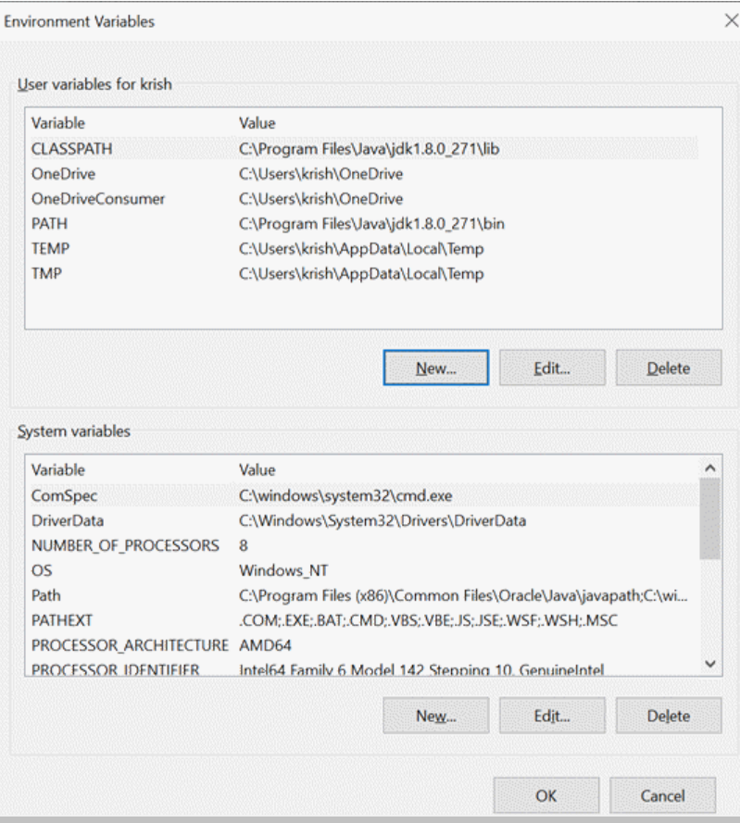
Step 6) Paste Path of bin folder in Variable value. Click on OK Button.

Slide 28
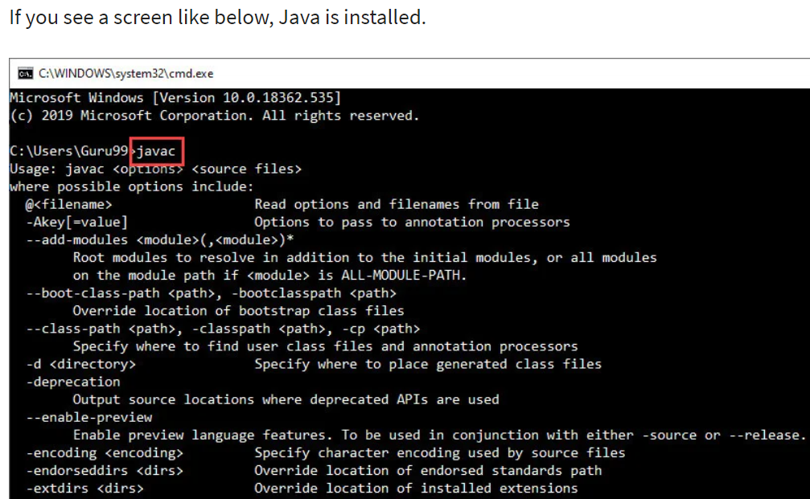
Step 7)Click on Ok and Go to command prompt and type javac commands.

Slide 29
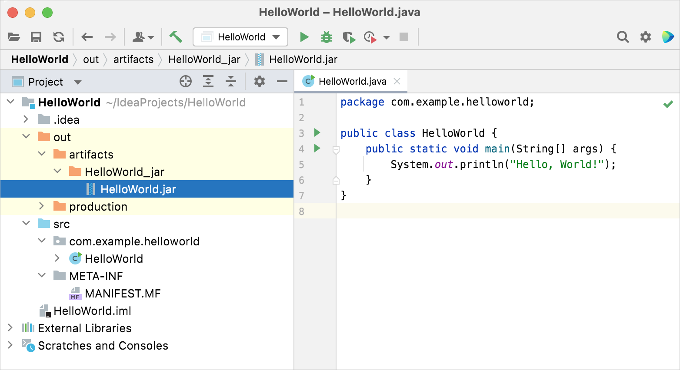
IntelliJ IDEA – the Leading Java IDE - JetBrains
https://www.jetbrains.com/help/idea/creating-and-running-your-first-java-application.html

