Slide 1
Frontend Web Development With React JS
Programming Pathshala

Slide 2
About Me
Name : Shubhansu Kumar Singh
Registration Number : 12104991
Course : B.Tech CSE (3rd Year)

Slide 3
Content
Introduction​
Technologies Learnt
​Gantt Chart
Projects

Slide 4
Introduction
Web development is the process of creating, building, and maintaining websites and web applications that are accessible via the internet. It involves a combination of various technologies, programming languages, and design principles to bring both the front-end (user interface) and back-end (server-side logic and database) aspects of a website to life.
I went with the frontend web development in ReactJS course by programming pathshala for my summer training. This course included live classes, course modules and doubt resolving sessions over the period of two months.
Technologies covered: HTML, CSS, JavaScript, and ReactJS.
Projects : Id Card generator
Random Quote generator
Board Games – Sudoku & Ticktacktoe.

Slide 5
Technologies I have learnt in Summer Training:
HTML & CSS
BOOTSTRAP
JAVASCRIPT
​REACT JS
JSON
​MONGO DB​

Slide 6
Gantt Chart

Slide 7
Projects:
ID Card Generator
Random Quote Generator
Board Games
Sudoku
Tic Tack Toe.

Slide 8



Technologies USED
ID Card Generator
Quote GEnerator
Board Games
HTML
CSS
JAVASCRIPT
HTML
CSS
API
JAVASCRIPT
HTML
CSS
JAVASCRIPT
API
REACT JS

Slide 9
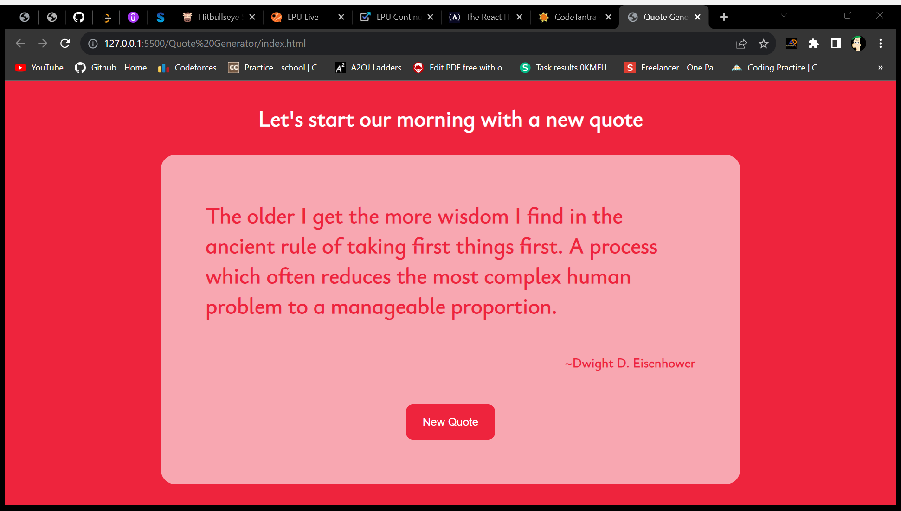
Quote Generator

Slide 10
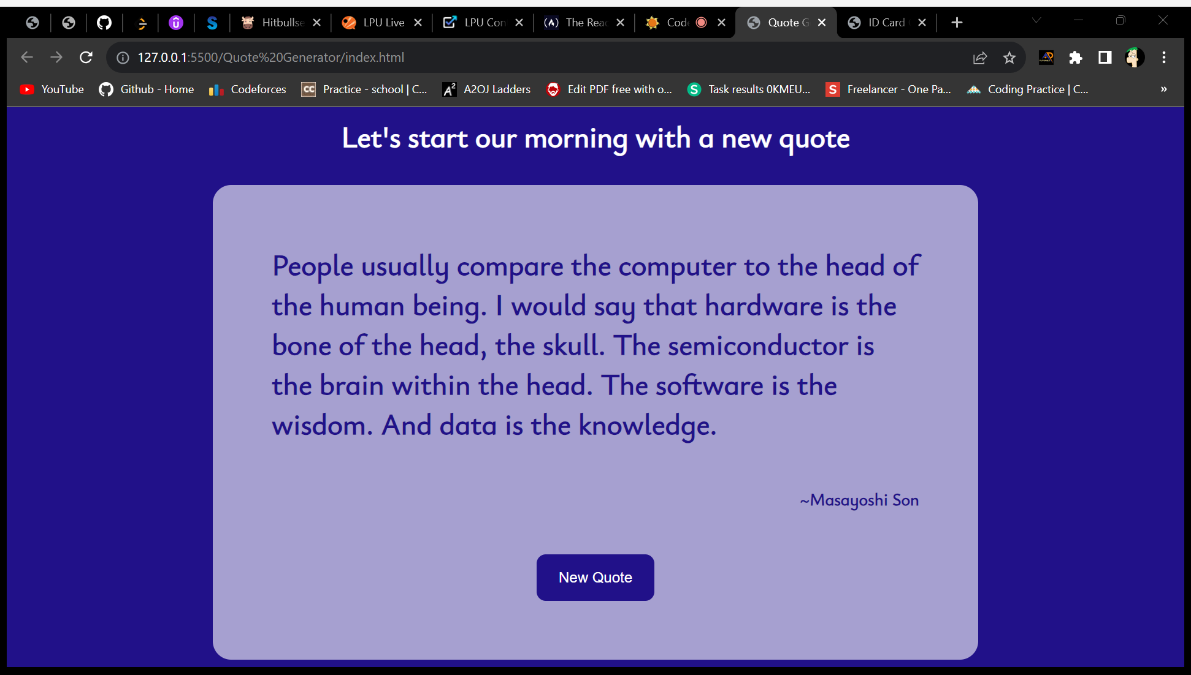
Quote Generator

Slide 11
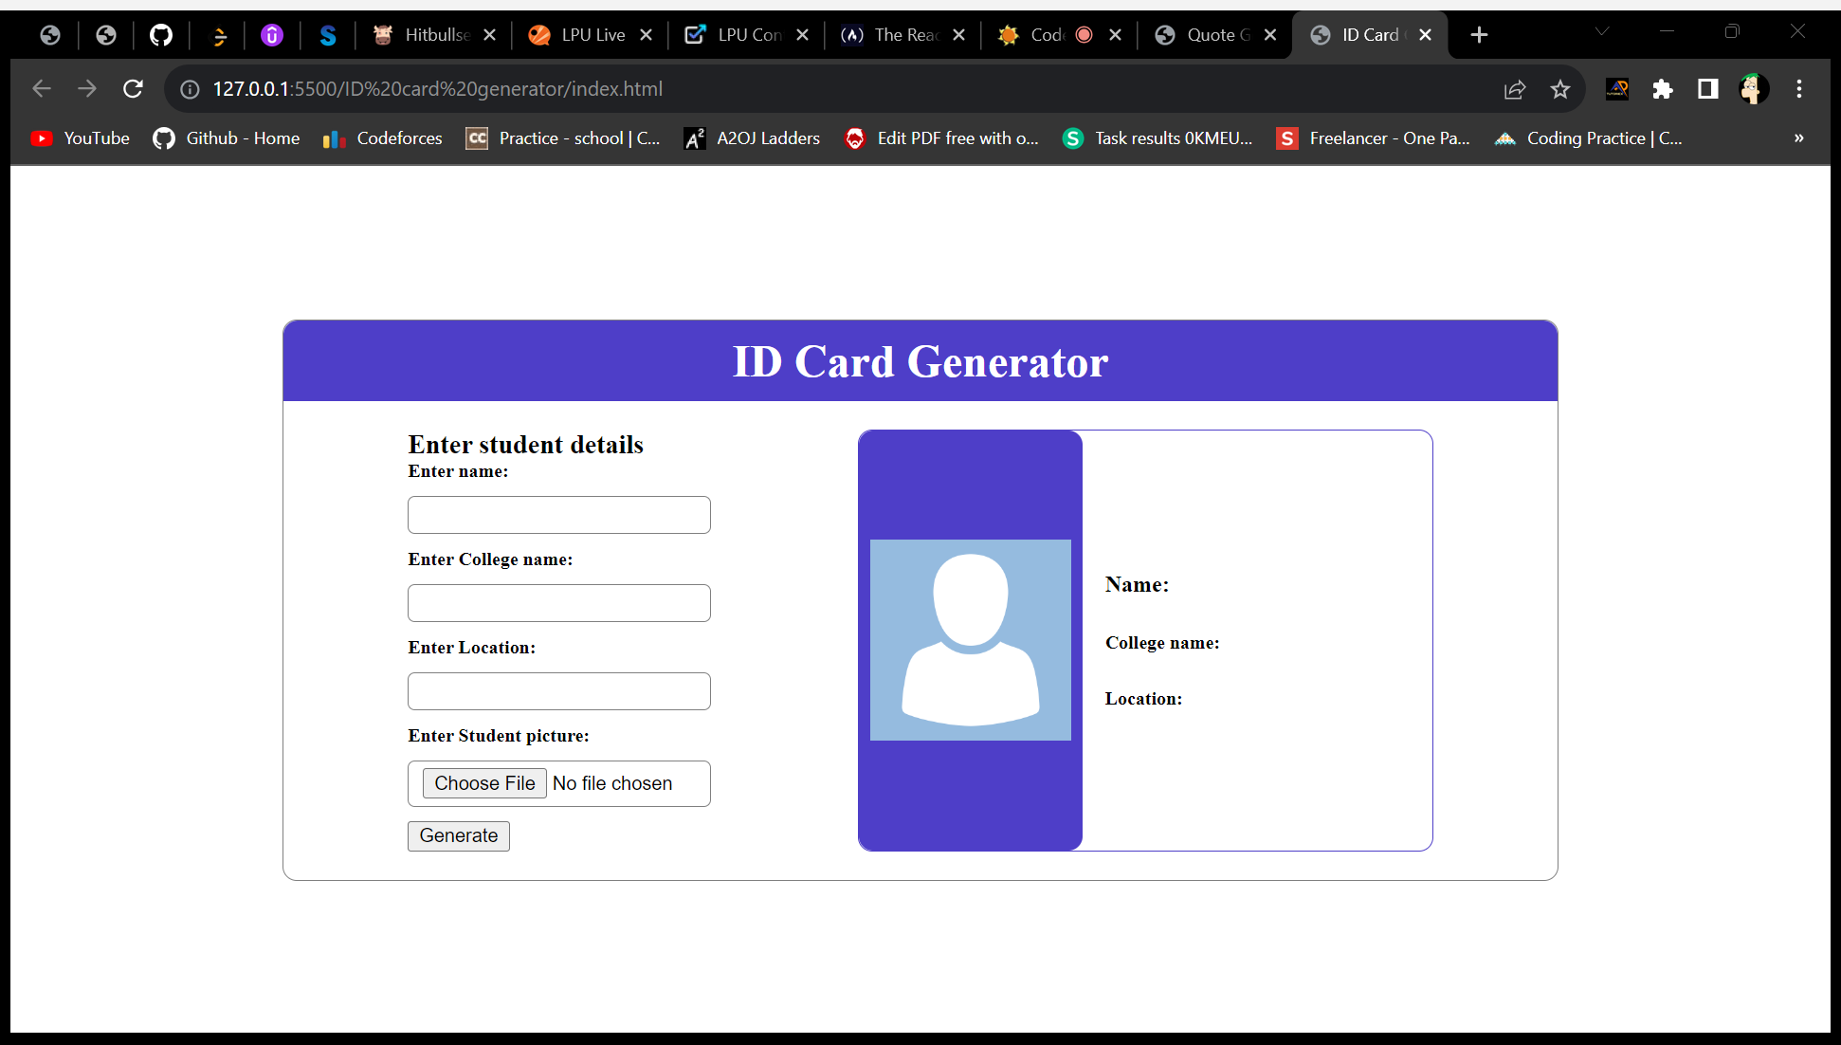
ID Card generator

Slide 12
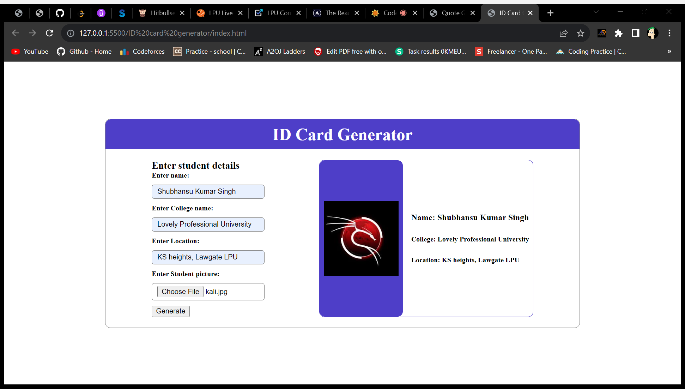
ID Card generator

Slide 13
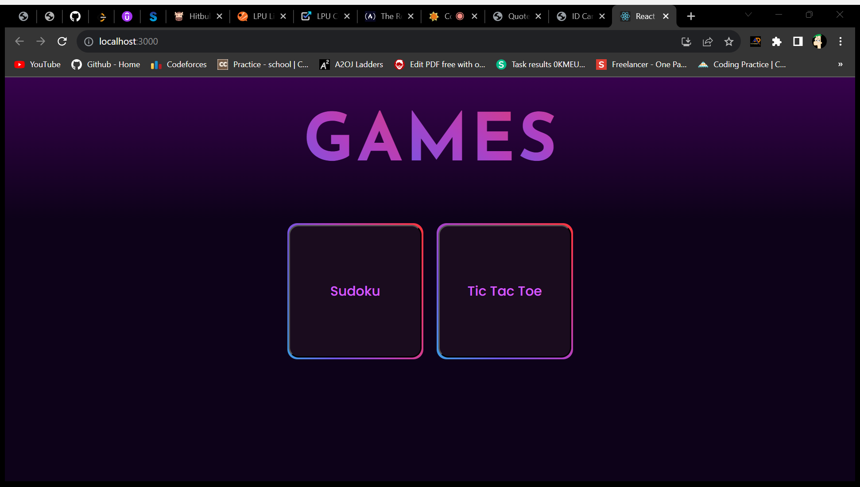
Board Games

Slide 14
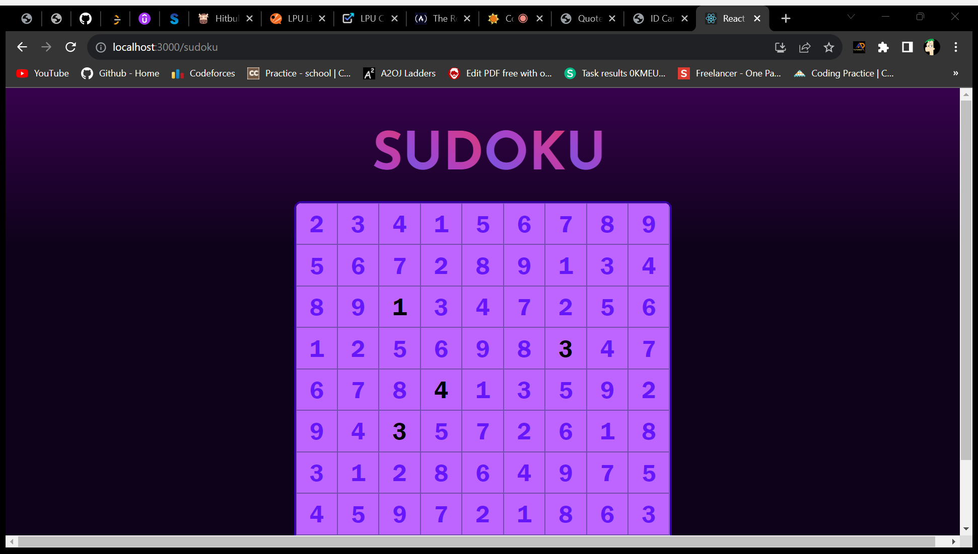
Board Games

Slide 15
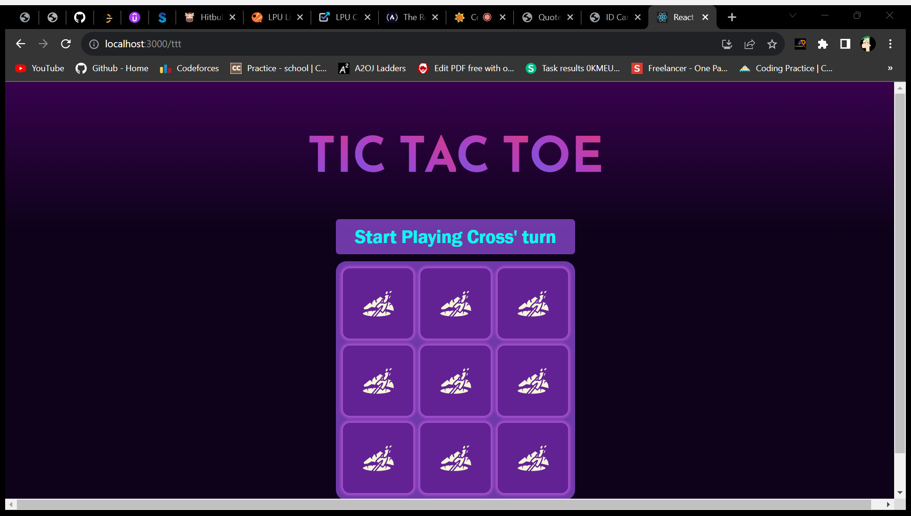
Board Games

Slide 16
Consistency is the key to success .
“
”

Slide 17
THANK YOU
Shubhansu-kr​
(12104991)

