Slide 1
Learning to Map-Match GPS Traces
Hidden Markov model with SVM-learned weights and sliding-window Viterbi
Machine Learning Mini Project
Sinndhu (PES2UG24CS661)
Shubha (PES2UG24CS660)

Slide 2
The task and the data
For every GPS point, predict the road edge and the direction of travel
Hard because of GPS noise, parallel roads and two-way streets
A ground-truth route supplies the labels to learn from
7,531
158,167
GPS points at 1 Hz, about 2 hours (Seattle, 17 Jan 2009)
road edges, of which 148,015 are two-way
575
7.4
unique ground-truth edges (562 matched to GPS)
candidate road states per GPS point on average

Slide 3
Five-stage pipeline
1
2
3
4
5
Project
Candidates
Features
Learn
Decode
UTM zone 10N metres, spatial index over 158k edges
Roads within 50 m give 55,484 directed states
Location, orientation, speed, distance gap, backtrack
L1 linear SVM turns features into weights
Sliding-window Viterbi, window T, buffer N
Noise estimated robustly: sigma = 2.4 m from the MAD of GPS-to-truth distances, instead of 15.3 m from the candidate spread

Slide 4
Two classifiers, five features
Emission (is this road the true one?)
Transition (does the path continue?)
Location: Gaussian of distance to road
Orientation: movement vs road tangent
Speed: GPS speed vs road limit
Distance gap: 1 / (|GPS move - road gap| + 1)
Backtrack: penalise returning to a recent edge
Training: labels from ground truth (14% positive). First 70% of the drive trains, last 30% tests. 10-fold contiguous CV avoids leakage between near-identical neighbouring points. Class-balanced L1 LinearSVC.

Slide 5
Learned weights from the SVM
0.561
Emission F1 (test accuracy 0.821). Location carries the most weight
0.465
Transition F1 (test accuracy 0.867). Distance gap beats backtrack

Slide 6
Delay versus accuracy
14.2%
emission-only baseline error
14.7%
best sliding Viterbi (T=10, N=8)
19.1%
worst setting (T=5, N=0)

Slide 7
Findings and next steps
What we found
Next steps
Full pipeline works: candidates, learned features, sliding Viterbi
A larger buffer N cuts error (T=5: 19.1% to 16.2%)
XGBoost lifts emission F1 from 0.56 to 0.71, yet decoding is worse in all 30 settings
Best HMM (14.7%) does not beat the emission-only baseline (14.2%)
Use network path distance, not midpoint distance, in transitions
Fix direction errors: edge-only error is about 6-7% but state error is 14-15%
Calibrate classifier scores before decoding
Tune sigma and candidate radius

Slide 8
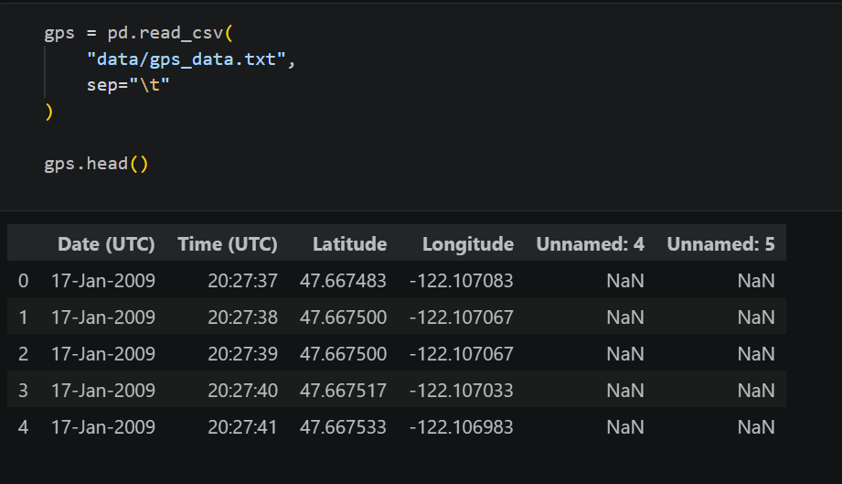
Results training data for gps_data.txt

Slide 9
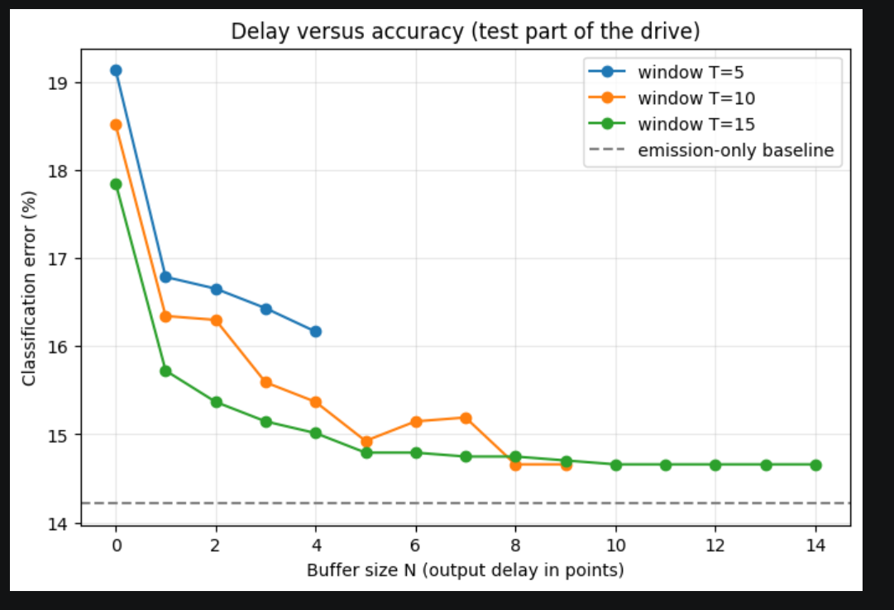

Slide 10
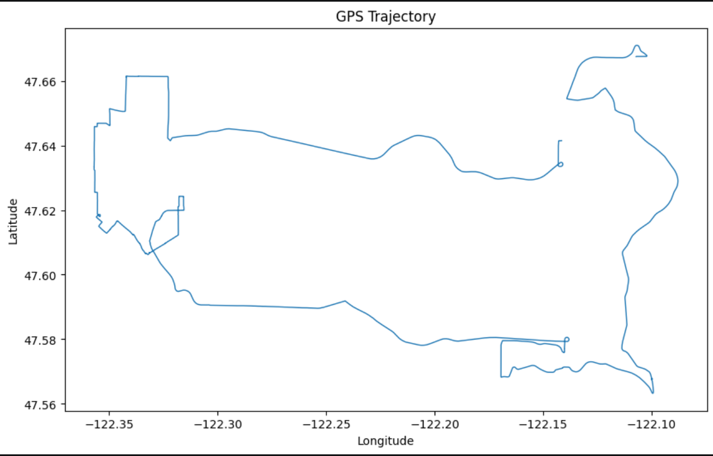

Slide 11
