Slide 1

APEX INSTITUTE OF TECHNOLOGY
DEPARTMENT OF COMPUTER SCIENCE & ENGINEERING
Advanced Database Management System (20CSt-434)
Faculty: Mr. Ankur Sharma(E13693)
Lecture – 1.1.1&1.1.2
TCL – Transaction Control Language
DISCOVER . LEARN . EMPOWER

Slide 2
DBMS: Course Objectives
COURSE OBJECTIVES
The Course aims to:
Develop understanding the advancement in SQL
Demonstrate methods to apply SQL using programming construct PL/SQL
Teach use and application of normalization techniques and implementing the concept of triggers.

Slide 3
COURSE OUTCOMES
On completion of this course, the students shall be able to:-
CO1. Describe and execute advanced level SQL queries
CO2. Create views of data and Implement transaction control using locks.

Slide 4
Unit-1 Syllabus
Advanced SQL-Transaction Control: Commit, Rollback, Save point. DCL Commands: Grant and Revoke. Locks, Deadlocks ,Types of Locks: Row level locks, Table level locks, Shared lock, Exclusive lock, Synonym: Create Synonym. Sequences: Create and alter Sequences. Index: Unique and Composite .Views: Create /replace, update and alter views.

Slide 5
Outline
TCL – Transaction Control Language
Commit
Rollback
Save point

Slide 6
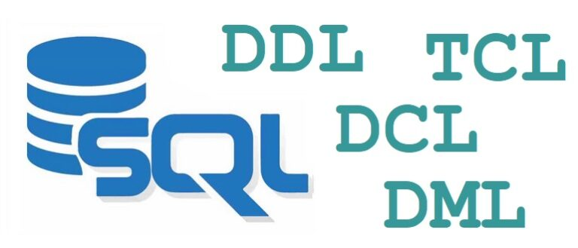
Advanced SQL :Introduction
Advanced SQL refers to the usage of complex and powerful features of the Structured Query Language (SQL) to handle intricate database operations and solve sophisticated data-related problems. It encompasses various techniques and functionalities that go beyond the basic SQL queries used for simple data retrieval and manipulation

Slide 7
Advanced SQL features
Subqueries: Subqueries allow you to nest one SQL query inside another, enabling you to retrieve data based on the results of another query. They can be used in various parts of a SQL statement, such as the SELECT, FROM, WHERE, and HAVING clauses.
Joins: SQL joins are used to combine rows from two or more tables based on a related column between them. Advanced join techniques include INNER JOIN, LEFT JOIN, RIGHT JOIN, and FULL JOIN. These allow you to retrieve data from multiple tables based on specific conditions and create more complex result sets.
Views: A view is a virtual table derived from the result of a query. It allows you to encapsulate complex queries into a reusable object, providing a simplified interface for data retrieval. Views can be used to present a subset of data or to join tables and provide a consolidated view of the underlying data.

Slide 8
Advanced SQL features
4.Indexing: Indexes are data structures that improve the performance of database operations by allowing faster data retrieval. Advanced SQL involves creating and managing indexes on appropriate columns to speed up query execution and optimize database performance.
5. Stored Procedures: A stored procedure is a named set of SQL statements that can be stored and executed on the database server. They enable you to encapsulate business logic and complex operations, providing a reusable and centralized way to perform tasks on the database.
6.Triggers: Triggers are database objects that are automatically executed in response to specified events, such as inserting, updating, or deleting data in a table. They allow you to enforce business rules, maintain data integrity, and automate certain actions.

Slide 9
Additional features and capabilities of advanced SQL
Dynamic SQL: Advanced SQL allows the execution of dynamically constructed SQL statements at runtime. It enables the flexibility to build queries based on changing conditions or user input.
Full-text Search: Full-text search capabilities allow you to perform advanced text-based searching within database columns. It supports features like keyword matching, phrase searching, stemming, and ranking of search results.
Transactions: SQL provides transaction management features, including the ability to define and control transactions explicitly. Transactions ensure data consistency and integrity by allowing you to group multiple SQL statements into a single atomic unit of work.

Slide 10
Additional features and capabilities of advanced SQL
4.XML and JSON Support: SQL databases often provide features for handling XML and JSON data. Advanced SQL enables you to query, extract, transform, and manipulate XML and JSON data using specialized functions and operators.
5.Data Partitioning: Partitioning is a technique that divides large database tables or indexes into smaller, more manageable partitions. It improves performance by allowing data to be distributed and accessed in parallel.
6. Materialized Views: Materialized views are precomputed and stored query results that can be refreshed periodically. They provide faster access to frequently used or complex queries, reducing query execution time.
7. Advanced Indexing: In addition to basic indexing, advanced SQL includes features like composite indexes, bitmap indexes, function-based indexes, and partial indexes. These indexing techniques optimize query performance for specific scenarios.

Slide 11
What is a transaction
The transaction allows us to group a set of related tasks as one logical unit and all of these sets of related tasks are either get committed or get rollback if there is an error.
A transaction in Oracle is a set of SQL statements (mostly DML Statements) that should be executed as one unit.
A transaction in Oracle ensures that either all of the command succeeds or none of the commands succeeds. If one of the commands in the transaction fails, then all of the commands fail and any data that is modified in the database is rolled back. If all the commands are executed successfully, then the modification made to the database are committed.

Slide 12
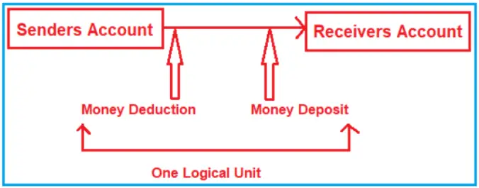
Why do we need Transaction Management
Understand this with an example. Suppose user 1 and user 2 have accounts in the same bank and user 1 wants to transfer rs 100 to user 2 account. There will be a series of statements involved in it, first user 1 account would be debited by rs100, then the user 2 account will be credited by rs100 and finally, the transaction details will be saved in the bank records.
The first update work successfully and user 1 account was debited by rs100 and the 2nd update failed and the user 2 account was not credited by rs100 and the 3rd query works successfully and the transaction details are saved successfully in the bank record. Though all the queries are interrelated they work separately and in case of failure of any of the queries, it makes it difficult to keep track of data or revert the changes. In such a case, we need to use transaction.

Slide 13
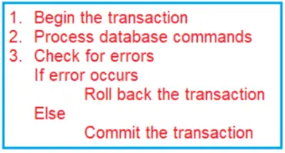
Transaction Management
The process of combining sets of inter-related Operations into a single unit and executing those operations by applying the do everything or do-nothing principle is called transaction management
Every transaction has two boundaries
Beginning
Ending
And controlling the boundaries of a transaction is nothing but transaction management.

Slide 14
TCL – Transaction Control Language
Definition :-Transaction Control Language can be defined as the portion of a database language used for maintaining consistency , Integrity of the database and managing transactions in the database.
The Transaction Control Language manages the changes in the data which are made by the DML operations. The alteration made by the DML commands is not permanent and these changes can be canceled before the present session gets closed. To control the changes and processing of data, TCL is used simultaneously with the Data Manipulation Language
A transaction is a unit of work that is performed against a database. If we are inserting / updating / deleting data to/from a table then we are performing a transaction on a table.

Slide 15
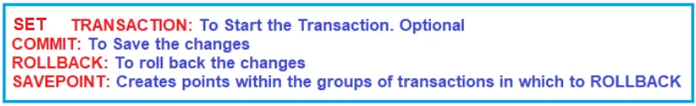
TCL – Transaction Control Language
SET TRANSACTION: It indicates that the transaction is started and is optional.
COMMIT: It indicates that the transaction was completed successfully and all the DML performed since the start of the transaction are committed to the database as well as frees the resources held by the transaction.
ROLLBACK: It will roll back the data to its previous state.
SAVEPOINT: This is used for dividing or breaking a transaction into multiple units so that the user has a chance of rolling back a transaction up to a point or location. It creates points within the groups of transactions in which to ROLLBACK.

Slide 16
TCL – Transaction Control Language
COMMIT: Commit command is used to permanently save any transaction into the database. The main use of Commit command is to make the transaction permanent.

Slide 17
COMMIT
Two types
a) Explicitly command terminates the current transaction and makes all the change permanent ,DML Commands are not affected
b) Implicitly command some operations which forces to COMMIT to occur automatically even user didn’t specifies
e.g. Quit ,Exit ,Create Alter etc …..

Slide 18
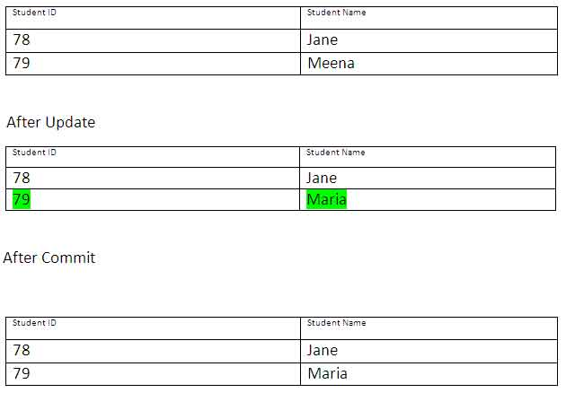
Example : UPDATE STUDENT SET STUDENT_NAME = ‘Maria’ WHERE STUDENT_NAME = ‘Meena’ ; commit;
By using the above set of instructions, you can update the wrong student name by the correct one and save it permanently in the database.

Slide 19
TCL – Transaction Control Language
ROLLBACK: This command restores the database to last committed state. It is also used with save point command to jump to a save point in a transaction.

Slide 20
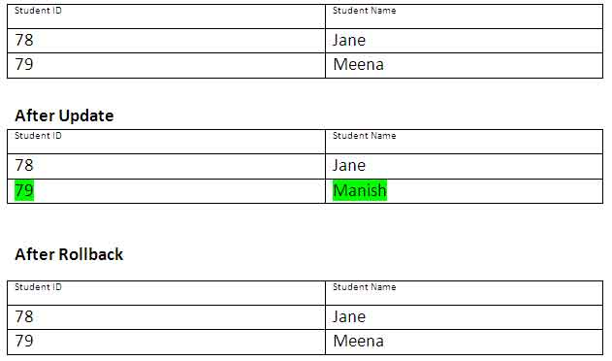
EXAMPLE
UPDATE STUDENT SET STUDENT_NAME = ‘Manish’ WHERE STUDENT_NAME = ‘Meena’; ROLLBACK;

Slide 21
References
RamezElmasri and Shamkant B. Navathe, “Fundamentals of Database System”, The Benjamin / Cummings Publishing Co.
Korth and Silberschatz Abraham, “Database System Concepts”, McGraw Hall.
C.J.Date, “An Introduction to Database Systems”, Addison Wesley.
Thomas M. Connolly, Carolyn & E. Begg, “Database Systems: A Practical Approach to Design, Implementation and Management”, 5/E, University of Paisley, Addison-Wesley.

Slide 22
THANK YOU
For queries
Email: ankur.e13693@cumail.in

