Slide 1

APEX INSTITUTE OF TECHNOLOGY
DEPARTMENT OF COMPUTER SCIENCE & ENGINEERING
Advanced Database Management System (20CSt-434)
Faculty: Mr. Ankur Sharma(E13693)
Lecture – 1.1.3&1.1.4
TCL – Transaction Control Language
DISCOVER . LEARN . EMPOWER

Slide 2
DBMS: Course Objectives
COURSE OBJECTIVES
The Course aims to:
Develop understanding the advancement in SQL
Demonstrate methods to apply SQL using programming construct PL/SQL
Teach use and application of normalization techniques and implementing the concept of triggers.

Slide 3
COURSE OUTCOMES
On completion of this course, the students shall be able to:-
CO1. Describe and execute advanced level SQL queries
CO2. Create views of data and Implement transaction control using locks.

Slide 4
Unit-1 Syllabus
Advanced SQL-Transaction Control: Commit, Rollback, Save point. DCL Commands: Grant and Revoke. Locks, Deadlocks ,Types of Locks: Row level locks, Table level locks, Shared lock, Exclusive lock, Synonym: Create Synonym. Sequences: Create and alter Sequences. Index: Unique and Composite .Views: Create /replace, update and alter views.

Slide 5
Outline
TCL – Transaction Control Language
Commit
Rollback
Save point

Slide 6
SET TRANSACTION: It indicates that the transaction is started and is optional.
A new transaction begins implicitly with the first DML statement that you execute after you make a database connection or with the first DML statement that you execute following a COMMIT or a ROLLBACK. You need to use SET TRANSACTION only when you want transaction attributes such as READ ONLY that are not the default .
The SET TRANSACTION marks the beginning of a transaction. Any changes you make to your data following the beginning of a transaction are not made permanent until you issue a COMMITe default.

Slide 7
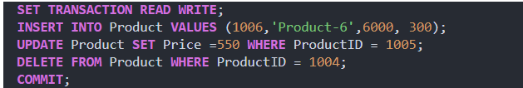
SET TRANSACTION: It indicates that the transaction is started and is optional.
Syntax: SET TRANSACTION [ READ ONLY | READ WRITE] [ NAME ‘transaction_name’ ];

Slide 8
SET TRANSACTION: It indicates that the transaction is started and is optional.
Transaction Types in Oracle:
SET TRANSACTION READ WRITE: It is the default transaction type specified as a read/write transaction. It allows us to issue statements such as UPDATE and DELETE.
SET TRANSACTION READ ONLY: It is a read-only transaction that does not allow the UPDATE and the DELETE DML statements.

Slide 9
SAVEPOINT
It is used is used for dividing (or) breaking a transaction into multiple units so that the user has a chance of roll backing the transaction up to a specific point .
Using Save Point we can roll back a part of a transaction instead of the entire transaction. Whenever a user creates SAVEPOINT within the transaction then internally system is allocating a special memory for a SAVEPOINT and storing the transaction information which we want to roll back (cancel).

Slide 10
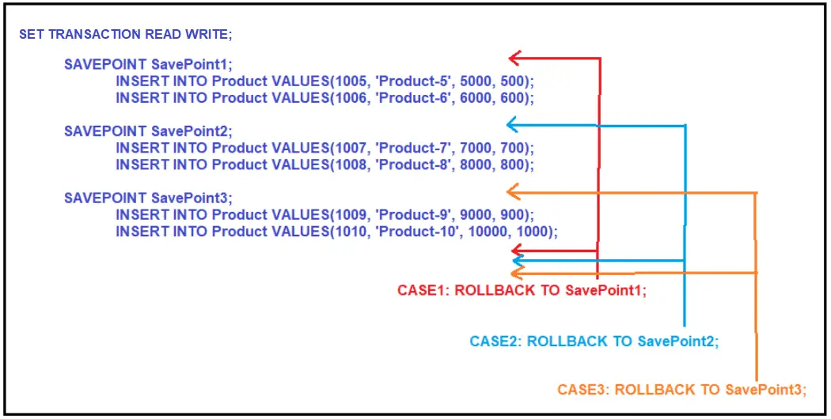
SAVEPOINT
Syntax: SAVEPOINT <pointer name>;

Slide 11
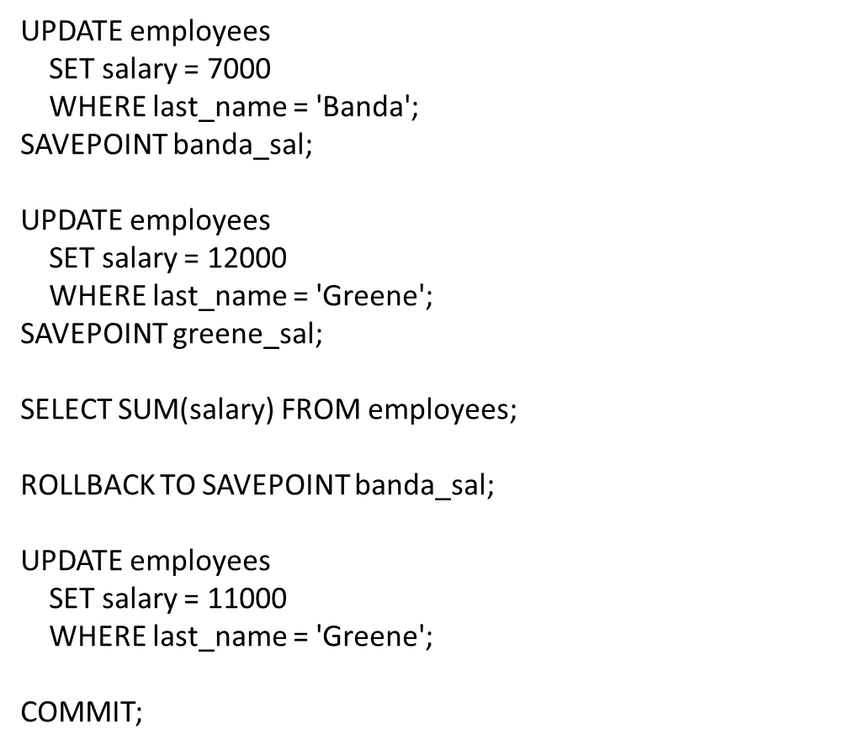
SAVEPOINT

Slide 12
References
RamezElmasri and Shamkant B. Navathe, “Fundamentals of Database System”, The Benjamin / Cummings Publishing Co.
Korth and Silberschatz Abraham, “Database System Concepts”, McGraw Hall.
C.J.Date, “An Introduction to Database Systems”, Addison Wesley.
Thomas M. Connolly, Carolyn & E. Begg, “Database Systems: A Practical Approach to Design, Implementation and Management”, 5/E, University of Paisley, Addison-Wesley.

Slide 13
THANK YOU
For queries
Email: ankur.e13693@cumail.in

