Slide 1

APEX INSTITUTE OF TECHNOLOGY
DEPARTMENT OF COMPUTER SCIENCE & ENGINEERING
Advanced Database Management System (20CSt-434)
Faculty: Mr. Ankur Sharma(E13693)
Lecture – 1.1.5
DCL – Data Control Language
DISCOVER . LEARN . EMPOWER

Slide 2
DBMS: Course Objectives
COURSE OBJECTIVES
The Course aims to:
Develop understanding the advancement in SQL
Demonstrate methods to apply SQL using programming construct PL/SQL
Teach use and application of normalization techniques and implementing the concept of triggers.

Slide 3
COURSE OUTCOMES
On completion of this course, the students shall be able to:-
CO1. Describe and execute advanced level SQL queries
CO2. Create views of data and Implement transaction control using locks.

Slide 4
Unit-1 Syllabus
Advanced SQL-Transaction Control: Commit, Rollback, Save point. DCL Commands: Grant and Revoke. Locks, Deadlocks ,Types of Locks: Row level locks, Table level locks, Shared lock, Exclusive lock, Synonym: Create Synonym. Sequences: Create and alter Sequences. Index: Unique and Composite .Views: Create /replace, update and alter views.

Slide 5
Outline
DCL – Data Control Language
Grant
Revoke

Slide 6
DCL – Data Control Language
A Data Control Language (DCL) can be defined as a computer language that is used for controlling privilege in the database. The privileges are required for performing all the database operations, such as creating sequences, views or tables.
DCL is the simplest of the SQL subsets, as it consists of only three commands: GRANT, REVOKE, and DENY. Combined, these three commands provide administrators with the flexibility to set and remove database permissions in granular fashion.

Slide 7
DCL – Data Control Language
Data Control Language(DCL) is used to control privileges in Database. To perform any operation in the database, such as for creating tables, sequences or views, a user needs privileges. Privileges are of two types,
System: System privileges are used for performing a particular type of action on objects, such as cache groups, synonyms, materialized views, tables, views, sequences, indexes, replication schemes, and PL/SQL procedures & functions. This type of privileges can only be granted or revoked by the instance administrator or a user.

Slide 8
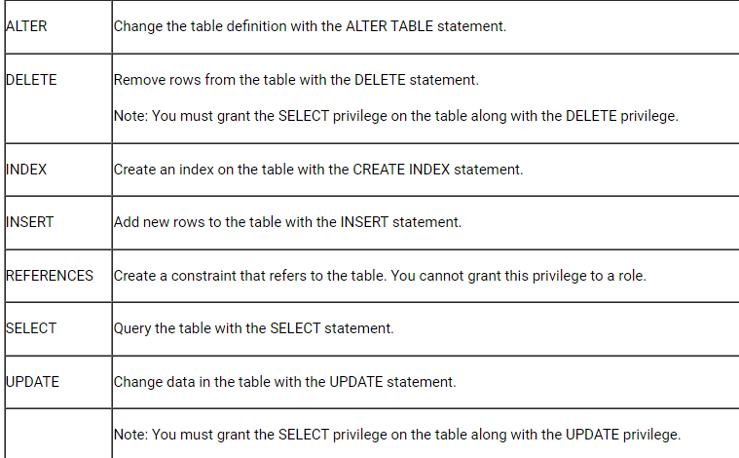
DCL – Data Control Language
Object privileges can be defined as the right for performing a special type of action on objects like materialized views, sequences, replication schemes, cache groups, synonyms, tables, views, etc. This type of privilege cannot be revoked and the owner of the object can grant object privileges.

Slide 9
DCL – Data Control Language
Data Control Language Statements are used to grant privileges on tables, views, sequences, synonyms, procedures to other users or roles.
The DCL statements are
GRANT :Use to grant privileges to other users or roles. REVOKE :Use to take back privileges granted to other users and roles.

Slide 10
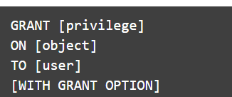
Grant Command
Grant Command is used for offering access or privileges to the users on the objects of the database. Through this command, the users get access to the privileges in the database.
GRANT privilege_name
ON object_name
TO {user_name I PUBLIC I role_name}
[WITH GRANT OPTION];
For Example
GRANT ALL ON workers
TO MNO;
[WITH GRANT OPTION]

Slide 11
Grant Command
Privilege — can be either the keyword ALL (to grant a wide variety of permissions) or a specific database permission or set of permissions. Examples include CREATE DATABASE, SELECT, INSERT, UPDATE, DELETE, EXECUTE and CREATE VIEW.
Object — can be any database object. The valid privilege options vary based on the type of database object you include in this clause. Typically, the object will be either a database, function, stored procedure, table or view.
User — can be any database user. You can also substitute a role for the user in this clause if you wish to make use of role-based database security

Slide 12
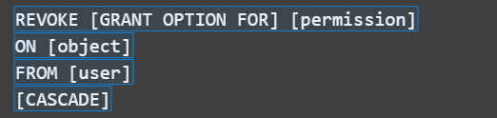
Revoke Command
REVOKE<privilege list>
ON <relation name or view name>
From <user name>
For Example
REVOKE UPDATE
ON worker
FROM MNO;
The main purpose of the revoke command is canceling the previously denied or granted permissions. Through the revoke command, the access to the given privileges can be withdrawn.

Slide 13
DCL – Data Control Language
Permission — specifies the database permissions to remove from the identified user. The command revokes both GRANT and DENY assertions previously made for the identified permission.
Object — can be any database object. The valid privilege options vary based on the type of database object you include in this clause. Typically, the object will be either a database, function, stored procedure, table, or view.
User — can be any database user. You can also substitute a role for the user in this clause if you wish to make use of role-based database security.

Slide 14
References
RamezElmasri and Shamkant B. Navathe, “Fundamentals of Database System”, The Benjamin / Cummings Publishing Co.
Korth and Silberschatz Abraham, “Database System Concepts”, McGraw Hall.
C.J.Date, “An Introduction to Database Systems”, Addison Wesley.
Thomas M. Connolly, Carolyn & E. Begg, “Database Systems: A Practical Approach to Design, Implementation and Management”, 5/E, University of Paisley, Addison-Wesley.

Slide 15
THANK YOU
For queries
Email: ankur.e13693@cumail.in

