Slide 1

APEX INSTITUTE OF TECHNOLOGY
DEPARTMENT OF COMPUTER SCIENCE & ENGINEERING
Advanced Database Management System (20CSt-434)
Faculty: Mr. Ankur Sharma(E13693)
Lecture – 1.2.3&1.2.4
Sequences
DISCOVER . LEARN . EMPOWER

Slide 2
DBMS: Course Objectives
COURSE OBJECTIVES
The Course aims to:
Develop understanding the advancement in SQL
Demonstrate methods to apply SQL using programming construct PL/SQL
Teach use and application of normalization techniques and implementing the concept of triggers.

Slide 3
COURSE OUTCOMES
On completion of this course, the students shall be able to:-
CO1. Describe and execute advanced level SQL queries
CO2. Create views of data and Implement transaction control using locks.

Slide 4
Unit-1 Syllabus
Advanced SQL-Transaction Control: Commit, Rollback, Save point. DCL Commands: Grant and Revoke. Locks, Deadlocks ,Types of Locks: Row level locks, Table level locks, Shared lock, Exclusive lock, Synonym: Create Synonym. Sequences: Create and alter Sequences. Index: Unique and Composite .Views: Create /replace, update and alter views.

Slide 5
Outline
Sequences

Slide 6
Sequences
Sequences are database objects from which multiple users can generate unique integers. The sequence generator generates sequential numbers, which can be used to generate unique primary keys automatically, and to coordinate keys across multiple rows or tables

Slide 7
Sequences
Without sequences, sequential values can only be produced programmatically. A new primary key value can be obtained by selecting the most recently produced value and incrementing it. This method requires a lock during the transaction and causes multiple users to wait for the next value of the primary key; this waiting is known as serialization. If developers have such constructs in applications, then you should encourage the developers to replace them with access to sequences. Sequences eliminate serialization and improve the concurrency of an application.

Slide 8
Sequence Characteristics
A sequence definition indicates general information about the sequence, including its name and whether the sequence ascends or descends.
A sequence definition also indicates:
The interval between numbers
Whether the database should cache sets of generated sequence numbers in memory
Whether the sequence should cycle when a limit is reached

Slide 9
Sequences
The following example creates the sequence customers_seq in the sample schema oe. An application could use this sequence to provide customer ID numbers when rows are added to the customers table.
CREATE SEQUENCE customers_seq
START WITH 1000
INCREMENT BY 1
NOCACHE
NOCYCLE;

Slide 10
Creating Sequences
statement creates a sequence used to generate employee numbers for the empno column of the emp table:
CREATE SEQUENCE emp_sequence
INCREMENT BY 1
START WITH 1
NOMAXVALUE
NOCYCLE
CACHE 10;
Create a sequence using the CREATE SEQUENCE statement.
To create a sequence in your schema, you must have the CREATE SEQUENCE system privilege. To create a sequence in another user's schema, you must have the CREATE ANY SEQUENCE privilege.

Slide 11
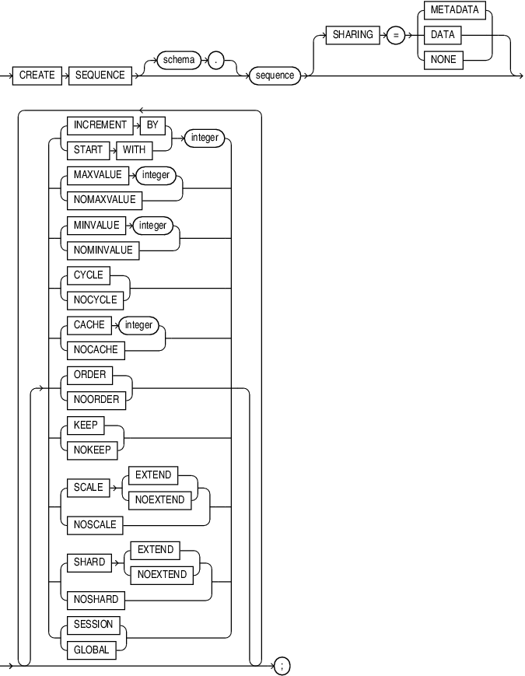
Syntax create_sequence::=

Slide 12
Sequences
INCREMENT BY
Specify the interval between sequence numbers. This integer value can be any positive or negative integer, but it cannot be 0. This value can have 28 or fewer digits for an ascending sequence and 27 or fewer digits for a descending sequence. The absolute of this value must be less than the difference of MAXVALUE and MINVALUE. If this value is negative, then the sequence descends. If the value is positive, then the sequence ascends. If you omit this clause, then the interval defaults to 1.
START WITH
Specify the first sequence number to be generated. Use this clause to start an ascending sequence at a value greater than its minimum or to start a descending sequence at a value less than its maximum. For ascending sequences, the default value is the minimum value of the sequence. For descending sequences, the default value is the maximum value of the sequence. This integer value can have 28 or fewer digits for positive values and 27 or fewer digits for negative values.

Slide 13
Sequences
MAXVALUE:-Specify the maximum value the sequence can generate. This integer value can have 28 or fewer digits for positive values and 27 or fewer digits for negative values. MAXVALUE must be equal to or greater than START WITH and must be greater than MINVALUE.
NOMAXVALUE:-Specify NOMAXVALUE to indicate a maximum value of 1028-1 for an ascending sequence or -1 for a descending sequence. This is the default.
MINVALUE:-Specify the minimum value of the sequence. This integer value can have 28 or fewer digits for positive values and 27 or fewer digits for negative values. MINVALUE must be less than or equal to START WITH and must be less than MAXVALUE.
NOMINVALUE:-Specify NOMINVALUE to indicate a minimum value of 1 for an ascending sequence or -(1027 -1) for a descending sequence. This is the default.

Slide 14
Sequences
CYCLE
Specify CYCLE to indicate that the sequence continues to generate values after reaching either its maximum or minimum value. After an ascending sequence reaches its maximum value, it generates its minimum value. After a descending sequence reaches its minimum, it generates its maximum value.
NOCYCLE
Specify NOCYCLE to indicate that the sequence cannot generate more values after reaching its maximum or minimum value. This is the default.

Slide 15
Sequences
CACHE
Specify how many values of the sequence the database preallocates and keeps in memory for faster access. This integer value can have 28 or fewer digits. The minimum value for this parameter is 2. For sequences that cycle, this value must be less than the number of values in the cycle. You cannot cache more values than will fit in a given cycle of sequence numbers. Therefore, the maximum value allowed for CACHE must be less than the value determined by the following formula:
CEIL ( (MAXVALUE - MINVALUE) / ABS (INCREMENT) )

Slide 16
Sequences
NOCACHE
Specify NOCACHE to indicate that values of the sequence are not preallocated. If you omit both CACHE and NOCACHE, then the database caches 20 sequence numbers by default.
ORDER
Specify ORDER to guarantee that sequence numbers are generated in order of request. This clause is useful if you are using the sequence numbers as timestamps. Guaranteeing order is usually not important for sequences used to generate primary keys.
NOORDER
Specify NOORDER if you do not want to guarantee sequence numbers are generated in order of request. This is the default.

Slide 17
Sequences
SCALE
Use SCALE to enable sequence scalability. When SCALE is specified, a numeric offset is affixed to the beginning of the sequence which removes all duplicates in generated values.
EXTEND
If you specify EXTEND with SCALE the generated sequence values are all of length (x+y), where x is the length of the scalable offset (default value is 6), and y is the maximum number of digits in the sequence (maxvalue/minvalue).
KEEP
Specify KEEP if you want NEXTVAL to retain its original value during replay for Application Continuity. This behavior will occur only if the user running the application is the owner of the schema containing the sequence. This clause is useful for providing bind variable consistency at replay after recoverable errors.
NOKEEP
Specify NOKEEP if you do not want NEXTVAL to retain its original value during replay for Application Continuity.

Slide 18
References
RamezElmasri and Shamkant B. Navathe, “Fundamentals of Database System”, The Benjamin / Cummings Publishing Co.
Korth and Silberschatz Abraham, “Database System Concepts”, McGraw Hall.
C.J.Date, “An Introduction to Database Systems”, Addison Wesley.
Thomas M. Connolly, Carolyn & E. Begg, “Database Systems: A Practical Approach to Design, Implementation and Management”, 5/E, University of Paisley, Addison-Wesley.

Slide 19
ALTER SEQUENCE
Many of the sequence attributes can be altered after creation using the ALTER SEQUENCE command. The full list of sequence attributes that can be altered are listed in the ALTER SEQUENCE documentation. If the schema isn't specified explicitly, it assumes you mean a sequence in the current schema. The following example alters some of the attributes of a sequence created in the previous section.
ALTER SEQUENCE my_seq_3
INCREMENT BY 1
MINVALUE 1
MAXVALUE 1000000
NOCYCLE;

Slide 20
DROP SEQUENCE
A sequence is dropped using the DROP SEQUENCE command. If the schema isn't specified explicitly, it assumes you mean a sequence in the current schema.
DROP SEQUENCE my_seq_1;
DROP SEQUENCE my_seq_2;
DROP SEQUENCE my_schema.my_seq_3;

Slide 21
Sequence privileges
The CREATE SEQUENCE system privilege to allow you to create, alter, and drop sequences.
This statement grants a user the CREATE SEQUENCE privilege:
GRANT CREATE SEQUENCE
TO user_name;
Code language: SQL (Structured Query Language) (sql)
In addition, the following privileges that allow you to manipulate sequences in all schemas, including the built-in ones:
CREATE ANY SEQUENCE
ALTER ANY SEQUENCE
DROP ANY SEQUENCE
SELECT ANY SEQUENCE

Slide 22
THANK YOU
For queries
Email: ankur.e13693@cumail.in

