Slide 1

APEX INSTITUTE OF TECHNOLOGY
DEPARTMENT OF COMPUTER SCIENCE & ENGINEERING
Advanced Database Management System (20CSt-434)
Faculty: Mr. Ankur Sharma(E13693)
Lecture – 1.3.3&1.3.4
Views
DISCOVER . LEARN . EMPOWER

Slide 2
DBMS: Course Objectives
COURSE OBJECTIVES
The Course aims to:
Develop understanding the advancement in SQL
Demonstrate methods to apply SQL using programming construct PL/SQL
Teach use and application of normalization techniques and implementing the concept of triggers.

Slide 3
COURSE OUTCOMES
On completion of this course, the students shall be able to:-
CO1. Describe and execute advanced level SQL queries
CO2. Create views of data and Implement transaction control using locks.

Slide 4
Unit-1 Syllabus
Advanced SQL-Transaction Control: Commit, Rollback, Save point. DCL Commands: Grant and Revoke. Locks, Deadlocks ,Types of Locks: Row level locks, Table level locks, Shared lock, Exclusive lock, Synonym: Create Synonym. Sequences: Create and alter Sequences. Index: Unique and Composite .Views: Create /replace, update and alter views.

Slide 5
Outline
Views

Slide 6
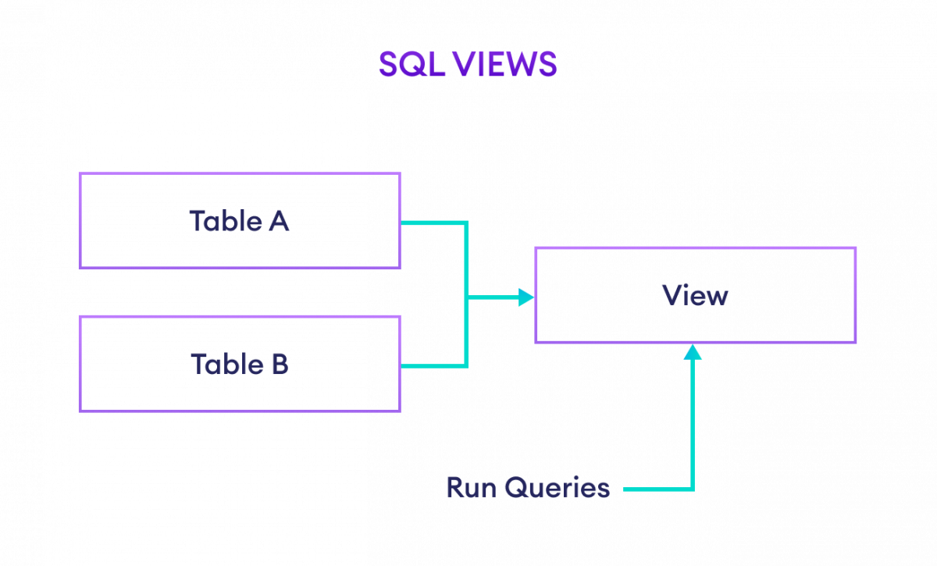
Views

Slide 7
Views
A PL/SQL view is a virtual table that contains data from one or more tables. PL/SQL Views are used to provide security or simplify complex queries
Views are customized presentations of data in one or more tables or other views. You can think of them as stored queries. Views do not actually contain data, but instead derive their data from the tables upon which they are based.
Similar to tables, views can be queried, updated, inserted into, and deleted from, with some restrictions. All operations performed on a view actually affect the base tables of the view. Views can provide an additional level of security by restricting access to a predetermined set of rows and columns of a table. They can also hide data complexity and store complex queries
Important views are in the SYS schema. There are two types:
Static data dictionary views and
Dynamic performance views

Slide 8
Views
Static data dictionary views
Dynamic performance views
The data dictionary views are called static views because they change infrequently, only when a change is made to the data dictionary
Dynamic performance views monitor ongoing database activity. They are available only to administrators. The names of dynamic performance views start with the characters V$. For this reason, these views are often referred to as V$ views.
Other two types of views, namely system-defined views and user-defined views.
The most common uses of views are : Simplifying data retrieval , Maintaining logical data independence, Implementing data security.

Slide 9
views
Simple View: Simple views are views that are created on a single table. We can perform only basic SQL operations in simple views. That means, we cannot perform analytical and aggregate operations by grouping, sets, etc. in simple views. We can definitely perform insert, update, delete directly from a simple view, but for that, we must have the primary key column in the view.
User defined views
System-defined views
They are views for routines, schemas,table_privileges, table_privileges,check_
constraints. They are automatically created when we create a database.
Complex View: Complex views as the name suggest are a bit complicated compared to simple views. Complex views are created on more than one database table. We can perform analytical and aggregate operations in complex views, but unlike simple views, we cannot perform insert, delete, and update directly from a complex view.

Slide 10
Creating a View in SQL
We can create views in SQL by using the CREATE VIEW command. For example,
CREATE VIEW us_customers AS
SELECT customer_id, first_name
FROM Customers
WHERE Country = 'USA';

Slide 11
Updating a View
It's possible to change or update an existing view using the CREATE OR REPLACE VIEW command. For example,
CREATE OR REPLACE VIEW us_customers AS
SELECT *
FROM Customers
WHERE Country = 'USA';

Slide 12
Deleting a View
We can delete views using the DROP VIEW command. For example,
DROP VIEW us_customers;

Slide 13
Pros and Cons of Views
Views can be utilized as a subset of actual data to perform certain operations. It helps us to provide an abstraction to various users or hide the complexity for users who are accessing data from the table. For example, a user has permission to access particular columns of data rather than the whole table. It can help us to simplify complex queries into a simpler one. It also simplifies data access from multiple joined tables. It can be used as aggregated tables using group by operations. Views can be used for security purposes or can add extra value from the security point of view. It does not hold any space because it only has the definition in the data dictionary, not the copy of actual data.

Slide 14
THANK YOU
For queries
Email: ankur.e13693@cumail.in

