Slide 1
Classifiers Trained on the Iris Data set

Slide 2
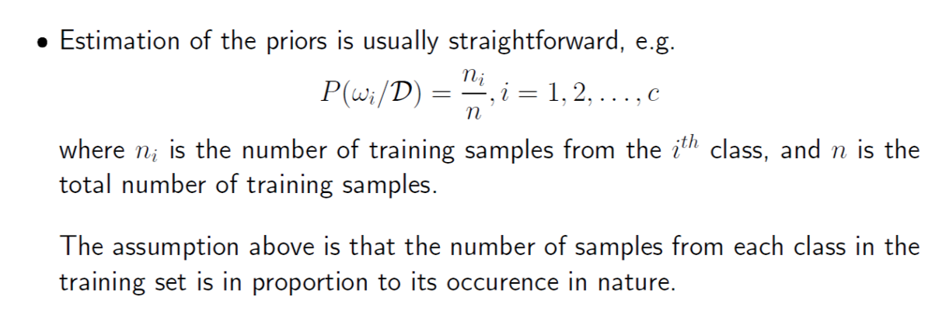
Estimating the Priors

Slide 3
Estimating the Priors
In the Iris data set, we have 50 data points from each of the three classes: 1) Setosa, 2) Versicolor, 3) Virginica, totalling to 150 points.
Irrespective of the number of data points K from each class that we use to train the model, by the formula given on the previous slide we see that the priors of all the three classes turn out to be
K/(3K) = 1/3

Slide 4
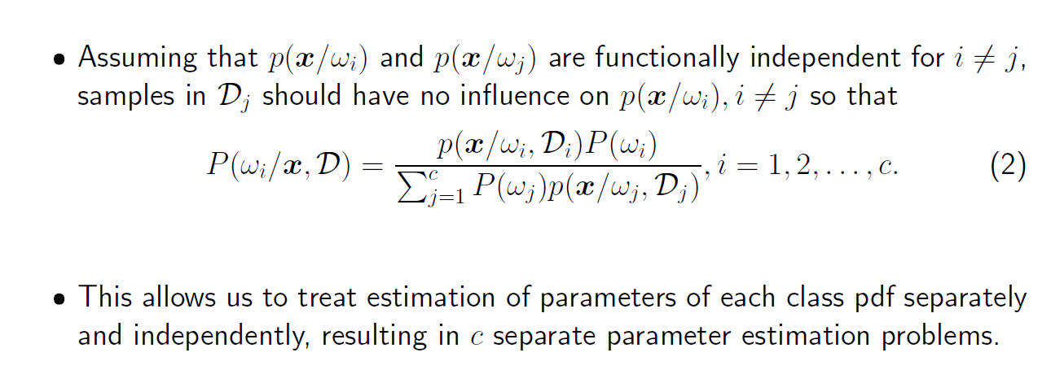

Calculating the Posteriors

Slide 5
Modelling with a Gaussian
Why a Gaussian?
There are 3 reasons for this:
1) The distribution of the data points suggests that a Gaussian will be a good fit.
2) The data acquisition and feature extraction process can introduce a large number of small, independent random errors, which by the central limit theorem leads to a Gaussian distribution.
3) Many patterns in nature (e.g. faces, spoken words, handwritten characters, etc.) can be viewed as a prototype pattern or template which has been corrupted by a large number of random variations; again the Gaussian is a good model for the probability distribution of such patterns.

Slide 6
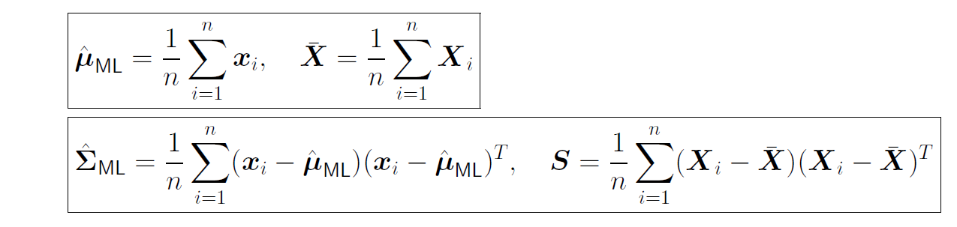
MLE Estimates of the Parameters of the Gaussian
The MLE estimates for the mean and the covariance matrix of a Gaussian are given by the following formulas:
For each sample of data points from the data set, the mean and the covariance matrix of the Gaussian will be estimated with these formulas.

Slide 7
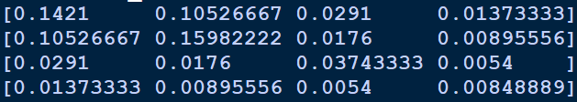
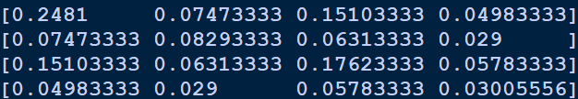
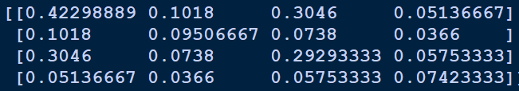
Training the Model
For each sample of size greater than 6 and smaller than 50, the mean and the covariance matrix were estimated and the covariance matrix turned out to be pretty different for the different classes. Here’s an example of the covariance matrix for the three classes for a sample size of 30:

Slide 8
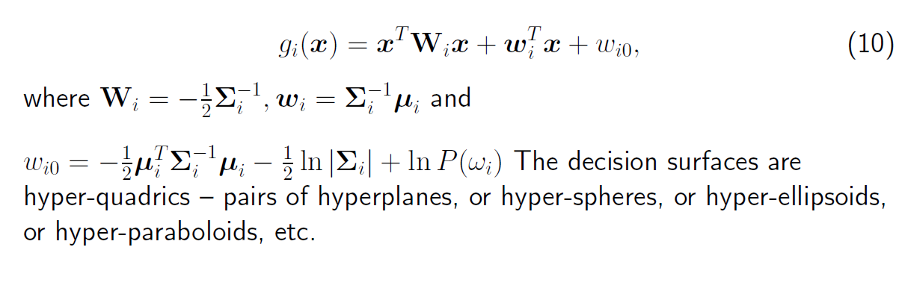







Choice of Discriminant Function
As the covariance matrices are arbitrary, the choice of our discriminant function is the following:

Slide 9


Choice of Discriminant Function
Note: As deduced earlier, P(wi) are the same for all classes. Therefore the last term in
can be omitted while comparing the values of the discriminant functions as it will bear the same value in all three functions.
But before we proceed to this discriminant function, we will look at how the models perform if we assume that:
1) and 2)

Slide 10
Comparing the Performance of the Classifiers Trained on Different Sample Sizes
To compare the performance of the classifiers trained on different sample sizes, I have done the following:
1) Randomized the data set
2) Picked a sample size of n for training from each of the three classes
3) Trained the models i.e estimated the mean and the covariance matrices
4) Tested the model on the remaining 150 – 3n points
5) Generated the confusion matrix and calculated the balanced accuracy of the model
6) Repeated steps 1 to 5, 30 times for each sample size ranging from 6 to 49. For each sample size, I collected the data for the worst balanced accuracy, the best balanced accuracy and the average balanced accuracy found over the 30 trials. The collated data will be plotted to analyse model performances.

Slide 11

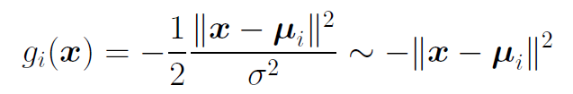
Case 1:
We will now look at the results by assuming that the covariance matrix is of the form: . For this case, the discriminant function turns out to be of the form:
when all the classes are equiprobable which it is in our case.
This kind of classifier is also known as minimum distance classifier.

Slide 12
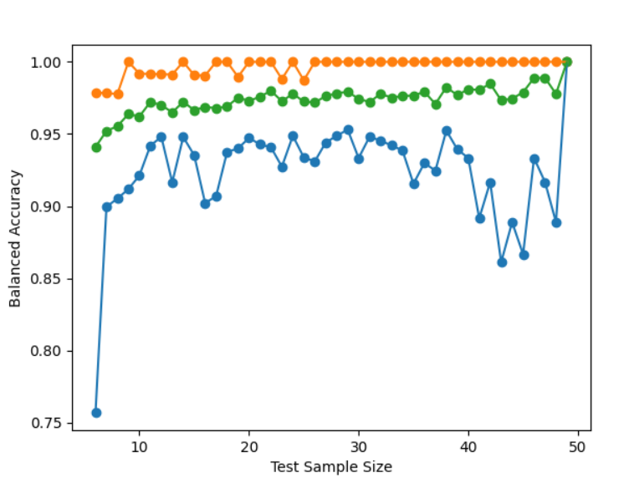
The average balanced accuracy rises steadily.
For test sample sizes in the range of 18 and 35, the minimum balanced accuracy is in the range of 93% - 94% and the average balanced accuracy is in the range of 96% to 97% while the maximums are at 100% accuracy.
For models that have been trained with a sample size >40, there isn’t enough test data to test their accuracy correctly.
Therefore, under this assumption ( ) ), we can pick any model with a 100% accuracy that has been trained on a sample size of 20 to 30.
Maximum
Average
Minimum

Slide 13

Case 2:
For this case, I randomly generated an invertible symmetric matrix and used the mean generated using MLE as the parameters for the discriminant function.
Here are the results:

Slide 14
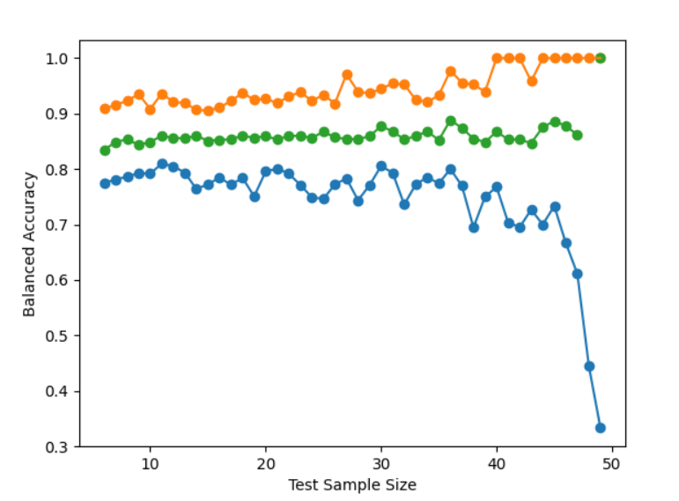
The results obtained for this case are not as good as the previous case.
The average here is lower than the average for the previous case, the maximum attained an accuracy of 100% for sample size > 40 whereas in the previous case, we had gotten models with a 100% accuracy for much smaller sample sizes.
Unlike the previous model where the graph for the minimums first increases, then flattens and subsequently decreases, here the graph for the minimums decreases from the start itself.
Maximum
Average
Minimum

Slide 15

Case 3:
Here, the covariance matrices are estimated using MLE.
Here are the results:

Slide 16
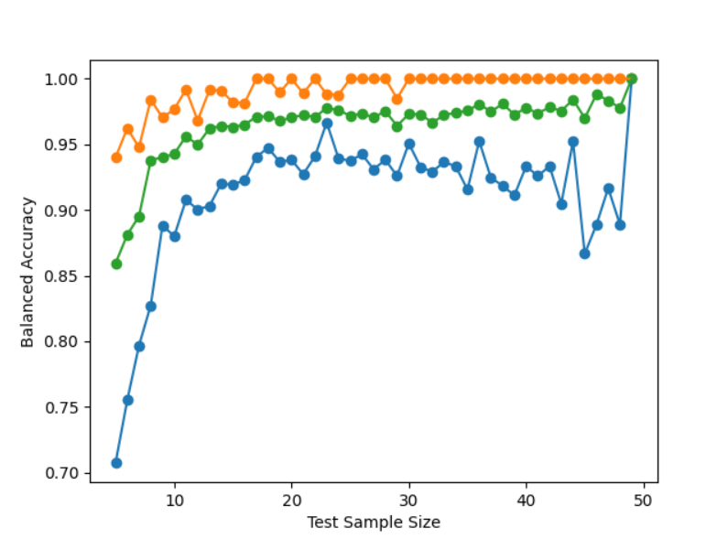
The average balanced accuracy rises steadily.
For test sample sizes in the range of 18 to 35, the minimum balanced accuracy is in the range of 93% - 94% and the average balanced accuracy is in the range of 96% to 97% while the maximums are at 100% accuracy.
For models that have been trained with a sample size >40, there isn’t enough test data to test their accuracy correctly.
Therefore, we can pick any model with a 100% accuracy that has been trained on a sample size of 20 to 30.
Maximum
Average
Minimum

Slide 17
Graph 2
Graph 1
Graph 3

Slide 18
Picking the Final Model
One way would be to pick any random model that has been trained on a sample size of 20 to 30 which has a balanced accuracy of 100% as it would have been trained and tested on an almost equal proportion of data points.
Another way would be to pick a set of 10 models that have been trained on sample sizes ranging from 20 to 30 that have an accuracy of 100% and find a common model by taking their average i.e by taking the average of the means and the covariance matrices. The rationale behind combining the models this way is that the models with 100% accuracy will tend to be similar to one another and therefore taking their average would have some sort of a smoothening effect.

Slide 19
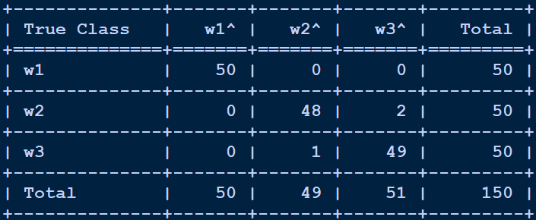
Picking the Final Model
Picking a final model this way and testing it on the entire data set we obtain the following confusion matrix:
with a balanced accuracy of 98.01%.

Slide 20
Thank you

